Slide 1
Building a Reactive Caching System with Serverless Computing
Tobias Buner
March 16, 2022

Slide 2



Latency is crucial
Network latency
CDN
Storage latency
In-memory object caching
How?
Self-hosted Redis
Managed cloud service

Slide 3
Latency is crucial for cloud storage, but comes at a price
How?
Self-hosted Redis
Managed cloud service
At what cost?
Expensive
Pay-per use model
Limitations?
Low elasticity for burst workloads

Slide 4
Building a Reactive Caching System with Serverless Computing
Better elasticity
Self-hosted Redis vs ElastiCache
No managed service?
Simple reactive system
Reactive design
Serverless computing
Cost-effective managed system

Slide 5
Setting
Single object
System works for a single object
Scaling
Only scales from zero to one instance
Consistency
Only get requests

Slide 6
Overview
Storage layers
Workflow
Reactive design
System
Latency
Simulations
Results/Evaluation

Slide 7
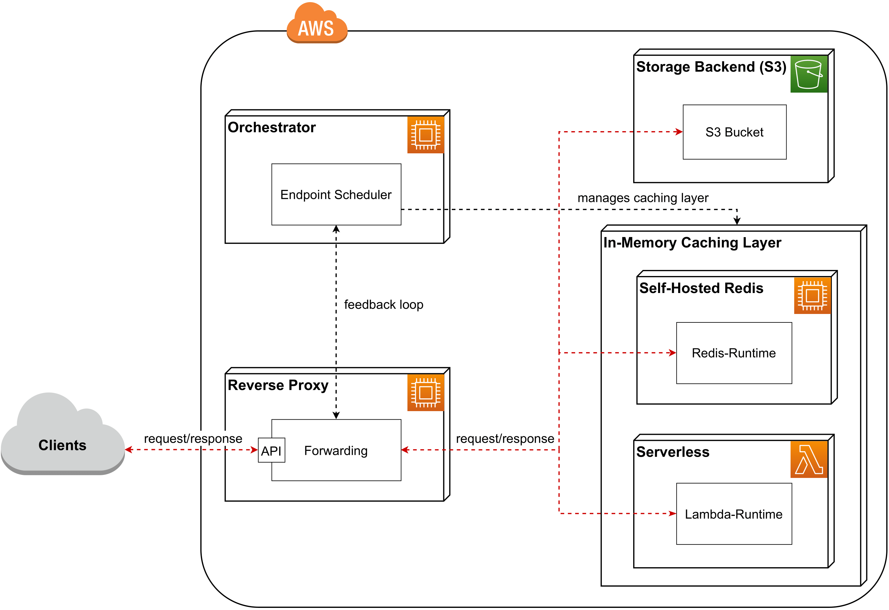
Overview

Slide 8



Storage Layers
Slow
AWS S3
Performance (latency)
Fast
Redis
AWS Lamda
Cheap
Expensive
Price

Slide 9
Storage Layers: Startup Time
Always running
AWS S3
AWS Lamda
Redis
< 1s
20-50s
Fast
Slow
Startup Time

Slide 10
Workflow

Slide 11
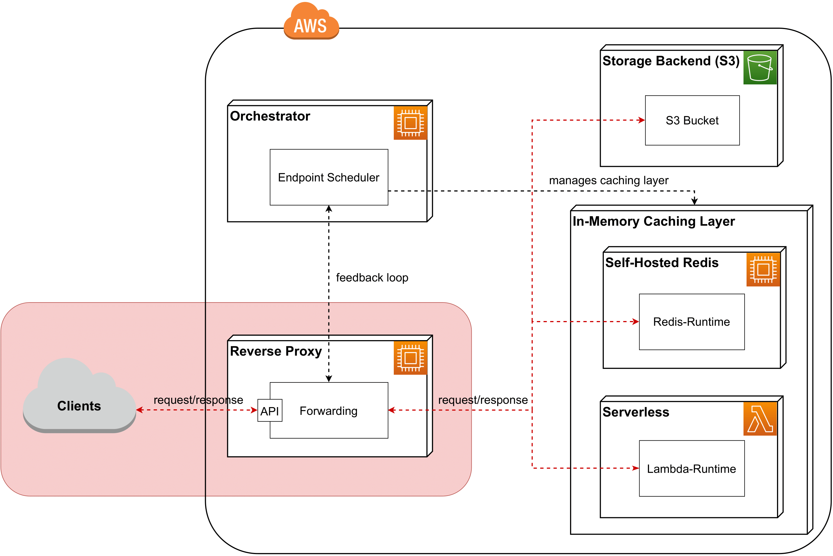
Workflow

Slide 12
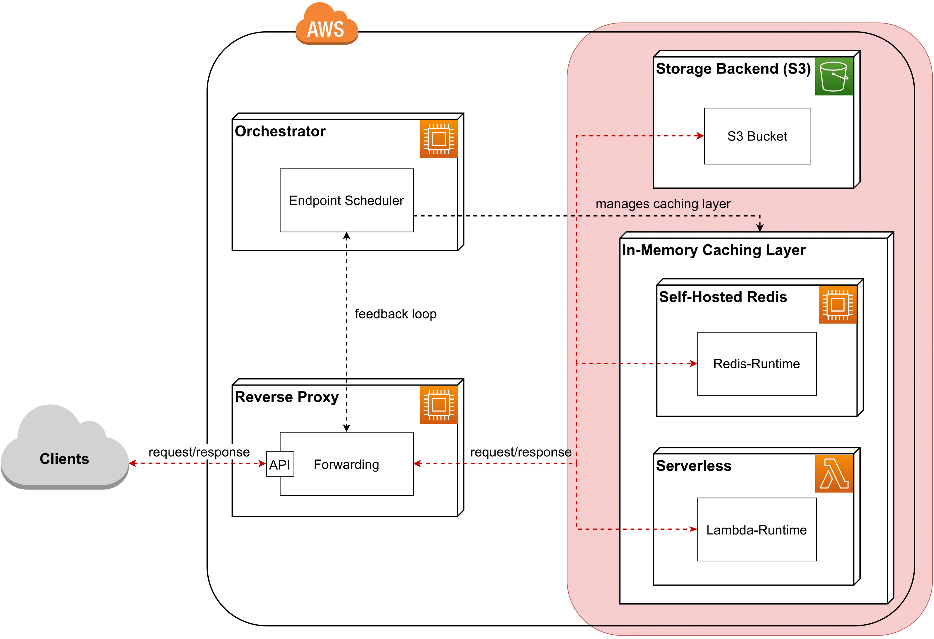
Workflow

Slide 13
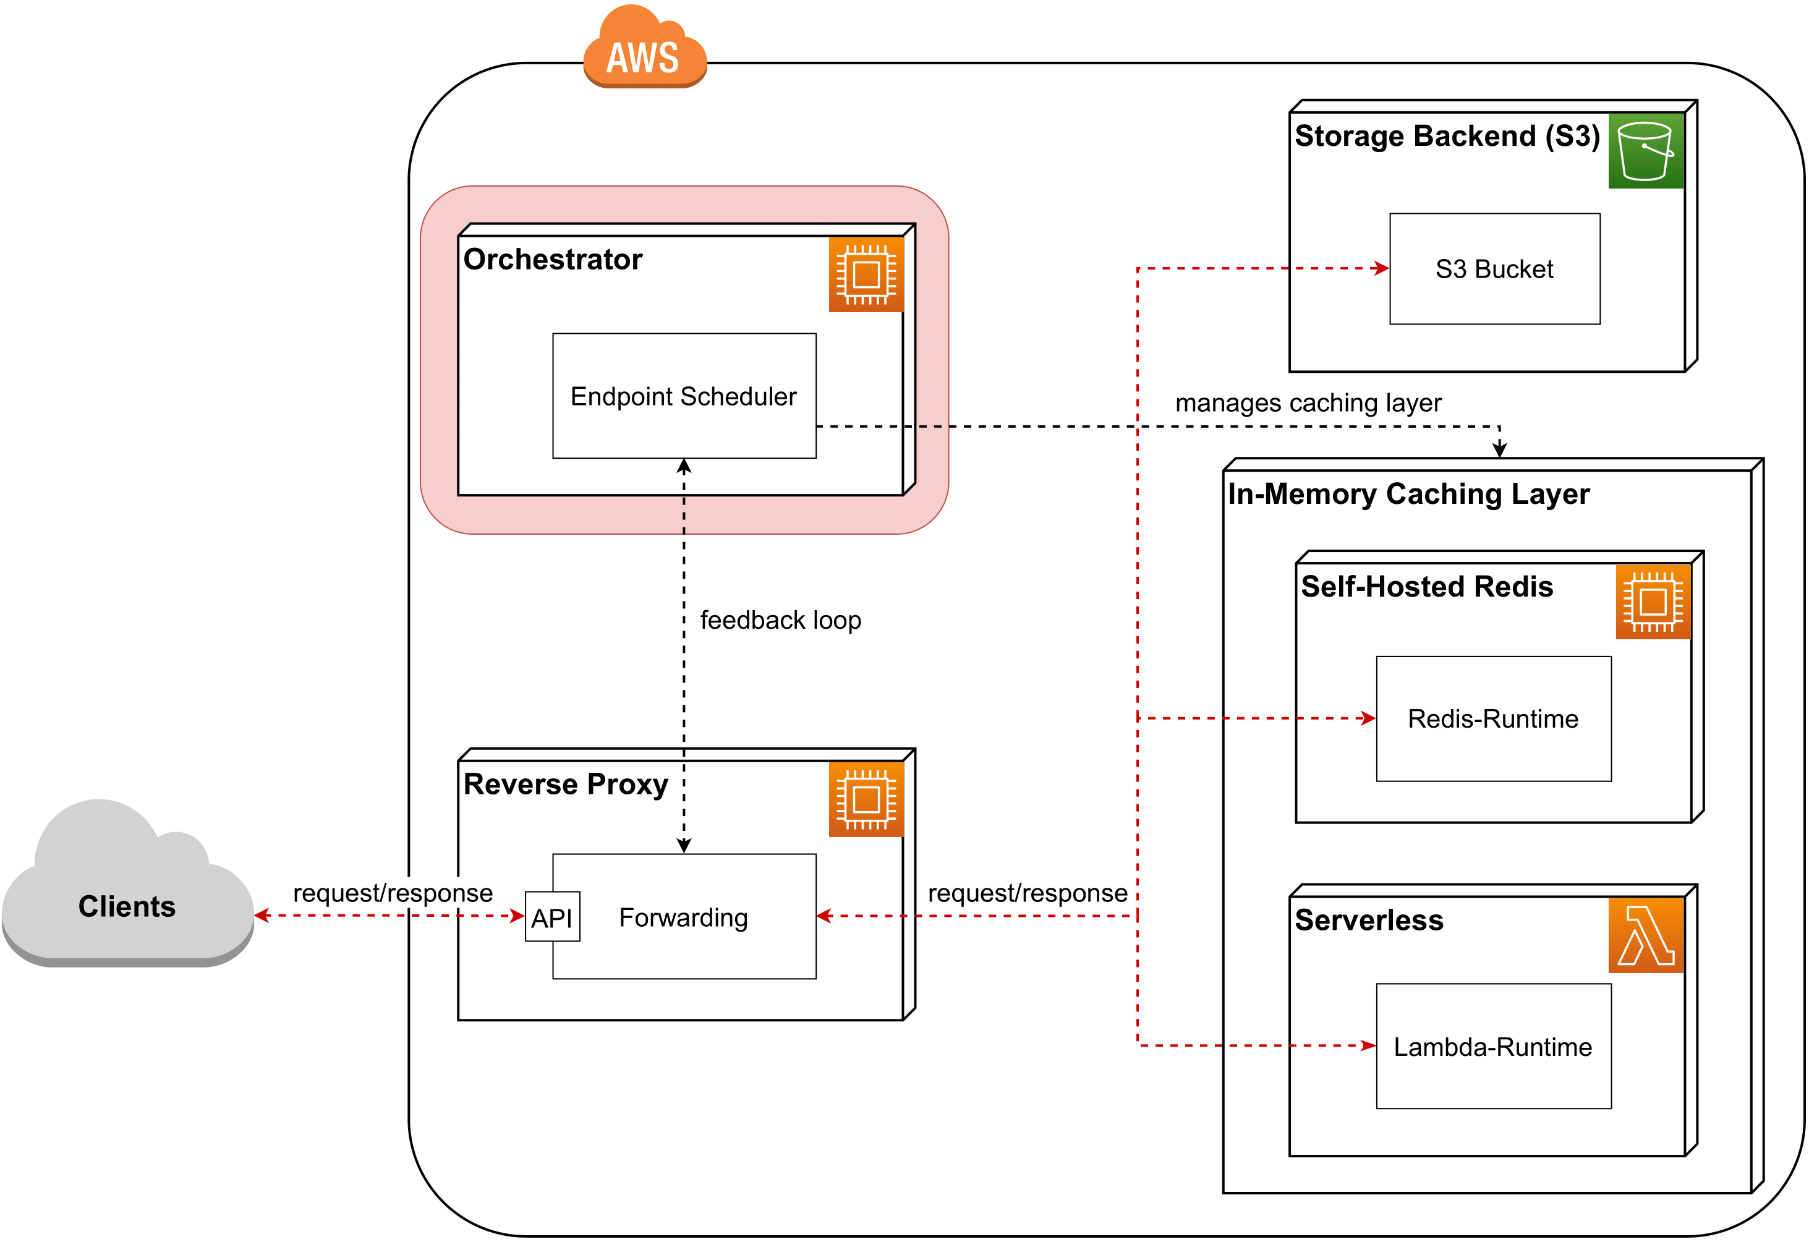
Workflow

Slide 14
Reactive Design: Endpoint Scheduler
S3
RedisRunning
Lambda
RedisBootup

Slide 15
Overview
Storage layers
Workflow
Reactive design
System
Latency
Simulations
Results/Evaluation

Slide 16
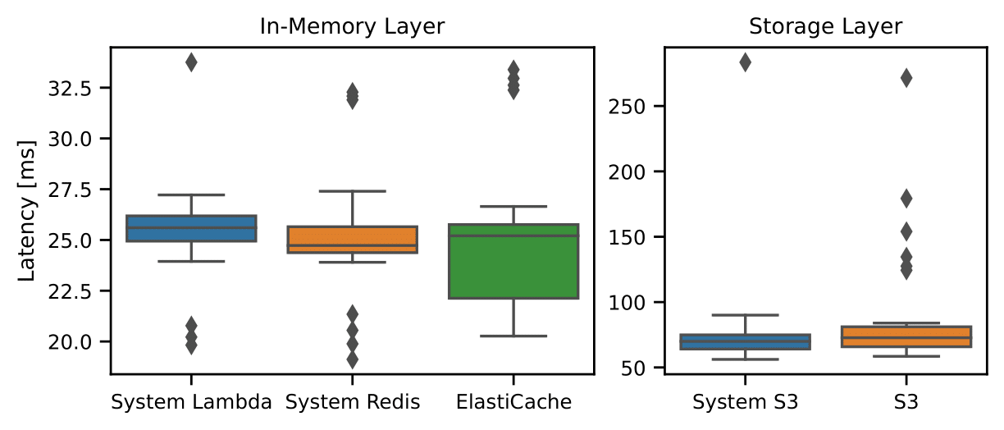
End-to-end Latency

Slide 17
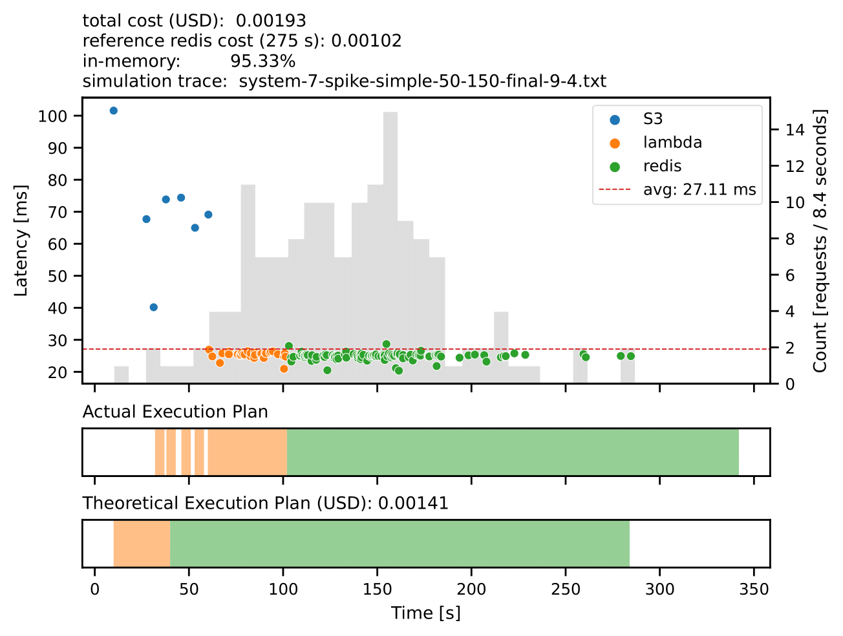
Simulation: Short Burst Workload
1.9x
more expensive

Slide 18
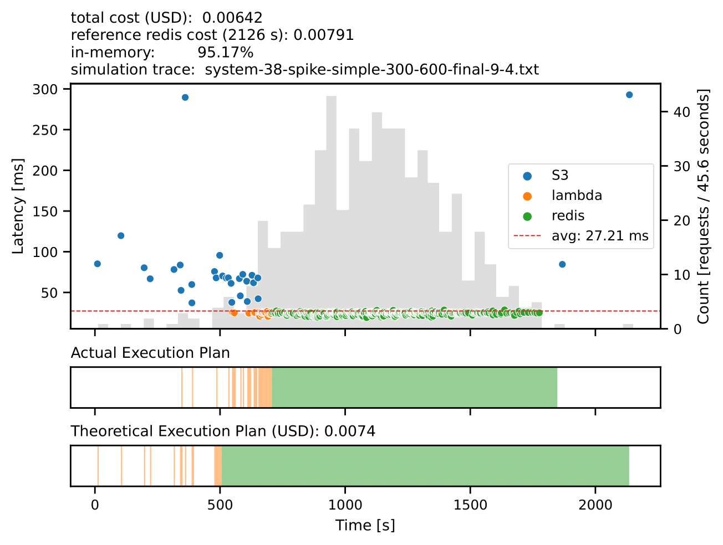
Simulation: Long Burst Workload
cheaper

Slide 19
Conclusion
Reactive managed caching system
Cost-effective usage of caching resources
Serverless computing
Applicability in a reactive caching system
Fully managed system?
Solid foundation

Slide 20
Appendix

Slide 21
Challenges
Build the system
Manage multiple cloud components
In-flight request handling
Orchestrator shuts down caching layer?
Serverless platform
Connection management
Synchronization
Reverse proxy mapping
Usability evaluation

Slide 22
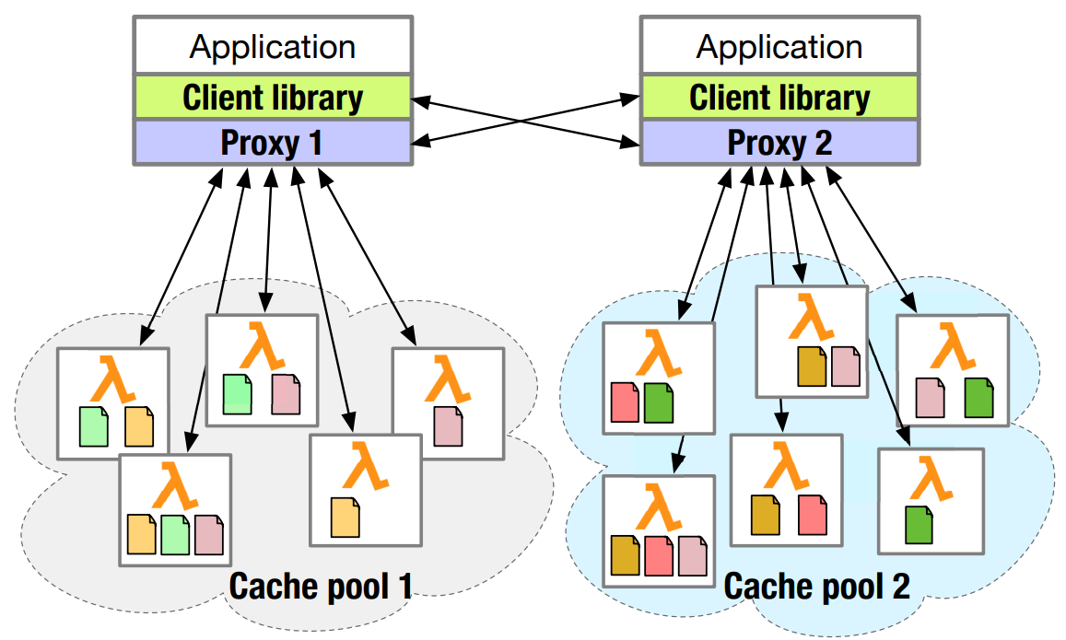
InfiniCache: Exploiting Ephemeral Serverless Functions to build a Cost-Effective Memory Cache

Slide 23
Reactive Design (Endpoint Scheduler)
S3
Instance stopped
LambdaThreshold
Lambda returns
LambdaThreshold
RedisShutdown
RestrictedLambda
Lambda
Instance stopped
Lambda returns
RedisUtilization
RedisRunning
RedisBootup
RedisThreshold
Instance running

Slide 24
System Parameters
Parameters used by the endpoint scheduler
Thresholds and timeout duration
Defines the behavior of our system
Start a caching layer?
How long we keep each layer running?
Strong dependency
Performance, cost, workload

Slide 25
System: In-Flight handling
Orchestrator
Shutdown
Reverse Proxy
Caching Layer
Request
Connection

Slide 26


System: In-Flight handling
Orchestrator
Inform about shutdown
Acknowledgment
Reverse Proxy
Caching Layer
Connection
Response

Slide 27
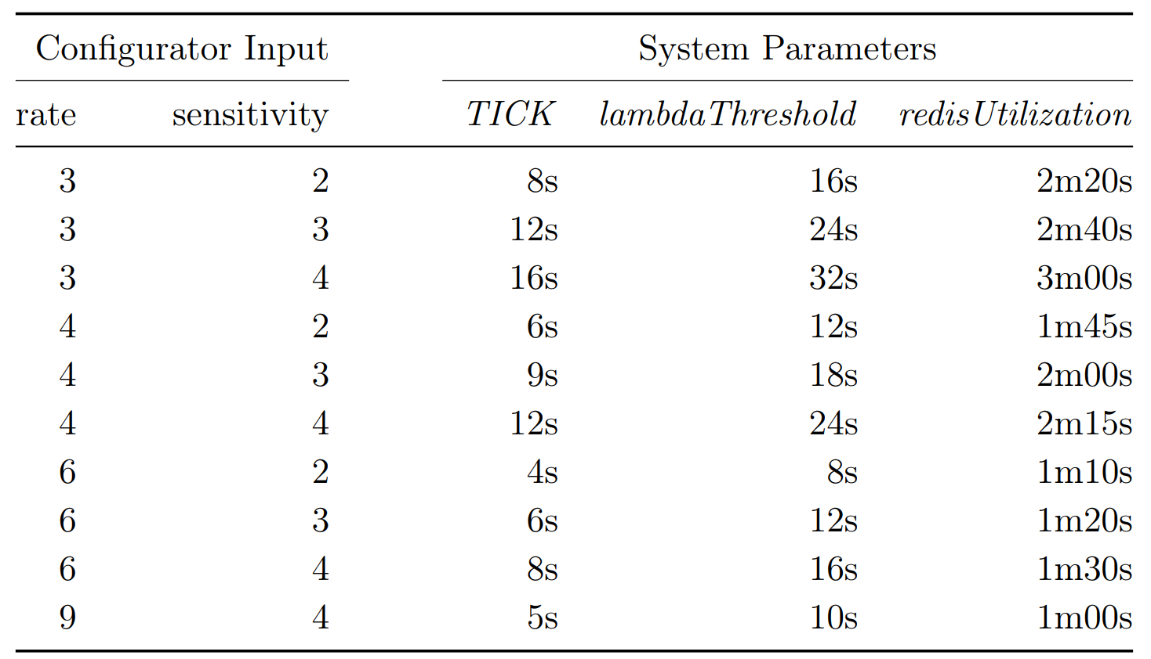
System: System Parameters

Slide 28
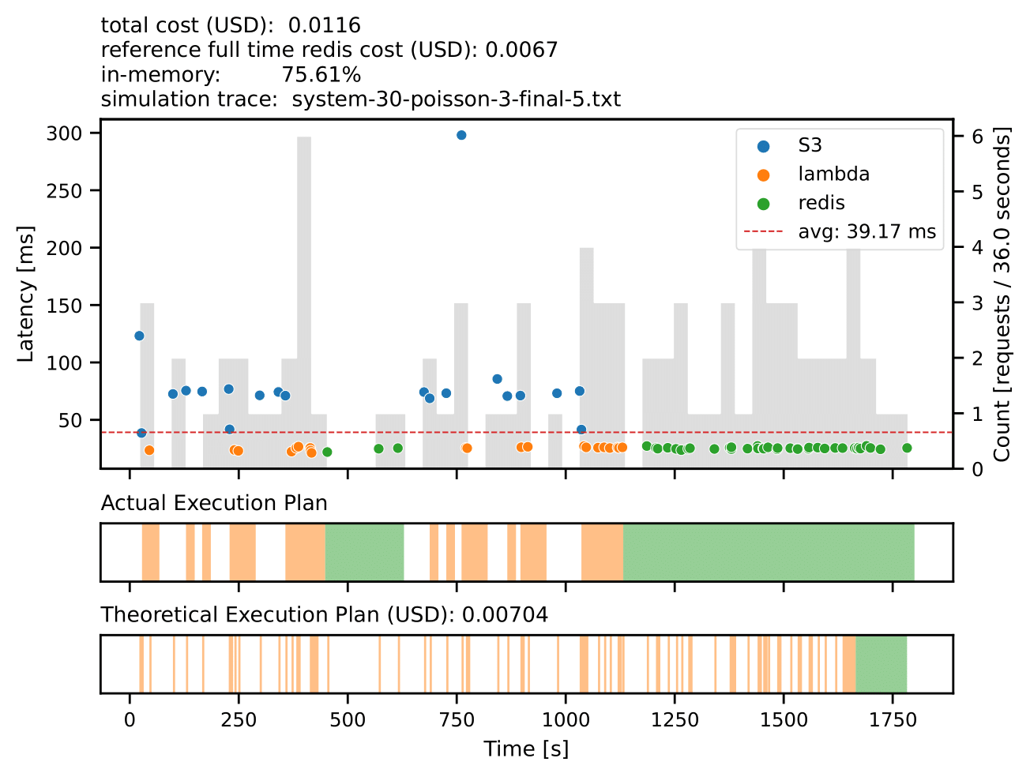
Simulation: Poisson Process (rate 3)

Slide 29
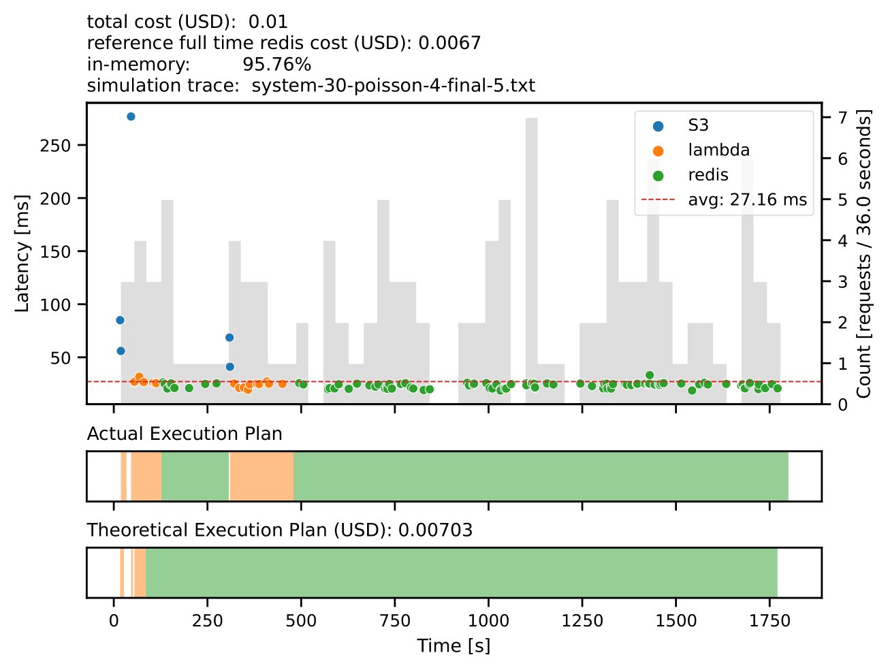
Simulation: Poisson Process (rate 4)

Slide 30
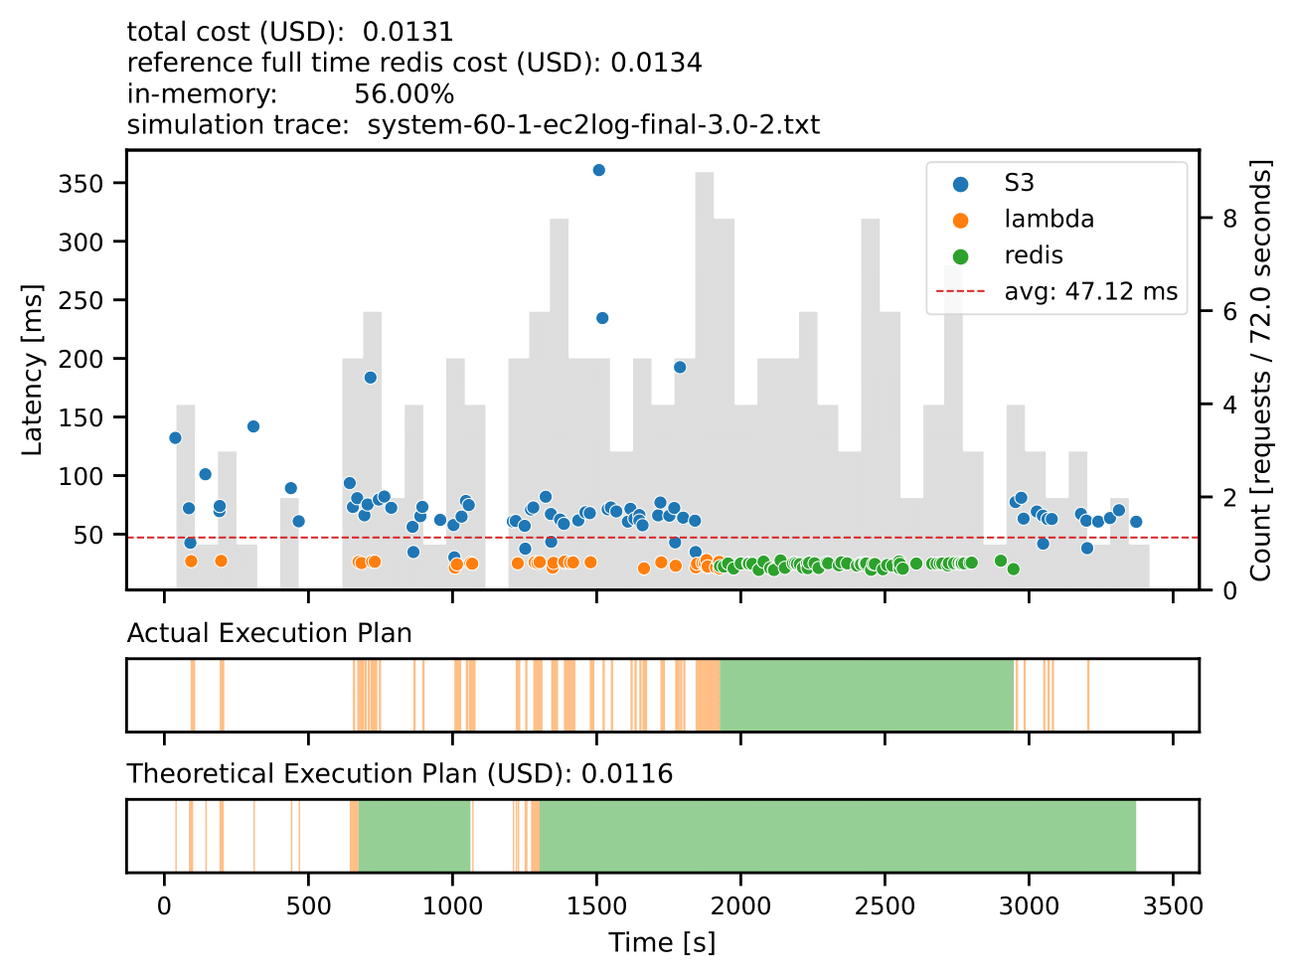
Simulation: Low Sensitivity

Slide 31
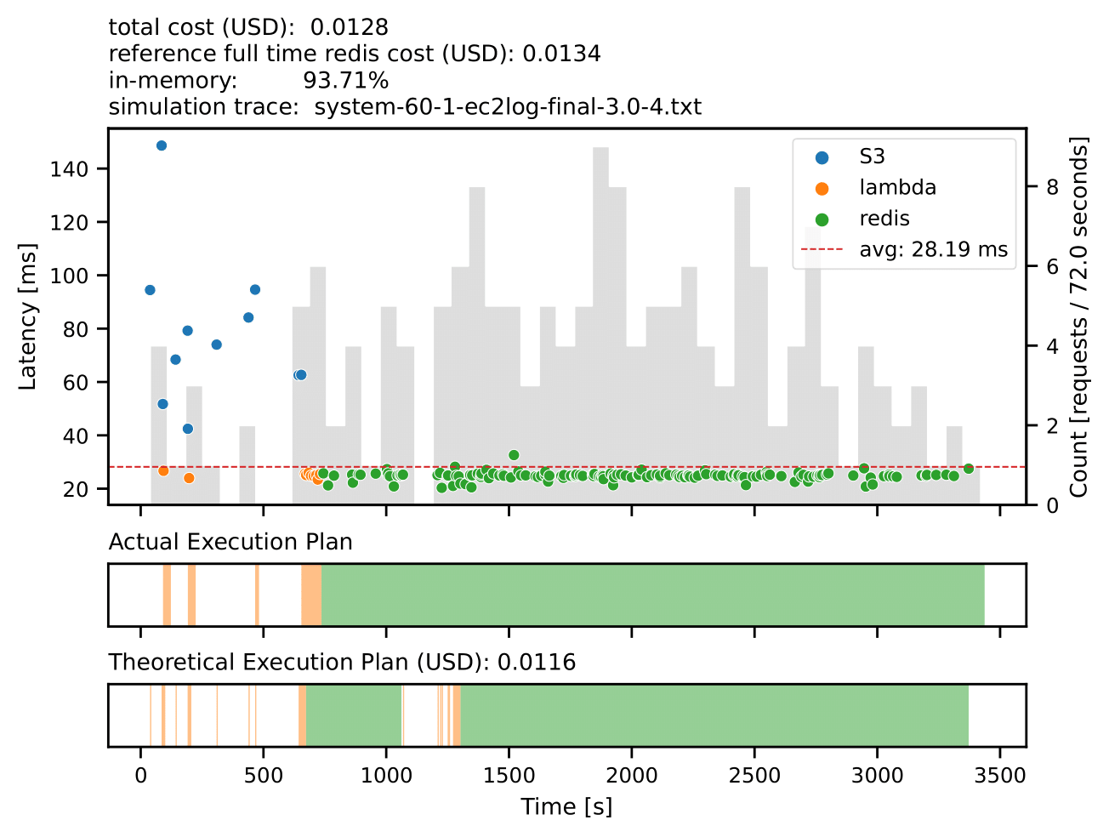
Simulation: High Sensitivity

Slide 32
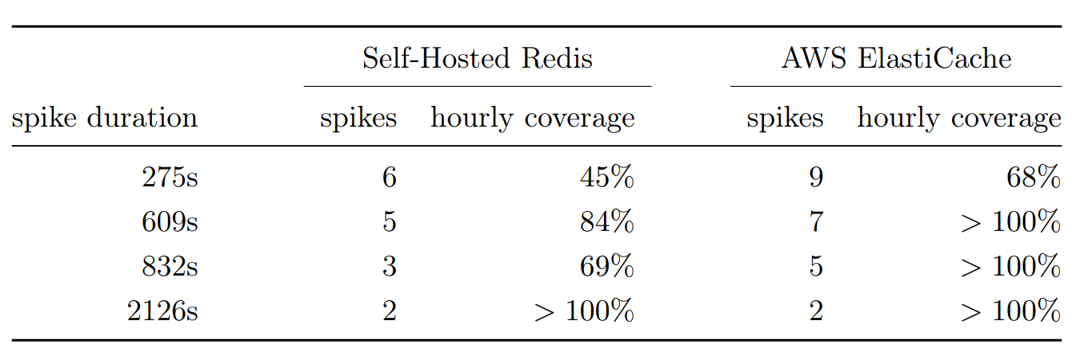
Burst Workloads: Cost-Efficiency

Slide 33
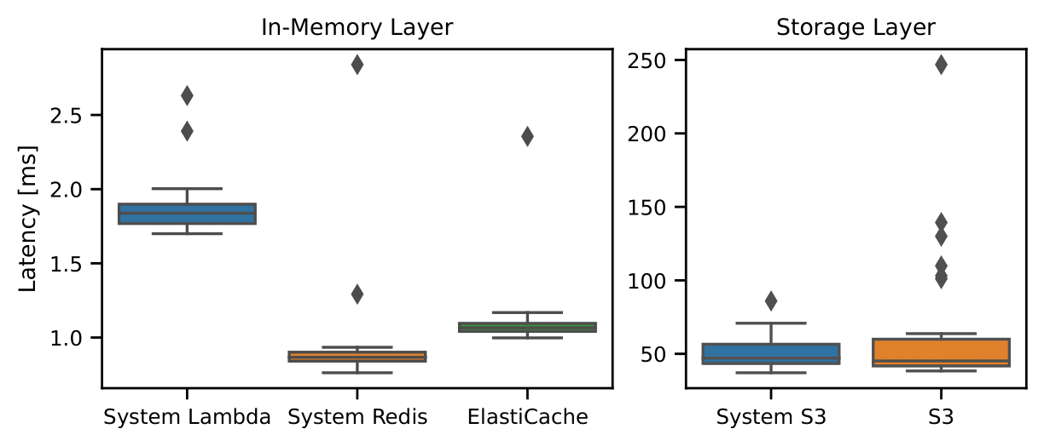
Latency
Reverse Proxy Latency
End-to-end Latency

Slide 34
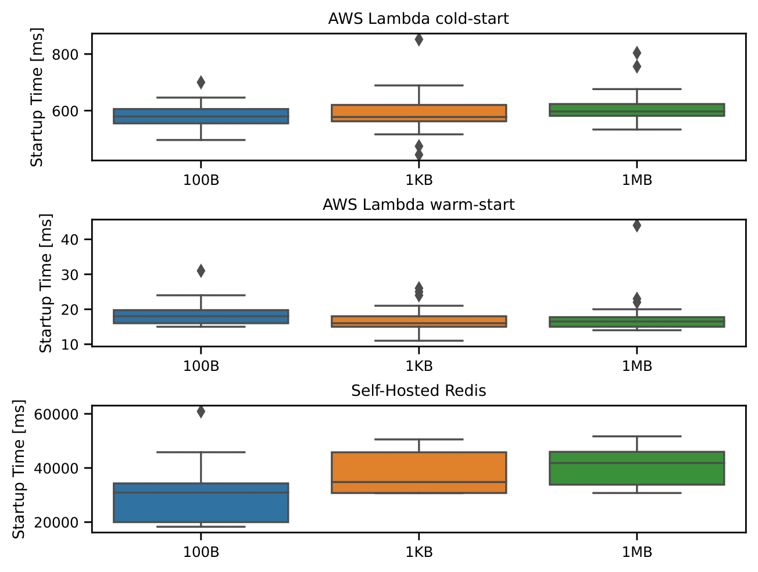
Startup
Notes:
Measuring the time, it takes when the reverse proxy receives the request which will trigger the start of the caching layer until the actual mapping on the reverse proxy is updated

Slide 35
Future Work
Multiple Objects
AWS Lambda connection management
Scaling
Base cache system
Reactive design for scaling
Consistency
S3 operations
InfiniCache integration
Low-rate workloads

