Slide 1
Bungeni Editor
Technical Presentation

Slide 2
Overview
Bungeni Editor Goals
Software Architecture
Features
Open Source

Slide 3
Goals
Legislative Markup Editor – using standard Word Processor UI
Generation of XML from within Word Processor
Support suggestive / prescriptive mechanisms to promote correct markup
Portable across different parliamentary scenarios i.e. easily adaptable business logic
Support multiple document types (Acts, Bills, Debates etc..)
Multilingual & Internationalization support

Slide 4
Software Architecture
Core Architecture – client / server model
  Bungeni Editor as a client application
  OpenOffice.org as both a server & a client
Java desktop application (java6, swing)
OpenOffice.org 3.1
Cross platform support – Windows, Linux (possibly Mac OS X in the future)

Slide 5
Software Architecture
Editor architecture can be viewed at 2 levels
  1 – Generic document management services – UI, Document metadata management, Configuration Database, i18n, Xml Translation
  2 – Document Type specific functionality - Type specific UI, Metadata, Functionality (e.g. bill numbering , consolidation). Loaded dynamically based on “document type”

Slide 6
OpenOffice.org -
Interaction via UNO wrapper,
OOComponentHelper
Action Toolbar -
toolbar_debate.xml,
IbungeniToolbarCondition
IbungeniToolbarOperator
Control Panels -
ItabbedPanel,
abstractTabbedPanel
Control Panels -
ItabbedPanel,
abstractTabbedPanel
Action configurations
Loaded from embedded
config database
(BungeniSettingsFactory,
BungeniClientDB)
Tabs enabled
Contextually based on
document type
DocumentSectionProvider,
DocumentSectionTypeProvider
I18n labels loaded
from
Message bundle

Slide 7
Bungeni Editor & OOo.Org
The Editor is a UNO client application
On startup – Editor bootstraps OpenOffice – and launches itself and then attaches itself to the running OpenOffice.org instance
UNO IS complicated and difficult to use directly – the Editor uses an abstraction layer to simplify access to the OpenOffice API (OOComponentHelper)

Slide 8
Bungeni Editor & OOo.Org
OpenOffice.org Word Processor
OpenOffice.org UNO
User
Interaction
OOComponentHelper
Library
Bungeni Editor, related
libraries & plugins

Slide 9
Bungeni Editor Configuration Interfaces
Property Files :
Themes, Webdav
XML configs for :
Plugins, Actions,
Structural Rules
I18n Message
Bundles
H2 db – embedded
Configuration Db (Browser based UI)
Bungeni Editor

Slide 10
Editor Customization via Configuration
Changing look and feel
Changing layouts (to some extent)
Adding new document types
Adding new action configurations
Modifying user interface behaviors
Changing message strings / labels
Modifying structural rules
Adding additional languages

Slide 11
Bungeni Editor Developer API Interfaces
OOComponentHelper – Java API abstracted access to UNO API – syntax modeled on StarBasic
IeditorPlugin – component plugin interface. Plugins loaded via an XML config file using reflection.
IlookAndFeel – interface to add custom UI skins to Editor

Slide 12
Bungeni Editor Core API Interfaces
ItabbedPanel, abstractTabbedPanel – to write new control panel tabs
IfloatingPanel – to create new extensible input forms
ItoolbarAction, ItoolbarActionOperator – to write new contextual toolbar actions, add new conditional operators
IeditorDocMetadataDialog – to add new metadata editors (for new document types)

Slide 13
Bungeni Editor Core API Interfaces
IbungeniDocTransform – to support multiple transformation interfaces (to html, pdf, xml, etc)
IstructuralRule – interface to add and extend new structural rules to editor
IgeneralNumberingScheme, InumberDecorator – extend and customize automatic numbering

Slide 14
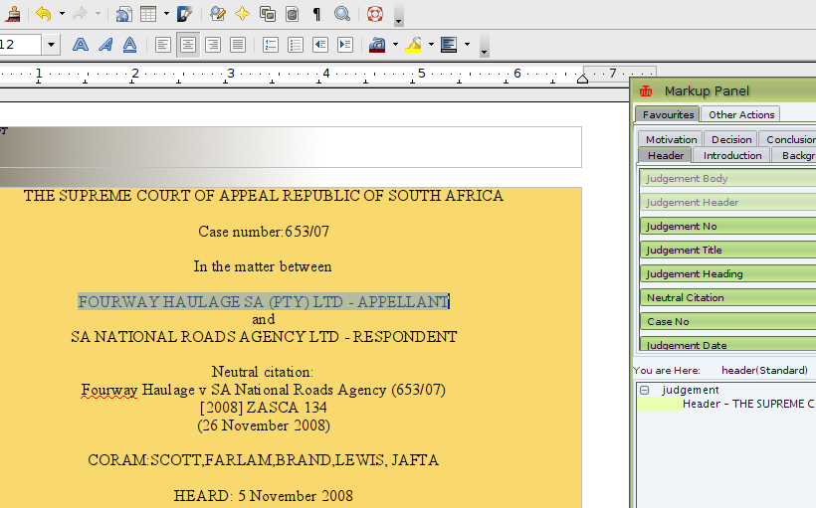
Features – Context Sensitive Actions
Actions loaded
from
toolbar.xml
Actions are context
sensitive based on
position of cursor in
document and selection
Action activation
context is defined
by rule definitions in
toolbar.xml

Slide 15
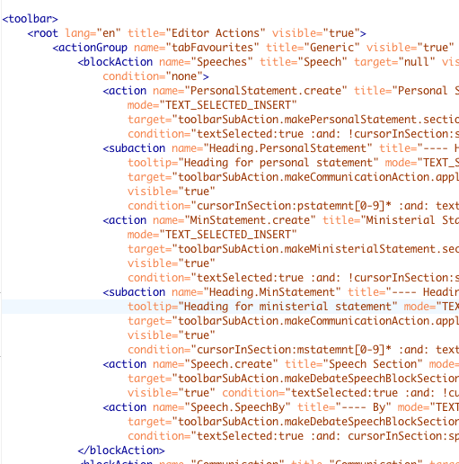
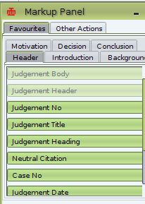
Context Sensitive Actions
BlockActions are
rendered as
Tab groupings
actions/subactions
are rendered as
individual toolbar
actions

Slide 16
Context Sensitive Actions
Action context is defined by a rule syntax associated with every action
e.g. <action … condition=”textSelected:true :and: !cursorInSection:speech[0-9]* :and: cursorInSection:debaterecord” ....>
translates to “activate the activation when some text has been selected and cursor is not in a numbered speech section and cursor is in a debaterecord section”

Slide 17
Context Action Syntax
Supports :and: and :or: operators
Conditions can be grouped using {} e.g. “{cursorInSection:speech :and: textSelected:true} :or: !fieldExists:speechRef[0-9]*”
Many conditions supported : cursorInSection, fieldExists, cursorInSectionType, imageSelected, sectionExists, sectionHasChild, textSelected, sectionHasChildType
Easily extensible via the IbungeniToolbarCondition interface

Slide 18
Document Actions
Actions also have target commands which change the document (i.e. do the markup) and are enabled when the context condition is satisfied
e.g. <action … target="toolbarSubAction.makeCommunicationAction.apply_style:heading_comchair" ...>
Defined in the Editor's config database and are mapped to an action via the @target syntax
Over 30 actions are provided in the Editor core
Easily extended using the IbungeniActionRouter interface

