Slide 1


**Python 2.6 or 2.7
SNOLab Computer Day 2014
Brian Mong

Slide 2

Python is a programming language, Pythonic is a philosophy
Python is a scripting/general purpose language with some general principals
Easy to read/write
Fun to program (spam, spam, spam, spam, eggs, spam spam …)
Interactive shell, just type python, ipython, etc.
Scripts are run as: python script.py
python –i scripy.py gives you prompt after script runs
python script.py args pass arguments to your script
Try this:
Run python
import this

Slide 3
Basics - Types
>>> 3/4 #Integer division
0
>>> 3./4 #float division
0.75
>>> a = (1,2,3) #Tuple
>>> a[1]
2
>>> b = [1,2,3] #List
>>> b[1]
2
>>> c = {'a':1,'b':2,'c':3} #Dict
>>> c['b']
2
>>> type(3)
<type 'int'>
>>> type(3.)
<type 'float'>
>>> type((1,2,3))
<type 'tuple'>
>>> type([1,2])
<type 'list'>
>>> type({})
<type 'dict'>
Integer
Float
Tuple
List
Dictionary
Custom Class

Slide 4
Basics2 - Python Cheat Sheet
True/False/None
range(5) = [0,1,2,3,4]
enumerate([‘a’,’b’]) = (0,’a’),(1,’b’)
for i in [1,2,3,4]:
continue / break
if ‘a’ in [‘a’,’b’,’c’] or ‘a’ == “A”:
elif 1.0 != 1 and type(1) == int:
else:
“””Multiline’z “String’z\””””
C-like string replacement
print "Hello %s %d, %0.2f"%('World',123,99.9901) Hello World 123, 99.99

Slide 5
Basics3
Lookup methods available on an object with dir()
>>> c
{'a': 1, 'c': 3, 'b': 2}
>>> dir(c)
['__class__', '__cmp__', '__contains__', '__delattr__', '__delitem__', '__doc__', '__eq__', '__format__', '__ge__', '__getattribute__', '__getitem__', '__gt__', '__hash__', '__init__', '__iter__', '__le__', '__len__', '__lt__', '__ne__', '__new__', '__reduce__', '__reduce_ex__', '__repr__', '__setattr__', '__setitem__', '__sizeof__', '__str__', '__subclasshook__', 'clear', 'copy', 'fromkeys', 'get', 'has_key', 'items', 'iteritems', 'iterkeys', 'itervalues', 'keys', 'pop', 'popitem', 'setdefault', 'update', 'values', 'viewitems', 'viewkeys', 'viewvalues']
>>> c.keys()
['a', 'c', 'b']
>>> c.has_key(3)
False
Note: Methods with __xxx__ are not meant to be used by you!

Slide 6
Question1
Look at dir(()) and dir([]) and determine the difference between a tuple and a list.
>>> dir(())
['__add__', '__class__', '__contains__', '__delattr__', '__doc__', '__eq__', '__format__', '__ge__', '__getattribute__', '__getitem__', '__getnewargs__', '__getslice__', '__gt__', '__hash__', '__init__', '__iter__', '__le__', '__len__', '__lt__', '__mul__', '__ne__', '__new__', '__reduce__', '__reduce_ex__', '__repr__', '__rmul__', '__setattr__', '__sizeof__', '__str__', '__subclasshook__', 'count', 'index’]
>>> dir([])
['__add__', '__class__', '__contains__', '__delattr__', '__delitem__', '__delslice__', '__doc__', '__eq__', '__format__', '__ge__', '__getattribute__', '__getitem__', '__getslice__', '__gt__', '__hash__', '__iadd__', '__imul__', '__init__', '__iter__', '__le__', '__len__', '__lt__', '__mul__', '__ne__', '__new__', '__reduce__', '__reduce_ex__', '__repr__', '__reversed__', '__rmul__', '__setattr__', '__setitem__', '__setslice__', '__sizeof__', '__str__', '__subclasshook__', 'append', 'count', 'extend', 'index', 'insert', 'pop', 'remove', 'reverse', 'sort']

Slide 7
Python Structure
Python uses indention to distinguish blocks of a script
The standard is 4 spaces per level, no tabs!
def square_eggs(x):
return x**2
square_spam = lambda x: x**2
y = [1,2,3,4,5]
spam = []
eggs = []
for i in y:
spam.append(square_spam(i))
eggs.append(square_eggs(i))
print i,i**2
print "spam == eggs?", spam==eggs
$ python indentions.py
1 1
2 4
3 9
4 16
5 25
spam == eggs? True
$

Slide 8
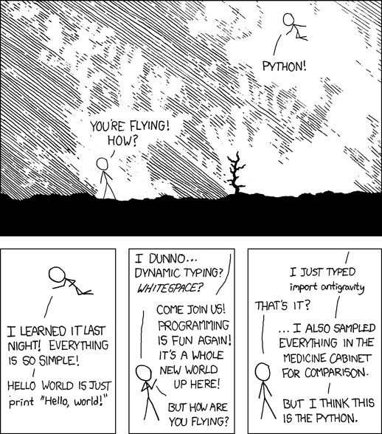
Import
Usually someone has already written functions that do what you want.
The hardest part is deciding how you want to import…
namespace
http://xkcd.com/353/
import module #pythonic
module.fun()
from module import fun
fun()
import module.fun as x
x()

Slide 9
Classes
Classes are how one defines new object types that contain
data structure
methods that act on that structure
Pythonists would recommend making sure a list or dictionary isn’t suitable first
class MyClass:
"""A simple example class"""
i = 12345
def f(self):
return 'hello world’
x = MyClass()
In this example:
i is an attribute
f is a method
x is an instance

Slide 10
PyROOT
PyROOT wraps ROOT to give you a better interactive shell
PyROOT calls ROOT functions compiled in C, so there isn’t any performance loss (for normal use)
Access PyROOT by: import ROOT
Generally replace (->,::) with .
ROOT commands available in ROOT namespace
c1 = ROOT.Tcanvas(…)
h1 = ROOT.TH1D("hist","hist",100,0,1)
h1.Draw()
tree = ROOT.TChain(…)
Verses CINT ROOT syntax:
TH1D *h1 = new TH1D("hist","hist",100,0,1);

Slide 11
PyROOT ReExample
import ROOT
ROOT.gROOT.SetStyle("Plain")
ROOT.gStyle.SetPalette(1)
mychain = ROOT.TChain("ntuple")
myhist = ROOT.TH1D("hist","hist Name",100,0,1)
myfit = ROOT.TF1("fitf","gaus")
c1 = ROOT.TCanvas()
dataCuts = "Zfit > 0 && Zfit < 7 && MinBin0 > 650 && MinBin0 < 700 "
dataCuts+= "&& MinBin1 > 650 && MinBin1 < 700 && abs(MinBin0 - MinBin1) < 10 "
dataCuts+= "&& EventCutID == 1 && Fprompt > 0 && HLatePE0 > 0 && HLatePE1 > 0"
mychain.Add("data/deap_ntp_013079_*.root")
print "Loaded %d entries"%mychain.GetEntries()
moar_cut = " && TotalPE > 120 && TotalPE < 240"
mychain.Draw("Fprompt>>hist", dataCuts + " && TotalPE > 120 && TotalPE < 240")
myhist.Fit("fitf","LL","",0.68,1)
c1.SetLogy(1)
Also see: pyroot_generic.py

Slide 12
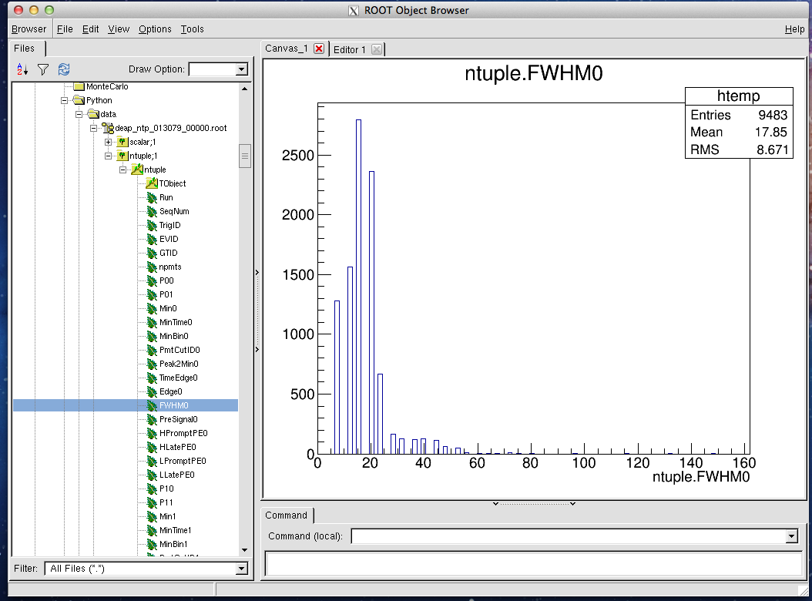
>>>ROOT.TBrowser()

Slide 13
ROOT tree.Scan
tree.Scan(“var1:var2”,cuts)
>>> t.Scan("TrigID:MinBin0:Zfit",cuts)
************************************************
* Row * TrigID * MinBin0 * Zfit *
************************************************
* 3 * 0 * 664 * 5.2510962 *
* 7 * 0 * 666 * 4.8705420 *
* 27 * 0 * 665 * 4.8093390 *
* 42 * 0 * 667 * 6.2409100 *
* 93 * 0 * 667 * 5.7747392 *
* 141 * 0 * 667 * 4.7239689 *
* 143 * 0 * 666 * 4.4660582 *
* 156 * 0 * 667 * 2.6396508 *
* 182 * 0 * 664 * 5.4336285 *

Slide 14
ROOT Tricks
tree.Draw is your best friend
Fastest way to do anything, including get data
[bmong@science1 Python]$ python
Python 2.6.6 (r266:84292, Nov 21 2013, 12:39:37)
[GCC 4.4.7 20120313 (Red Hat 4.4.7-3)] on linux2
Type "help", "copyright", "credits" or "license" for more information.
>>> import ROOT
>>> t = ROOT.TChain("ntuple")
>>> t.Add("data/*")
14
>>> cuts = "Zfit > 0 && Zfit < 7 && MinBin0 > 650 && MinBin0 < 700 "
>>> cuts+= "&& MinBin1 > 650 && MinBin1 < 700 && abs(MinBin0 - MinBin1) < 10 "
>>> cuts+= "&& EventCutID == 1 && Fprompt > 0 && HLatePE0 > 0 && HLatePE1 > 0"
>>> cuts+= “&& TotalPE > 120 && TotalPE < 240"
>>> t.GetEntries()
1396683L
>>> t.Draw(">>+elist",cuts,"goff")
56733L
>>>

Slide 15
ROOT Tricks – Part doux
tree.Draw is your best friend
Fastest way to do operations on your trees
TTree:Draw@2
You can also get size of ntuple, Max$() Sum$(), and more with Draw
>>> elist = ROOT.gDirectory.Get("elist")
>>> elist.GetN()
56733
>>> for i in range(elist.GetN()):
... t.GetEntry(elist.GetEntry(i))
...
Use event lists to reduce data before looping over entries

Slide 16
But Wait… There's More
matplotlib - matlab like plotting syntax
numpy - matrices, vectors & linalg oh my
scipy - bunch of random scientific functions
iminuit - minuit wrapper
Tons of others….

Slide 17
Parting wisdom
Save useful python functions to a file and import them when needed:
import sys
sys.path.append(“/path/to/myfunctions.py”)
import myfunctions
example: bungfun.py

Slide 18
Exercises
Try converting a ROOT script to PyROOT
Read random walk example provided
Convert a ROOT.TH1 to only python objects
hint1: Read TH1.GetBin*(), TH1.GetNBinsX()
hint2: import matplotlib.pyplot as plt plt.plot(x,y) plt.show()
Note: science1 and most other remote servers require you to run matplotlib with matplotlib.use(“Agg”)

