Slide 1


Group Term Project Data and Systems
Indiana Soccer Referee Association
Team 03
Alex Newquist | Asha Anil | Kenzie Cooper | Vladislav Marinov

Slide 2
About this template
AGENDA
Value Proposition
03
Demo
05
Lessons Learned
07
Appendix
11

Slide 3
About this template
The ISRA Desires an Automated Process for Referee Assignments to Increase Efficiency
Current Problems
Tracking game and referee assignments is a full-time job
Assigning one or many referees to a game
Download reports
IT Personnel and resources are limited
Easy assignments of referees and games
Business Outcomes
Consolidated view of games and referee details
Efficient tracking and documentation of referees to games
CRUD operations on the referee and games table
Decreased human labor and error for assigning referees
Relieve stress and increase focus on other responsibilities
Decrease on-premise data storage costs due to cloud
Value Proposition
Demo
Lessons Learned
Appendix

Slide 4


Our Team Defined Scope, Time, Resources, & Future Vision to Identify “Must Have” Features
Scope
Vision
Develop a system that tracks and documents referee game assignments for U.S.S.F. sanctioned club matches in the greater- Indianapolis area. Ensuring the assignor assigns referees accurately and the referee accepts or declines the assignment.
Extend the application to encompass nation-wide games and referee assignments. The extension would allow teams to travel for increased competition and referees could login and sign up from around the country for games near them.
Time
Resources
Developing a Login page to allow referees to sign up for new games and view past game assignments.
2 Weeks – 1 Month
Develop User Stories| Create Design Plans (wireframes, Entity relationships)
Human Capital
Confirm Functionality
Github
Scope
Time
SEPT
OCT
NOV
Docker
Resources
AWS
Develop HTML, JAVA, PHP for Games, Assignments, Referees, & Reports
Human Capital, Github, Docker, AWS
Value Proposition
Demo
Lessons Learned
Appendix

Slide 5
We Employed a Drill Down Solution Process to Ensure All Requirements Were Addressed
Development
Deployment
Limited Resources| AWS decreases the need for in house experts to tend to data storage and or house data on premises.
Develop understanding of how referees are assigned to tames
Referees and Games have a many to many relationship.
Build HTML for Assignment, Referees, Repots, and Games
The content from a user's point of view
Build corresponding, JS, PHP, and SQL Files
Allowing the content to interact with each other
AWS Cloud
Develop functionalities
(add, edit, delete, etc.)
Allowing the user to interact with the content
Design website
aesthetic using CSS
The first impression of content presentation
Scalability| AWS allows ISRA to scale up in the future without adding physical resources or unnecessary costs.
Test & Host
Ensuring content and site capabilities are capable of functioning for the user.
Let’s Take a Look!
Value Proposition
Demo
Lessons Learned
Appendix

Slide 6

Our Tech Stack Enables Flexibility and Scalability for future Business Growth
BEC Solutions decision to utilize the tech stack below is based on the necessary capability requirements that the association
desires its web application to perform. The combination of languages below provides the ability to style, organize, and perform the assignments for referees and games efficiently. Our Tech Stack was also dependent on the deployment platform, which we decided to be AWS Cloud. We wanted to ensure that the code was manageable and scalable for future open-source use.
Organizes Data into Clear and Concise Queries and Tables
SQL
PHP/JSON
Ensures interactivity between HTML Pages and JavaScript pages without needing to call on external sources: Server Side
Enables dynamic functionality features for the user to interact with the interface: Client Side
Vue JS
CSS
Easily Implements Standardized Design Properties for all HTML pages
Provides Overall structure for the web application
HTML
Value Proposition
Demo
Lessons Learned
Appendix

Slide 7
Our Process for Designing and Deployment of the System utilized Agile Methodology Process of Continuous Development and Testing
Design documents and dummy data
Connect cloud database
HTML front ends
Export option
Create data model
Create HTML pages
CRUD operations
Single working entities
Value Proposition
Demo
Lessons Learned
Appendix
Notes:
What was your process for designing and building this system? (You may show design documents here, if you wish)

Slide 8
Our Team Developed Together and Individually During Our Project
Forming
Storming
Norming
Performing
Adjourning
Clear goals
Defined roles
Role | Task
Alex | Developed “Assignments” and “Details” html pages and added CRUD operations where applicable. Created assignment data table for the same.
Asha | Developed “Referee” html page and added CRUD operation to it. Created Referee data table for the same.
Kenzie | Developed “Games” html page and added CRUD operation to it. Created Games data table for the same.
Vladi | Developed “Reports” html page and created options to export reports as csv.
Proper coordination
Equal contribution
Consensus Decision
making
Timely deliverables
Value Proposition
Demo
Lessons Learned
Appendix
Notes:
How did you self-organize? (team dynamics, structure, communication, & effectiveness; who built which parts of the application?)

Slide 9
Our Team Developed Milestones to Stay on Schedule
Data Milestone
HTML Milestone
PHP/API Milestone
VueJS Milestone
Presentation File
Draft data model
Sketches of application appearance and flow
"Final" data model, ER diagrams
SQL file with CREATE TABLE statements; loaded in MySQL
General HTML template; at least one page wireframed in HTML
MySQL server created in AWS, populated
Start on VueJS and PHP APIs for at least one page
Three pages wireframed in HTML
Several APIs implemented (PHP/JSON); begin integrating into page with VueJS
VueJS consumes APIs for at least one VueJS app
VueJS apps working on all pages, including insert/update/delete
Application fully complete, begin planning presentation
Value Proposition
Demo
Lessons Learned
Appendix
Notes:
What was your process for designing and building this system? (You may show design documents here, if you wish)

Slide 10
Individual Learnings
Role | Learnings
Alex | I learned the basics of Vue.js and how to host an application on AWS. I also had to chance to formally learn about many other tools and technologies I had used before but not fully understood.
Asha | I learned new technical skills such as PHP, Vue.js, API, Docker, HTML, MySQL. Doing CRUD operation was my favorite part. Apart from that I learned how to solve problems and debug code efficiently.
Kenzie | I developed a deeper understanding of how HTML, JavaScript, and JSON interact with each other. I was also able to learn PHP as a completely new skill set. Most importantly I learned how to problem solve and debug my own code.
Vladi | I learned a lot about APIs, specifically how PHP, Javascript, and JSON interact with each other. I learned about the importance of a good database schema because that makes writing queries that connect many data values a lot of simpler.
Value Proposition
Demo
Lessons Learned
Appendix

Slide 11
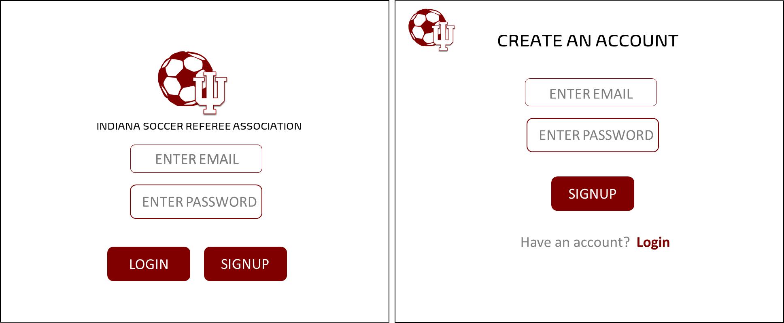
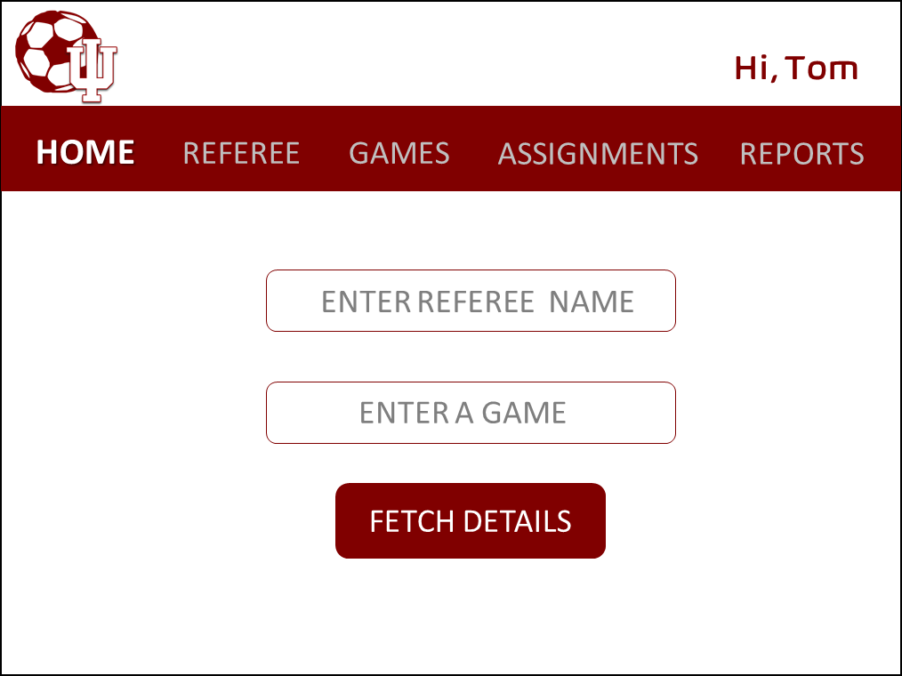
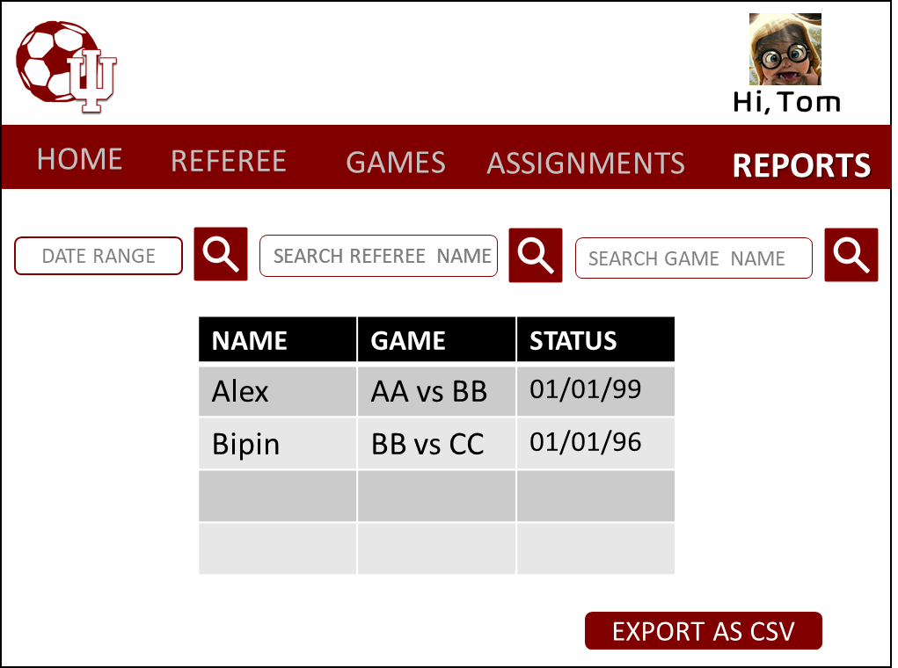
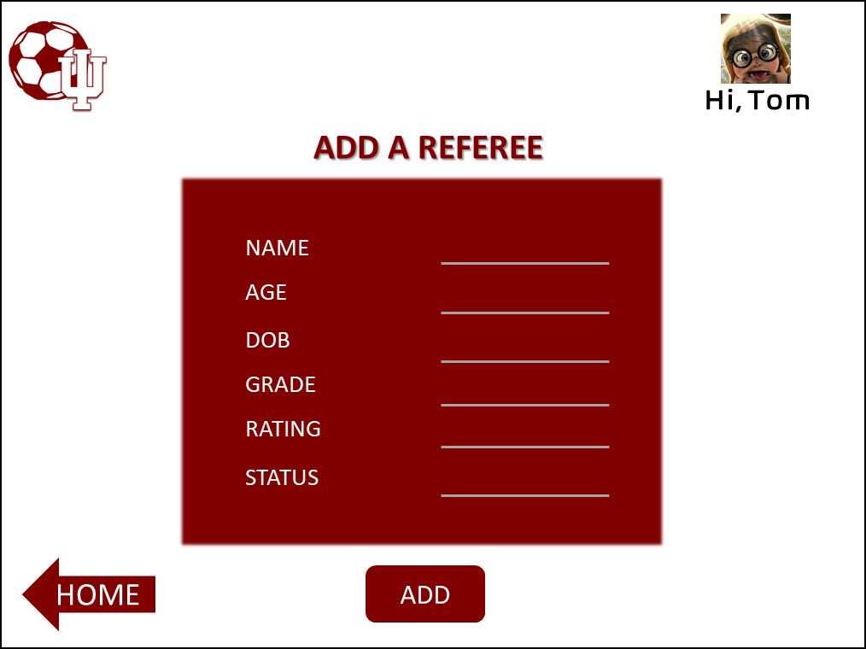
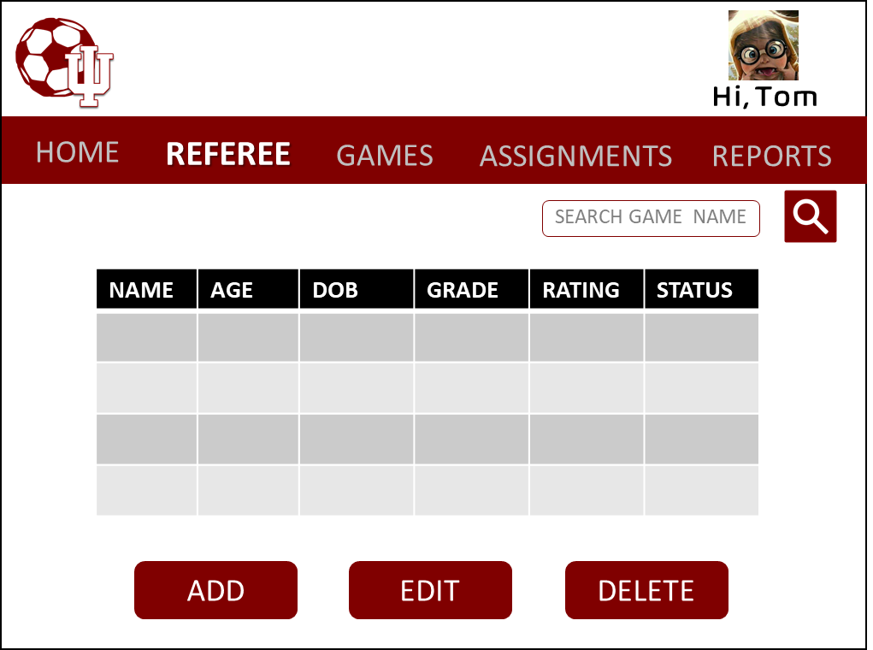
Appendix
WIREFRAMES
Value Proposition
Demo
Lessons Learned
Appendix

Slide 12
Appendix
USER STORIES | ACCEPTANCE CRITERIA
As a user, I want to able to view referee and game details | User is able to view all the details of referees and games under their respective tabs in a tabular form
As a user, I want to be able to do CRUD operation on the referee and game tables | User able to do add, delete, update on referee and games table. The CRUD operation reflects the operation on the back end as well
As a user, I want to be able to assign a referee to a particular game | Under the assignment table, user is able to choose a game and assign a referee to that game
As a user, I want to be able to download reports as per future games or past games | User able to filter the required time frame for games with assigned referee and further download the report as a csv file
Value Proposition
Demo
Lessons Learned
Appendix

Slide 13

Appendix
LIKELIHOOD
Risks | Mitigation
BEC Solutions cannot finish the project by the deadline. | Allocate enough time and do individual parts sequentially. Follow Gregory’s checklist of deliverables closely and have set due dates for those deliverables. Trello is a good application for tracking project deadlines.
BEC Solutions does not posses the coding knowledge to do the project. | A mitigation to this is starting the project early and asking questions when we run into issues. Make use of office hours and Alex’s expertise and experience in programming.
BEC Solutions loses the project files due to not utilizing version control applications or due to a push mistake. | Utilize Git and Github and communicate pushes and mergers with the main code.
SEVERITY

Slide 14
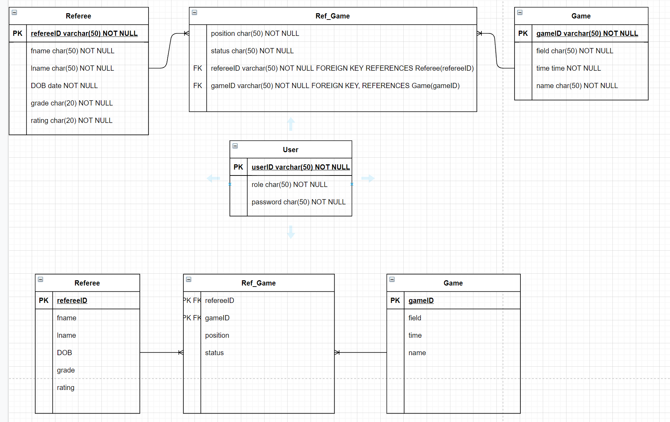
Appendix
DATA MODEL
Value Proposition
Demo
Lessons Learned
Appendix

