Slide 1
Data Oriented Gateway Engine

Slide 2
System outline
Cloud
Cloud
Edison
Hardware
UDP
Webserver
Python
TUI
Socket
Queue
IPC
Sketch
Serial
915MHz radio
MSP430
2.4GHz radio
SPI
SPI

Slide 3
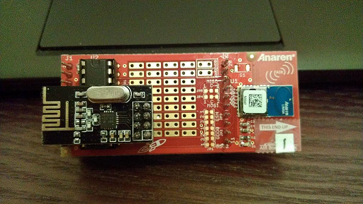
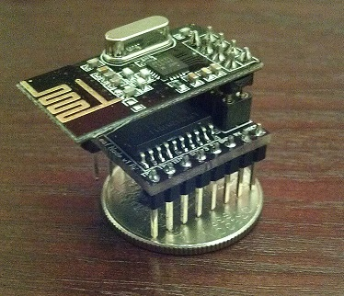
Hardware overview
BoosterPack Node
Leaf Node
Microcontroller: MSP430G2553
Main radio: Anaren 915MHz
Misc: Temperature sensor, LDO
Cost: ~$13
Microcontroller: LPC812
Radio: Nordic 2.4GHz
Misc: Temperature sensor
Cost: ~$5

Slide 4
Demo 1 – Cloud to local node
SparkFun Cloud
Edison System
WiFi
Leaf Node
Laptop

Slide 5
Demo 2 – 915MHz to 2.4GHz node
Edison System
2.4GHz radio
915MHz radio
LPC812
MSP430

Slide 6
Demo 3 – 915MHz rssi plot
Webserver
Edison System
TUI
MSP430
MSP430
MSP430
MSP430

Slide 7
DEMO 4 – CLOUD DATA serVICES
SparkFun’s Open Phant Data Cloud Service https://data.sparkfun.com/doge_edison_test/
Intel’s Open Data Analytics Cloud Service https://dashboard.us.enableiot.com/v1/ui/dashboard

Slide 8
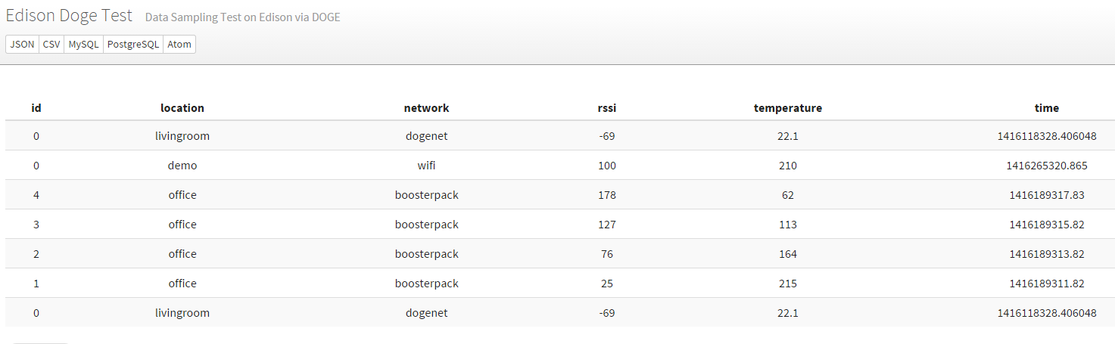
SparkFun’s Open Phant Data Cloud Service

