Slide 1
Strings and StringBuilders
Dr. Christopher Summa (2024)

Slide 2
Strings and StringBuilders
Strings and StringBuilders are closely related in the sense of what kind of data they represent (a sequence of characters) and what operations they support (their instance methods)
They differ mostly in the fact that Strings are immutable and StringBuilders are mutable – this is a result of different implementation details (what’s going on under the hood in these classes) which also results in performance differences
Basic idea – use Strings for performance, UNLESS you need to modify the contents of the strings you are producing, in which case use StringBuilder

Slide 3
Measuring real-world performance
We are going to look at performance today, and in order to do that we need to introduce a few concepts
Open up a shell and type the following:
top
This command stands for “table of processes” and shows all the things that running on your computer right now, taking up processor cycles, in order of decreasing percentage of CPU resources used.
Notice that there are a LOT OF THINGS going on. When you run a program, that program will be added to this list while it is running and will be removed when it is done. Try opening up a new program, like MS Word and watch how the listing changes.
Using the “q” keystroke will quit top

Slide 4
Measuring real-world performance
One fairly easy way to get a feel for performance is to literally measure how long it takes to do certain operations.
This is exactly analogous to measuring your time in the 40 yard dash. If all you had was a standard watch, you’d have someone look at the time you started running, look at the time you finished, and subtract one from the other. This is how long you were actually running, right?

Slide 5
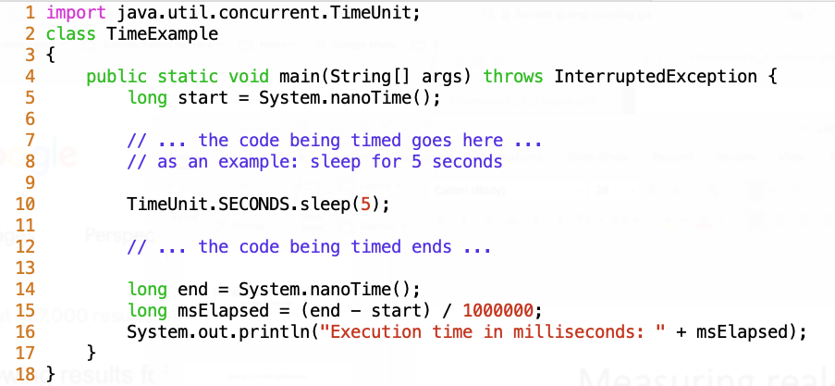
Measuring real-world performance
We are going to do precisely this, but by asking the CPU “what time is it” before and after we do something that requires a bunch of work, then take the difference. The code for that looks like so, and has been provided for you in a file called Timing.java

Slide 6
Exercise 1
Download, compile, and run Timing.java. Run it 5 times, and write down the milliseconds answer you get each time. Are they exactly the same each time? Why or why not?

Slide 7
Measuring real-world performance
When running real-world performance analysis it should be clear to you now that the other programs running in the background can have a large effect on the result, as well as the hardware you are running on. It is for this reason that any time you do this sort of analysis you should try to:
A) minimize the number of other programs vying for your CPU’s resources, so close web browsers, text editors, etc.
B) run multiple times (5 or more) and average the results

Slide 8


Exercise 2
Copy Timing.java as Timing_String.java and Timing_StringBuilder.java. We want to measure the difference that each type takes to do concatenation, so we want to replace the ”sleep” work with either the code on the bottom left or the bottom right. Don’t forget to change the name of the class declarations in the file to match the filenames! Run it 5 times, and calculate the average. Which would be the better choice if we were doing a lot of concatenations?
String version
StringBuilder version

Slide 9
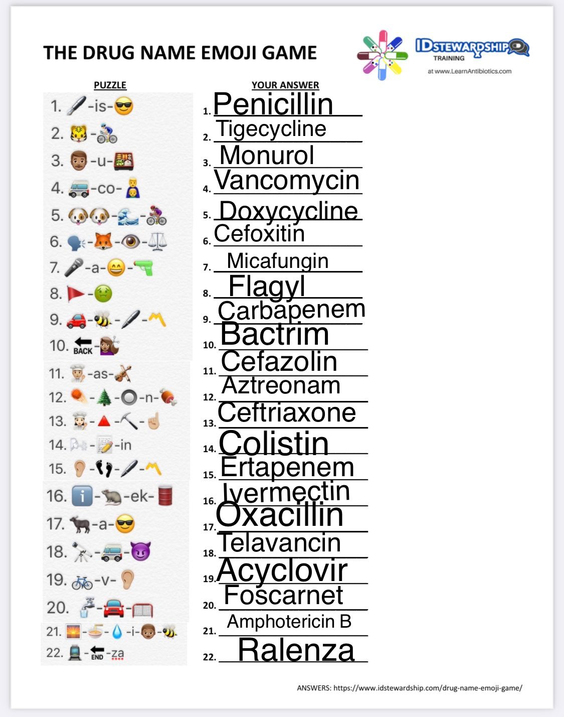


Building a String From Scratch
Pharmaceutical companies each have team of folks with Marketing degrees whose job it is to dream up gibberish words that sound cool to name their drugs. CLICK HERE FOR SOME MORE EXAMPLES

Slide 10
Building a String From Scratch
We are going to write an automated drug name generator called:
PharmaceuticalGibberishCreator
The basic idea is the following:
Create two arrays – one containing all possible consonant characters and one containing all possible vowel characters
Based on a pattern of consonants and vowels, randomly choose one from each array and stitch them together into a string. For example, the drug name “wegovy” has a consonant-vowel-consonant-vowel-consonant-vowel pattern.

Slide 11
Exercise 3
We are going to write an automated drug name generator called:
PharmaceuticalGibberishCreator
The basic idea is the following:
Create two arrays – one containing all possible consonant characters and one containing all possible vowel characters
Based on a pattern of consonants and vowels, randomly choose one from each array and stitch them together into a string. For example, the drug name “wegovy” has a consonant-vowel-consonant-vowel-consonant-vowel pattern.
The starter code is provided for you – have fun!

