Slide 1
Recursion
Dr. Christopher Summa (2024)

Slide 2

Recursion as Problem Solving Method
Recursion is basically when a function invokes itself (typically with an argument specifying the version of the problem that the method call is being tasked to solve)
For example, if we assume that we can solve Factorial(4), multiplying the result by 5 is the solution to Factorial(5)
The recursion ends when we have reached the simplest possible version of the problem we can envision solving. For example, Factorial(1) is simply 1, and no further calculation is necessary, so we can return 1.
This “simplest version” of the problem is known as the “base case”, which ends the recursion, and is the first version of the algorithm that actually returns a result.

Slide 3
Recursion with shell commands
Many shell commands support the idea of recursion by using flags. For example, when you type the command:
ls –R directoryname
This will produce a listing of each of the files and directories in the directory “directoryname” and if any of things are directories, it will produce a listing of of the contents of that subdirectory, etc.
Try this outside of your repository…
Another shell command that supports this idea is “cp” – for example if I want to make a copy of a directory and everything it contains, including subdirectories, and everything they contain, etc.
cp –R directoryname copyname
Try this with your homework repository… (you can delete the copy once you’ve poked around a bit)

Slide 4
Exercise 1
Download the uncompress the following file in a new directory in your repo called “Lab6” :
lab6_starter_code.zip
Open up the file RecursiveLister.java in your favorite text editor. We are going to reproduce the behavior of “ls –R” using Java.
You’ll remember during our discussion of Files and Streams that it’s possible to create a DirectoryStream object that iterates through each of the Path objects in a directory – this is shown on the next slide:

Slide 5
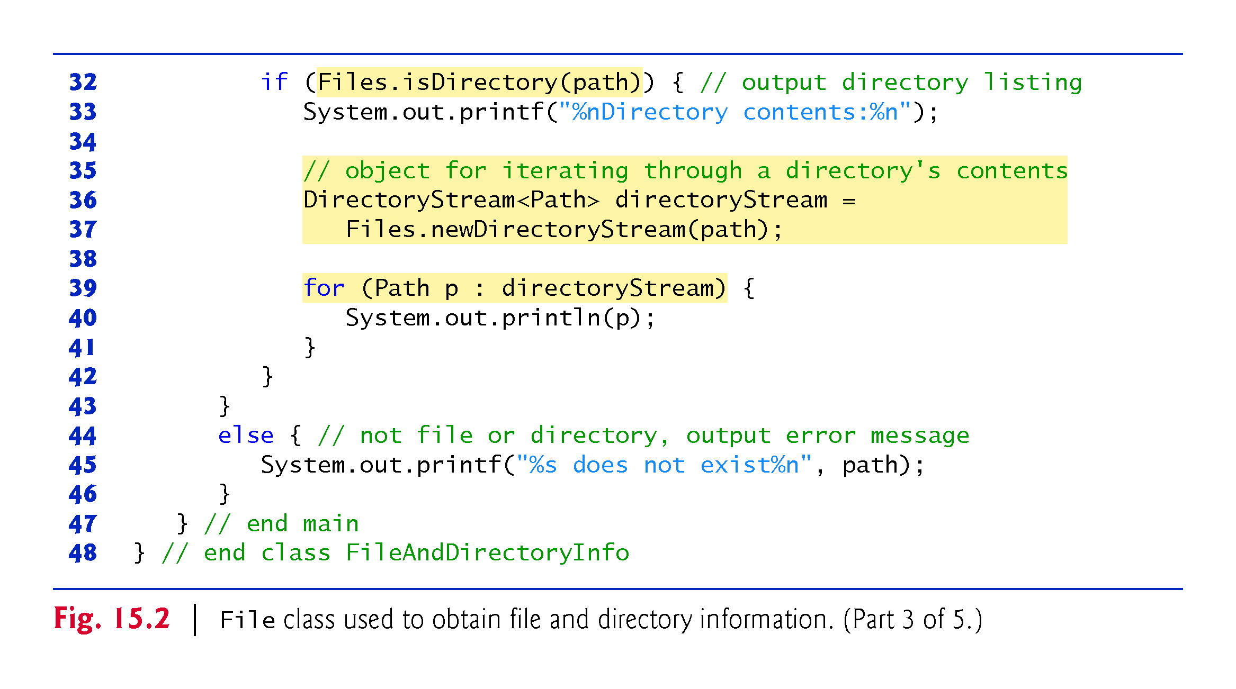
Exercise 1 (continued)

Slide 6
Exercise 1 (continued)
Using the code in the prior slide as an example, finish the code in the method recursivelyListDirectories…

Slide 7
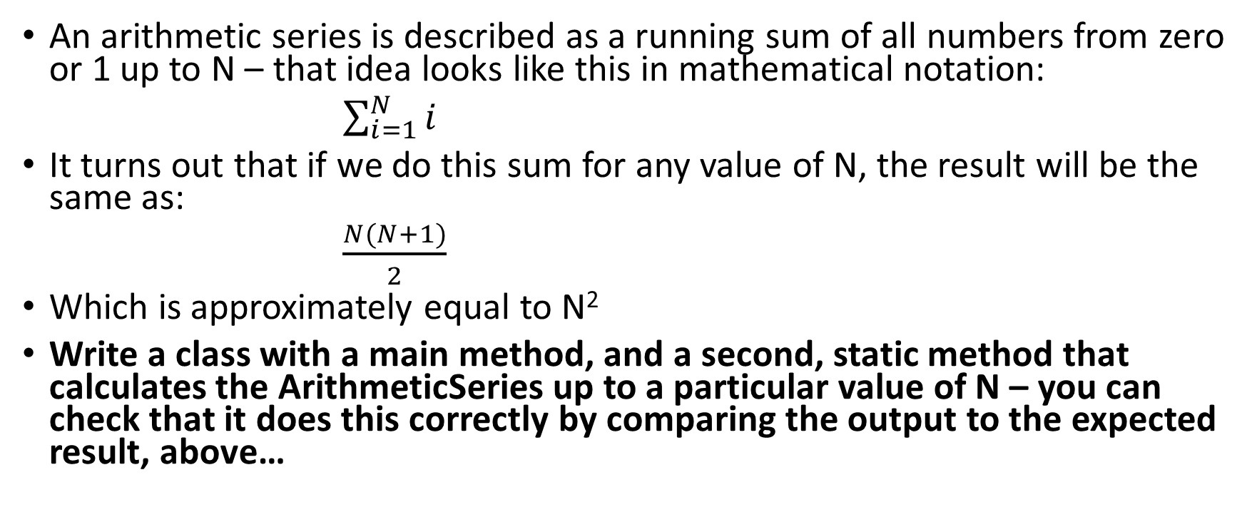
Exercise 2 (a different idea)
An arithmetic series is described as a running sum of all numbers from zero or 1 up to N – that idea looks like this in mathematical notation:
$\sum_{i=1}^{N}{i}$
It turns out that if we do this sum for any value of N, the result will be the same as:
$\frac{N(N+1)}{2}$
Which is approximately equal to N²
Write a class with a main method, and a second, static method that calculates the ArithmeticSeries up to a particular value of N – you can check that it does this correctly by comparing the output to the expected result, above…

