Slide 1
Generic Classes
Dr. Christopher Summa (2024)

Slide 2
Generics
Generics in Java allow for the writing of code ”in the general” in cases where the algorithms/class definition is exactly the same across multiple potential classes or methods but what changes is a type, of either parameters or instance variables.
We declare a type parameter in angle brackets, such as <T>, which will stand in a ”variable for type’
When writing a generic method this type parameter comes before the return type of the method in the method signature (note that this allows us to declare the return type as “T”)
public <T> void doSomethingWith(T[] data)
When writing a generic class, this type parameter declaration comes after the name of the class in the class declaration
public class Queue<T> {

Slide 3
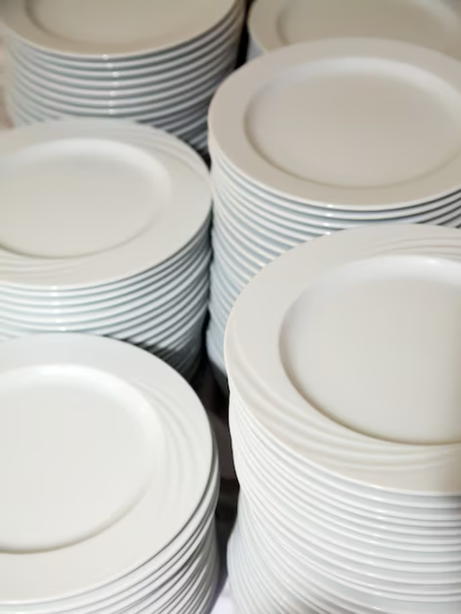
Stacks
A stack is a very common data structure – that works like a stack of dishes that is built into the buffet at your favorite buffet restaurant
The stack is loaded by someone from the kitchen and the last dish that is loaded is the first one that will be removed by a customer. Note that the “side” that the loading is done is the same “side” that the removal is done.
The stack data structure is a Last In, First Out (LIFO) data structure
Stacks are used for many things, one of which is the implementation of an area of memory in the JVM called the method call stack which you learned about last semester.
Stacks support, at a minimum, the following operations:
public void push(T element)
public T pop()
public T peek()

Slide 4
Exercise 1
Download the uncompress the following file in a new directory in your repo called “Lab7” :
lab7_starter_code.zip
Have a look around at the relationships between the classes listed. Notice that there is an interface, Stack<T>, which is a generic and defines the method signatures for the all the methods a Stack should support
Open up the file ArrayListStack.java in your favorite text editor.
This stack should be implemented with an ArrayList (also generic) as its data store.
Before you start programming you’ll need to make a decision as to where the ”top” is going to be
If the top is “at the beginning” of the ArrayList what position will this be?
If the top is “at the end” of the ArrayList what position will this be?
Using the comments to guide your design, implement the ArrayListStack

Slide 5

Queues
A queue is another very common data structure – that works like the line at the grocery store
You enter a queue at the back, and leave the queue from the front.
The queue data structure is a First In, First Out (FIFO) data structure
Queues can be used for simulations of factories, to schedule jobs on computers and printers and may other things
Queues support, at a minimum, the following operations:
public void enqueue(T element)
public T dequeue()
public T peek()

Slide 6
Exercise 2
Have a look around at the relationships between the classes listed. Notice that there is an interface, Queue<T>, which is a generic and defines the method signatures for the all the methods a Queue should support
Open up the file ArrayListQueue.java in your favorite text editor.
This queue should be implemented with an ArrayList (also generic) as its data store.
Before you start programming you’ll need to make a decision as to where the ”back” and “front” are going to be
One will have to be “at the beginning” of the ArrayList: what position will this be?
One will have to be “at the end” of the ArrayList: what position will this be?
Using the comments to guide your design, implement the ArrayListQueue

