Slide 1
Flappy BIRDS Project

Slide 2
INTRODUCING THE MEMBERS
Dương Đặng Minh Cường
ITCSIU22285
Dương Đặng Minh Cường
ITCSIU22285
Dương Đặng Minh Cường
ITCSIU22285
Dương Đặng Minh Cường
ITCSIU22285
Dương Đặng Minh Cường
ITCSIU22285

Slide 3
01
Game mechanics

Slide 4
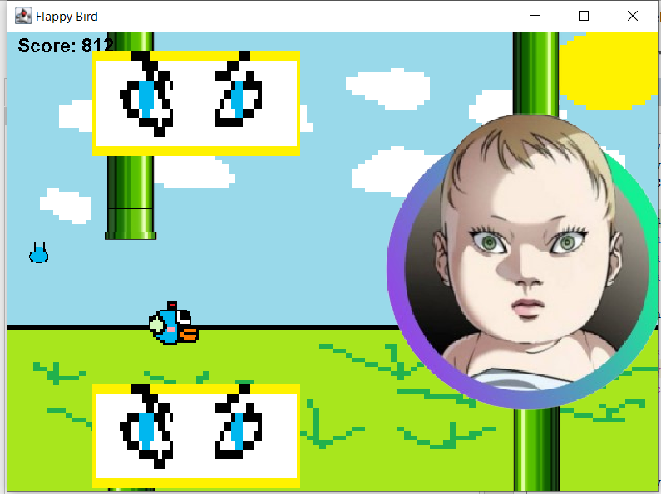
Flappy Birds
The player controls the bird's vertical movement by pressing the UP arrow key to pass through obstacles

Slide 5
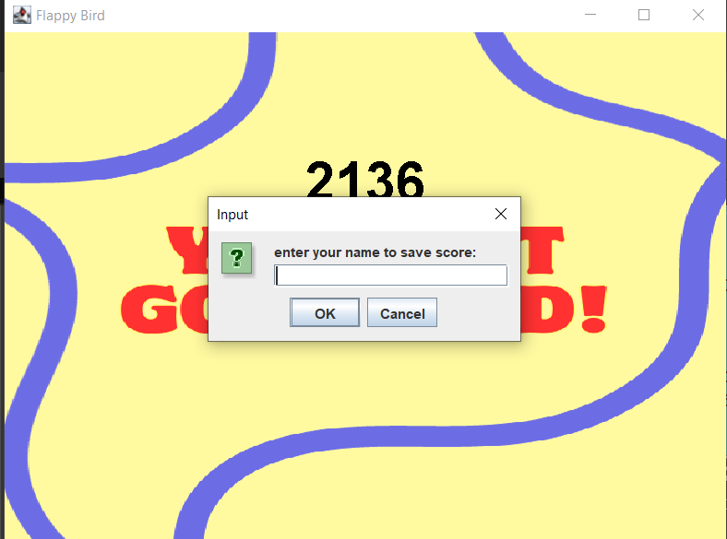
Flappy Birds
The player can choose to save name and score when complete hard mode.

Slide 6
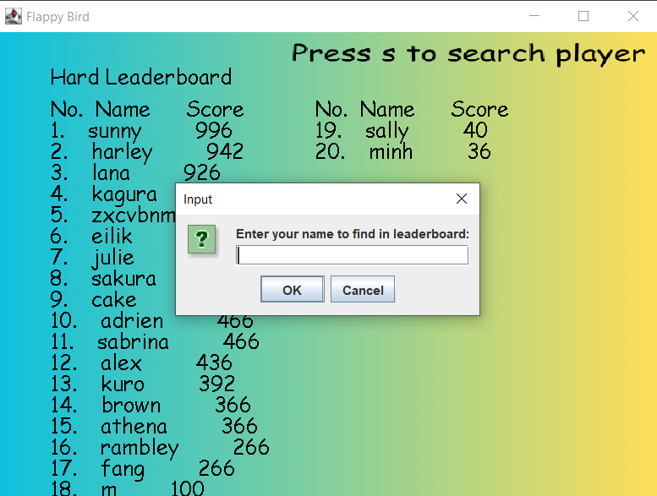
Flappy Birds
The player can also choose to see leaderboard and search player in the leaderboard

Slide 7
02
Data structures

Slide 8
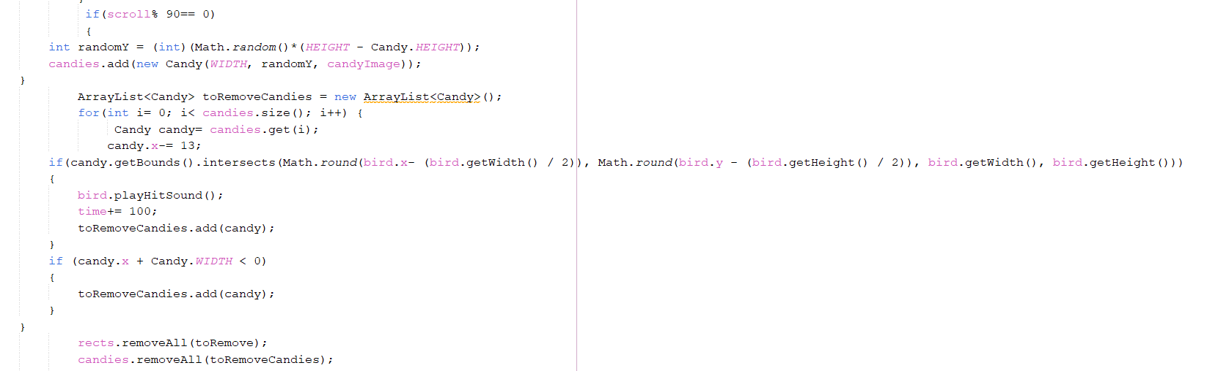
ArrayList:
Bird: The player-controlled character.
Rectangles: Representing the pipes that serve as obstacles.
Candies: Collectible items that provide additional points.
Attacks: Objects that pose a threat to the player.
ScoreEntry: Objects that store player names and scores for the leaderboard.

Slide 9
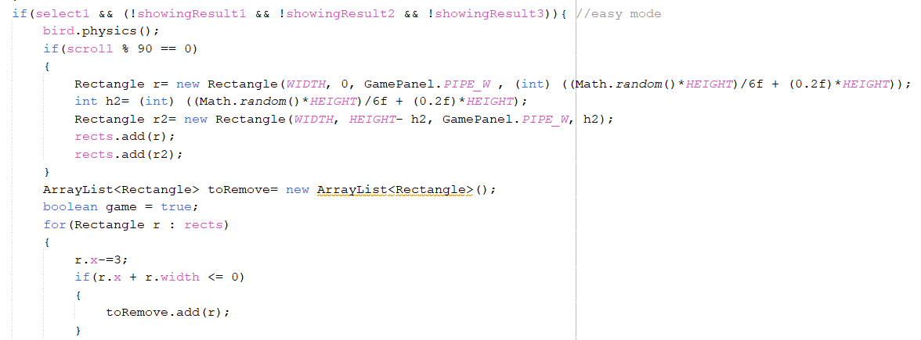
The Rectangle class is used for collision detection between the bird and obstacles. Each pipe and the bird itself can be represented as rectangles, allowing for straightforward intersection checks.

Slide 10
03
algorthim

Slide 11
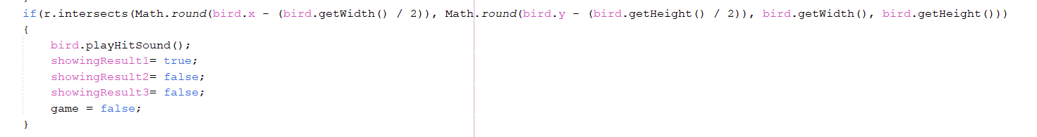
Collision Detection:
Collision detection is performed to determine if the bird intersects with any pipes or attacks.
Implementation: For each frame, the game checks if the bird's rectangle intersects with any of the rectangles representing pipes or attacks.

Slide 12
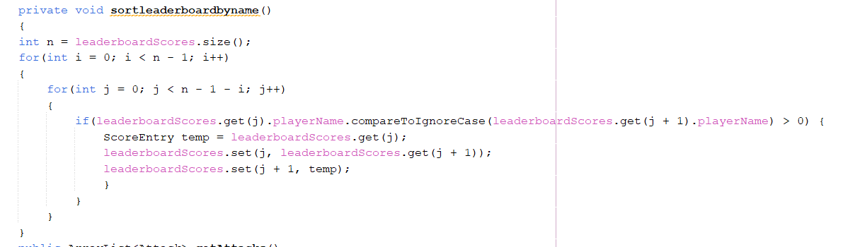
Sorting Algorithm:
The Bubble Sort algorithm is used to sort the leaderboard by player names when displaying the leaderboard.
Implementation: The algorithm iterates through the list of ScoreEntry objects, comparing player names and swapping them as necessary to achieve a sorted order.
Time Complexity: The time complexity of Bubble Sort is O(n^2), where n is the number of entries in the leaderboard.

Slide 13
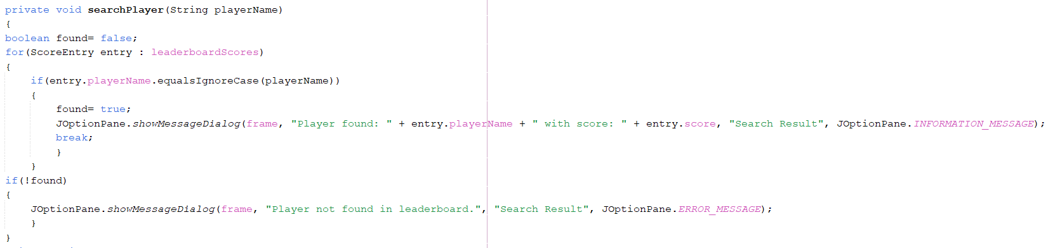
Search Algorithm:
A linear search algorithm is used to find a player by name in the leaderboard.
Implementation: The algorithm iterates through the list of ScoreEntry objects, checking each player's name against the input name.
Time Complexity: The time complexity is O(n), where n is the number of entries in the leaderboard.

Slide 14
04
Libraries

Slide 15
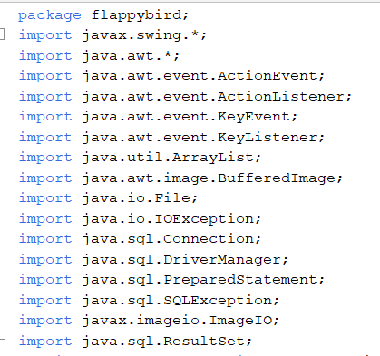

Slide 16
THANKS!
DO YOU HAVE ANY QUESTIONS?

Slide 17
ALTERNATIVE RESOURCES

