Slide 1


THERMOELECTRIC NANO- COATING
TechExpo
Theme: Smart & Sustainable Technologies(Senior Category)
Team Name : VisionHack
Team Members : S Trinaini
A Bhargavi
Kandanulu Likhitha
Jetty Usha Rani

Slide 2
Problem Statement
TechExpo
Challenge:
Buildings loses a lot of heat through their walls and surfaces . This heat is often wasted and not used.
Old ways of collecting heat energy are bulky, costly and hard to install on all surfaces.
So, there is a need for a smart , low –cost , and flexible solution.
Thermoelectric nano-coatings use temperature changes around buildings to produce useful electrical energy.
Concept:
“Simple Heat-to-Power Conversion”
Regular paints improve appearance but don’t help in capturing the heat that escapes from buildings.
We need smart coatings that turns this heat into electricity without changing how buildings look.
Thermoelectric Nano Paint uses special materials to absorb heat from the sun and air and turn it into power.
It functions well even in the absence of sunlight and matches well with any wall

Slide 3
The Solution
TechExpo
Identify Heat Loss : Look for areas like walls, roofs and other surfaces where buildings lose heat regularly.
Apply Thermoelectric Nano Coating: Coat the identified areas with a heat – sensitive nano layer that works like regular paint but has energy-harvesting abilities.
Produce Electricity: The coating silently converts temperature variations between indoor and outdoor surfaces into usable electrical energy, requiring no additional input.
Use the Power: This generated energy can be used to power small devices, lighting or stored for later use-reducing your dependence on external electricity sources.

Slide 4
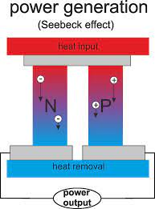
Key Features
TechExpo
Heat Capture : Efficiently gathers warmth from sunlight and surrounding air temperatures.
Power Generation : Uses advanced thermoelectric nanomaterials to turn absorbed heat into electrical energy.
Seamless Appearance : Looks like ordinary paint, keeping the original style of the building intact.
Easy Care : Strong and reliable over time , needing very little maintenance.

Slide 5
Working Elements
TechExpo
Nanomaterials: High- performance thermoelectric compounds, such as Bismuth Telluride(Bi2Te3), designed to effectively transform heat into electrical energy.
Coating Method: Applied with nano layer spraying or brushing to provide smooth, uniform coverage of the surfaces.
Simulation Tools : Online platforms are utilized to model energy harvesting behavior and showcase how well the system performs.
Energy Management: Integrates with a small-scale energy storage systems or IoT driven devices to leverage the harvested electricity.

Slide 6
IMPLEMENTATION
TechExpo
Formulate Printable Ink : Develop a thermoelectric paste utilizing Bismuth Telluride or Magnesium Silicide as the core material.
Substrate Cleaning : Select a flexible base material and clean it thoroughly.
Ink Application : Apply the formulated ink onto the substrate using inkjet or screen-printing techniques.
Thermal Insulation Attachment: Apply an aerogel pad to the back of the coated surface to limit heat dissipation.
Protective Coating : Cover the full structure with a transparent layer to safeguard it from external factors.
Testing : Assess power generation under thermal gradients and improve output.
Deployment : Scale up for use on building surfaces to harness ambient heat.

Slide 7
Feasibility & Viability
TechExpo
Aspect | Details
Technical Readiness | Paint-based system, scalable application
Operational Simplicity | Easy to apply, no structural changes needed
Cost Effectiveness | Moderate; reduces long-term energy costs
Market Potential | Growing demand in green building sectors

Slide 8
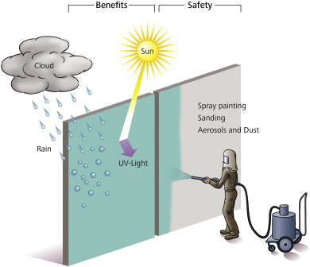
Impacts & Benefits
TechExpo
Reduces heat waste by generating electricity.
Supports eco-friendly, sustainable energy use.
Requires little to no maintenance.
Maintains the building’s original look.
Works automatically without manual effort.

Slide 9
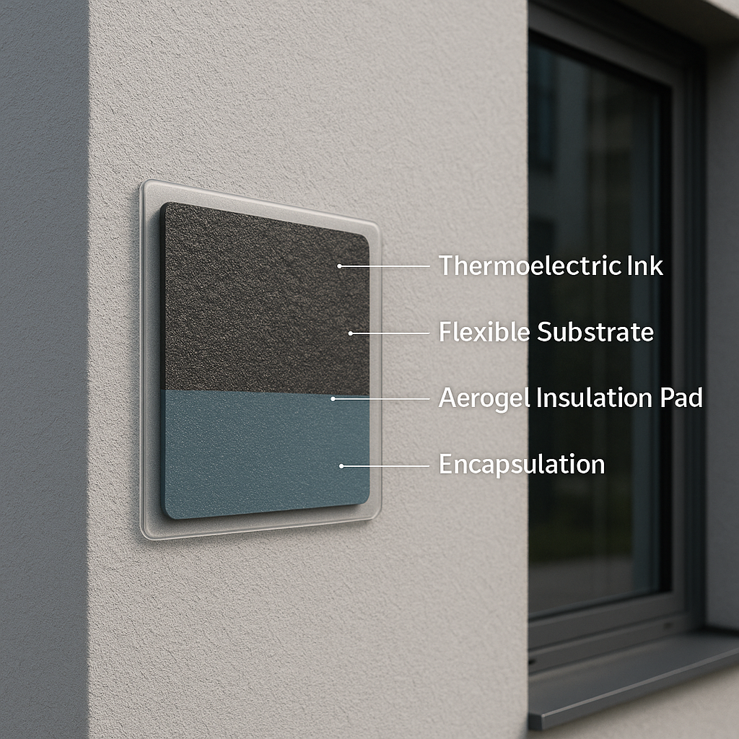
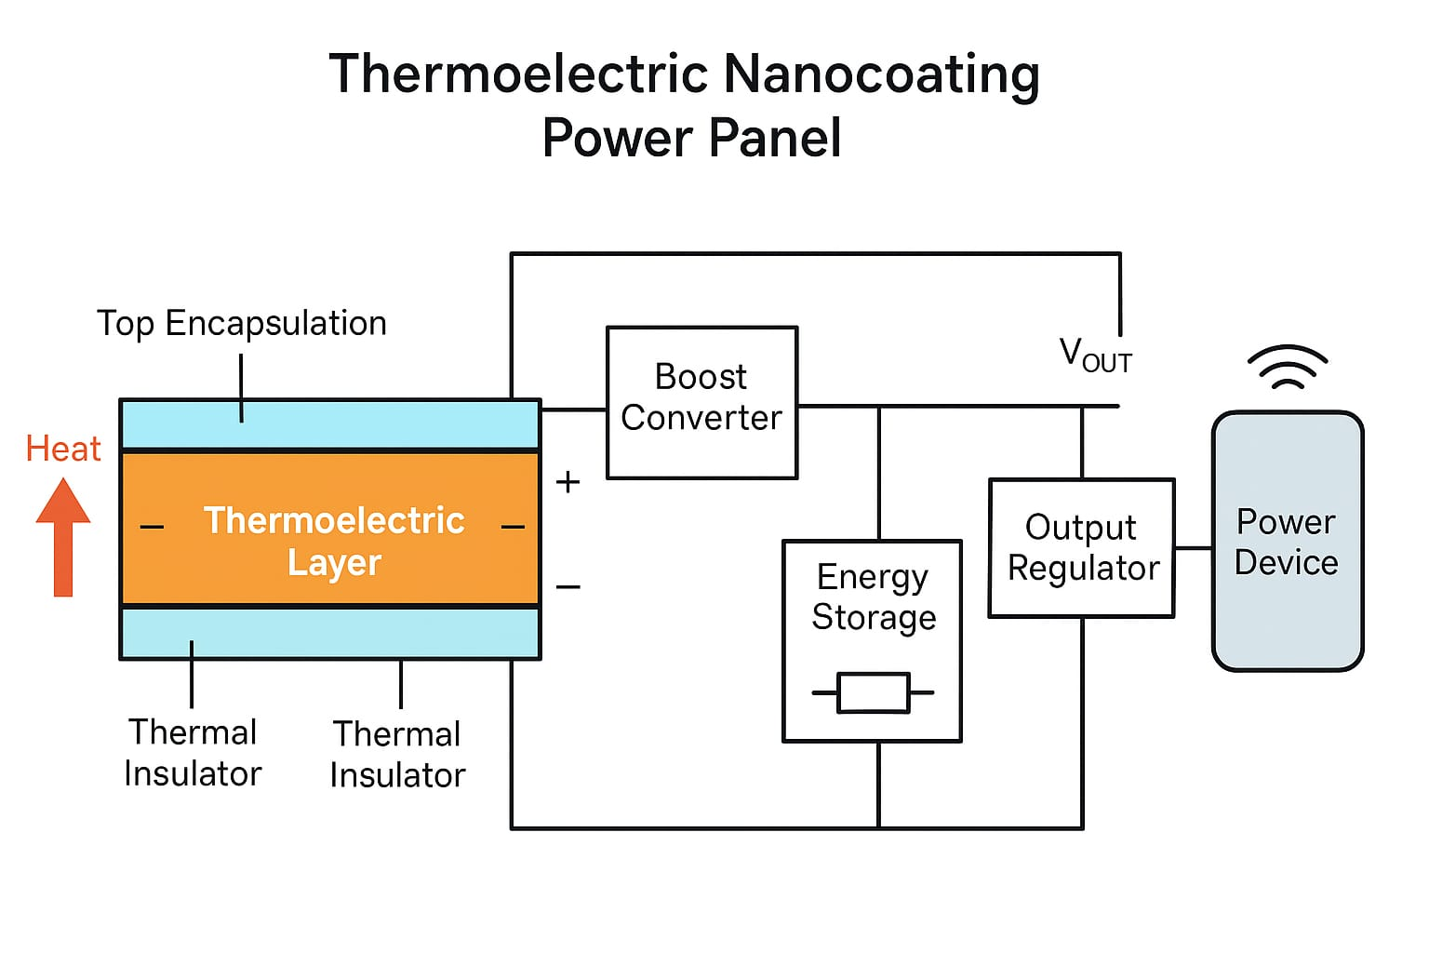
Reach
TechExpo
Building walls / rooftops
Smart homes
Railway Station and metros
Satellites and aerospace
Wearable electronics
Industrial equipment
Construction materials

Slide 10
Resources
TechExpo
Scientific Research Papers & Journals: Studies on thermoelectric materials and nanotechnology coatings: https://www.sciencedirect.com https://ieeexplore.ieee.org https://link.springer.com
Industry Reports: Market trends and emerging technologies in nano coatings and green building materials: https://www.statista.com https://www.alliedmarketresearch.com
Government & Energy Agencies: Green building guidelines, energy efficiency programs, and certifications: https://www.energy.gov (U.S. Department of Energy) https://beeindia.gov.in (Bureau of Energy Efficiency - India)
Conferences & Webinars: Events on nanotechnology, smart coatings, and sustainable construction: Nanotech Conferences - https://www.nanotechworld.org Smart Building Summit - https://www.smartbuildingshow.com

Slide 11

Thank You !

