Slide 1
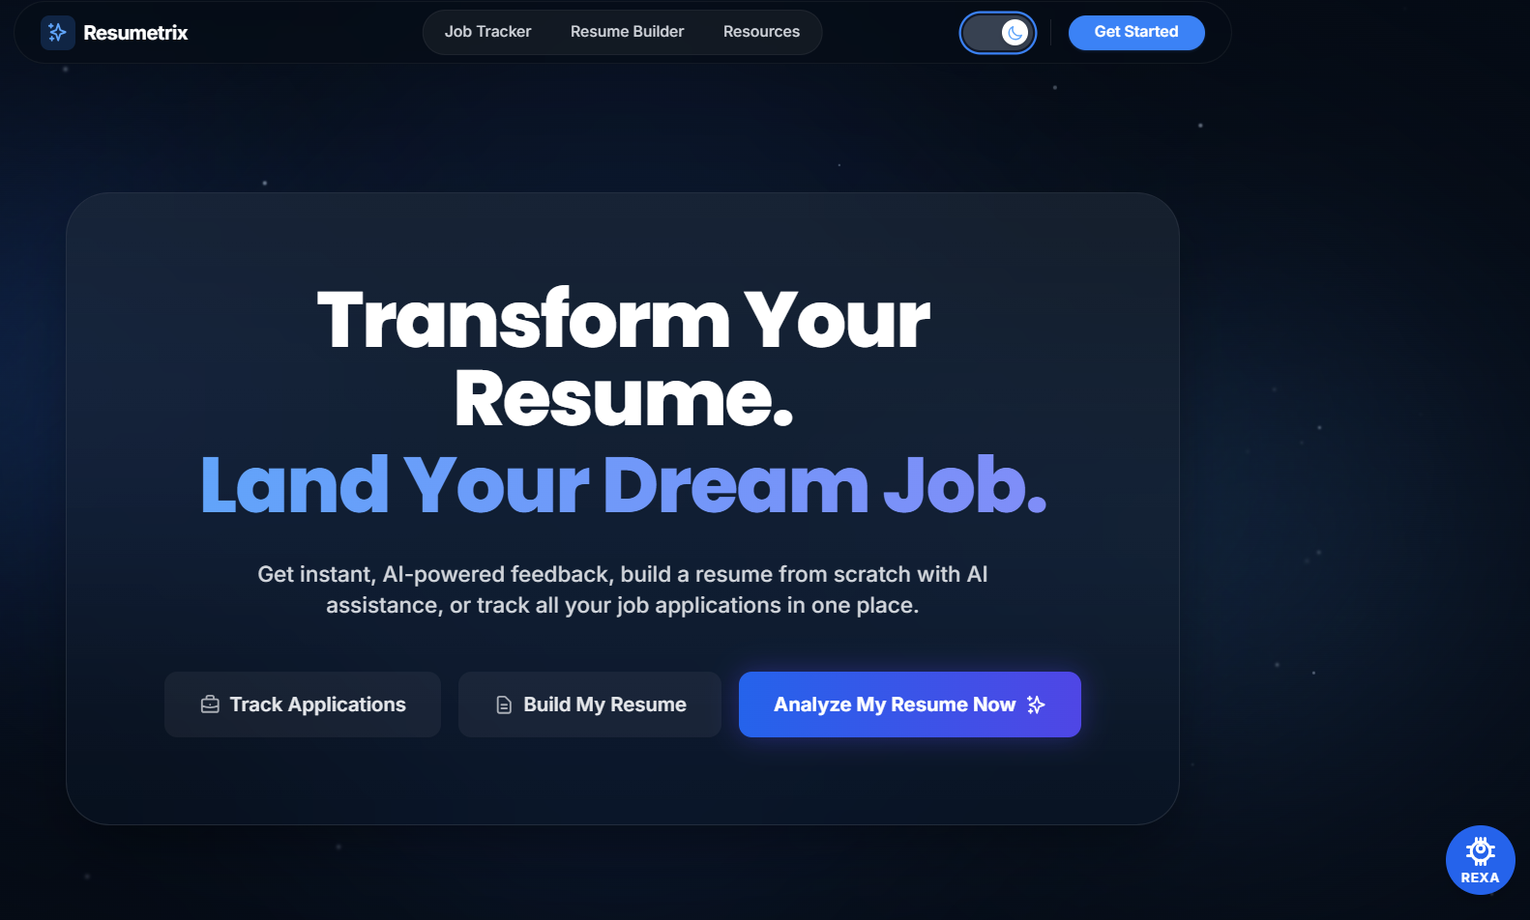
MINI PROJECT PRESENTATION
RESUMETRIX
AI-Powered Resume Screening and Application Tracking System
FastAPI · React
spaCy · Gemini AI
Supabase · PostgreSQL
Interview Prep
Job Tracker
ATS Score
Presented By BHUVANESH JUJARE
Skill Gap Analysis
Roll Number 24AK5A0503
Branch & Year CSE – IV , Sec 1
Academic Year 2024 – 2027
Final Year Mini Project

Slide 2
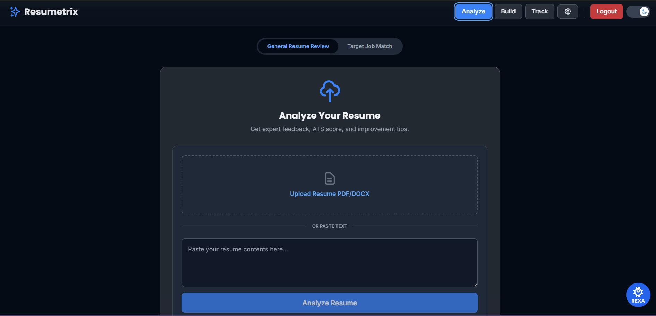
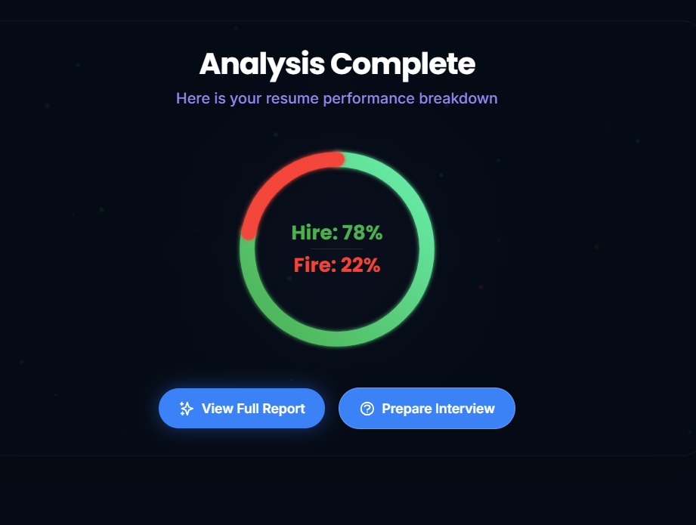
02 · PROBLEM STATEMENT
Why do qualified students still fail to get interviews?
75% of resumes never reach a human reviewer · Most candidates prepare without referencing the actual JD · Only 2% of applications result in an interview call
01
ATS Rejection Without Feedback
02
Unknown Skill Gaps
03
Disconnected Interview Prep
04
Manual Job Tracking

Slide 3
03 · METHODOLOGY & APPROACH
How Resumetrix Works
Resume
Upload
Resume
Parsing
ATS
Analysis
JD
Matching
Skill Gap
Detection
Interview
Prep
Job
Tracking
▶
▶
▶
▶
▶
▶
Step 1
Step 2
Step 3
Step 4
Step 5
Step 6
Step 7
TECHNOLOGY STACK
FRONTEND
BACKEND
DATABASE
React + TypeScript
FastAPI · Python
Supabase · PostgreSQL
Vite · Tailwind CSS · shadcn/ui
PyMuPDF · python-docx · spaCy NLP
Auth · Storage · REST APIs
AI LAYER
HOSTING
CHARTS
Gemini 1.5 Flash API
Vercel + Render.com
Recharts
1500 free req/day · Prompt engineering
Frontend CDN + Backend Python
Radar · Line · Bar charts

Slide 4
04 · RESULTS & IMPLEMENTED FEATURES
What Resumetrix Delivers
F01
Rule-Based
F02
spaCy NLP
F03
Taxonomy JSON
ATS Compatibility Audit
Weighted Match Score
Skill Gap Analysis
20+ formatting rules checked: file type, tables, headers, date format, contact info, word count.
Hard skills (50%) · Tools (25%) · Soft skills (15%) · Certifications (10%) — weighted scoring.
Matched skills vs Missing skills. Color-coded output. Recommendations for each missing skill.
F04
Gemini AI
F05
NLP + Regex
F06
Kanban UI
Interview Preparation
Bullet Point Scorer
Job Application Tracker
5 technical + 3 behavioral questions generated from the JD. AI scores each answer on 4 dimensions.
Each resume bullet rated on action verbs, metrics, passive voice, length. Score 0–10 per line.
5-column Kanban board: Saved → Applied → OA → Interview → Outcome. Analytics per stage.
6 Core Modules Implemented · spaCy NLP + Gemini AI · Free-Tier Stack · 500+ Skills Taxonomy · Deployed on Vercel + Render

Slide 5
05 · CONCLUSION
Project Summary
KEY BENEFITS
FUTURE ENHANCEMENTS
✓
Improves resume quality through ATS-aware feedback
→ LinkedIn Profile Optimization
✓
Clearly identifies missing skills for specific roles
→ GitHub Portfolio Analyzer
✓
Supports interview preparation using the actual JD
→ Semantic Matching with Sentence Transformers
✓
Simplifies job application management with Kanban tracking
→ AI Resume Rewriter (Gemini-powered)
Free platform accessible to all students and job seekers
→ Multi-language Support (Hindi, Telugu)
✓
Thank You · Questions Welcome

