Slide 1
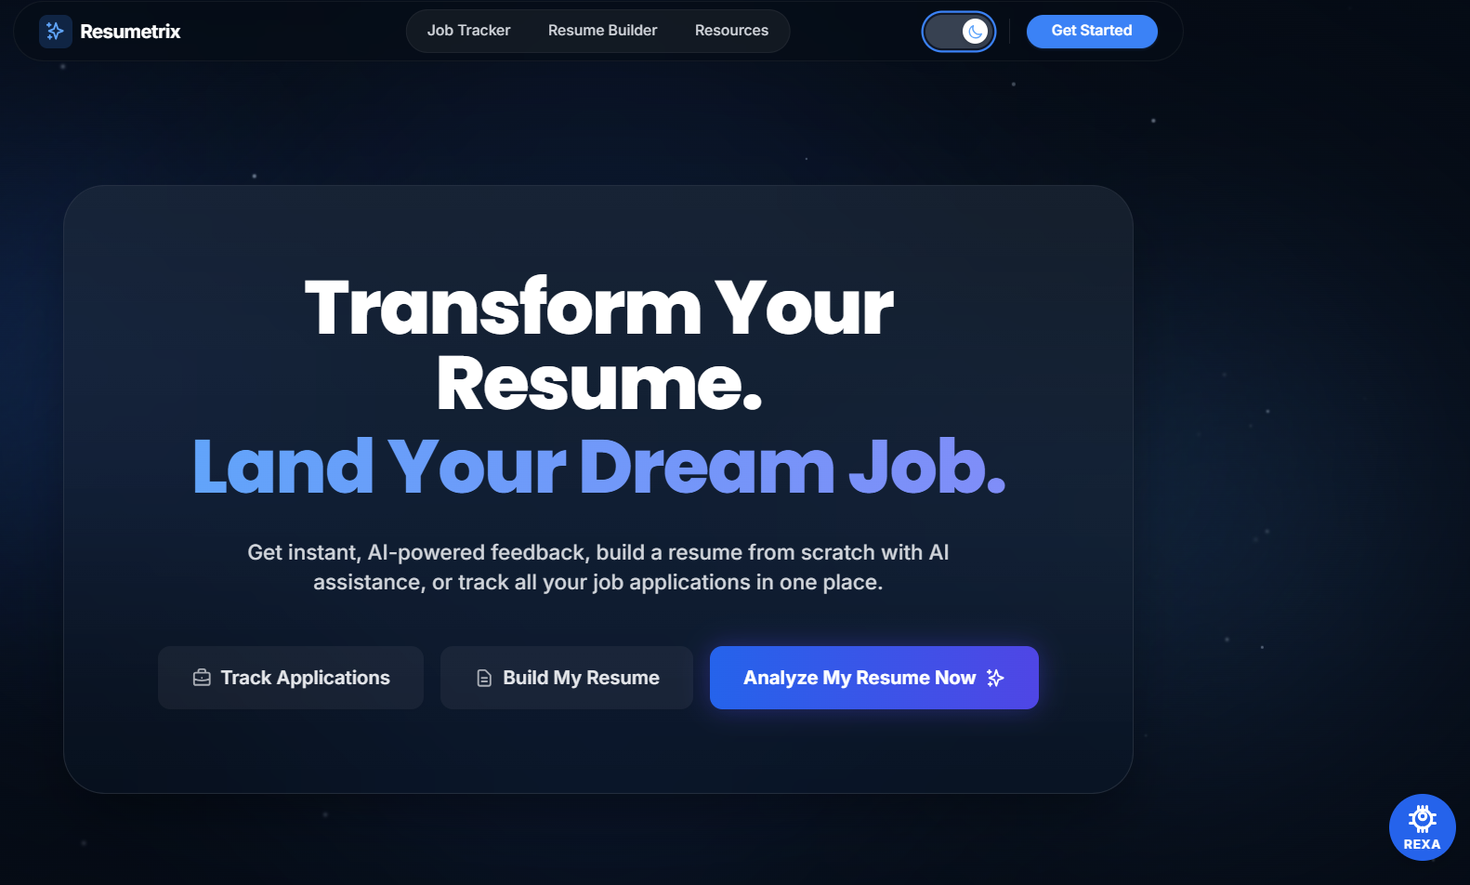
RESUMETRIX
Mini Project 2024–2027
AI-Powered Resume Screening & Application Tracking System
Presented By
Bhuvanesh Jujare
Roll Number
24AK5A0503
Branch & Year
CSE – IV, Sec 1
Academic Year
2024 – 2027
FastAPI · React
spaCy · Gemini AI
Supabase · PostgreSQL
ATS Score
Interview Prep
Job Tracker
B.Tech Computer Science Engineering · Final Year Mini Project

Slide 2
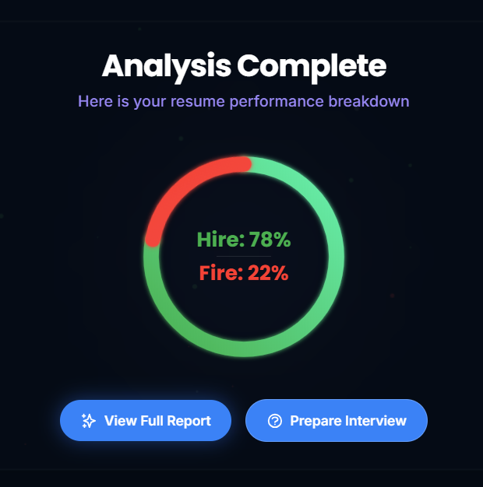
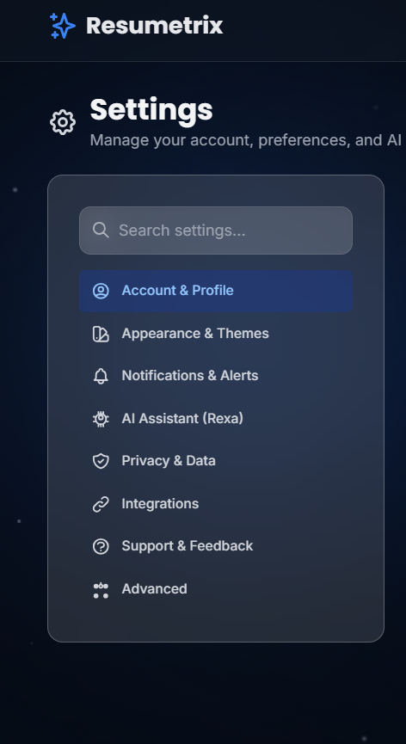




PROBLEM STATEMENT
Why do qualified students still fail to get interviews?
75%
Resumes rejected before human review
2%
Applications that result in interviews
5+
Platforms needed for full interview prep
01 ATS Rejection Without Feedback
02 Unknown Skill Gaps
03 Disconnected Interview Prep
04 Manual Job Tracking
75% of resumes never reach a human reviewer · Most candidates prepare without referencing the actual JD · Only 2% of applications result in an interview call

Slide 3
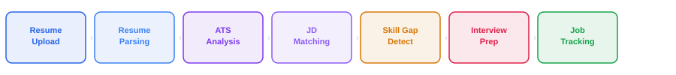
METHODOLOGY & APPROACH
How Resumetrix Works
Step 1
Step 2
Step 3
Step 4
Step 5
Step 6
Step 7
TECHNOLOGY STACK
FRONTEND
React + TypeScript
BACKEND
FastAPI · Python
DATABASE
Supabase · PostgreSQL
Vite · Tailwind CSS · shadcn/ui
PyMyPDF · python-docx · spaCy NLP
Auth · Storage · REST APIs
AI LAYER
Gemini 1.5 Flash API
HOSTING
Vercel + Render.com
CHARTS
Recharts
1500 free req/day · Prompt engineering
Frontend CDN + Backend Python
Radar · Line · Bar charts

Slide 4




RESULTS & IMPLEMENTED FEATURES
What Resumetrix Delivers
Rule-Based
F01
spaCy NLP
F02
Taxonomy JSON
F03
ATS Compatibility Audit
Weighted Match Score
Skill Gap Analysis
20+ formatting rules checked: file type, tables, headers, date format, contact info, word count.
Hard skills (50%) · Tools (25%) · Soft skills (15%) · Certifications (10%) — weighted scoring.
Matched skills vs Missing skills. Color-coded output. Recommendations for each missing skill.
Gemini AI
F04
NLP + Regex
F05
Kanban UI
F06
Interview Preparation
Bullet Point Scorer
Job Application Tracker
5 technical + 3 behavioral questions generated from the JD. AI scores each answer on 4 dimensions.
Each resume bullet rated on action verbs, metrics, passive voice, length. Score 0–10 per line.
5-column Kanban board: Saved → Applied → OA → Interview → Outcome. Analytics per stage.
6 Core Modules Implemented · spaCy NLP + Gemini AI · Free-Tier Stack · 500+ Skills Taxonomy · Deployed on Vercel + Render

Slide 5





CONCLUSION
Project Summary — Resumetrix
KEY BENEFITS
FUTURE ENHANCEMENTS
Improves resume quality through ATS-aware feedback
LinkedIn Profile Optimization
Clearly identifies missing skills for specific roles
GitHub Portfolio Analyzer
Supports interview preparation using the actual JD
Semantic Matching with Sentence Transformers
Simplifies job application management with Kanban tracking
AI Resume Rewriter (Gemini-powered)
Free platform accessible to all students and job seekers
Multi-language Support (Hindi, Telugu)
Thank You · Questions are Welcome

