Slide 1
Logic Circuits
CSC133 Lab 1 (Logic Flow Worksheet)
Name ________________________ Section ___________ Date ________
Overview

Slide 2
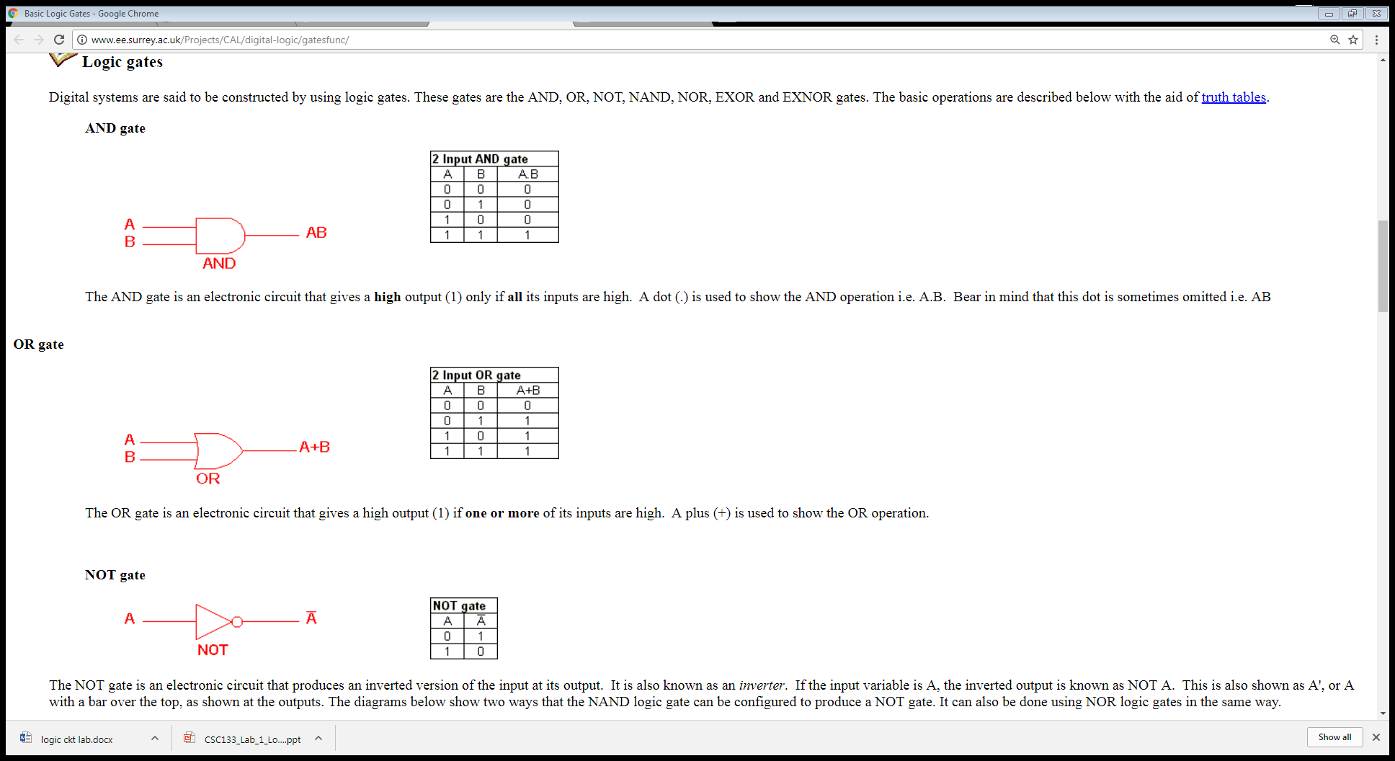

Slide 3
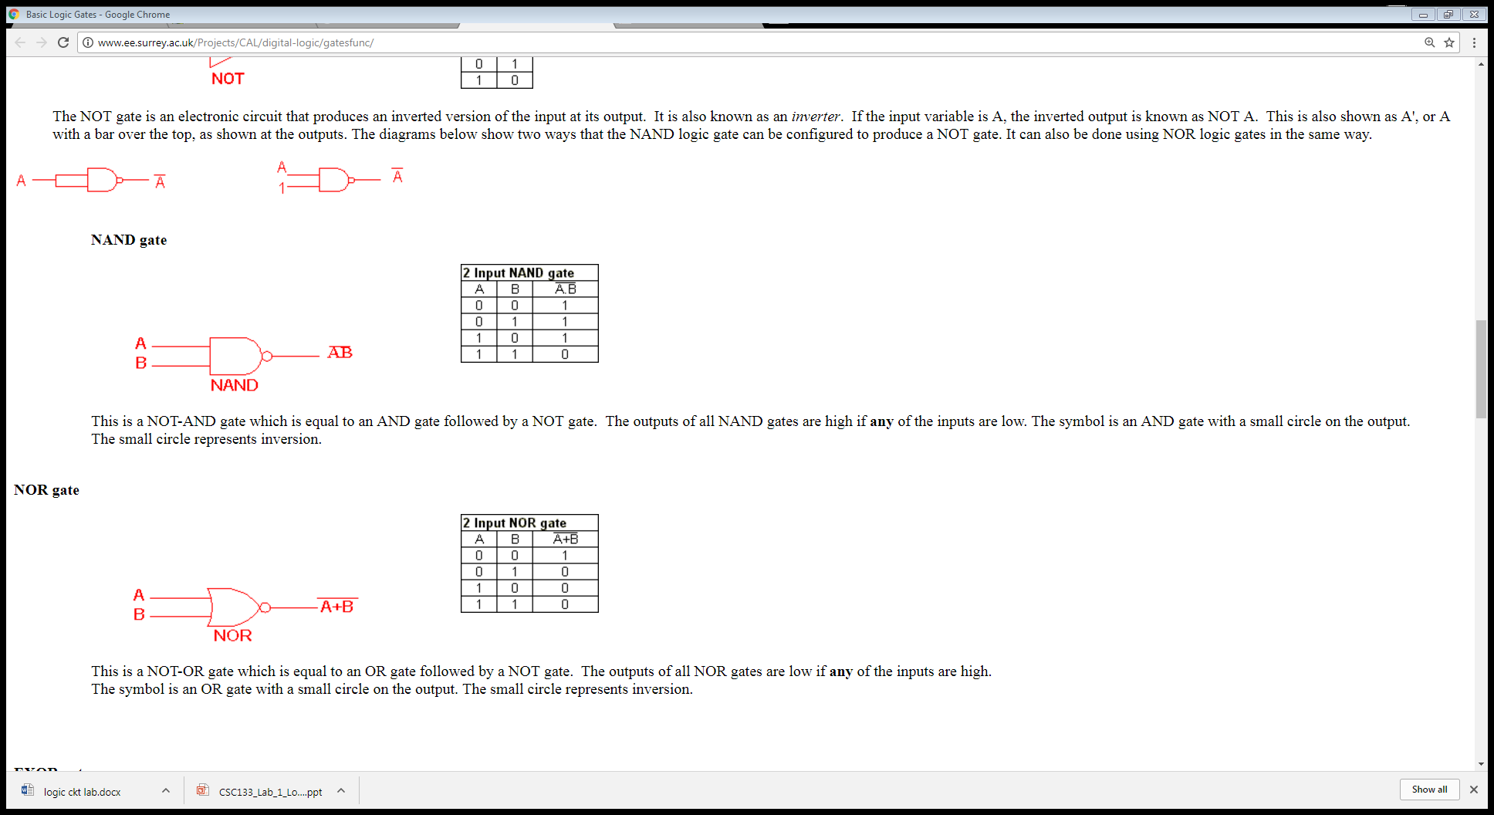

Slide 4
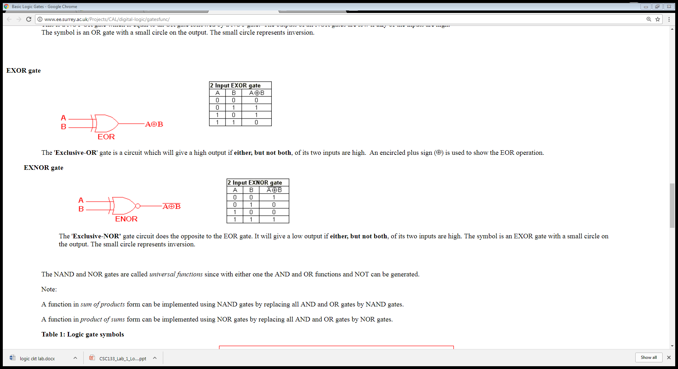

Slide 5
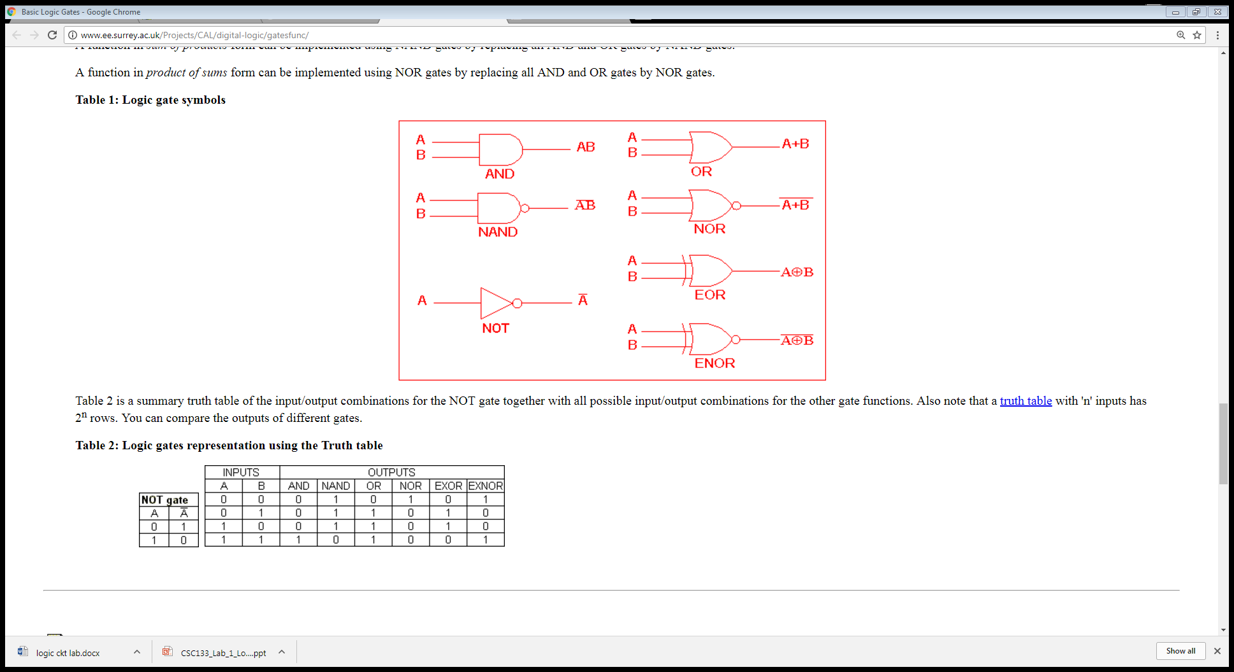

Slide 6
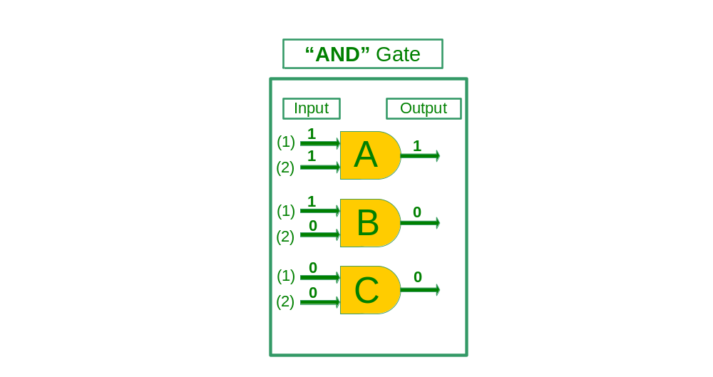
Logic Components
True Input= 1
False Input = 0
True Output = 1
“A”
If Input (1) “and” Input (2) “True” then output “True”
“B”
If Input (1) “True” But Input (2) “False” then output “False”
“C”
If Input (1) “and” Input (2) “False” then output “False”
Notes:
Analog vs. Digital
Analog: infinite, smooth and continuous
Digital: discrete or finite
https://learn.sparkfun.com/tutorials/analog-vs-digital

Slide 7

Logic Components
True Input = 1
False Input = 0
True Output = 0
“A”
If Input (1) “and” Input (2) “True” then output “True”
“B”
If Input (1) “True” But Input (2) “False” then output “False”
“C”
If Input (1) “and” Input (2) “False” then output “False”

Slide 8
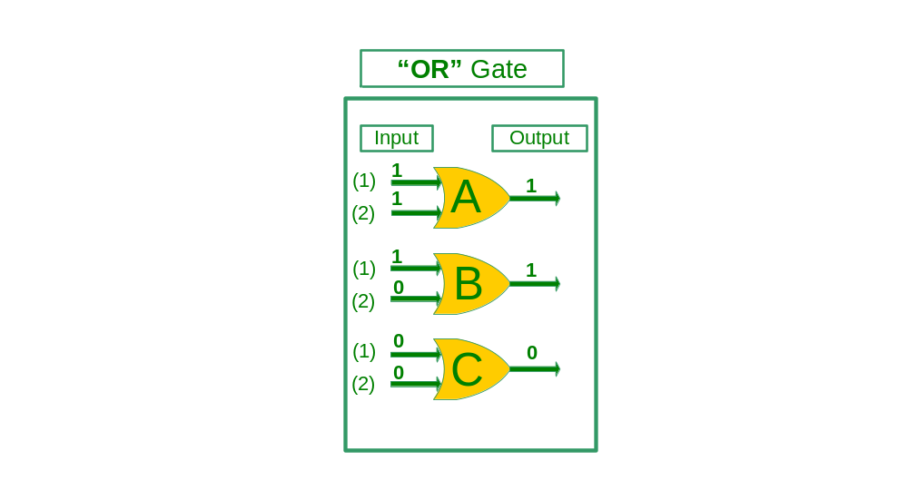
Logic Components
True Input= 1
False Input = 0
True Output = 1
“A”
If Input (1) “or” Input (2) “True” then output “True”
“B”
If Input (1) “True” But Input (2) “False” then output “True”
“C”
If Input (1) “and” Input (2) “False” then output “False”

Slide 9
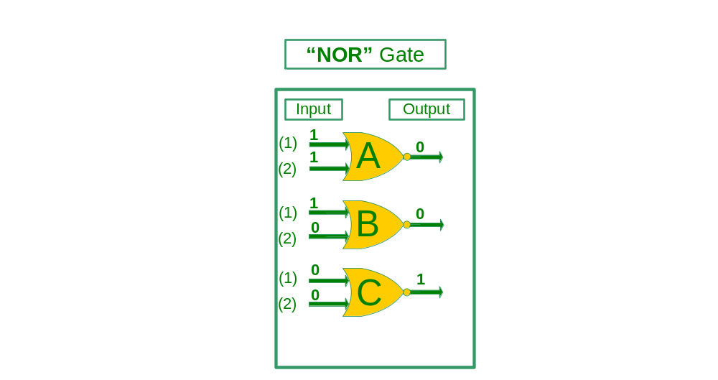
Logic Components
True Input= 1
False Input = 0
True Output = 0
“A”
If Input (1) “or” Input (2) “True” then output “True”
“B”
If Input (1) “True” But Input (2) “False” then output “True”
“C”
If Input (1) “and” Input (2) “False” then output “False”

Slide 10
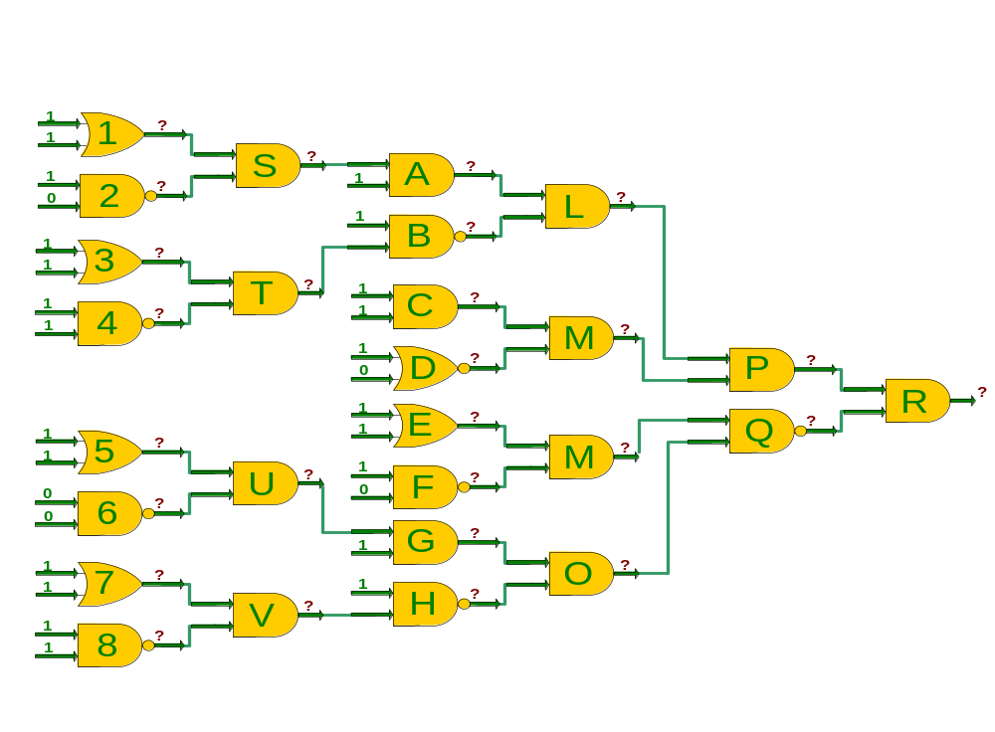
Sample Logic Circuit Worksheet
Using the Information Provided work through this logic diagram and identify the logic levels at each question mark. “1” or “0”

