Slide 1
DOS Commands

Slide 2
DOS (Disk Operating System MS-DOS)
This is developed by Microsoft for X-86 based computer.
This OS is operated with the help of commands only.
This is still a part of windows OS , can be run under command prompt.
The last retail version of MS-DOS was 6.22
Instead of clicks and menus commands are used to operate the system.

Slide 3
Difference between DOS and GUI based OS
GUI
DOS
Command
Clicks, menus
Icons
Interface
Interface
USER
USER

Slide 4
Why to use DOS over GUI
Much faster for IT support technician to manage files.
In some troubleshooting situation CMD is the primary option to use..
This provides more secured way by giving two level of windows option.
Standard window and elevated windows (admin window)
Performs operation with batch scripting.

Slide 5
DOS commands
Internal command
External command
GENERAL
PURPOSE
CLS
DIR
VER
VOL
DATE
TIME
FILE
BASED
COPY CON
TYPE
COPY
REN
DEL
DIRECTORY
BASED
MD
CD
RD
XCOPY
MOVE
FC
FORMAT
MEM
SORT
ATTRIB

Slide 6
STEPS TO OPEN COMMAND PROMPT
search COMMAND PROMPT and click on it, one black window will pop up on your desktop
Other way is to click on run in windows options and then type cmd in run bar and click on ok.

Slide 7
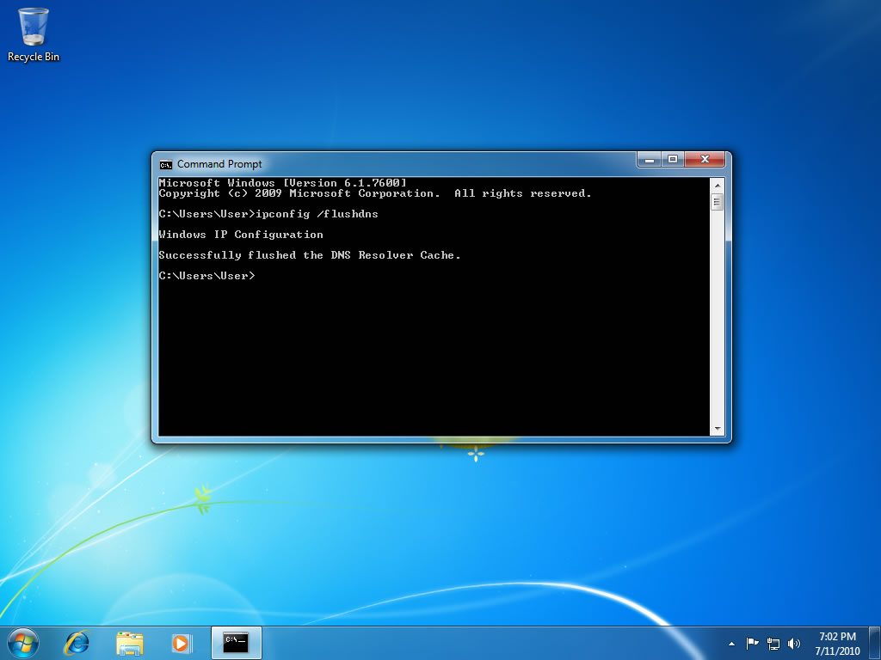

Slide 8
Internal Commands
Copy con bryna.txt
Ctl+z to close the file
Ren bryna.txt zhao.txt
Mkdir demo
Copy zhao.txt demo
Del zhao.txt
Rd demo
Mkdir c:\Users\D222\demo
Help color
Color dd(bg color + pen color)

Slide 9
External Commands
Fc file1.txt file2.txt
Comp file1.txt file2.txt
Fc cs comp (display and compare size)
Attrib +h bryna.txt => hide file
Attrib -h bryna.txt => make it visible
Dir/ah => check all hidden files
Help dir=> check documentation
Move bryna.txt newFolder
Move C:\...path…\newFolder\bryna.txt C:\...path…\oldFolder
Xcopy oldFolder C:\...path…\csc133demo => files in the olderFolder moved
Copy vs xcopy: enter the folder and specify the files, stay out of the folder and only mention the folder

