Slide 1
CHAPTER 2
Terms and things you should know while working with computer

Slide 2
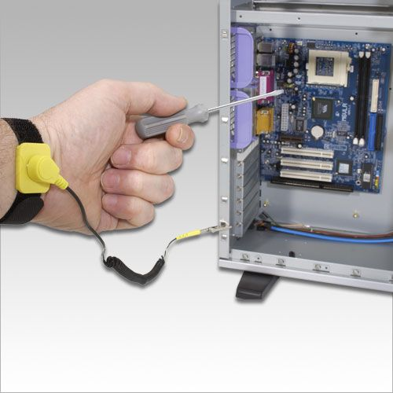
ELECTROSTATIC DISCHARGE (ESD) STARP
This is one of the most important tool.
This is also called as ground bracelet.
Static electricity can damage chips and distroy motherboard.
Use strap to ground your hand to case.

Slide 3
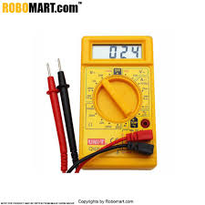
MULTIMETER
It is used to check cables and power supply output.
You can use it to measure output of each pin on power supply connector.

Slide 4
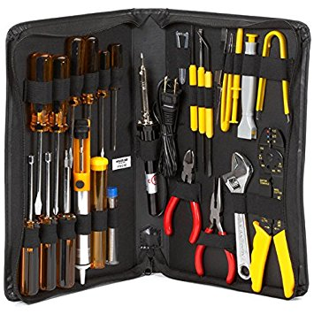
IT Technician toolkit

Slide 5
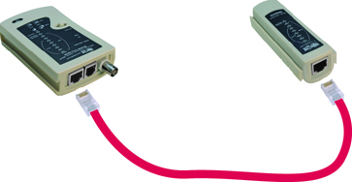
Network Cable Tester
Use to test if network cables are working correct.

Slide 6
Useful Terms
FRU- Field replaceable unit
ATX form Factor- Advance technology extended

Slide 7
Other useful things
Software recovery CD or DVD for any OS you might work on.
Cleaning solution and monitor wipes.
Small cups or bags to help keep crews organized as you work.
Pen and paper for taking notes and drawing diagram
Power supply tester.

Slide 8
Tips before you start working inside computer
Step 1: Plan and Organize Your Work
When you first begin to learn how to work inside a computer case, make it a point to practice
good organization skills. If you keep your notes, tools, screws, and computer parts well
organized, your work goes smoother and is more fun. Here are some tips to keep in mind:
Make notes as you work so that you can backtrack later if necessary. (When you’re first learning to take a computer apart, it’s really easy to forget where everything fits when it’s time to put it back together. Also, in troubleshooting, you want to avoid repeating or overlooking things to try.)
Remove loose jewelry that might get caught in cables and components as you work.
To stay organized and not lose small parts, keep screws and spacers orderly and in one place, such as a cup or tray.
Don’t stack boards on top of each other: You could accidentally dislodge a chip this way. When you remove a circuit board or drive from a computer, carefully lay it on an antistatic mat or in an antistatic bag in a place where it won’t get bumped.

Slide 9
When handling motherboards, cards, or drives, don’t touch the chips on the device. Hold expansion cards by the edges. Don’t touch any soldered components on a card, and don’t touch the edge connectors unless it’s absolutely necessary. All this helps prevent damage from static electricity. Also, your fingerprints on the edge connectors can cause later corrosion.
To protect a microchip, don’t touch it with a magnetized screwdriver.
Never ever touch the inside of a computer that is turned on. The one exception to this rule is when you’re using a multimeter to measure voltage output.
Consider the monitor and the power supply to be “black boxes.” Never remove the cover or put your hands inside this equipment unless you know about the hazards of charged capacitors and have been trained to deal with them. The power supply and monitor contain enough power to kill you, even when they are unplugged.
As you work, remember to watch out for sharp edges on computer cases that can cut you.
In a classroom environment, after you have reassembled everything, have your instructor check your work before you put the cover back on and power up.

