Slide 1
CHAPTER 4
Processor and Memory

Slide 2
PROCESSOR
Types and characteristics of Processor
How it works????
Manufacturar of CPU
How to match CPU with Motherboard

Slide 3
PROCESSOR
Processor determines the computing power of the system.
Two major manufacturar of processor is Intel and ADM.
Performance depends on the Processor
Needs compatibility with Motherboard

Slide 4
Characteristics of Processor
Feature 1:- Processor Speed
-processor frequency = procesor speed
-measured in Gigahertz
-current processor speed= 1.8 Ghz to 4.4 Ghz

Slide 5
Feature 2:- Socket and Chipset the processor can use
-Intel:- LGA1150,LGA1155,LGA1156,LGA2011,LGA1366 and LGA 775
-ADM:-
AM3+,AM3,AM2+,AM2,FM1,FM2+ and FM2

Slide 6
Feature 3:- Processor Architecture
-32 bit
-64 bit
-Hybrid

Slide 7
Feature 4:- Multiprocessing Abilities
-Multiprocessing
-two processor unit (ALU) installed in single processor
-Pentium was first processor of this type.
-Multithreading
-each processor process two threads at the same time.

Slide 8
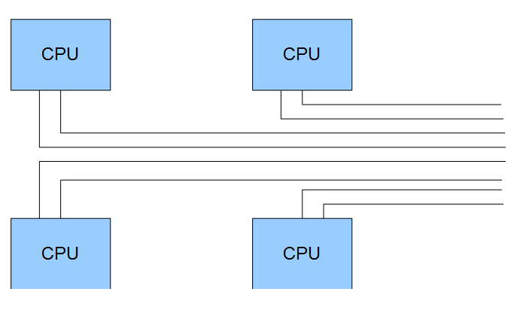
-Multicore Processing
-multiple processors installed in same processor housing
-upto eight cores(dual core,triple core,quad core)
Two
Threads
Per CPU

Slide 9
-Dual Processor Socket
- server motherboard might have two CPU sockets
-multiprocessor platform
-example:- Xeon processor for server
Feature 5:- Memory cache
-It is the amount of memory included in the processor package.
-L1 cache, L2 cache, L3 cache.

Slide 10
Feature 6:- Memory features on the motherboard that processor can support
-Amount of memory
-Memory speed
-Number of memory channels
Feature 7:- Support for Virtualization
-Manage multiple virtual machines.

Slide 11
Feature 8:- Security
-Execute disable bit (EDB)
-Stops malware from executing instruction.
Feature 9:- Integrated Graphics
-Graphics processing Unit
-allows graphics data to form image on monitor screen

Slide 12
How CPU Works
-All processors have same common elements.
-Pentium was the first advance processor introduced.
-Two ALU
-Introduced in 1993

Slide 13
Pentium CPU
Registers
Registers
Back side bus
Internal
Memory
(cache)
ALU
ALU
Internal
data bus
32 bit
Control Unit
I/O Unit
External data bus
64 bit

Slide 14
-A central processing unit (CPU) is the electronic circuitry within a computer that carries out the instructions of a computer program by performing the basic arithmetic, logical, control and input/output (I/O) operations specified by the instructions.
-I/O unit manages the data entering and leaving the processor.
-control unit manages all activities inside the processor itself.
-Arithmetic and logical unit (ALU) performs all logical comparisons
-Registers are small holding areas on processor.
-Internal memory holds data and instruction waiting to be executed by processor
-Buses connects component inside the Processor and perform data flow.

