Slide 1
MEMORY

Slide 2
TYPES OF MEMORY
Computer Memory
Primary storage/
Volatile/
Main memory/
RAM
Secondary storage/
Non-volatile/
Hard-disk drive/
ROM
Static RAM
(SRAM)
Dynamic RAM
(DRAM)
DIMM

Slide 3
DIMM Technologies
It uses 64 bit data path
DIMM stands for dual in-line memory module
Early DIMM did not run in sync with clock because they were to slow to keep up.
First DIMM to sync with clock is SDRAM.
SDRAM stands for synchronous DRAM.
SDRAM has two notches and 168 pins.

Slide 4

Extensions of SDRAM (DDR=Double Data Rate)
DDR4
DDR3
DDR2
DDR SDRAM
(DDR)

Slide 5
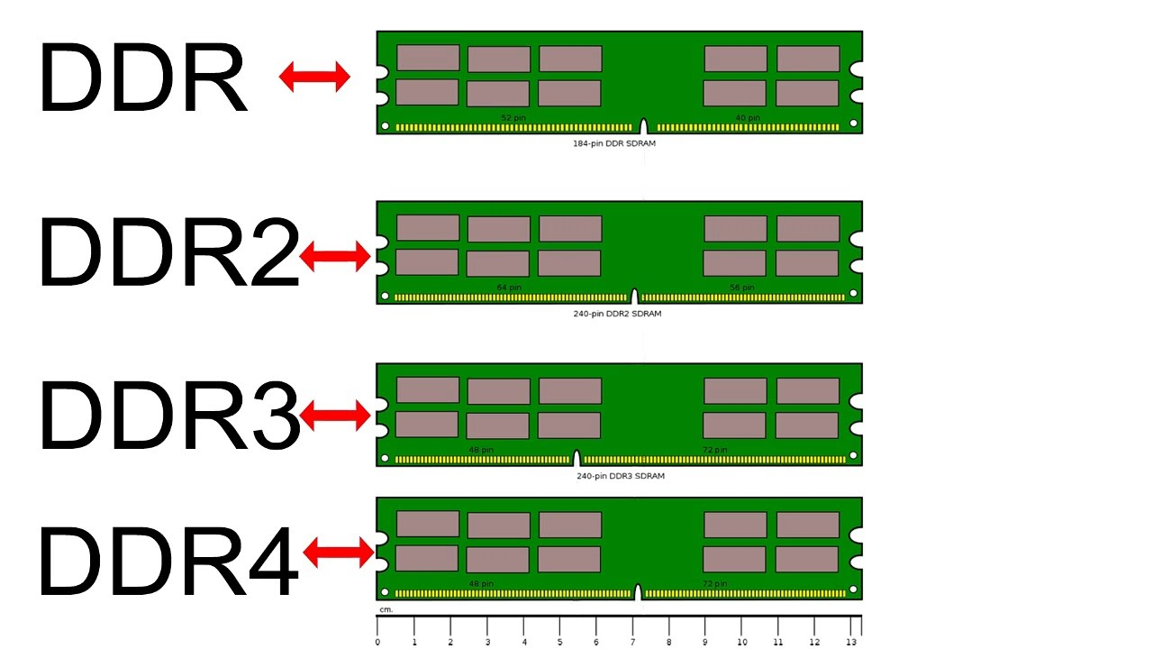

Slide 6
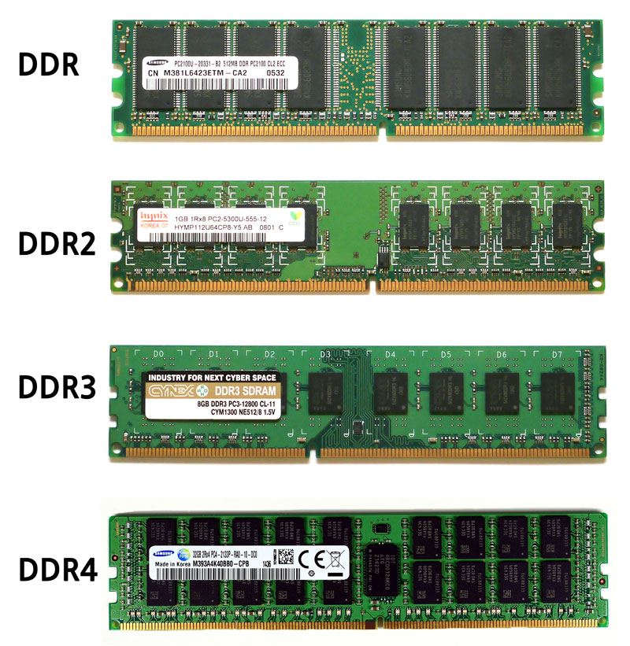

Slide 7
Single,Dual,Triple,Quad Channels
DIMM slots are different color on the motherboard.
Color coding used to identify each slots.
Channels specifies how many DIMM slots cab be accessed at a time.
More channel acces will improve the perfpormances.
Improves the speed of memory acces depends on channels.

Slide 8
Dual channel block diagram
Memory controller
Processor
64 bit bus
64 bit memory
Bus 1
64 bit memory bus 2
Channel A slot
Channel A slot
Channel B slot
Channel B slot
Figure:- Using dual channels, the memory controller can read from two DIMMs at the
same time

Slide 9
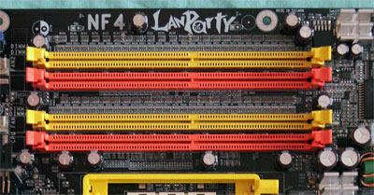
Two channels must be matched in size, speed and features.
Recommende from same manufacturer.
Two yelow slots makes up the first channels (A) and two orange slots makes second channels (B)

Slide 10
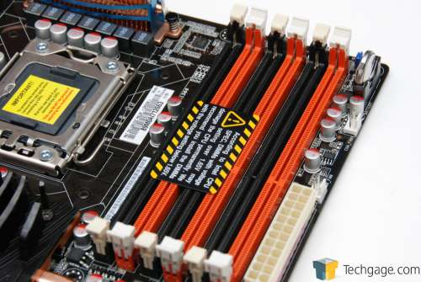
Triple DIMM
Three DIMM slots with must be matching three DDR3 DIMMs.
Can be work as dual channels by adding two matching slots.
Faster than dual channels.

Slide 11
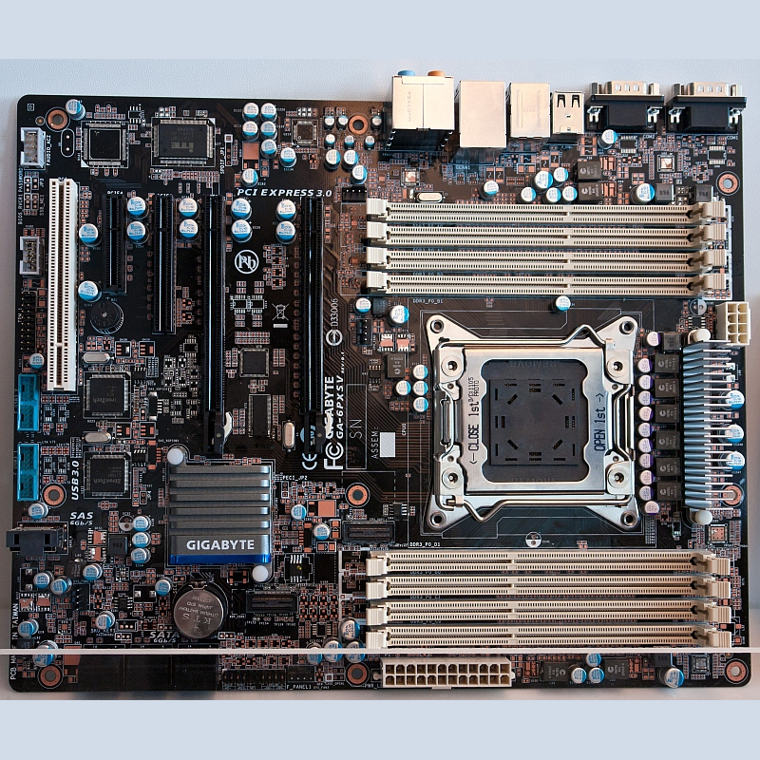
Quad channeling
Introduced with intel sand bridge chipset.
Has 8 memory slots.
DDR4 is faster and uses less power than other 3 (DDR,DDR2,DDR3).

