Slide 1
DMA
Direct Memory Access

Slide 2
Definition - What does Direct Memory Access (DMA) mean?
Direct memory access (DMA) is a method that allows an input/output (I/O) device to send or receive data directly to or from the main memory, bypassing the CPU to speed up memory operations.
The process is managed by a chip known as a DMA controller (DMAC).

Slide 3

With and Without DMA
Without DMA
With DMA
Without DMA, when the CPU is using programmed input/output, it is typically fully occupied for the entire duration of the read or write operation, and is thus unavailable to perform other work.
With DMA, the CPU first initiates the transfer, then it does other operations while the transfer is in progress, and it finally receives an interrupt from the DMA controller when the operation is done.

Slide 4
Use of DMA
This feature is useful at any time that the CPU cannot keep up with the rate of data transfer, or when the CPU needs to perform useful work while waiting for a relatively slow I/O data transfer.
Disk drive, controller, sound card, graphics card, video card uses DMA to communicate with memory without CPU

Slide 5
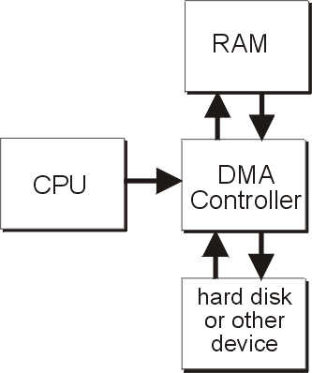
Simlified connection of DMA controller

Slide 6
