Slide 1
Cooling Methods and Devices

Slide 2
Focus Point
This chapter mainley focus on how to keep heat producing devices cool??
Heat producing devices are
-motherboard
-processor
-memory
-video cards/ graphics card
Fans and heat sinks used to keep it cool.

Slide 3
What will happen without fans or heat sinks?????
If cooling system is not installed
Parts got overheated
Then System get unstable
Components fail/damaged

Slide 4
Processor coolers,Fans and
Heat sinks
Most heat producing component is processor
Every processor needs cooling assembley to keep it cool.
Agenda is to keep tempreture below the maximum tempt.
If processor reaches its max temp It will atomatically shuts down
Fans task is to maintain temp in range of 90-110 degree F (32-43 degree C).
boot process begins, but system suddenly turns off after a short period when fan is not install correctly.

Slide 5
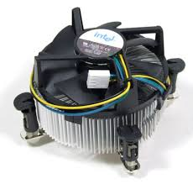
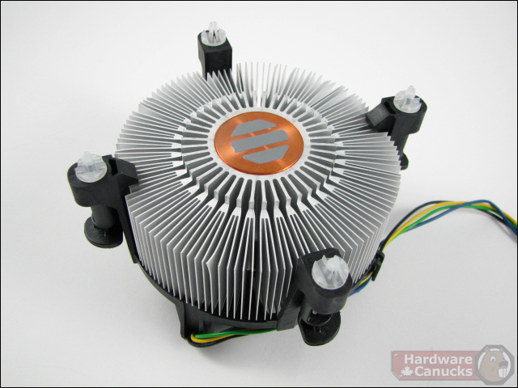
CPU Cooler
Up side
Down side

Slide 6
The coolers is made of
-Aluminium
-Copper
-Combination of both
Copper is more expensive but does a better job for cooling.
Go to site www.thermaltake.com

Slide 7
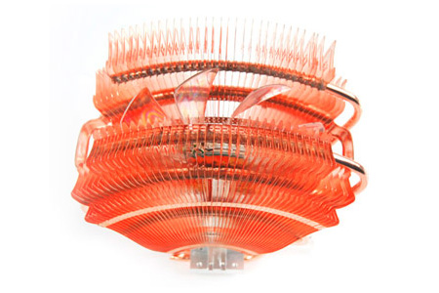
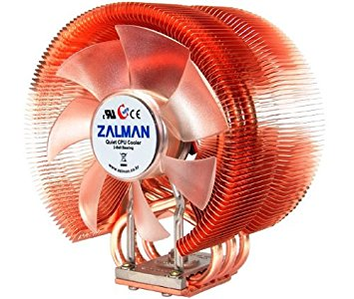
Adjustable fan control
Cooling fan

Slide 8
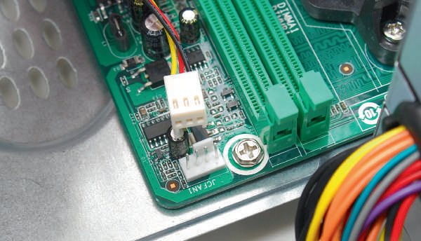
3 pin CPU fan power
cord
4 pin CPU fan header

Slide 9
Fanless Coolers
Fan is noise creating components
To run computer with less noise use Fanless CPU Cooler or Passive CPU Cooler.
The coolers contain heat pipes ,which contain small amount of liquid that becomes vapor when heated.
Vapor draws heat away from the CPU towards the fins on the cooler.
Large in size.
Required to match withg the CPU and Motherboard size.

Slide 10
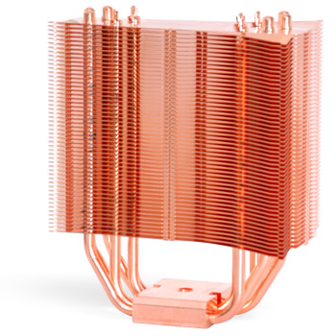
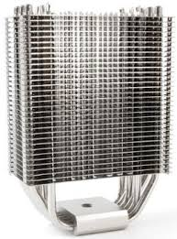
Aluminum fanless
cooler
Copper fanless
cooler

Slide 11
LIQUID COOLING SYSTEMS
It tends to run quieter than the other cooling methods.
It this the small pump sits inside the computer case.
Tubes moves liquid around the computer.
Then fans cools the liquid.

Slide 12
