Slide 1
Hard drives
Most important permanent Storage device in a computer.
Also called Hard Disk Drive (HDD)
Comes in different sizes according to need.
Whether using for desktop or laptop.
Desktop HDD is larger than laptop HDD

Slide 2
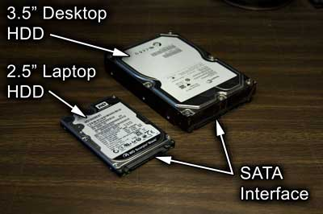

Slide 3
Technologies used inside a hard drives
Solid state drive(SDD)
-it has no moving parts.
-it is non-volatile memory
Magnetic hard drive
-it has one or more platters
-required reading and writing data to the drive to communicate
-RPM (rotation per minute) will decide the speed (5400,7200 or 10,000)

Slide 4
Hybrid hard drives
-called as H-HDD
-Sometimes called as solid-state hybrid drive
(SSHD)
-OS must support it.

Slide 5
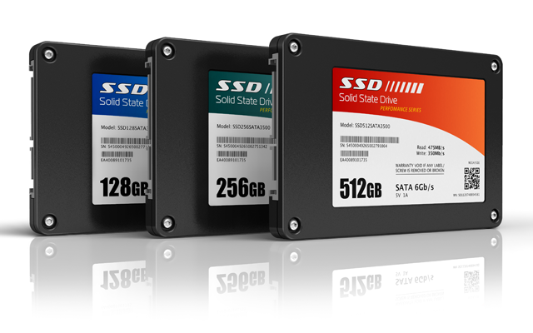

Slide 6
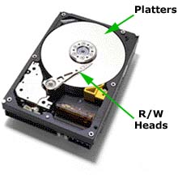

Slide 7
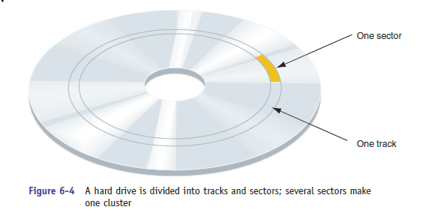
-Data is organized on a magnetic hard drive in concentric circles called tracks.
-Each track is divided into segments called sectors.
-Most current hard drives use 4096-byte sectors.

Slide 8
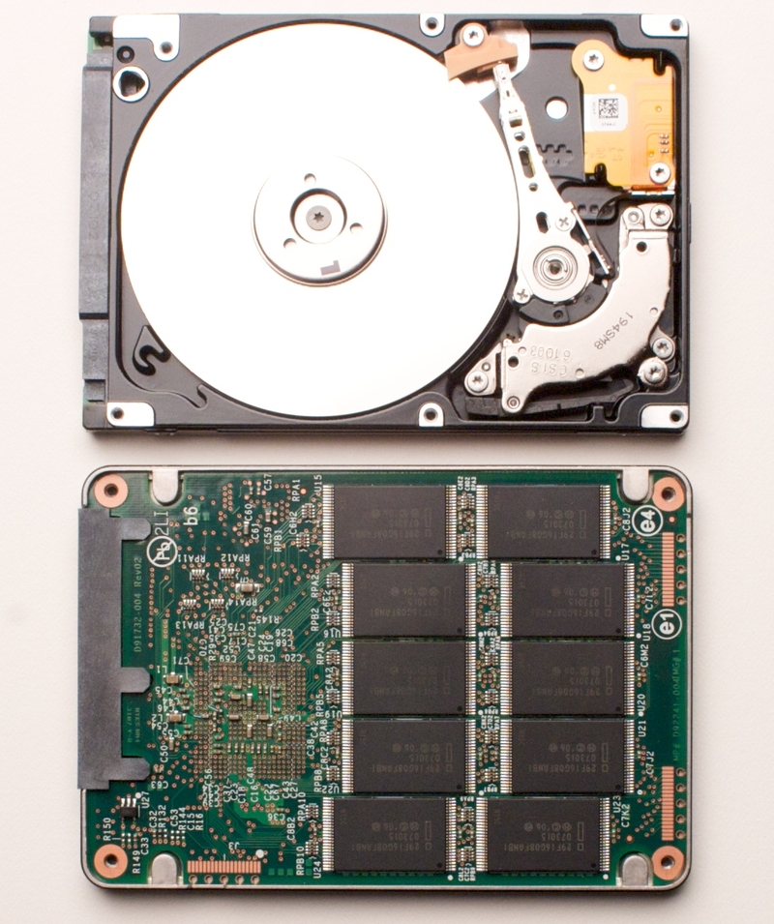

Slide 9
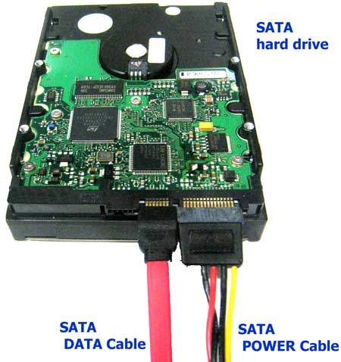
Power cable for Hard Drives

Slide 10
SATA Data cable goes with (connects to) motherboard.
SATA Power cable is connected to battery
Find different hard drives manufacturer?????

Slide 11
RAID
(Redundant Array of Independent Disks)
The technology that configures two or more hard drives to work together as an array of drive is called RAID.
Reason of using RAID:-
-Fault tolerance
-Improve performance

Slide 12
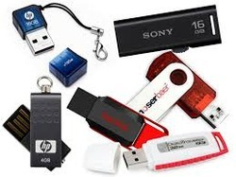
OTHER SOLID STATE STORAGE
Pen drives /USB drives
Direct USB plug in
Simplest and small amount memory

Slide 13
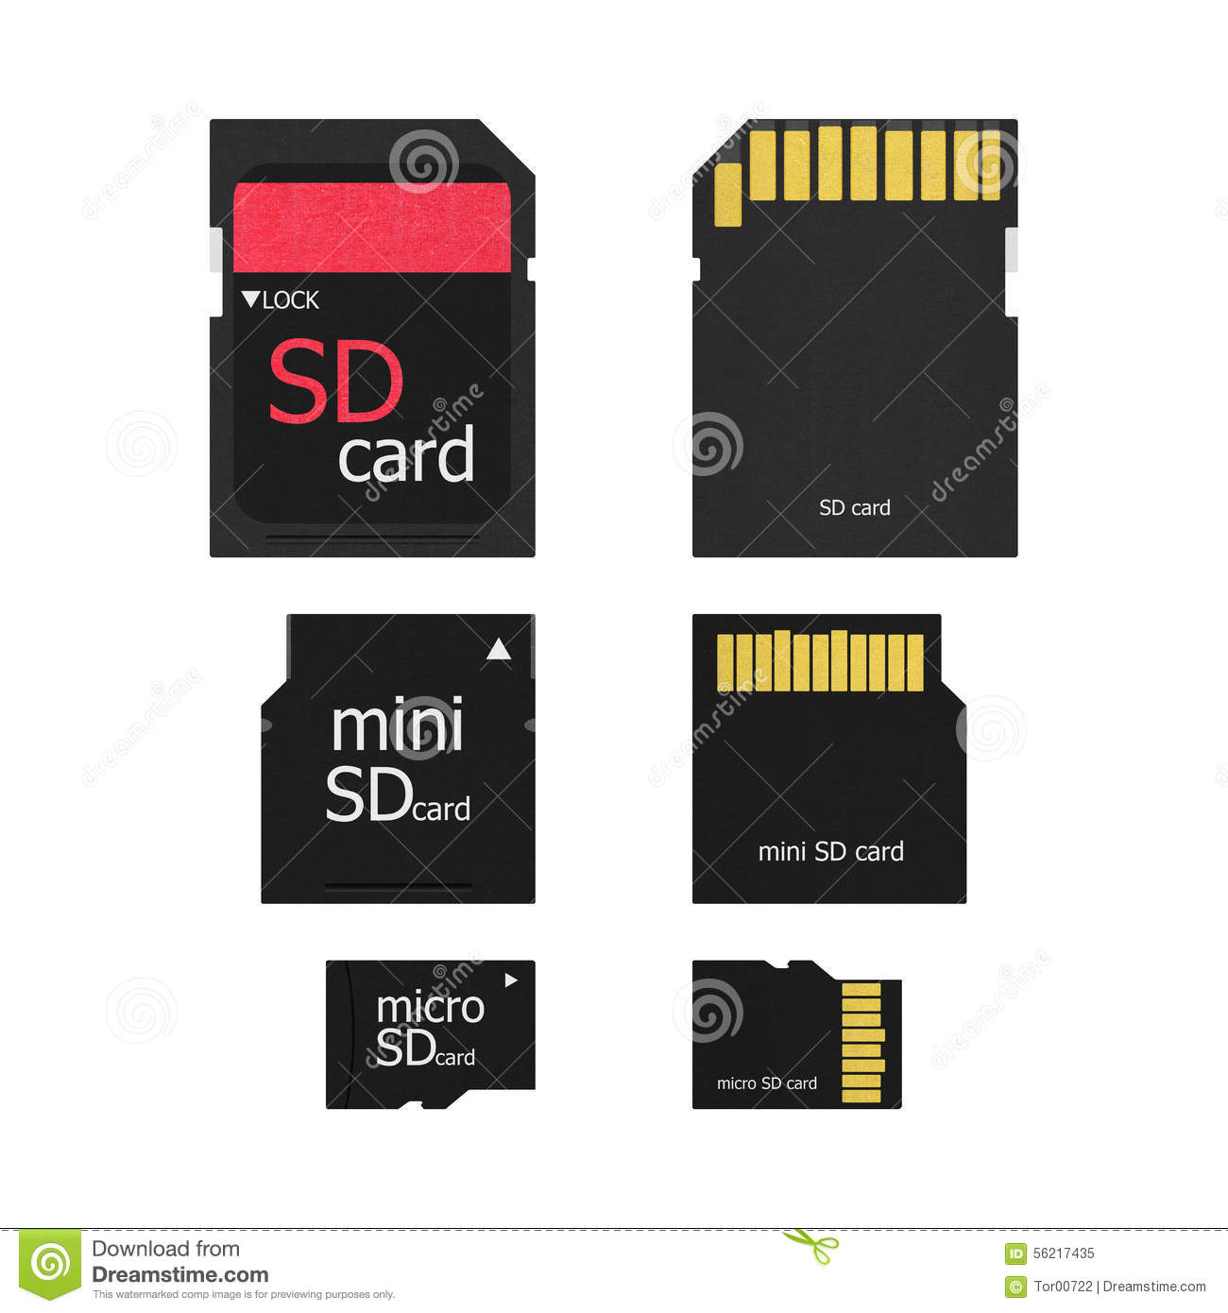
Memory cards
Digital camera, tablets , cell phones, MP3 player.
Laptop have SD slot.

