Slide 1
CHAPTER 7
Windows Features and
Support Tools

Slide 2
Microsoft Windows
Provides interface between user and application
Interface between application and hardware devices
Windows tools and utility
Manage, examine and troubleshoot simple problems.

Slide 3
Windows Interface
It is the middle man between application and hardware
OS is installed to meet user needs.
At least one OS should be istalled in computer
Although several can be installed on one machine

Slide 4
Main functions of all OS
Function 1:- provide user interface
Function 2:- Manage Files
Function 3:- Manage Hardware
Function 4:- Manage Applications

Slide 5
Every IT support technician must be (needs to be) a power user of :
-Windows 10
-windows 8
-Windows 7
-windows Vista
-windows Xp

Slide 6
Files and Directories
Every OS mange data in the form of folders and sub-folders.
Also called as directories and sub-directories.
Hard drive, Optical drive, USB drive or other type of drive use the same way of storing the data.

Slide 7

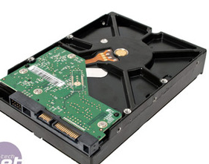
C:\
Hard Disk
C:\users
C:\data
C:\program
files
C:\data\work
C:\data\personal
Figure : various storage devices organized into directories and sub directories
that contains files

Slide 8
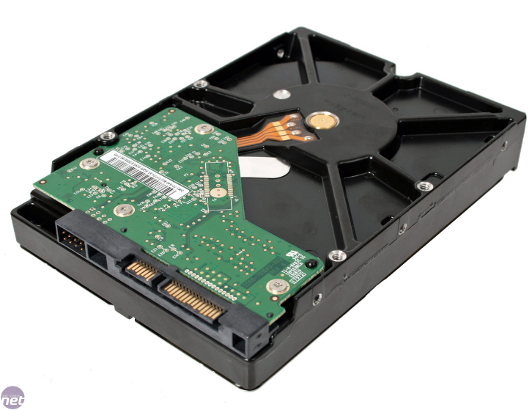
Partition 1:drive C
Partition 2:drive D
root
root
Folder 1
Folder 2
Folder 2
Folder 1
Files
Files
Figure : Disk drive divided into volume

Slide 9
Windows Network Connection
Two types of network connections windows can support is
-wired network connection (LAN connection)
-wireless connection (WiFi)
Network can be public (coffee shop, public hotspot) or private (classroom, college,home)
In private network resources can be shared like shared data files and printers

Slide 10
Windows offers three ways to share resources
-Workgroup
-Homegroup
-Domain

Slide 11
Windows Workgroup and Homegroup
This type of network doesn’t have centralize control
Such as small office or home office (SOHO)
This type of network is called peer to peer (P2P)
Windows can allow PC to share resources on P2P by homegroup or workgroup.
Each computer share resources and peripherals without central server.
Each comp. Controls its own resources.

Slide 12

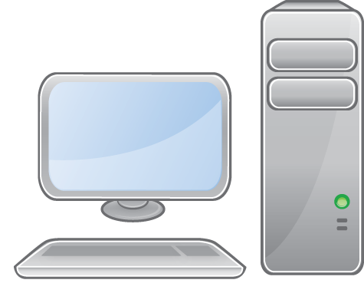
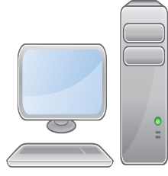
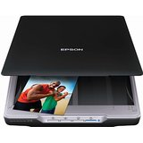
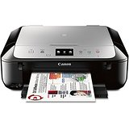
Windows 7
Windows 8
Windows 8
Windows 7
Windows 8
Scanner
Printer

Slide 13
Windows Domain
It is implemented on large private network.
Example college or corporate
Controlled by centralize database of user account information and security.
It is a kind of client server network.
Resources manage by server
Logically connected to each other.
Windows server is OS specially design for server m/c

Slide 14
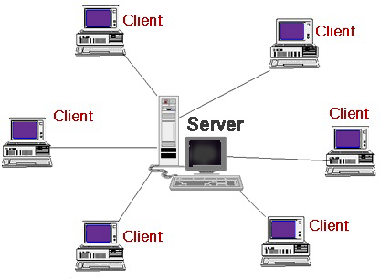

Slide 15
Client /server model
A client is a piece of computer hardware or software that accesses a service made available by a server
Client access the services (given by server) by using network
Also called as master slave model
For example:-
Web browser send request to web server for web pages.
Email clients retrieve emails from email server

