Slide 1
CHAPTER 8
Installing Windows

Slide 2
Choose the Edition, License, and Version of Windows
Edition of windows:
-professional, enterprise, starter, home basics
License:
-OEM, Upgrade license, purchase from online store.
Architecture:
-32, 64 bit

Slide 3
MBR and GPT Partitioning System
It is a method to partition hard drive.
Hard drive is devided into one or more partition.
Windows two methods to partition drive:
-The Master Boot Record (MBR)
-Partition Table (GPT)

Slide 4
Master Boot Record (MBR)
- It is a older methode
-Allows 4 Partition per drive
-Limited to 2TB drives only
-The MBR holds the information on how the logical partitions, containing file systems, are organized on that medium.

Slide 5
GUID Partition Table (GPT)
This method is newer.
It can have upto 128 partition on the drive.
GPT works on drives larger than 2TB.
globally unique identifiers (GUID).
Unified Extensible Firmware Interface (UEFI) supports GPT.

Slide 6
Installation with Special consideration
When computer does not have DVD drive
-download OS from microsoft website
-Use and external drive
-Use DVD drive on other computer on network.

Slide 7
Installation In Virtual Computer
A virtual computer or virtual machine (VM) is software that simulates the hardware of a physical computer
Using this software, you can install and run multiple operating systems at the same time on a single computer, which is called the host machine.
Software used to manage VMs installed on a workstation is called a hypervisor.
Some popular hypervisors are
-client Hyper-V, Virtual PC by Microsoft, Virtual box by Oracle, Vmware.

Slide 8
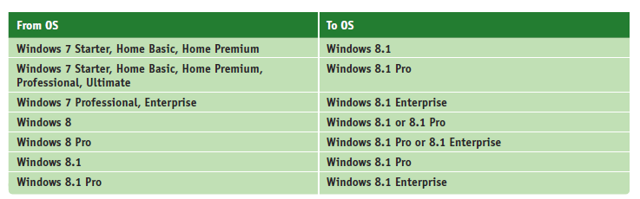
Choose the Type of Installation
Clean Install
In place Upgrade
Multiboot

Slide 9
A 64-bit version of Windows can only be upgraded to a 64-bit OS. A 32-bit OS can only be upgraded to a 32-bit OS.
If you want to install a 64-bit version of Windows on a computer that already has a 32-bit OS installed, you must perform a clean install.
You cannot upgrade from Windows XP or Vista to Windows 8, and you cannot upgrade from XP to Windows 7. You must perform a clean install.

