Slide 1
CHAPTER 11
OPTIMIZING WINDOWS

Slide 2
Objective of this unit
Shells and Kernel
How windows manage application.
Windows tools to optimize windows.
Performance monitoring of windows.
What is windows registry.

Slide 3
What are the SHELL and the KERNEL?
Shell and Kernel is usefull to solve the problem of windows.
Shell is the portion of OS that relates to the user and to applications.
The Kernel is responsible to interact with hardware.

Slide 4
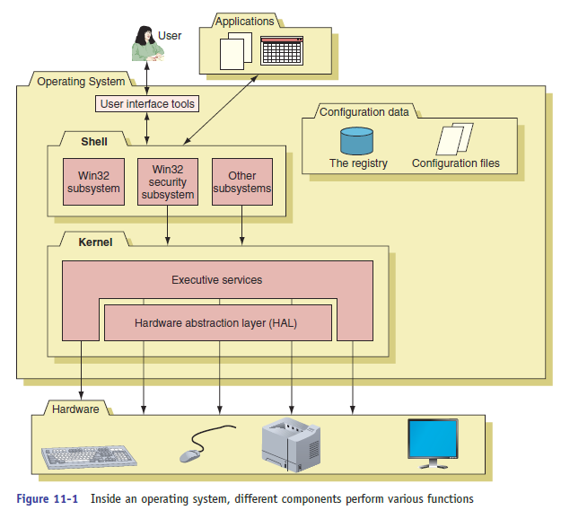

Slide 5
The Windows Shell
The shell provides tools for user convenience.
It allow you to use commands and procedures to call the process.
Example: print a document, read from storage device.
All windows32 subsystem and its security files are managed by shell.

Slide 6
The Windows Kernel
This is the core of OS.
This is responsible for connecting user with hardware for communication.
Shell pass the user request of interacting with hardware to kernel first.
The kernel has two main components
-(1) HAL (Hardware abstraction layer). (closest to the hardware)
-(2) The executive services. (interface between HAL and shell)

Slide 7
How windows manage applications
Program files copied from storage device to memory to run the task called as process.
Process is program running under the authority of shell.
The thread is the single task like printing a file with the help of kernel request.
An executing instance of a program is called a process.
A thread is a subset of the process.

Slide 8
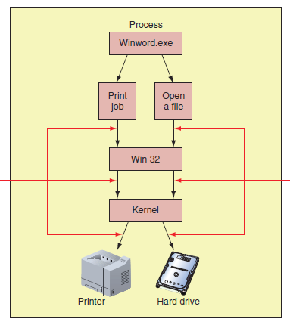
thread
thread

Slide 9
Task Manager
This tool help to manage windows component and processes.
This lets you view the application and process running on your computer.
There are multiple tabs on task manager and they are used to represent the further details about processes running on your pc.

Slide 10
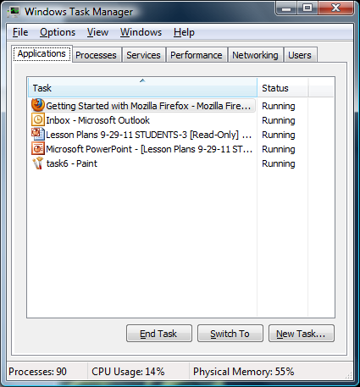

Slide 11
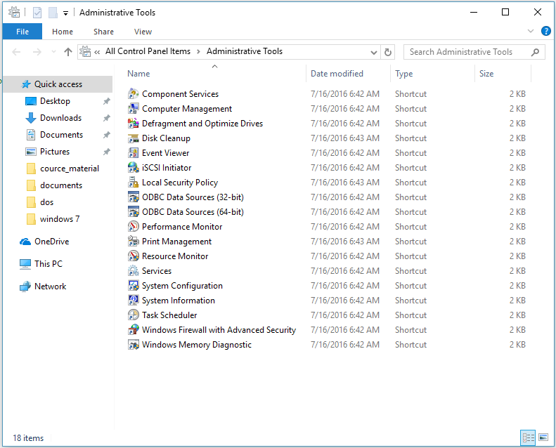
Administrative tools
Windows offers a group of administrative tools in control panel.
This tools are responsible for managing and setting authorities to the local user on pc.

Slide 12
System Configuration
The system configuration of windows is also called as “M-S-config”
This is used to temporarily disable program from launching at startup.
This is use to troubleshoot startup problems.
To open write down msconfig.exe in the run box.

Slide 13
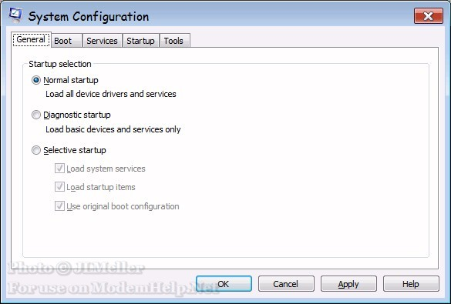

Slide 14
Service console
This function of windows allows you to control the windows and third party services.
To launch service console write services.msc in the run box.
Here in this window you can change the startup type of services in properties and set them as following:
-automatic
-manual
-disabled

Slide 15
Performance Monitor
This is the Microsoft management console snap-in that can track activity by hardware and software in order to measure performance.
To open this tab you have to write perfmon.msc in run box.
By the evaluation of different parameters we can also measure the hard drive performance.
This also used by developer to check the performance efficiency of developed software.

Slide 16
Registry Editor
The most important windows component that holds information for windows is the registry.
This is nothing but the database designed as tree like structure.
It contains configuration information for windows user, software application and installed hardware devices.
To open registry write regedit.exe in run box.

Slide 17
