Slide 1
CHAPTER 14
CONNECTING TO AND SETTING UP A NETWORK

Slide 2
Objective of this unit
Parameters to consider while connecting to network
Understand OSI model.
Working of windows TCP/IP protocol
IP addresses

Slide 3
What is Networking?
A computer network is a set of computers connected together for the purpose of sharing resources. The most common resource shared today is connection to the Internet.
Internet connection Networking
Internet connection can be wired or wireless.

Slide 4
Level of Communication to be considered
Communication between two computers happens on threen layers:
-Hardware
find the computer to connect.
-Operating System (OS)
both computers must agree on rules (protocol)
-Application
role of making request and getting response (client-server model)

Slide 5
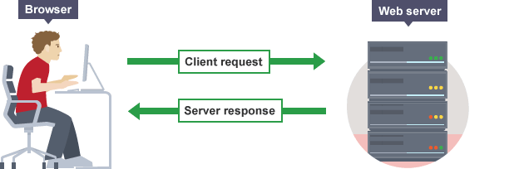
Fig:Client server model of sending request and getting response

Slide 6
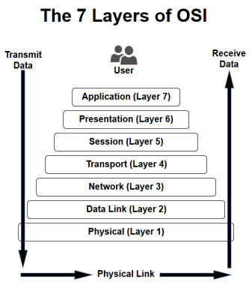
OSI model
The Open System Interconnection (OSI) model defines a networking framework to implement protocols in seven layers.
This is just a conceptual framework

Slide 7
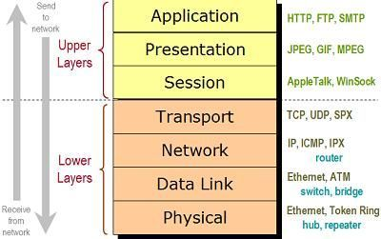
OSI model

Slide 8
Layers of Network Communication
Level 1: Hardware level
-physical connection like network cable, phone line,modem cable
-network adapter/ network card (NIC)
-unique MAC (media access control) address/ physical /hardware address
-6 byte hexadecimal unique address.

Slide 9
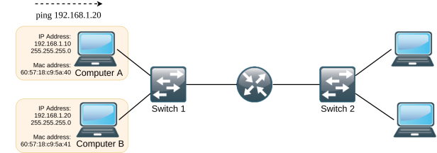
Level 2: OS Level
-Use of IP address to find other computer on network
-it can be 32 bit or 64 bit string assigned to network for connection.
-IP address is used to find computer anywhere in the network.
Communication by
IP address

Slide 10
Level 3: Application Level
-Client server application
-client applications -→IE , google chrome, outlook
-server --→ Web server, email server
-each client and server application installed on specific address on each computer called as port number, port address.
-example: port 80 for HTTP, port 25 for SMTP

Slide 11
TCP/IP
TCP and UDP both are used for transferring data or packets on internet. They are the protocols to sent the data.
TCP is a connection-oriented protocol in which the data can be transferred bidirectionally after connection is being setup.
TCP is reliable and secure but comparatively slower as it keeps the data smooth and checks error.
UDP stands for “User Datagram Protocol.” UDP is connection-less protocol in which data is needed to send in chunks.
UDP don’t have error checking mechanism that is why it is less reliable but is faster in data transferring than TCP.

Slide 12
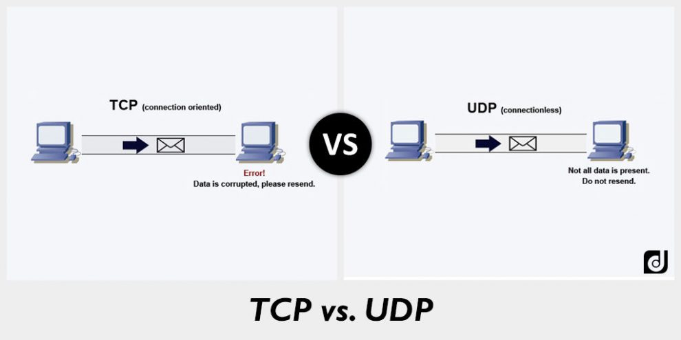

Slide 13
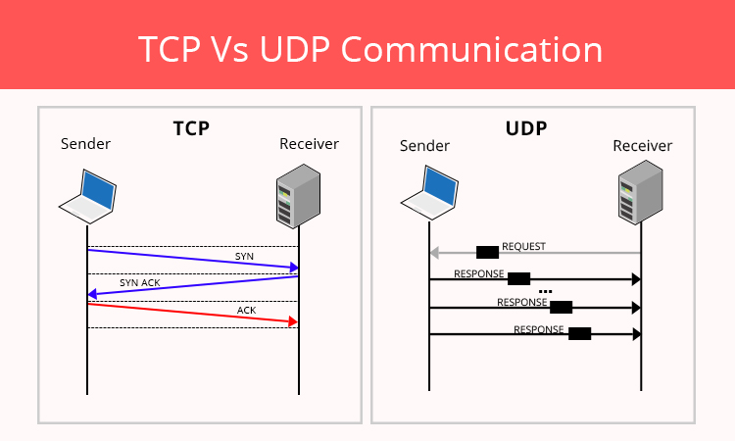

Slide 14
Protocols used for TCP and UDP
TCP:
World Wide Web(HTTP)
E-mail (SMTP TCP)
File Transfer Protocol (FTP)
Secure Shell (SSH)
UDP:
Domain Name System (DNS)
Streaming media applications such as movies
Online multiplayer games
Voice over IP (VoIP)
Trivial File Transfer Protocol (TFTP)

Slide 15
How IP Addresses get assigned
Two different types of IP addresses can be used:
-32 bit (IPV4)
-128 bit (IPV6)
The internet assigned numbers authority (IANA) is responsible for keeping track of assigned IP addresses
It has already released all of its available 32-bit IP address.

Slide 16
TYPES OF IP ADDRESS
MAC address is assigned in factory , but IP addresses are assigned manually or by software.
-Dynamic IP address
Assigned automatically by server each time computer connect to network. (with DHCP)
-Static IP address
Manually assigned by user and can be changed.

Slide 17
HOW IPV4 ADDRESSES ARE USED??
A 32 bit IP address is organized into 4 group of 8 bit each.
They are 4 decimal no. separated by periods (.)
Example of IPV4 IP address
-72.56.105.12
The largest possible 8 bit no is
-11111111

Slide 18
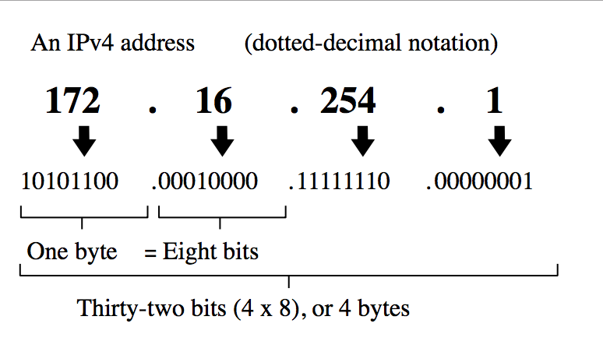

Slide 19
So the largest possible IP address is
-255.255.255.255
which is equal to
-11111111.11111111.11111111.11111111
The range of numbers can be anything from 0 to 255
It can form total 4.3 billion IP address
-(255*255*255*255)

Slide 20
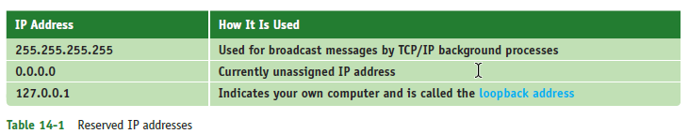
Reserved IP addresses
Some IP addresses are reserved by protocol.
You can not assigned them to device.
They are used for particular purpose.

Slide 21
Identification of IPV4 address
The IP address is basically divided into two pars
-Network address (first part)
-Host address (last part)
When new message comes in, the network portion of address is use to locate correct network and
Then the host is located in the network to send the message.

Slide 22
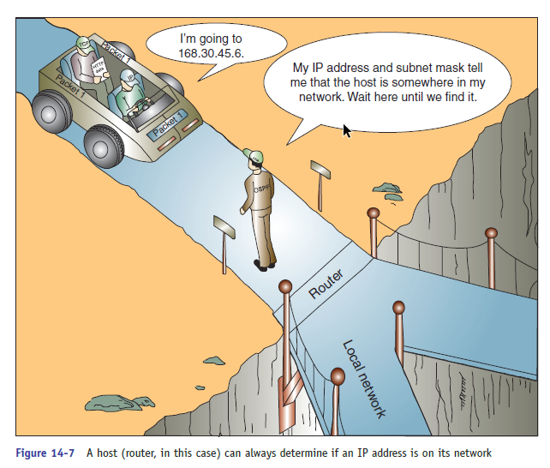
SUBNET MASKS
The computer and other devices uses its subnet mask to know if IP address is from save network or another network.

Slide 23
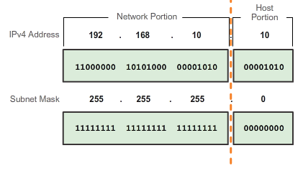

Slide 24
The subnet mask is string of one’s followed by string of 0’s.
Exaple of subnet address
-255.255.0.0 or
-11111111.11111111.0.0
In this address the group of zero says it is a host address.

Slide 25
Example?
Suppose IP address on network is
-201.18.20.160
Subnet mask is
-255.255.0.0
The subnet address first 16 bits are 1 so it is network address part.
This can be also written as
-201.18.20.160/16

Slide 26

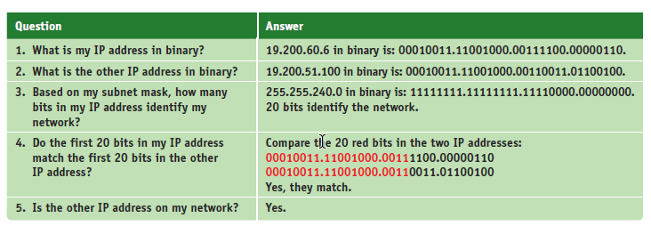

Slide 27
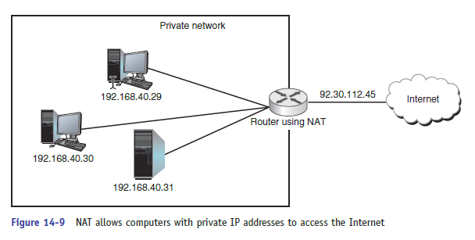
Network Address Translation
It is technique to assign private IP address to the network IP.
The advantage of NAT is security, the gateway hides the private network during this address

Slide 28
How IPV6 addresses are used??
An IPV6 addresses has 128 bit, 8 blocks of hexadecimal no. separated by colons.
Example: 2001:0000:0B80:0000:0000:00D3:9C5A:00CC
Each block is 16 bit. (2⁴=16)
If all characters in hex box has 0 that can be omitted and above address can be written as
2001:0000:0B80:0000:0000:00D3:9C5A:00CC is same as
2001:0000:0b80::00d3:9C5A:00CC

Slide 29
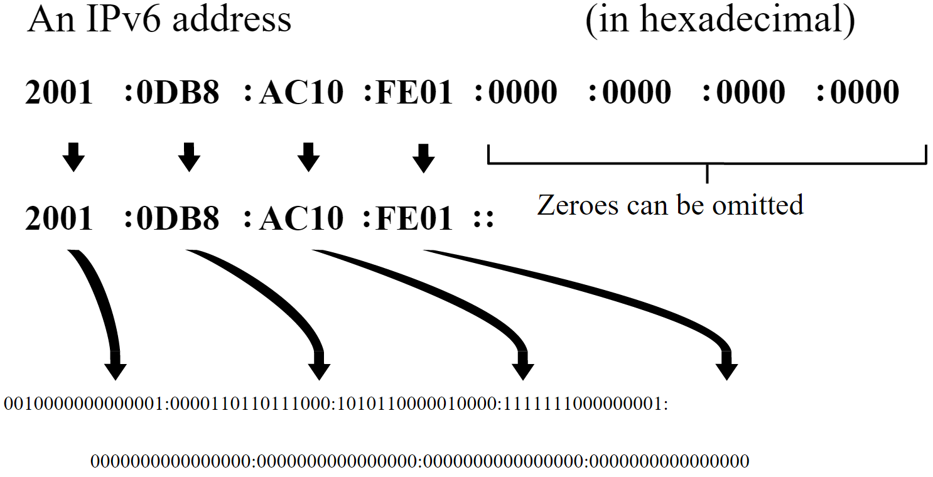

Slide 30
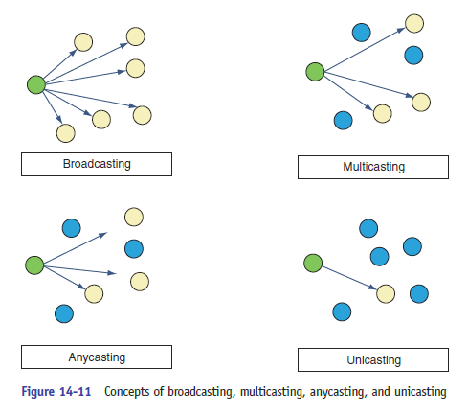
IPV6 Message Sending

Slide 31
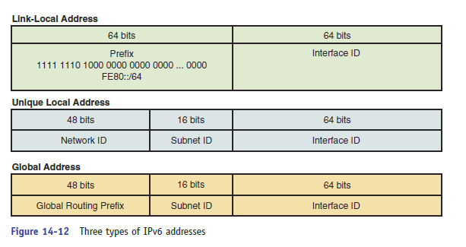
Three types of IPV6 address

Slide 32
