Slide 1
IP Addressing
Overview

Slide 2
IP Addressing
Format Rules:
1: The Subnet Mask defines IP Local and Network Address.
2: “NETWORK” Portion of Address “Must” be same to share Subnet.
3: Local “HOST” Portion of Address “Must” be unique.
4: “1”s in Subnet Mask = “NETWORK” Portion of Address
5: “0”s in Subnet Mask = “HOST” Portion of Address
6: “0”s in Subnet Mask = are “0’s” in “NETWORK” Address
7: The value of the last“1”s in Subnet Mask = the size of the “Subnet Range”
8: Broadcast Address = Last Available Address in each “Subnet Range”.

Slide 3
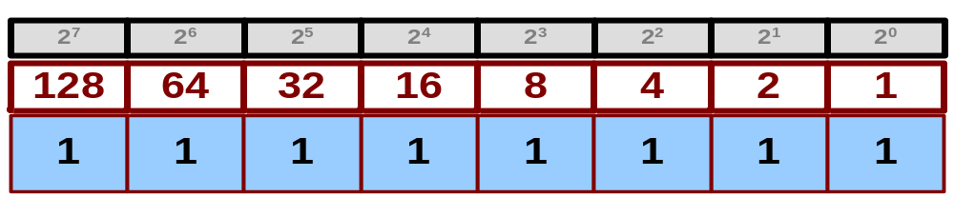
Dotted Decimal Notation
1
1
0
1
0
0
1
1
0
0
0
1
0
0
0
1
1
0
0
1
0
0
0
0
0
1
0
0
1
1
1
1
211 . 17 . 144 . 79
128
64
32
16
8
4
2
+ 1
255
Example:
“11111111” Binary = “255” Decimal
Binary Numbering System
Grouped in sets of Eight
Written as a Decimal Value

Slide 4
Standard Subnet Masks by “Class”
Subnet Mask for a Class “A” Address
255 . 0 . 0 . 0
/8
Subnet Mask for a Class “B” Address
255 . 255 . 0 . 0
/16
Subnet Mask for a Class “C” Address
255 . 255 . 255 . 0
/24
“1”s in Subnet Mask = “NETWORK” Portion of Address
“0”s in Subnet Mask = “HOST” Portion of Address

Slide 5
Class “A” Network Addresses
Class “A” Addresses
1st Octet Ranges from: 1.x.x.x through 127.x.x.x
Can have 16,777,213 local “Host” devices
Standard “Class A” Subnet Mask
255 . 0 . 0 . 0
Network
Host
“1”s in Subnet Mask = “NETWORK” Portion of Address
“0”s in Subnet Mask = “HOST” Portion of Address

Slide 6
Class “B” Network Addresses
Class “B” Addresses
1st Octet Ranges from: 128.x.x.x through 191.x.x.x
Can have the 65,534 local “Host” devices
Standard “Class B” Subnet Mask
255 . 255 . 0 . 0
Network
Host
“1”s in Subnet Mask = “NETWORK” Portion of Address
“0”s in Subnet Mask = “HOST” Portion of Address

Slide 7
Class “C” Network Addresses
Class “C” Addresses
1st Octet Ranges from: 192.x.x.x through 223.x.x.x
Can have up to 254 local “Host” devices
Standard “Class C” Subnet Mask
255 . 255 . 255 . 0
0
Network
Host
“1”s in Subnet Mask = “NETWORK” Portion of Address
“0”s in Subnet Mask = “HOST” Portion of Address

Slide 8
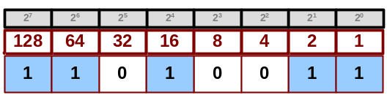
Defining a Network Address
Rule 4: “1”s in Subnet Mask = “NETWORK” Portion of Address
255 . 0 . 0 . 0
1
1
0
1
0
0
1
1
0
0
0
1
0
0
0
1
1
0
0
1
0
0
0
0
0
1
0
0
1
1
1
1
211 . 17 . 144 . 79
Network
1
1
1
1
1
1
1
1
0
0
0
0
0
0
0
0
0
0
0
0
0
0
0
0
0
0
0
0
0
0
0
0
1
1
0
1
0
0
1
1
0
0
0
1
0
0
0
1
1
0
0
1
0
0
0
0
0
1
0
0
1
1
1
1
Rule 6: “0’s” in Subnet Mast = “0’s’ in Network Address
211 . 0 . 0 . 0

Slide 9
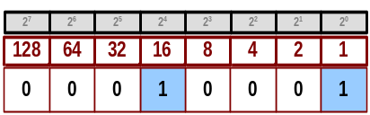
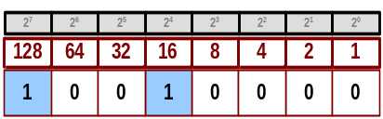
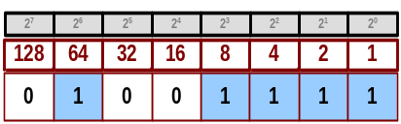
Defining the Local “Host” Address
Rule 5: “0”s in Subnet Mask = “HOST” Portion of Address
255 . 0 . 0 . 0
1
1
0
1
0
0
1
1
0
0
0
1
0
0
0
1
1
0
0
1
0
0
0
0
0
1
0
0
1
1
1
1
211 . 17 . 144 . 79
Host
1
1
1
1
1
1
1
1
0
0
0
0
0
0
0
0
0
0
0
0
0
0
0
0
0
0
0
0
0
0
0
0
1
1
0
1
0
0
1
1
0
0
0
1
0
0
0
1
1
0
0
1
0
0
0
0
0
1
0
0
1
1
1
1
“1’s” in Subnet Mask = “0’s” in “Host” Address
0 . 17 . 144 . 79

Slide 10










Network Addressing
Class “A” Networking Example
IP Address = 112.200.63.202 Subnet Mask = 255.0.0.0
Subnet Mask
255 . 0 . 0 . 0
IP Address
112 . 200 . 63 . 202
Network Address
112 . 0 . 0 . 0
Local “Host”
0 . 200 . 63 . 202
“1”s in Subnet Mask = “NETWORK” Portion of Address
“0”s in Subnet Mask = “HOST” Portion of Address

Slide 11
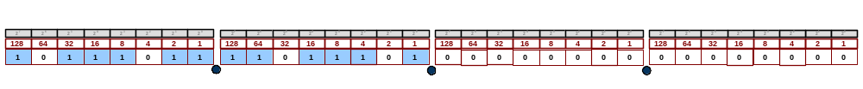
Network Addressing
Class “B” Networking Example
IP Address = 187.220.163.20 Subnet Mask = 255.255.0.0
Subnet Mask
255 . 255 . 0 . 0
IP Address
187 . 220 . 163 . 20
Network Address
187 . 220 . 0 . 0
Local “Host”
0 . 0 . 163 . 20
“1”s in Subnet Mask = “NETWORK” Portion of Address
“0”s in Subnet Mask = “HOST” Portion of Address

Slide 12
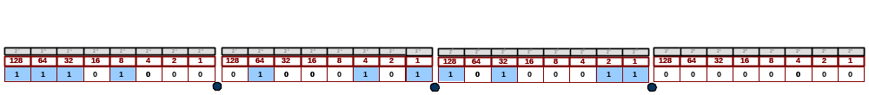
Network Addressing
Class “C” Networking Example
IP Address = 232.69.163.59 Subnet Mask = 255.255.255.0
Subnet Mask
255 . 255 . 255 . 0
IP Address
232 . 69 . 163 . 59
Network Address
232 . 69 . 163 . 0
Local “Host”
0 . 0 . 0 . 59
“1”s in Subnet Mask = “NETWORK” Portion of Address
“0”s in Subnet Mask = “HOST” Portion of Address

Slide 13








Subnet Mask Numbers and Ranges
128 2 Subnets Range 128
192 4 Subnets Range 64
224 8 Subnets Range 32
240 16 Subnets Range 16
248 32 Subnets Range 8
252 64 Subnets Range 4
254 128 Subnets Range 2
255 255 Subnets Range 1
Rule 7: The value of the last“1”s in Subnet Mask = the size of the “Subnet Range”

Slide 14
Subnet Ranges from Subnet Mask
Range Size
128 2 Subnets 128
Subnet 1 = 0-127 Subnet 2 = 128-255
192 4 Subnets 64
Subnet 1 = 0-63 Subnet 2 = 64- 127 Subnet 3 = 128-191 Subnet 4 = 192-255
224 8 Subnets 32
Subnet 1 = 0-31 Subnet 2 = 32-63 Subnet 3 = 64-95 Subnet 4 = 96-127
Subnet 5 = 128-159 Subnet 6 = 160-191 Subnet 7 = 192-223 Subnet 8 = 224-255
240 16 Subnets 16
Subnet 1 = 0-15 Subnet 2 = 16-31 Subnet 3 = 32-47 Subnet 4 = 48-63
Subnet 5 = 64-79 Subnet 6 = 80-95 Subnet 7 = 96-111 Subnet 8 = 112-127
Subnet 9 =128-143 Subnet 10 = 144-159 Subnet 11 = 160-175 Subnet 12 = 176-191
Subnet 13 = 192-207 Subnet 14 = 208-223 Subnet 15 = 224-239 Subnet 16 = 240-255

Slide 15
Subnet Ranges from Subnet Mask
Range Size
248 32 Subnets 8
Subnet 1 = 0-7 Subnet 2 = 8-15 Subnet 3 = 16-23 Subnet 4 = 24-31
Subnet 5 = 32-39 Subnet 6 = 40-47 Subnet 7 = 48-55 Subnet 8 = 56-63
Subnet 9 =64-71 Subnet 10 = 72-79 Subnet 11 = 80-87 Subnet 12 = 88-95
Subnet 13 = 96-103 Subnet 14 = 104-111 Subnet 15 = 112-119 Subnet 16 = 120-127
Subnet 17 =128-135 Subnet 18= 136-143 Subnet 19 = 144-151 Subnet 20 = 152-159
Subnet 21 =160-167 Subnet 22 = 168-175 Subnet 23 = 176-183 Subnet 24 = 184-191
Subnet 25 =192-199 Subnet 26 = 200-207 Subnet 27 = 208-215 Subnet 28 = 216-223
Subnet 29 =224-231 Subnet 30 = 232-239 Subnet 31 = 240-247 Subnet 32 = 248-255
252 64 Subnets 4
Subnet 1 =0-3 Subnet 2 =4-7 Subnet 3 =8-11 Subnet 4 =12-15 Subnet 5 =16-19 Subnet 6 =20-23 Subnet 7 =24-27 Subnet 8 =28-31 Subnet 9 =32-35 Subnet 10 =36-39 Subnet 11 =40-43 Subnet 12 =44-47 Subnet 13 =48-51 Subnet 14 =52-55 Subnet 15 =56-59 Subnet 16 =60-63 Subnet 17 =64-67 Subnet 18 =68-71 Subnet 19 =72-75 Subnet 20 =76-79 Subnet 21 =80-83 Subnet 22 =84-87 Subnet 23 =88-91 Subnet 24 =92-95 Subnet 25 =96-99 Subnet 26 =100-103 Subnet 27 =104-107 Subnet 28 =108-111 Subnet 29 =112-115 Subnet 30 =116-119 Subnet 31 =120-123 Subnet 32 = 124-127 Subnet 33 =128-131 Subnet 34 =132-135 Subnet 35 =136-139 Subnet 36 =140-143 Subnet 37 =144-147 Subnet 38 =148-151 Subnet 39 =152-155 Subnet 40 =156-159 Subnet 41 =160-163 Subnet 42 =164-167 Subnet 43 =168-171 Subnet 44 =172-175 Subnet 45 =176-179 Subnet 46 = 180-183 Subnet 47 =184-187 Subnet 48 =188-191 Subnet 49 =192-195 Subnet 50=196-199 Subnet 51 =200-203 Subnet 52 =204-207 Subnet 53 =208-211 Subnet 54 =212-215 Subnet 55 =216-219 Subnet 56 =220-223 Subnet 57 =224-227 Subnet 58 =228-231 Subnet 59 =232-235 Subnet 60 =236-239 Subnet 61 =240-243 Subnet 62 =244-247 Subnet 63 =248-251 Subnet 64=252-255

Slide 16




Subnetting Class “A” Addresses
IP 11.17.144.79 Subnetted with 255.192.0.0:
Allows Class “A” address to be broken into 4 Subnets.
“1”s in Subnet Mask = “NETWORK” Portion of Address
“0”s in Subnet Mask = “HOST” Portion of Address
255 . 192 . 0 . 0
1
1
1
1
1
1
1
1
1
1
0
0
0
0
0
0
0
0
0
0
0
0
0
0
0
0
0
0
0
0
0
0
0
0
0
0
1
0
1
1
0
0
0
1
0
0
0
1
1
0
0
1
0
0
0
0
0
1
0
0
1
1
1
1
11 . 17 . 144 . 79
Network Address = 11.0.0.0
Local “Host” = 0.17.144.79

Slide 17



Subnetting Class “B” Addresses
IP 161.17.144.79 Subnetted with 255.255.240.0:
Allows Class “B” address to be broken into 16 Subnets.
“1”s in Subnet Mask = “NETWORK” Portion of Address
“0”s in Subnet Mask = “HOST” Portion of Address
255 . 255 . 240 . 0
1
1
1
1
1
1
1
1
1
1
1
1
1
1
1
1
1
1
1
1
0
0
0
0
0
0
0
0
0
0
0
0
1
0
1
0
0
0
0
1
0
0
0
1
0
0
0
1
1
0
0
1
0
0
0
0
0
1
0
0
1
1
1
1
161 . 17 . 144 . 79
Network Address=161.17.144.0
Local “Host” = 0.0.0.79

Slide 18



Subnetting Class “C” Addresses
IP 211.17.144.79 Subnetted with 255.255.255.240:
Allows Class “C” address to be broken into 8 Subnets.
“1”s in Subnet Mask = “NETWORK” Portion of Address
“0”s in Subnet Mask = “HOST” Portion of Address
255 . 255 . 255 . 224
1
1
1
1
1
1
1
1
1
1
1
1
1
1
1
1
1
1
1
1
1
1
1
1
1
1
1
0
0
0
0
0
1
1
0
1
0
0
1
1
0
0
0
1
0
0
0
1
1
0
0
1
0
0
0
0
0
1
0
0
1
1
1
1
211 . 17 . 144 . 79
Network Address=211.17.144.64
Local “Host” = 0.0.0.15

Slide 19
Uni-cast Communications
192.168.0.15
192.168.0.250
192.168.0.100
One PC Directly Communicating with another.
Example:
PC-192.168.0.15 addresses PC-192.168.0.128 specifically by IP Address
192.168.0.50
192.168.0.1
192.168.1.250
192.168.0.150
192.168.0.63
192.168.1.64
192.168.0.128

Slide 20
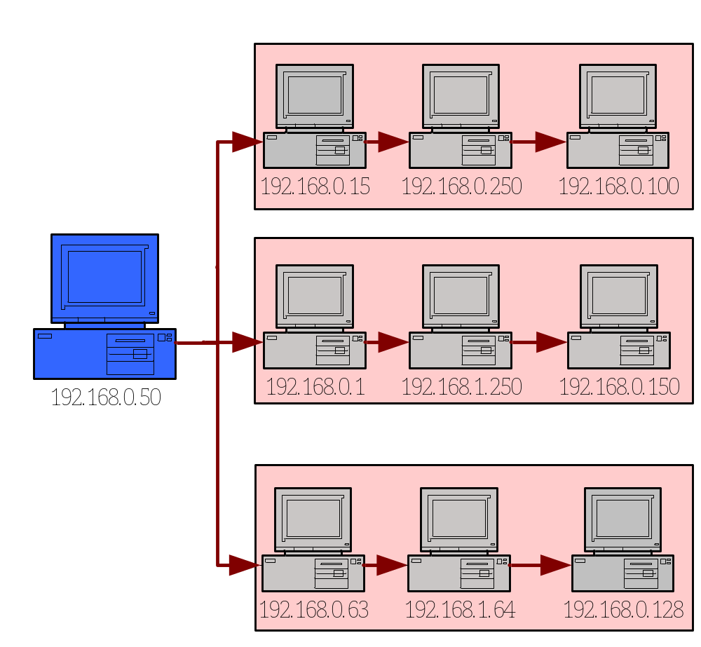
Multi-Cast Communications
Multi-Cast Server Communicates
“One-way” with many.
Like “Radio” Transmissions
Example:
PC-192.168.0.50 addresses all PC’s listening to Multi-Cast Servers Multi-Cast transmission.
Multi-Cast
Server
(Mult-Cast IP = Class “D” Addresses = 224.X.X.X through 239.X.X.X)

Slide 21
Subnet Communications
A
Which PC’s are on the same Subnet with PC “A”?
Subnet Mask = 255.255.255.128
192.168.0.15
192.168.0.250
192.168.0.100
With a Subnet Mask ending with 128 you create “2” Network ranges: 0-127 and 128-254
PC 192.168.0.15 is in the 1st Range along with:
192.168.0.100
192.168.0.50
192.168.0.1
192.168.0.63
192.168.0.50
192.168.0.1
192.168.1.250
192.168.0.150
192.168.0.63
192.168.1.64
192.168.0.128

Slide 22
Subnet Communications
Match the Subnet Mask to the Communications groups below!
1: Which PC’s will Subnet Mask 255.255.248.0
allow to talk?
A
B
C
192.168.0.15
192.168.0.250
192.168.0.100
2: Which PC’s will Subnet Mask 255.255.255.0
allow to talk?
D
E
F
G
3: Which PC’s will Subnet Mask 255.255.255.192
allow to talk?
192.168.0.50
192.168.0.1
192.168.1.250
192.168.0.150
H
I
J
4: Which PC’s will Subnet Mask 255.255.255.224
allow to talk?
192.168.0.63
192.168.1.64
192.168.0.128
“A”
(A,B,C,D,E,G,H,J),(F,I)
“B”
A,B,C,D,E,F,G,H,I,J
“C”
(A,E)(B),(C),(D,H),(F),(G,J),(I)
“D”
(A,D,E,H),(B),(C),(F),(G,J),(I)

