Slide 1
CHAPTER 9
Supporting I/O Devices

Slide 2
Objective of this unit
How toinstall and support many I/O devices ??
Learn about devices to enhance system
To manage peripheral devices connction and upgrade.
Troubleshoot problems with I/O devices

Slide 3
I/O devices
There can be two types of I/O devices
-Internal devices
example : Video card, TV tuner card
-External devices
example: barcoad reader, scanner

Slide 4
Basic Principles for Supporting Devices
Every device is controlled by software
- you must install both device and device driver
When it comes to supporting or installing device the manufacturar knows the best
-read manufacurar documentation and follow guidelines

Slide 5
Some devices need application software to use the device
-even after installing scanner and its drivers, adobe photoshop is needed to run scanner.
The device is no faster than the port or slot it is designed to
-USB drive of 3.0 will not work with port of
USB 2.0

Slide 6
Use an administrator account in windows.
-signed in to the system with highest level of privilege also called as admin login.
Problems with the device can sometimes be solved by updating device drivers.
-by device manager you can update the driver to solve the problem and to add new functions.

Slide 7
Install only one device at a time
-install one device and restart and check if that is working correct
-then start other device installation.
-repeat the procedure if you want to install several devices

Slide 8



USB connections
Three levels of USB port
1. Original USB (USB 1.1)
transfer data at up to 1.5 Mbits/sec
2. Hi-speed USB (2.0)
transfer data at up to 480 Mbits/s
3. Super Speed USB (3.0)
transfer data at up to 5 Gbits/s

Slide 9
127 USB devices can be chained together using USB cable.
It uses serial transmission. Uses two communication wire and two power wire.
It is hot-swappable. You can plug and unplug the USB without power off.

Slide 10
Serial Transmission
serial communication is the process of sending data one bit at a time, sequentially, over a communication channel or computer bus.
This is contrast to parallel transmission where several bits are sent on parallel channels.
This requires only one transmission line.
Reduces the cost of cable.
Used over large distance with data cable.

Slide 11
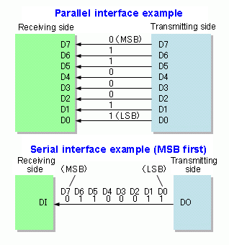
Figure : serial versus parallel transmission

Slide 12
Supporting the Video subsystem
Primary output device is monitor.
Two important component of video outage are
-Monitor
-Video card
It is also called as video adapter and graphics adapter
Video cables and connectors

Slide 13
Monitor Technology and Features
The most popular type of monitor is LCD flat screen.
LCD display is nothing but liquid crystal display monitor.
This produces an image on screen using liquid crystal
This concept work in a layer to create appropriate image

Slide 14
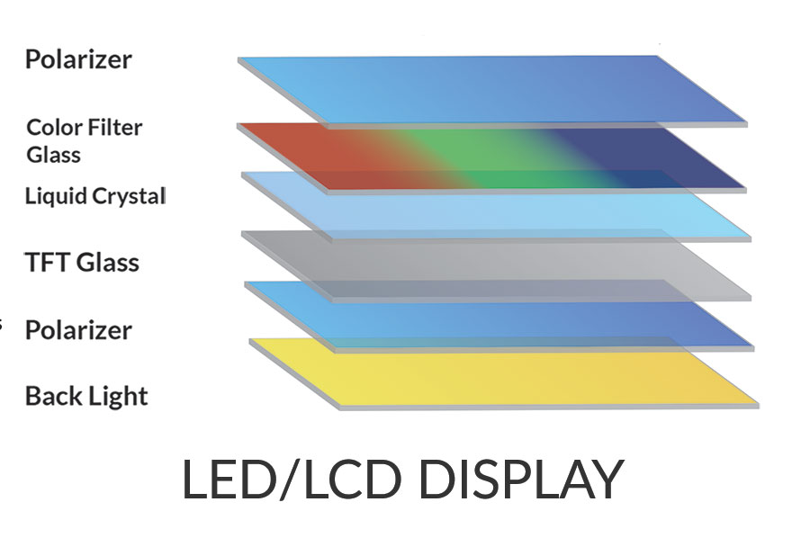


Image form on screen
user

Slide 15

A Pixel is formed by the intersection
Of row and column electrodes.

Slide 16
Plasma monitor
This is advance than LCD monitor
Provide high contrast with better color than LCD
They are expensive and heavy comes in large sizes.

Slide 17
Projector
This is used to project the transparent image on large screen
Basically used for large group of people.
It is install in a computer as dual monitor.
Example: used in classrooms.

Slide 18
Video cards and connectors
It is also called as
-graphics card or
-graphics adapter or
-display cards
Most computer has video port in it.
Video card can use the PCI or PCI express slots on motherboard.

Slide 19
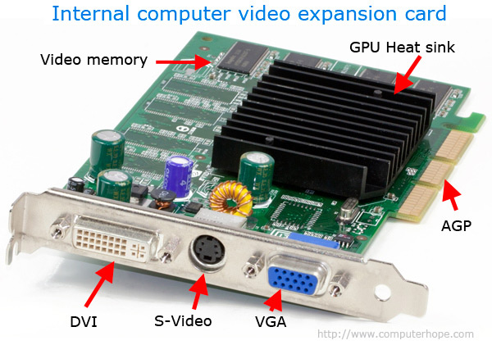
PCI
connection

Slide 20
Types of video ports
1. VGA (Video Graphics Array)
2.S-video
3.DVI (digital visual interface)
4.Display Port
5.HDMI connector

Slide 21
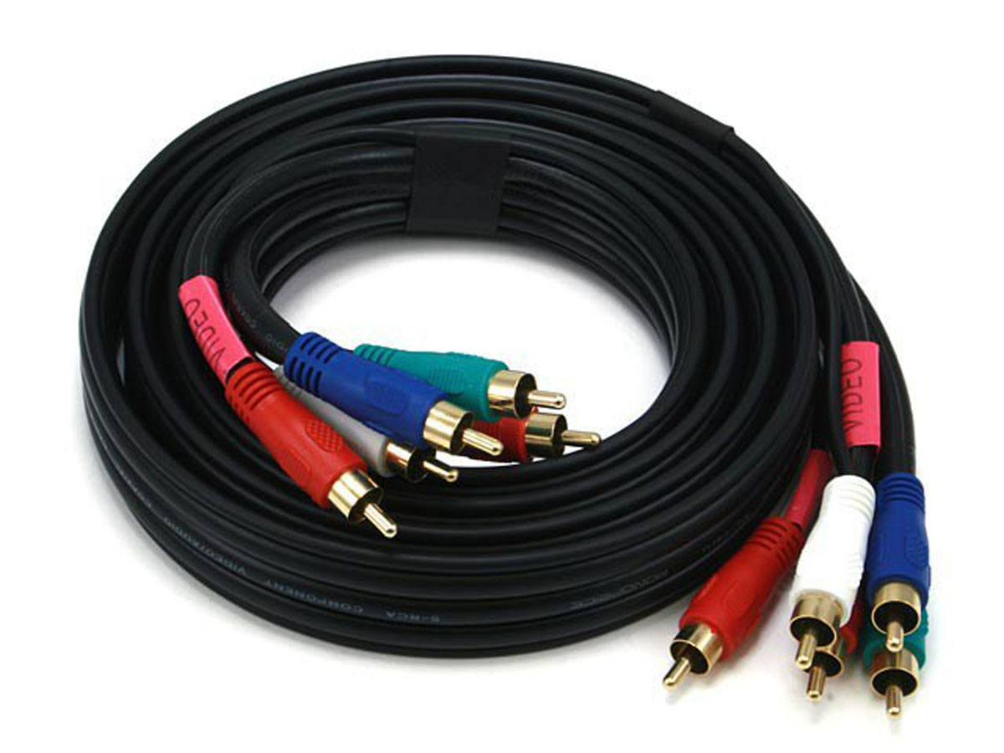
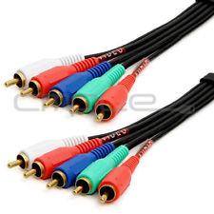
Component video
It is split into different signals RGB
It is a combine 5 piece cable with display and audio connector

Slide 22
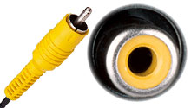
Composite video
Also called RGB port
Red,green and blue are mixed together in same signal
Method mostly used in TV and DVD player.
Does not produce sharp image as VGA

Slide 23
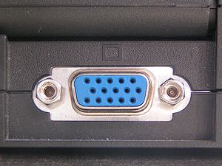
VGA (Video Graphics Array) port
It is a 15 pin port
This is the standard analog video port
Transmits 3 signals RED, GREEN, BLUE (RGB)
Also called as DB-15 port

Slide 24
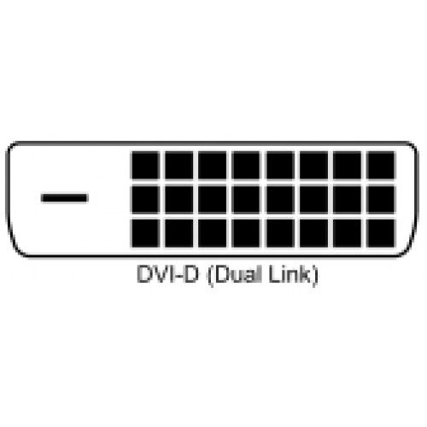
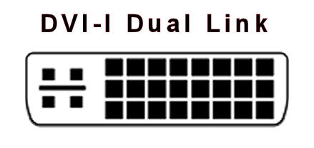

DVI (digital visual interface) Ports
Designed to replace VGA
It can transmit analog or digital data
Different DVI standards is shown in table
DVI-D Digital only | DVI-I Analog or digital | DVI-A Analog only

Slide 25
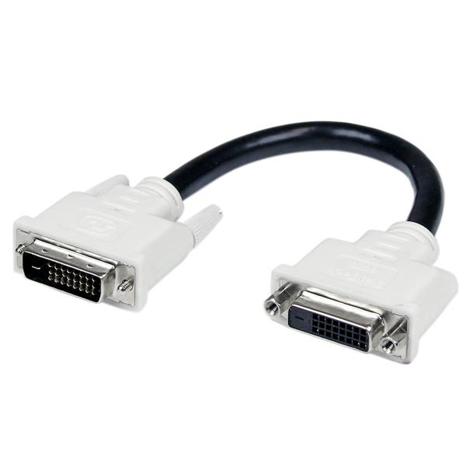
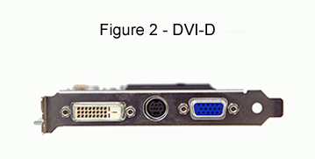
DVI-D port and cable

Slide 26
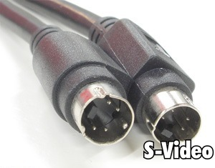
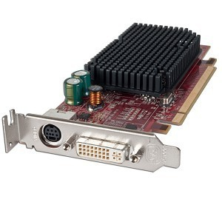
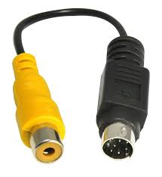
S-Video (super video) port
It is 4 pin or 7 pin
Used in television and video equipment

Slide 27
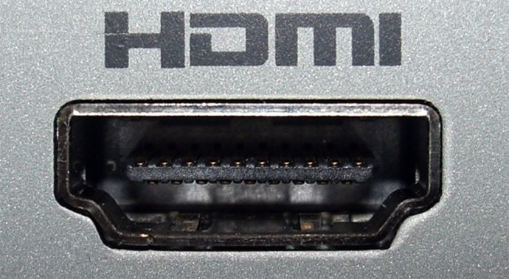
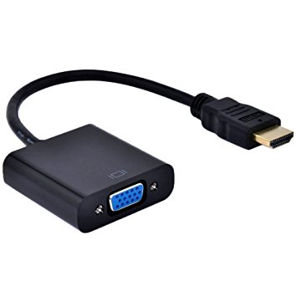
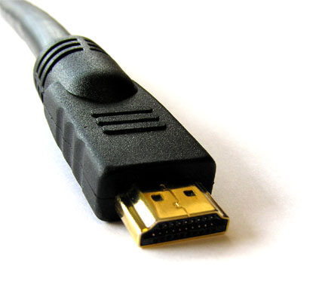
HDMI connectors
Transmits both digital video and audio
Mostly used by home theater equipment

Slide 28
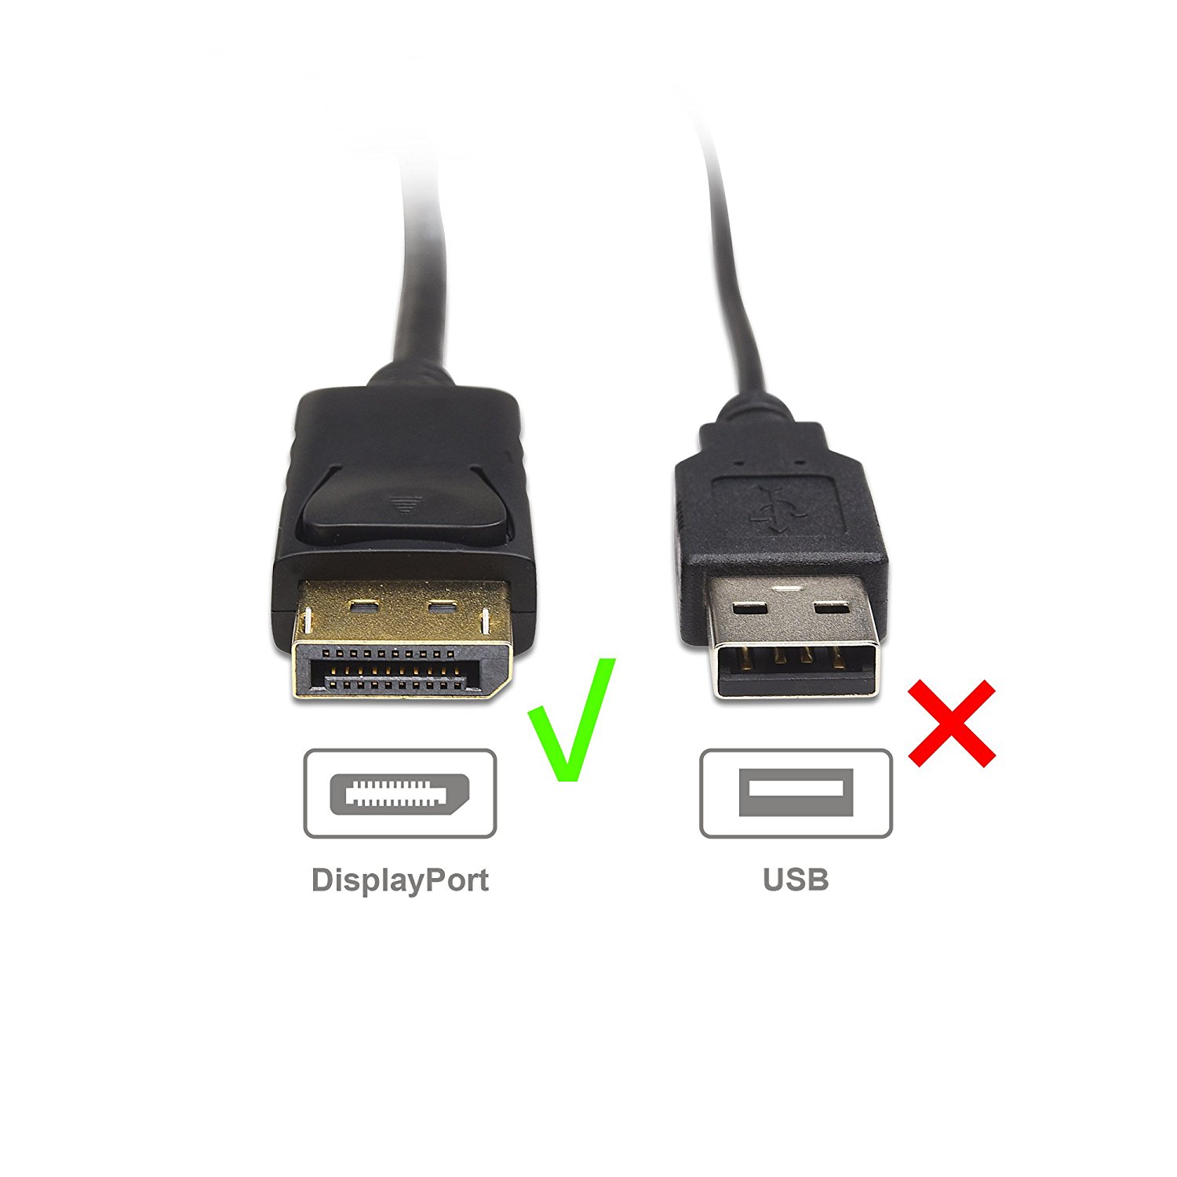
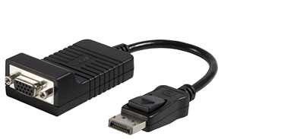
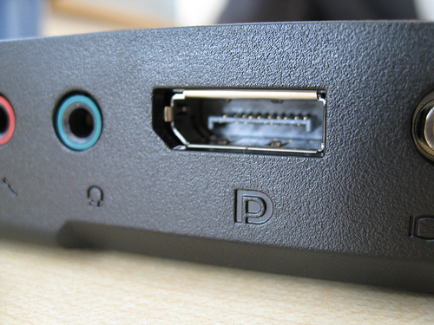
Display port
Designed to replace DVI
Can transmit digital data and audio signal
So it ultimately replace VGA,DVI,HDMI on laptop and computer

