Slide 1
BUILDING THE ULTIMATE PC
Bryna Zhao CSC133

Slide 2
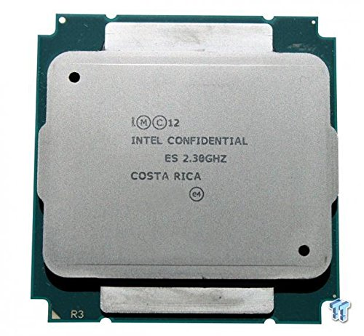
Cpu Intel - Xeon E5-2699 V3 2.3GHz 18-Core OEM/Tray Processor $ 3400
DATA WIDTH: 64-bit SOCKET
LGA2011-3
OPERATING FREQUENCY: 2.3GHz
MAX TURBO FREQUENCY: 3.6GHz
CORES: 18
L1 CACHE: 18 x 32KB Instruction 18 x 32KB Data
L2 CACHE: 18 x 256KB
L3 CACHE: 1 x 45MB
LITHOGRAPHY: 22 nm
THERMAL DESIGN POWER: 145 Watts
SIMULTANEOUS MULTITHREADING

Slide 3
Motherboard Asus - X99-E WS SSI CEB LGA2011-3 Motherboard $700
Quad Strength Graphic Power – 4-Way PCI-E Gen3 x16 link supporting NVidia GeForce SLI and AMD CrossFireX on demand
Supreme Power Solution – Premium components deliver industry-leading power efficiency
5-Way Optimization by Dual Intelligent Processor 5s – One click, total system optimization
Superb Storage Flexibility – Onboard M.2 x4 and support for both ASUS PIKE II and ThunderboltEX II cards
Easy Maintenance – ASUS Q-Code Logger, an easy-maintenance button and Dr. Power LED displays unusual power statuses

Slide 4
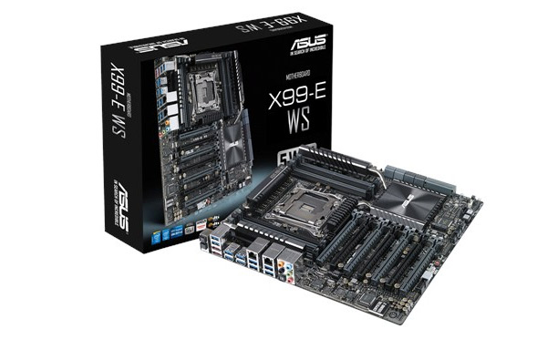
Asus - X99-E WS SSI CEB LGA2011-3 Motherboard

Slide 5
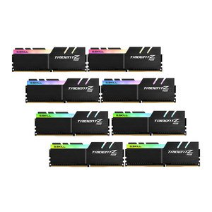
Memory G.Skill - TridentZ RGB 128GB (8 x 16GB) DDR4-3200 Memory $2200
TYPE: 288-pin DIMM
SPEED: DDR4-3200
SIZE: 128GB (8 x 16GB)
PRICE/GB: $17.19
CAS LATENCY: 14
TIMING: 14-14-14-34
VOLTAGE: 1.35V
HEAT SPREADER

Slide 6
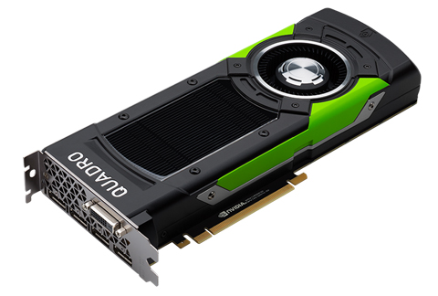
Video card PNY - Quadro P6000 24GB $7296
INTERFACE:PCI-Express x16
CHIPSET: Quadro P6000
MEMORY SIZE:24GB
MEMORY TYPE:GDDR5X
CORE CLOCK:1.42GHz
BOOST CLOCK:1.53GHz
TDP:250 Watts
FAN: Yes
SLI SUPPORT: Yes
DVI-D DUAL-LINK:1
DISPLAYPORT:4

Slide 7
Hard drive Intel - DC P3608 1.6TB PCI-E Solid State Drive $3000
Enhanced Power Loss Management Protection from unplanned power loss called PLI (Power Loss Imminent) is obtained using a propriety combination of hardware, firmware algorithms, built in self-test, and the robust validation at a multitude of corner cases. 20mmHETMLCNAND (High-Endurance Technology) Up to 3 DWPD (Drive Writes Per Day) over 5 years. The endurance is based on the JEDEC enterprise workload, and real world endurance is application based and may exceed the rated value. The Intel SSD DC P3608 Series 4TB can write up to 21.9PB over the life of the drive before wearing out. End-to-End Data Protection End-to-end data protection and ECC (Error Correction Code) on all internal and external memories in the data path for protection at every layer. Dual NVMe Controller The NVMe protocol is more efficient than SATA or SAS, providing more IOPS at a lower CPU utilization. The dual controller architecture allows the SSD to simultaneously transfer data with this improved efficiency, and can be aggregated through the Intel RSTe software.

Slide 8
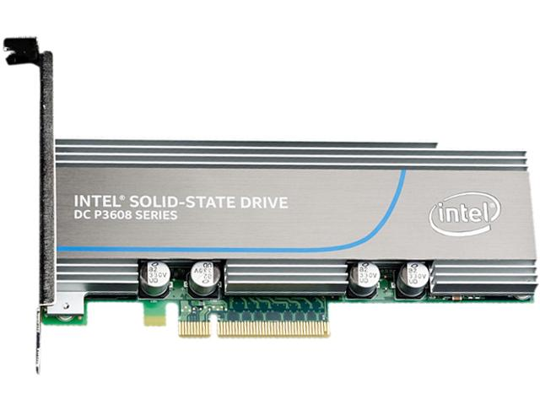
Intel - DC P3608 1.6TB PCI-E Solid State Drive

Slide 9
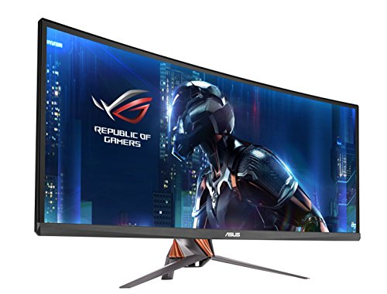
Monitor Asus - ROG SWIFT PG348Q 34.0" 3440x1440 100Hz Monitor $ 1200
SCREEN SIZE:34"
CURVED: Yes
RECOMMENDED RESOLUTION:3440 x 1440
CURVED SCREEN: Yes
WIDESCREEN: Yes
ASPECT RATIO:21:9
VIEWING ANGLE:178° H x 178° V
BRIGHTNESS:300 cd/m²
RESPONSE TIME:5 ms
REFRESH RATE:100Hz
IPS: Yes
LED: Yes
SUPPORTS G-SYNC: Yes
BUILT-IN SPEAKERS: Yes

Slide 10
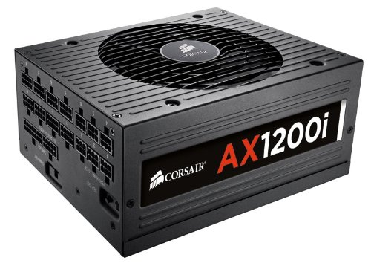
Power supply Corsair - 1200W 80+ Platinum Certified Fully-Modular ATX $299
Digital Signal Processor (DSP) for delivering extremely clean, efficient power with real-time adjustments
Corsair Link Integration for monitoring and adjustment of performance, noise, and OCP settings
80 PLUS Platinum Efficiency for lower power usage and energy costs
Fanless operation at low loads, for outstanding noise reduction
Fully Modular low profile cables for easy installation and less clutter
Ten year warranty: Your guarantee of reliable operation that will last across several system builds

Slide 11

Keyboard Corsair - Vengeance K70 Wired Gaming Keyboard $80

Slide 12

Logitech - G500 Wired Laser Mouse $125

Slide 13
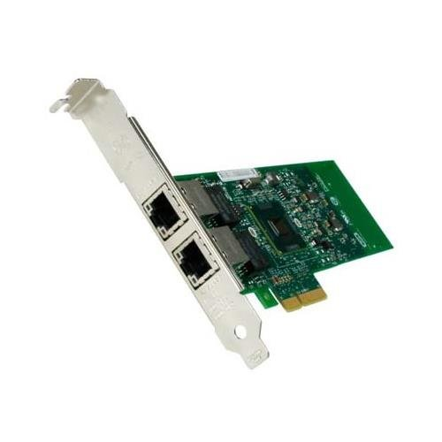
Nic Intel - E1G42ETBLK PCI-Express x4 10/100/1000 Mbps Network Adapter $137
INTERFACE
PCI-Express x4PORTS
2 x 10/100/1000 Mbps

Slide 14
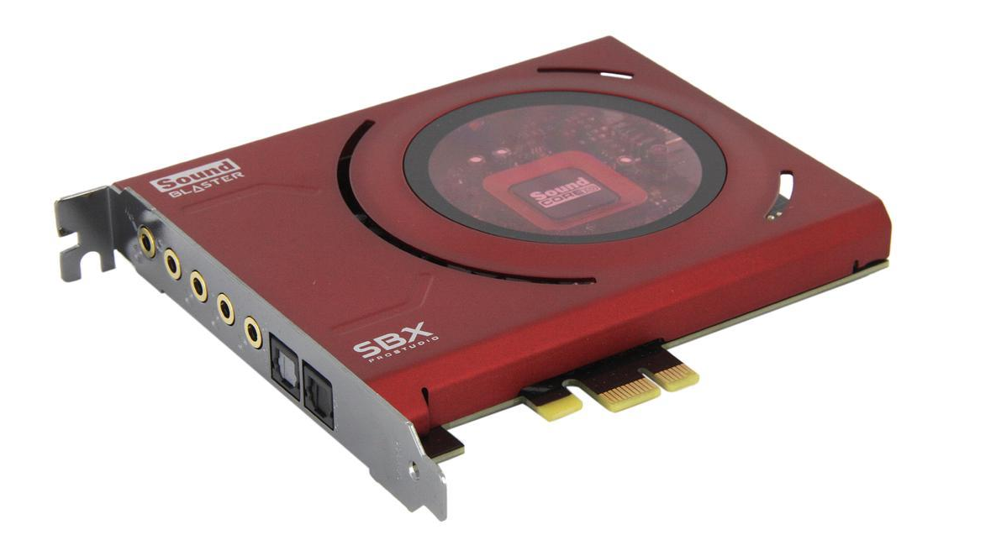
Sound Card Creative Labs - Z PCIe 24-bit 96 KHz Sound Card $99
PCI Express x1, 5.1 Channels
TOSLink Optical Input and Output
Sound Core 3D Processor
Beamforming Microphone

Slide 15
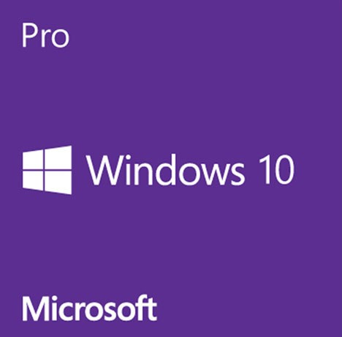
OS Microsoft - Windows 10 Pro OEM 64-bit $136
Stay productive with Windows 10 Pro, which combines the best features from Windows 7 and Windows 8.1 to please both touch and mouse users
Quickly access your apps, settings and files in a few keystrokes, clicks or taps with the return of the Start Menu, which has been enhanced with sizeable tiles and new capabilities
Harness the power of the Task View button on the taskbar to quickly switch among your running apps
Keep your open apps organized with Virtual Desktop support, which lets you create desktops with apps that pertain to certain needs
Enjoy seamless functionality between modern and Win32 apps with the ability to minimize, maximize, resize and change position on the desktop
Change the layout of your open windows on your desktop with Snap enhancements, which deliver consistency across modern and Win32 apps — use four-quadrant Snap to fill your screen with four apps in a two-by-two configuration
Utilize Cortana, your personal digital assistant, which is always at the ready and brings you what you need — search the Web, read the news and find things on your PC
Keep your favorites, interests, investments and more easily accessible with Cortana's Notebook, where she keeps track of your personal likes and preferences
Surf the Web with Microsoft Edge, a Web browser that is fast, compatible and built for today's Internet, and keep your online collections of favorites, reading lists, browsing history and current downloads in The Hub
Safeguard your PC with Windows Defender and Windows Firewall — both working to protect your PC by scanning for malicious software

Slide 16
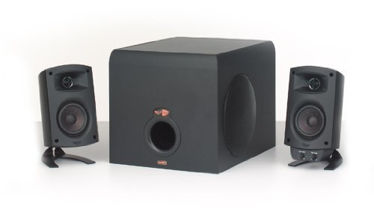
Speakers Klipsch - ProMedia 2.1 120W 2.1ch $149
Maximum Acoustic Output: 106dB SPL Amplifier: Digital/Linear A/B amplifier with discrete MOSFET output power section Satellites: Two-way system using 0.75" polymer dome tweeter with a MicroTractrix Horn and one 3" long-throw midBass driver Subwoofer: Side-firing 6.5" long-throw driver

Slide 17
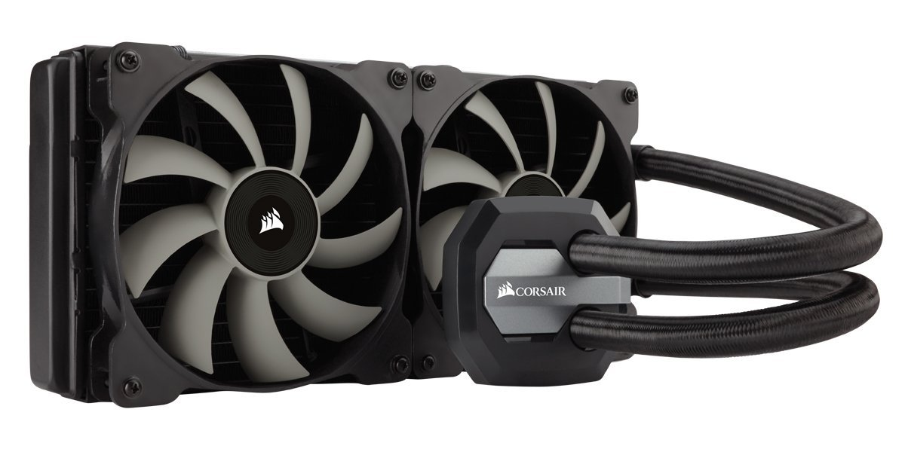
Cooling System Corsair - H115i 104.7 CFM Liquid CPU Cooler $109
A 280mm radiator and dual SP140L PWM fans provide cooling for overclocked CPUs
The Hydro Series H115i is an extreme performance, factory sealed, all-in-one liquid CPU cooler for cases with 280mm radiator mounts.
The 280mm radiator and dual SP140L PWM fans provide the excellent cooling you need for highly overclocked CPUs.

Slide 18
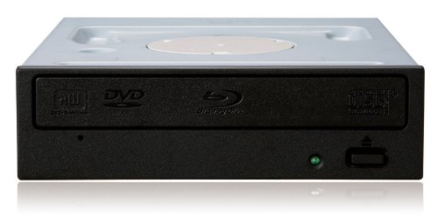
CD/DVD/DVD-RW Pioneer - BDC-207DBK Blu-Ray Reader, DVD/CD Writer $384
Read Speed
DVD-ROM (Single): 16x
DVD-ROM (Dual): 12x
Write Speed
DVD-R: 16x
CD - RW: 24x
Interface
Serial-ATA (SATA)

Slide 19
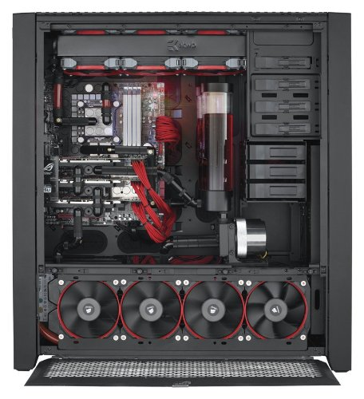
Case Corsair - 900D ATX Full Tower Case $329
Aluminum ATX Super Tower
2 x USB 3.0, 4 x USB 2.0, Audio Front Ports
4 External 5.25" Drive Bays
9 Internal 3.5" Drive Bays

Slide 20
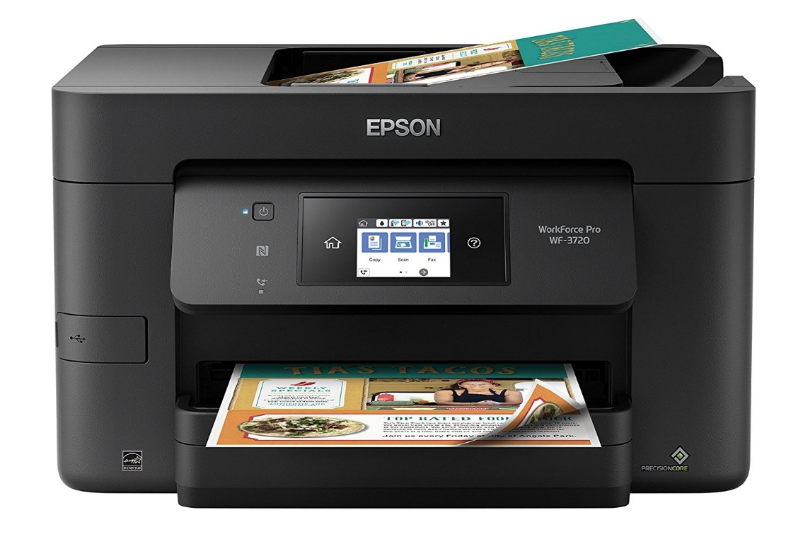
Printer Epson WorkForce Pro WF-3720 Wireless All-in-One Color Inkjet Printer $90
Fast printing — professional-quality prints at speeds of 20 ISO ppm (black) and 10 ISO ppm (color) (†).
Economical — up to 30 percent lower printing costs vs. color laser (1).
Reload paper less often — large 250-sheet capacity.
Efficient — powerful performance packed in a compact, space-saving printer.

Slide 21
TOTAL PRICE: $17830

