Slide 1
Trees
Chapters 8 (&, perhaps 9)

Slide 2
Interview questions about trees
http://blog.hackerrank.com/the-unhealthy-obsession-with-tree-questions/
http://www.developer.com/mgmt/three-types-of-interview-questions-software-developers-should-expect.html
http://citeseerx.ist.psu.edu/viewdoc/download?doi=10.1.1.471.4772&rep=rep1&type=pdf
http://javarevisited.blogspot.com/2012/01/google-interview-questions-answers-top.html
https://www.careercup.com/page?sort=votes

Slide 3
Definitions
node
parent
child/children
root
sibling
external node / leaf / leaves
internal node
ancestor
descendant
subtree
path (from root to leaf)
height
depth

Slide 4
General Tree
Usually an array or list of children in each node.

Slide 5
Tree height
BASE CASE: If there's no tree, return 0.
MAX(height1, height2) + 1
Node
Left subtree
Right subtree
height2
height1

Slide 6
Node count
BASE CASE: If there's no tree, return 0.
lCount+rCount+1
BSTNode
lCount
Left subtree
Right subtree
rCount

Slide 7
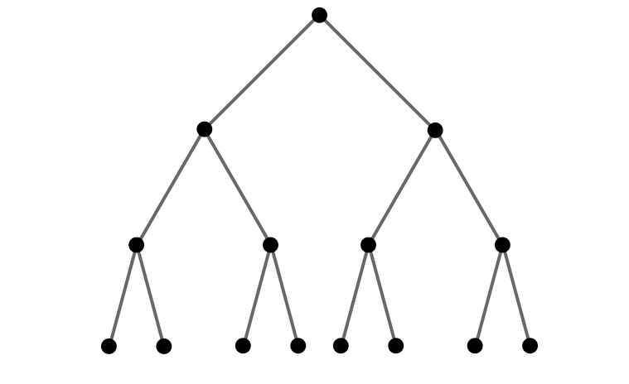
Binary Tree
root
Each node has at most two children, a left child and a right child.
Each node (except the root, perhaps) has a parent.
Often the parent of the root will be itself or null
nodes
height
leaves

Slide 8
A tree (recursively)
BSTNode
Left subtree
Right subtree

Slide 9
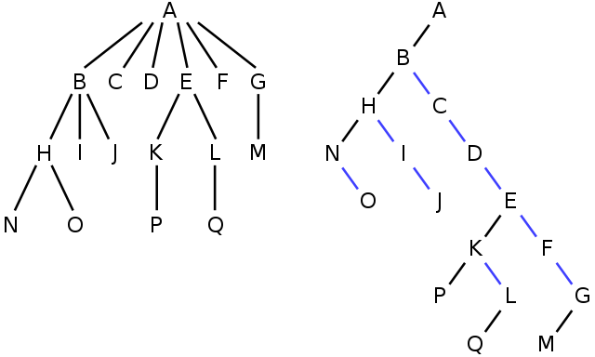
Examples of trees

Slide 10
Printing trees (traversal)
A traversal visits every node in the tree.
Pre order traversal
Print the node, then the left, then the right subtrees (recursively)
In order traversal
Print all the values in the tree 'In order" or sorted
Post order traversal
Print the left, then the right subtrees, then the node (recursively)
"Breadth First" traversal

Slide 11
inorder traversal
BASE CASE: If there's no tree, print nothing
Print after the left subtree
BSTNode
Least, print first
Left subtree
Right subtree
Print after the node

Slide 12
Inorder traversal
inorder(50)
inorder(25) , print 50, inorder(60)
inorder(null), print 25, inorder(45)
25
inorder(30), print 45, inorder(48)
inorder(null), print 30, inorder(null)
30
45
inorder(null), print 48, inorder(null)
48
(and so on)
The print is 'in' between the left and right
50
25
60
45
55
70
30
48
66
86
68

Slide 13
Generators in python
function runs, like any other function, until "yield" in encountered.
Then it returns the yielded value but KEEPS ITS STATE,
The next time it's run, it starts from where it left off.
def foo(): print "begin" for i in range(3): print "before yield", i yield i print "after yield", i print "end"
f = foo() f.next() f.next() f.next()
for i in foo(): print (i)

Slide 14
priority queue
triage at an emergency room.
Usually two pieces, the priority and the data.
Same operations a queue, different results

Slide 15
priority queue
Implemented with a 'heap' which requires either a vector or a deque
A heap is a 'full' binary tree built into an array
The 'heap property' says the parent is greater than both children
root
children of node n are a 2n+1 and 2n+2

Slide 16
Heaps

