Slide 1
Hackerrank Challenges
Set 1 - Getting started

Slide 2
Parkland Academic Honesty Policy
The work you turn is to be your own. You are not allowed to copy other's work as and turn it in as your own.
I honor Parkland’s core values by affirming that I have followed all academic integrity guidelines for this work.

Slide 3
Taking an image of the screen
It's useful to be able to take screen images and send those image to the instructor. It's also important to be able to manipulate those files on your computer.
We're also going to start our 'tour' of programming environments with a site called hackerrank.com which has programming tutorials, contests and examples.
It's probably best to use the controls of your machine to take the picture, but you can always use a cell phone in a pinch :-)

Slide 4
Solving Some Challenges
If you don't have a hackerrank account, create one (later slide)
Go to the 'python' section https://www.hackerrank.com/domains/python/
Do any 10 challenges
Take a screenshot showing your username and your rank and some of the solved challenges (as many as you can). You do not need to give me the code or screenshots of individual challenges.
Attach that screenshot to the cobra learning dropbox

Slide 5
Instructions if you don't have an account
Create an account on http://hackerrank.com
Sign into that account.
There's an 'all tracks' link that may or may not be selected. If it's not selected, the select it.
Under 'all tracks' there's a column called 'Languages'. Select 'Python' from that column.
When the 'Python' make sure under the 'subdomain' column that 'Introduction' is selected.
In the 'Say "Hello World" in Python challenge, select 'Solve Challenge'. This is one challenge, now choose 9 more.

Slide 6
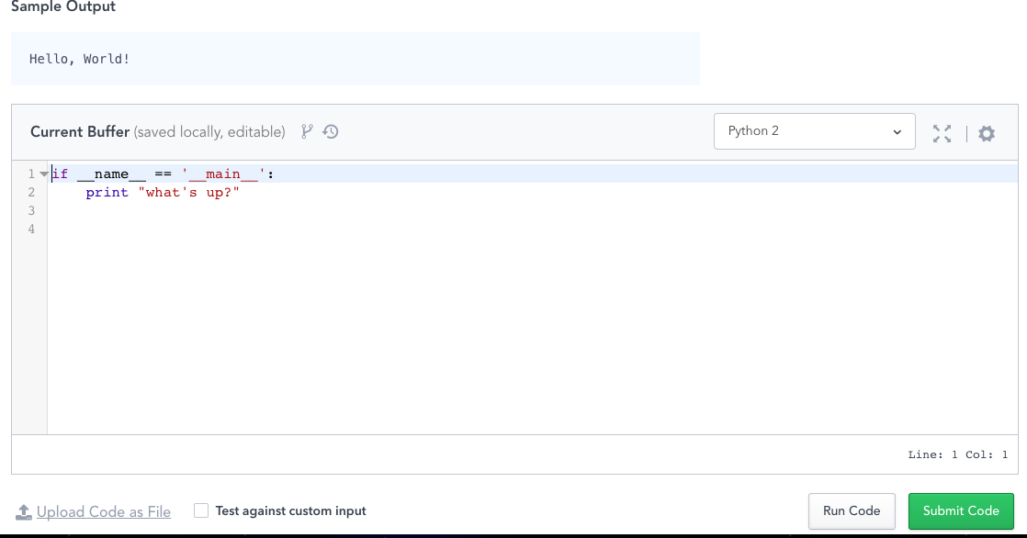
Help on the code in hackerrank
You should select Python 3 from the pulldown menu here.
This first line is for use with larger python projects that are split into multiple files. It's saying 'If this is the file you're loading do this' (This image is python2, you should use python3!)

Slide 7
Notes
You can turn in as many times as you want, I will generally only grade the last one submitted, so resubmit something if you need to.
I only see the message area when I grade items, so you should not ask for help here!

