Slide 1
Hackerrank Challenges
Set 3 - Implementation

Slide 2
Parkland Academic Honesty Policy
The work you turn is to be your own. You are not allowed to copy other's work as and turn it in as your own.
I honor Parkland’s core values by affirming that I have followed all academic integrity guidelines for this work.

Slide 3
Printing a webpage as a pdf file
It's useful to be able to take webpage and save them as documents. It's also important to be able to manipulate those files on your computer.
We're also going to continue our 'tour' of programming environments with a site called hackerrank.com which has programming tutorials, contests and examples.
You can use Ctrl-P or Command-P to open the print open, then choose 'save as PDF' rather than printing it.

Slide 4
Solving More Challenges
If you don't have a hackerrank account, create one (later slide)
Go to the 'algorithm' section, then choose implementation.
Do the following challenges
https://www.hackerrank.com/challenges/grading
https://www.hackerrank.com/challenges/kangaroo
https://www.hackerrank.com/challenges/between-two-sets
https://www.hackerrank.com/challenges/breaking-best-and-worst-records
Generate a .pdf of the implementation page
Attach that .pdf to the cobra learning dropbox

Slide 5
Instructions if you don't have a hackerrank account
Create an account on http://hackerrank.com
Sign into that account.
There's an 'all tracks' link that may or may not be selected. If it's not selected, the select it.
Under 'all tracks' there's a column called 'Languages'. Select 'Python' from that column.
When the 'Python' make sure under the 'subdomain' column that 'Introduction' is selected.
In the 'Say "Hello World" in Python challenge, select 'Solve Challenge'. This is one challenge, now choose 9 more.

Slide 6
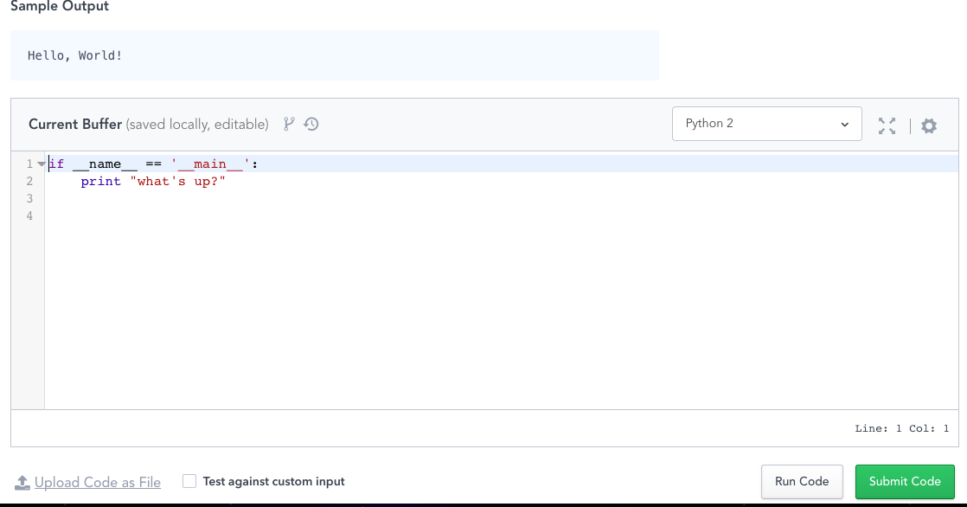
Help on the code in hackerrank
You should select Python 3 from the pulldown menu here.
This first line is for use with larger python projects that are split into multiple files. It's saying 'If this is the file you're loading do this' (This image is python2, you should use python3!)

Slide 7
Notes
You can turn in as many times as you want, I will generally only grade the last one submitted, so re-submit something if you need to.
I only see the message area when I grade items, so you should not ask for help here!

