Slide 1
DATA STRUCTURES AND ALGORITHMS DESIGN
Session-1

Slide 2
DSECLZG519-Introduction to Algorithms

Slide 3
Course Objective and Overview

Slide 4
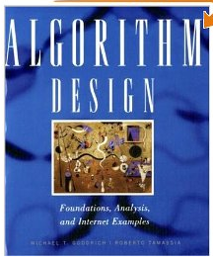
Text Book
Micheal T. Goodrich and Roberto Tamassia: Algorithm Design: Foundations, Analysis and Internet examples (John Wiley &Sons, Inc., 2006)

Slide 5
Session plan
Introduction to Algorithm
Algorithms and its specification
Random Access Machine model
Counting primitive operations
The notion of best case, average case and worst case
Use of asymptotic notation, Big-Oh, Omega and Theta notations

Slide 6
Introduction

Slide 7
What is a program?
Algorithm
An algorithm is a step-by-step procedure for solving a problem in a finite amount of time.
Data Structures
Is a systematic way of organizing and accessing data, so that data can be used efficiently.
Algorithms + Data Structures = Program

Slide 8
Algorithmic Solution
Specification of input
Specification of output
ALGORITHM
Algorithm describes actions on the input instance.
Infinitely many correct algorithm for the same problem.
Infinite number of input instances satisfying the specification.

Slide 9
What is a good algorithm?
Resources Used
Running time
Space used
Resource Usage
Measured proportional to (input) size

Slide 10
How to analyze time complexity?
Running time depends on:
Single vs multi processor
Read/write speed to memory
32 bit or 64 bit architecture
Input given to algorithm
A function which defines rate of growth of time w.r.t input

Slide 11
Measuring the running time
Write a program implementing the algorithm.
Run the program with inputs of varying size and composition.
Use a method like System.currentTimeMillis() to get an accurate measure of the actual running time.

Slide 12
Limitations of experimental studies
Implementation is a must.
Execution is possible on limited set of inputs.
If we need to compare two algorithms we need to use the same environment
(like hardware, software etc)

Slide 13
Analytical model to analyze algorithm
Algorithm should be analyzed by using general methodology.
This approach uses:
High level description of the algorithm.
Takes into account all possible inputs.
Allows one to evaluate the efficiency of any algorithm in a way that is independent of the hardware and the software environment.

Slide 14
Model machine: Random Access Machine model
Algorithms can be measured in a machine-independent way using the Random Access Machine (RAM) model.
This model assumes a single processor.
In the RAM model, instructions are executed one after the other, with no concurrent operations.
This model of computation is an abstraction that allows us to compare algorithms on the basis of performance.
The assumptions made in the RAM model to accomplish this are:
Each simple operation takes 1 time step.
Loops and subroutines are not simple operations.
Each memory access takes one time step, and there is no shortage of memory.

Slide 15
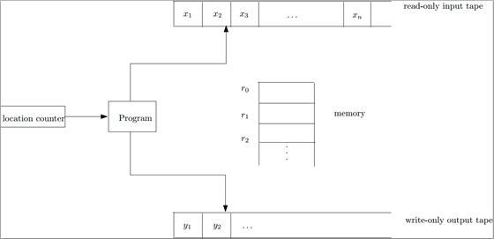
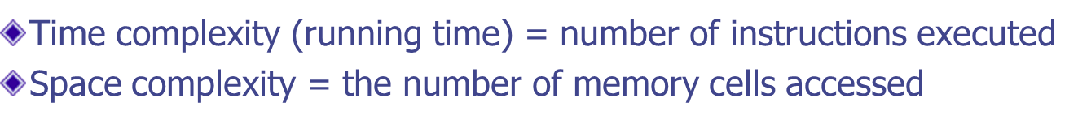
Model machine: Random Access Machine model

Slide 16
Pseudo-code
A mixture of natural language and high level programming concepts that describes the main ideas behind a generic implementation of a data structure and algorithms.
Algorithm arrayMax(A, n)
Input: An array A of n integers
Output: The maximum element of A
currentMax ←A[0]
for i ← 1 to n - 1 do
if A[i] > currentMax then currentMax ← A[i]
return currentMax

Slide 17
Pseudo-code (Some guidelines)
Is structured than usual text but less formal than a programming language.
Expressions
Use standard mathematical symbols to describe numeric and Boolean expressions.
Uses for assignment.
Use = for the equality relationship.
Method declaration
Algorithm name(param1,param2…)

Slide 18
Assumptions
Individual statement considered as “unit” time
Not applicable for function calls and loops
Individual variable considered as “unit” storage
Often referred to as “algorithmic complexity”

Slide 19
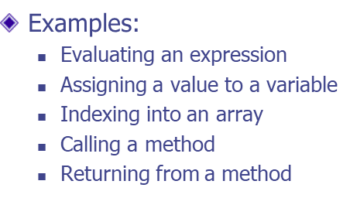
Primitive Operations
Basic computations performed by an algorithm
Identifiable in pseudocode
Largely independent from the programming language

Slide 20
Analyzing pseudocode (by counting)
For each line of pseudocode, count the number of primitive operations in it.
Pay attention to the word "primitive" here; sorting an array is not a primitive operation.
Multiply this count with the number of times this line is executed.
Sum up over all lines.

Slide 21
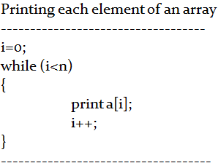
Counting primitive operations
By inspecting the pseudocode, we can determine the maximum number of primitive operations executed by an algorithm, as a function of the input size

Slide 22
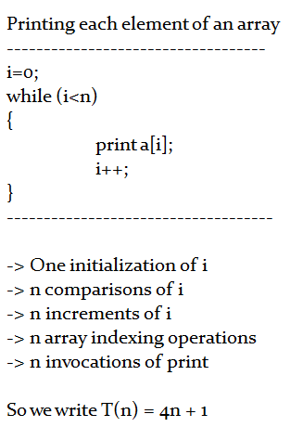
Counting primitive operations

Slide 23
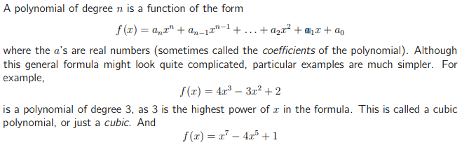
Polynomial functions
A polynomial function is a function such as a quadratic, a cubic, a quartic, and so on, involving only non-negative integer powers of x

Slide 24
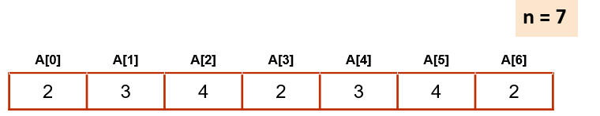
Understanding ArraySum
Algorithm ArraySum(A, n)
Sum = A [0] i = 1 while (i<n) Sum = Sum + A[i] i = i + 1 return Sum

Slide 25
Counting primitive operations
By inspecting the pseudocode, we can determine the maximum number of primitive operations executed by an algorithm, as a function of the input size
Algorithm ArraySum(A, n) | #Operations | Remarks
Sum = A [0] i = 1 while (i<n) Sum = Sum + A[i] i = i + 1 return Sum | 2 1 n 3 (n-1) 2 (n-1) 1 | Indexing , Assignment Assignment Comparison (n-1) times indexing, addition and assignment (n-1) times addition and assignment 1 times returning
Total Primitive Operations = 2 + 1 + n + 5 (n-1 ) + 1 = 4 + n + 5n - 5 = 6n -1

Slide 26
Exercise 1: Find polynomial? (10 Min)
sum(a, b)
return a+b
T(n) = 2
Algorithm arrayMax(A, n)
Input: An array A of n integers
Output: The maximum element of A
currentMax ←A[0]
for i ← 1 to n - 1 do
if A[i] > currentMax then currentMax ← A[i]
{ increment counter i }
return currentMax

Slide 27
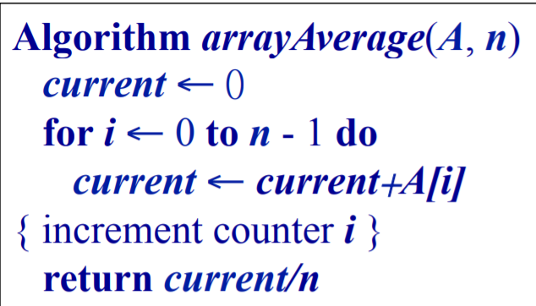
Exercise 2: Find polynomial? (10 Min)

Slide 28
Exercise 3: Find polynomial? (10 Min)
Find (a and N are input)
j = 0;
while (j < N) do
a[j] = a[j] * a[j];
b[j] = a[j] + j;
j = j + 1;
endwhile;
Notes:
numberOfEvenElements \leftarrow← 0 for currentValue \leftarrow← nextElementInA (starting from the 1st element in A) to EndOfA do if currentValue mod 2 = 0 then numberOfEvenElements \leftarrow← numberOfEvenElements + 1 return numberOfEvenElements
Line 1, numberOfEvenElements \leftarrow← 0, is 11 operation since we're assigning a value to a variable.
Line 2, for currentValue \leftarrow← nextElementInA (starting from the 1st element in A) to EndOfA do, is once again c_1 + c_2nc1​+c2​n operations for the same reasons as the previous examples.
Line 3, if currentValue mod 2 = 0 then, consists of 2n2n operations since we're performing an arithmetic operation and then comparing the result with 0 during each iteration of the loop.
Line 4, numberOfEvenElements \leftarrow← numberOfEvenElements + 1, consists of 2n2n operations since we're assumuing the worst-case input which means each element in A is even, so we're performing an arithmetic operation and assigning the result to a variable during each iteration of the loop.
Line 5, return numberOfEvenElements, consists of 11 operation since we're only returning a value from a function.
Therefore, the running time of the algorithm is:
t = 1 + c_1 + c_2n + 2n + 2n + 1 = 2 + c_1 + c_2n + 4nt=1+c1​+c2​n+2n+2n+1=2+c1​+c2​n+4n

Slide 29
Exercise 4: Find polynomial? (10 Min)
Write code to count how many elements are even numbers in the given array list.
Notes:
j = 0; | 1
while (j < N) do | N
a[j] = a[j] * a[j]; | 4 (N-1)
b[j] = a[j] + j; | 4 (N-1)
j = j + 1; | 2 (N-1)
endwhile;
----------------------------------------------------------
Put together:
1 + N + 4(N-1) + 4(N-1) + 2(N-1)
= 1 + N + 4N -4 + 4N -4 + 2N -2
= 1+ 11N -10
= 11N-9

Slide 30
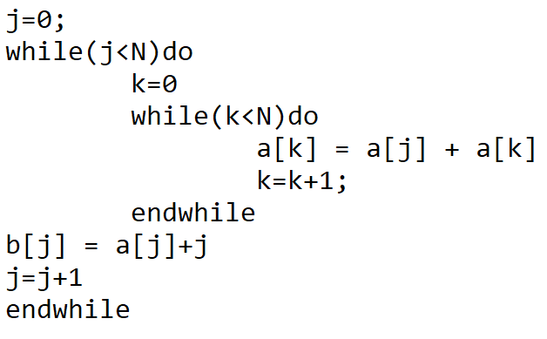
Exercise 5: Find polynomial? (10 Min)
Notes:
Leverage following URL for Maths formula expansion: https://www.chegg.com/math-solver

Slide 31
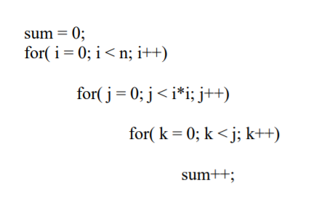
Exercise 4: Find polynomial? (10 Min)

Slide 32
Asymptotic Notations

Slide 33
Order Notation
Purpose
Capture proportionality
Machine independent measurement
Asymptotic growth
(i.e. large values of input size N)

Slide 34
Asymptotic Analysis
Goal: To simplify analysis of running time of an algorithm .eg 3n²=n².
Capturing the essence: how the running time of the algorithm increases with the size of the input in the limit.

Slide 35
Asymptotic Notations
Asymptotic Notations are languages that allow us to analyze an algorithm’s running time by identifying its behavior as the input size for the algorithm increases.
This is also known as an algorithm’s growth rate.

Slide 36
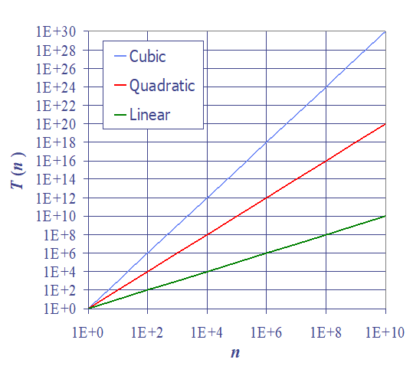
Relative performances of
Cubic, Quadratic and Linear Algorithms
Growth Rates

Slide 37
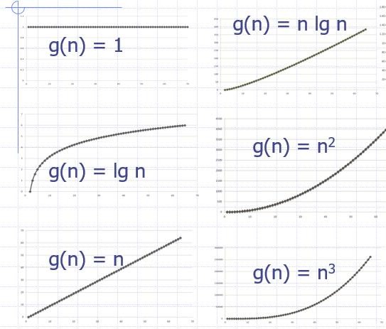
Functions Graphed using “Normal” scale
The growth rate is not affected by
constant factors or
lower-order terms
Examples
102n + 105 is a linear function
105n2 + 108n is a quadratic function

Slide 38
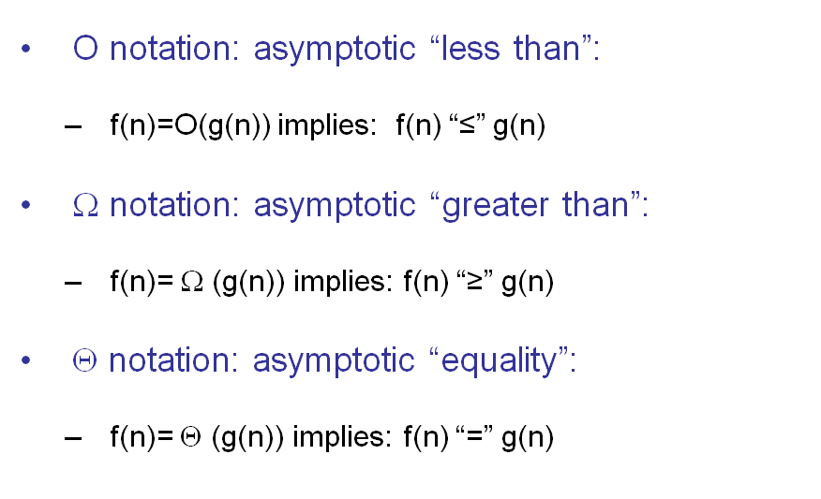
Asymptotic Notation
Upper Bound
Lower Bound
Average Bound

Slide 39
Some Examples
“The delivery will be there within your lifetime.” (big-O, upper-bound)
“I can pay you at least one dollar.” (big-omega, lower bound)
“The high today will be 25ºC and the low will be 19ºC.” (big-theta, narrow)
“It’s a kilometer walk to the beach.” (big-theta, exact)

Slide 40
Asymptotic Notation
The big O notation for worst case scenario
Definition
Let f and g be functions from the set of integers to the set of real numbers. We say that f(x) is in O(g(x)) if there are constants C > and k such that
|f(x)| ≤ C |g(x)|, whenever x > = k.
This is read as f(x) is big-oh of g(x)
Note: Pair of C and k is never unique.

Slide 41
Asymptotic Algorithm Analysis
The asymptotic analysis of an algorithm determines the running time in big-Oh notation
To perform the asymptotic analysis
We find the worst-case number of primitive operations executed as a function of the input size
We express this function with big-Oh notation
Example:
We determine that algorithm arrayMax executes at most 7n − 1 primitive operations
We say that algorithm arrayMax “runs in O(n) time”
Since constant factors and lower-order terms are eventually dropped anyhow, we can disregard them when counting primitive operations

Slide 42
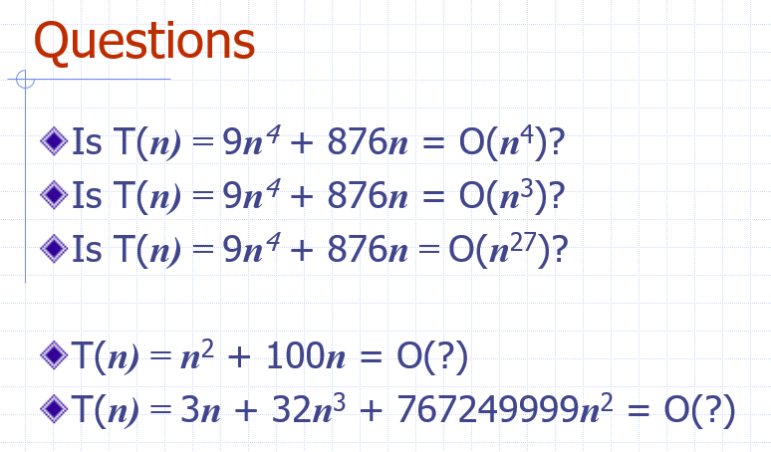
Questions

Slide 43
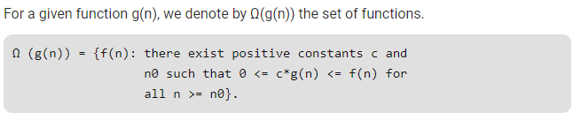
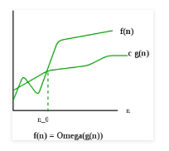
Big-Omega Ω

Slide 44

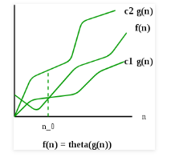
Big Θ Notation

Slide 45
Thank You!!

