Slide 1
Introductory Python
Day 2

Slide 2

Topics for Today
Input/Output
Functions
Scope
Modules

Slide 3
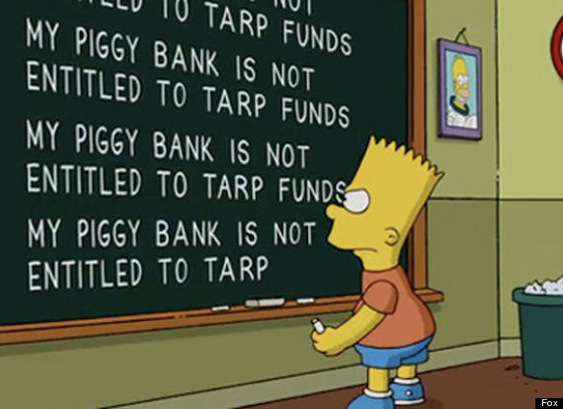
Exercise 6
Try the following code
response = input(‘message here’)
Write a program that asks for your name and then prints “hello your name” once for each letter in your name.

Slide 4
File Input & Output
Reading Files
There are 2 main ways of reading in files
Read and act on the file a line at a time
This is generally the preferred method
Read in the entire contents of the file at once
You should generally avoid this method unless you have a specific reason
For example you might do this if you want to interact with multiple separate lines at the same time

Slide 5
File Objects
Reading a file one line at a time
First you need to open a “file handle” for the file you which to read.
Then you loop over the file object. Python automatically loops a line at a time on a file object
f = open(‘filename.txt’, ‘r’)
for line in f:
print( line )

Slide 6
Read Methods
Reading in an entire file
Once you have a file handle you can read the file
x = f.read() will read the entire file in as one big string into x
x = f.readlines() will read all the lines in the file into a list
f = open(‘filename.txt’)
list_of_lines = f.readlines()
print( list_of_lines )

Slide 7
Write Methods
Writing to a file
File must be opened in ‘write mode’
f = open(‘filename.txt’, ‘w’)
x = f.write() will write a string to the next line of the file
x = f.writelines() will write a list of strings to the file
f = open(‘filename.txt’)
for i in range(10):
f.write(“line number “ + str(i))
f.close()

Slide 8
Exercise 7
Fill a text document with a series of numbers each on its own line
Write a script that will read in the numbers from this text file, calculate the sum and mean of their values and then writes the sum and mean to a second output file
Hint: sum(), len()

Slide 9
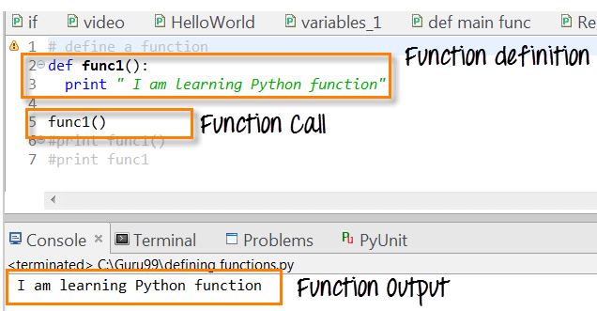
Functions
Functions take some number of arguments as input
perform an operation
Return a single output

Slide 10
Function Arguments & Return Values
def multiply(input1, input2):
'''Three quotes creates docstrings.’’’
out = input1 * input 2
return out

Slide 11
Exercise 8
Write a function that takes a string as an argument and returns the same string with every even numbered letter removed
Ex: function(“abcdefg”) = “aceg”
Hint: “ab” + “cd” = “abcd”

Slide 12
Variable Scope
x = “friendly variable”
def my_function():
x = 3.14
print(x)
What gets printed in the preceding code?

Slide 13
LEGB Rule
Local: any variable declared within a function or lambda
Enclosing: for nested functions, the next set of enclosing function locals in order
Global: variables defined at the top-level of a module or declared as “global x = 5”
Built-In: preassigned names such as sum, open etc.

Slide 14
Modules
A set of functions and executable code that can be imported into the local space.
You can write your own modules or use some of the massive amounts of pre-written modules other programmers have made available

Slide 15
Module Example
import urllib.request
response = urllib.request.urlopen(http://python.org/)
html = response.read().decode(‘utf-8’)
Import a module for retrieving websites
Call the method to open the site
Call the method to read the response into a string

Slide 16

Exercise 9
Write a program to read in all the content from a webpage and output a file with a frequency count of every unique word found on that page.
HINT: my_string.split(‘ ‘)
returns a list of all token in a string separated by whitespace
Bonus: use the library beautiful soup to remove html tags from your input

