Slide 1
Introductory Python
Day 1

Slide 2

Python
Interpreted programming language
Dynamic type system
Multiparadigm

Slide 3
About Me
Previously CIS grad student
Worked as web-developer
Worked as AI/Data person
Switched from matlab to python 2nd year of grad school and been using it ever since (5+ years)

Slide 4
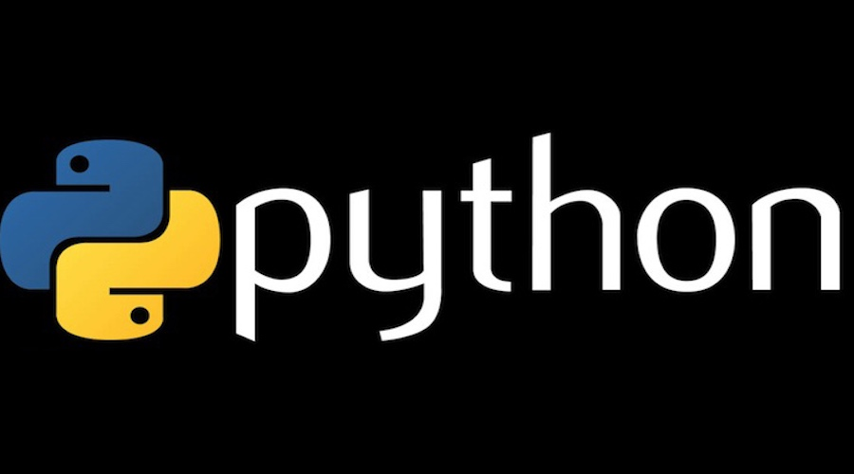
Topics for Today
Variables
Basic Types
Conditionals
Lists & Dictionaries
Loops

Slide 5
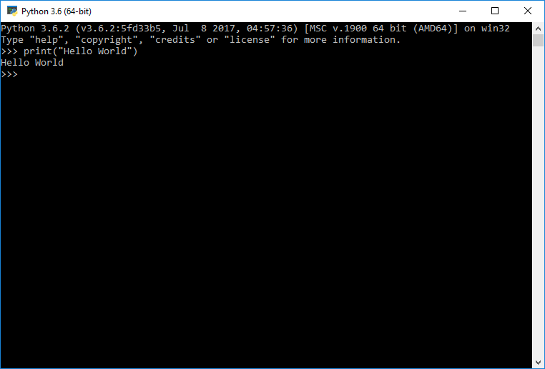
Exercise 1
Open your python interpreter
Use print() to output a message
Now transfer your code to a .py file and run the script

Slide 6
Exercise1: Hints
All platforms should be able to run scripts from the commandline using “python myscript.py”
Linux/Unix max require shebang line at the top of script file(yes its really called that)
#!/usr/bin/env/python

Slide 7
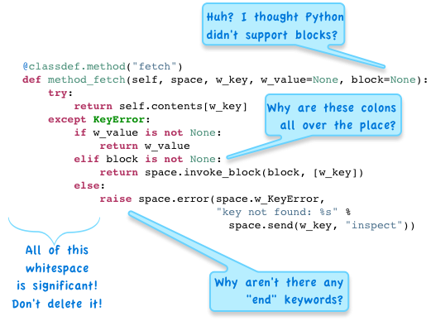
Indentation
White space matters!
Use 4 spaces for tabs in python
Most editors will do this automatically
Check out all of the other style guidelines in PEP8
http://legacy.python.org/dev/peps/pep-0008/

Slide 8
Variables
How to assign a variable:
x = 3
y = 7.8
favorite_cheese = ‘brie’
Variable names should start with a lower case letter. Case matters. Use under_scores instead of CamelCase in python
Avoid Reserved Words for variable names
Ex: “for”, “class”, “sum”, “max”

Slide 9
Outputting Variables
Try the following code
my_name = “Inigo Montoya”
print(“Hello”, my_name)
Experiment with other types of variables
Ex: my_num = 3.452

Slide 10
Variable Types
Run the following code
x = 3
y = 3.2
z = “3.2”
type(x)
This is dynamic typing python picks the variable type for you
Not all operations work for all types or give expected output
Ex: “3” * “2” or “3” * 2

Slide 11
Integers
Ex: x = 5
Basic numeric type
Negative and positive numbers
No decimal numbers
Uses magic to expand memory size as needed, no need to worry about oversized numbers

Slide 12
Floats
Ex: x = 5.15
Negative and positive numbers
Yes decimal numbers
Also magic

Slide 13
Strings
Ex: x = ‘I am a happy little string’
Basic type for dealing with all text
Can be indexed with array notation
Ex: x[2] returns “a”
Many useful methods
https://docs.python.org/3/library/stdtypes.html#string-methods

Slide 14
Converting Between Types
You will often need to convert between different types.
Ex: if you read numbers from a text file you may want to convert them from strings to ints
Functions that will convert to their respective types
int(x)
float(x)
str(x)
int(‘2’) -> 2
float(2) -> 2.0
str(2) -> ‘2’

Slide 15
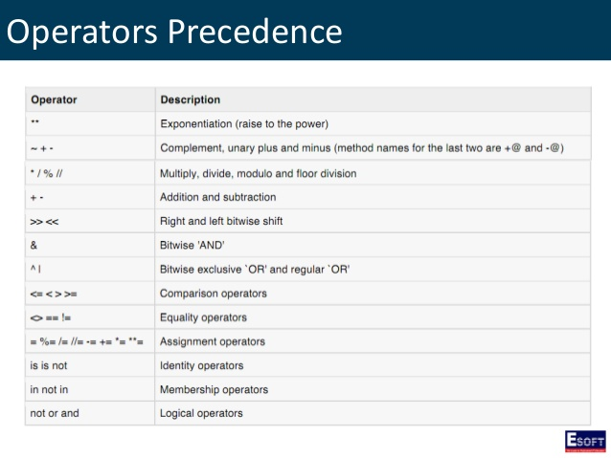

Slide 16
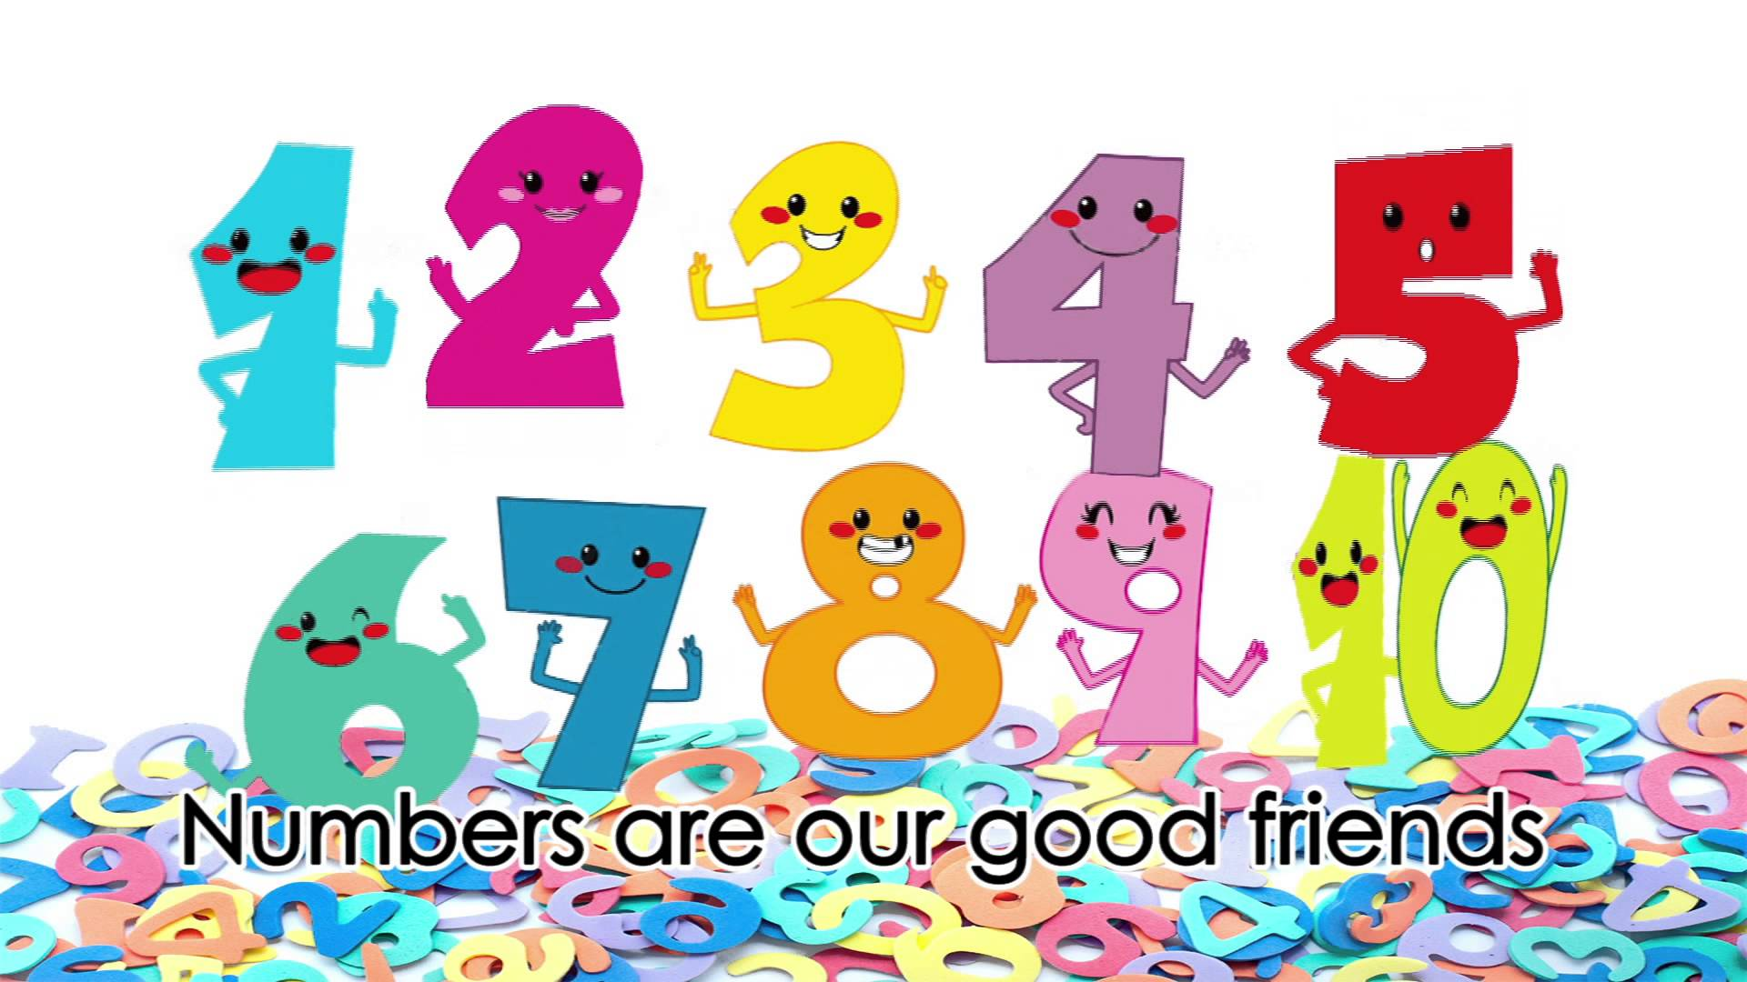
Exercise 2
Write a script that uses two arbitrary numbers and prints to output the two numbers as well as their: sum, product, quotient and remainder
Each output should be labeled
Ex: “ x = 3, y = 4 “
“ Product = 12 “

Slide 17
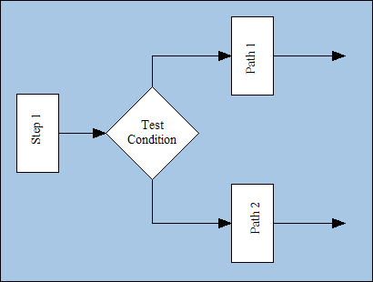
Conditionals
Conditionals
The mighty if statement
Checks the truth value of a statement
if 5 > 3:
print( ‘5 is greater!’ )
elif 5 < 3:
print( ‘5 is lesser!’ )
else:
print( ‘The same!’ )

Slide 18
Exercise 3
Write a program that outputs only the longer of two strings and its length.
Outputs the longer of two strings
And the length of the longer string
If they are equal length it outputs “I can’t decide!!”
Hint: len(my_string)

Slide 19
Lists
Lists contain ordered groups of things. They are declared with [ and ]
List1 = [1, 2, 5, 20]
List2 = [‘b’, 6, ‘brie’]
You can access items in lists based on their location
>>>List1[2]
5
>>>List2[0]
‘b’

Slide 20
Creating & Adding
Creating empty lists
List1 = []
List1 = list()
Adding items to lists
append() will add an object to the end of the list
List1.append(‘monkey’)

Slide 21
Dictionaries
Dictionaries or “dicts”
Unordered containers made up of key/value pairs
You access a value by using the key
>>>name_count_dict = {‘joe’:3, ‘bob’:2, ‘mary’:1, ‘sue’:2}
>>>print name_count_dict[‘bob’]
2
>>>name_count_dict[‘sue’] = name_count_dict[‘sue’] + 1
>>>print name_count_dict
{'bob': 2, 'joe': 3, 'mary': 1, 'sue': 3}

Slide 22
IN Keyword
The in keyword can frequently be useful when dealing with containers (ex: lists, tuples, dictionaries )
Use in to check if a value exists inside the container
<- list1 = [ 2, 6, 12 ]
<- 6 in list1
-> True
<- 4 in list1
-> False
Note: For dictionaries in checks if the value is a key

Slide 23

Exercise 4
Create your own count dictionary but this time it’s their name and number of facebook friends. Pick a person and write a statement that adds their name to a list of very important people if they have >= 100 friends or a list of unimportant people if they have < 100.
Output both lists.

Slide 24
Loops
They loop over stuff
for i in range(0,10):
print( i )

Slide 25
For Loops
Loops in python loop over each item. Not just a series of numbers
akin to foreach in other languages
example:
<-
fruits = ['apple', 'banana', 'pear']
for item in fruits:
print(item)
->
apple
banana
pear

Slide 26
Enumerate
enumerate() is handy if you want to keep track of the loop iterator
<-
for i, item in enumerate(fruits):
print(i, item)
->
(0, 'apple')
(1, 'banana')
(2, 'pear')

Slide 27
Exercise 5
Modify your code from exercise 4 to loop over all names in your friend count dictionary and add them to either the important or unimportant people list.
Hint: For loop over a dictionary returns all the key values

Slide 28
Challenge
Harris-Benedict BMR calculator
Female
Bmr = 655 + (4.3* weight lbs) + (4.7 * height inch) – (4.7 * age)
Male
Bmr = 66 + (6.3* weight lbs) + (12.9 * height inch) – (6.8 * age)
Get interactive input in a python script
“users_name = input(“please enter your name: ”)

