Slide 1
Introductory Python
Day 1

Slide 2

Topics for Today
Input/Output
Functions
Scope
Modules

Slide 3
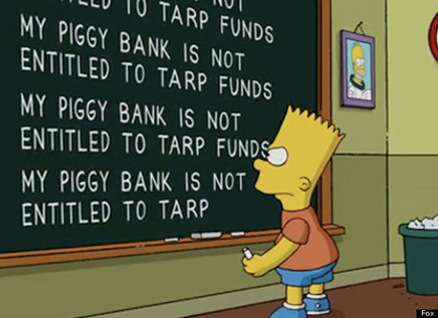
Exercise 6
Try the following code
response = input(‘message here’)
Write a program that asks for your name and then prints “hello your name” once for each letter in your name.

Slide 4
File Input & Output
Reading Files
There are 2 main ways of reading in files
Read and act on the file a line at a time
This is generally the preferred method
Read in the entire contents of the file at once
You should generally avoid this method unless you have a specific reason
For example you might do this if you want to interact with multiple separate lines at the same time

Slide 5
File Objects
Reading a file one line at a time
First you need to open a “file handle” for the file you which to read.
Then you loop over the file object. Python automatically loops a line at a time on a file object
f = open(‘filename.txt’, ‘r’)
for line in f:
print( line )

Slide 6
Read Methods
Reading in an entire file
Once you have a file handle you can read the file
x = f.read() will read the entire file in as one big string into x
x = f.readlines() will read all the lines in the file into a list
with open(‘filename.txt’) as f:
list_of_lines = f.readlines()
print( list_of_lines )

Slide 7
Write Methods
Writing to a file
File must be opened in ‘write mode’
f = open(‘filename.txt’, ‘w’)
x = f.write() will write a string to the next line of the file
x = f.writelines() will write a list of strings to the file
f = open(‘filename.txt’)
for i in range(10):
f.write(“line number “ + str(i))
f.close()

Slide 8
Exercise 7
Fill a text document with a series of numbers each on its own line
Write a script that will read in the numbers from this text file, calculate the sum and mean of their values and then writes the sum and mean to a second output file
Hint: sum(), len()

