Slide 1
COLLEGE PROJECT SUBMISSION
WhatsApp AI Lead Qualification &
Site-Visit Booking Agent
An AI agent for local plot and villa developers that chats on WhatsApp, answers questions from a knowledge base, qualifies leads, books real site visits via Cal.com, and emails the owner.
PROJECT AUTHORS (TEAM):
• Gunda Ganesh
• Guddati Rosi
• Grandhi Karthik
ACADEMIC PROGRAM & DEGREE:
Sathyabama Institute of Science and Technology
Department of Computer Science & Engineering
B.E. CSE
ACADEMIC YEAR:
2025 – 2026
PROJECT STATUS:
Working Prototype
Notes:
Good morning, respected professors, panel members, and classmates. On behalf of our project team—Gunda Ganesh, Guddati Rosi, and Grandhi Karthik from Sathyabama B.E. Computer Science and Engineering—we present our final-year engineering project: the WhatsApp AI Lead Qualification and Site-Visit Booking Agent for the academic year 2025 to 2026. This working prototype automates inbound WhatsApp chat qualification and verified site-visit scheduling for local real estate developers. Let us examine the problem.

Slide 2
CHALLENGE OVERVIEW
The Problem: High Lead Leakage
Digital ads drive high chat volume, but manual handling creates severe bottlenecks.
High WhatsApp Ad Inquiries: Dozens of inbound chats overwhelm sales reps daily.
Before: The Manual Failure Flow
1
Buyer Clicks Meta Ad
Sends inbound WhatsApp inquiry.
Slow First Response: Hours of delay cause eager buyers to cool off or leave.
2
Hours of Silence & Delay
No instant reply; customer interest cools.
Unclear Buyer Intent: Reps waste time chasing casual window-shoppers.
3
Cluttered Manual Chat
Sales rep asks ad-hoc questions.
Manual Scheduling: Clunky back-and-forth chat causes dropped site visits.
4
Lead Drops Off & Lost Sale
Buyer visits competitor; zero visit booked.
WhatsApp AI Lead Qualification & Site-Visit Booking Agent | Working Prototype
Slide 02 of 15
Notes:
Real estate developers spend significantly on Meta and Google ads that drive potential buyers directly to WhatsApp. However, because responses depend entirely on manual sales staff, incoming chats often remain unanswered for several hours or overnight. By the time a sales representative replies, the customer has cooled off or reached out to a competitor. Furthermore, sales teams waste valuable time conversing with casual browsers. Without quick qualification and easy scheduling, promising leads are regularly lost.

Slide 3
SYSTEM OVERVIEW
The Solution: Automated Qualification
Instant conversational responses that qualify buying intent and book verified site visits.
Core Concept: An AI agent that engages WhatsApp leads instantly, scores their buying readiness, and books live calendar visits automatically.
Instant Replies
Lead Scoring
Real Booking
Owner Alerts
Answers questions in seconds 24/7 using verified plot catalog data.
Categorizes buyers into Cold, Warm, or Hot based on budget and timeline.
Checks live slots and books confirmed site visits atomically via Cal.com.
Sends immediate email summaries with qualification notes and visit details.
After: The Automated Workflow
1. Inbound Lead Chat
2. Instant AI Response
3. Intent Qualification
4. Cal.com Visit Booked
5. Owner Alert Emailed
WhatsApp AI Lead Qualification & Site-Visit Booking Agent | Working Prototype
Slide 03 of 15
Notes:
Our solution replaces the broken manual workflow with a continuous automated pipeline. When a customer messages our WhatsApp number, the Fastify server and Gemini AI agent respond within seconds. The agent conducts a polite, structured conversation to assess budget and timeline, checks real-time availability on Cal.com, completes an atomic site-visit reservation, and alerts the business owner by email. This guarantees zero lead leakage and frees the sales team to focus on high-priority buyers.

Slide 4
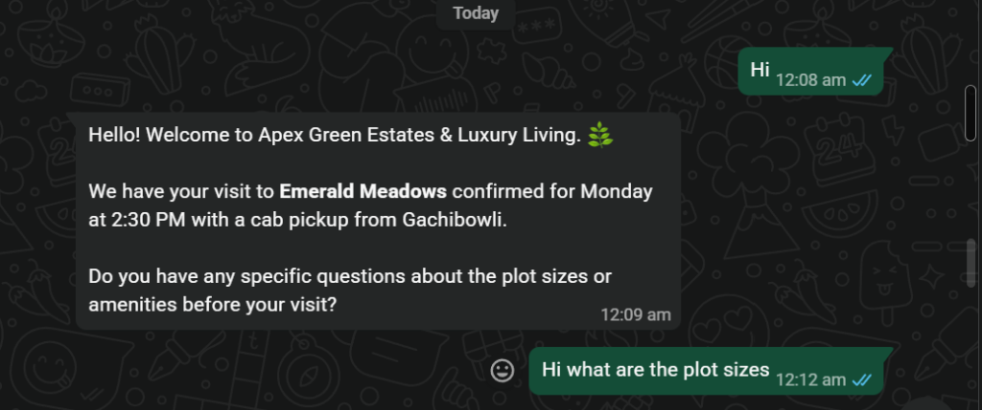
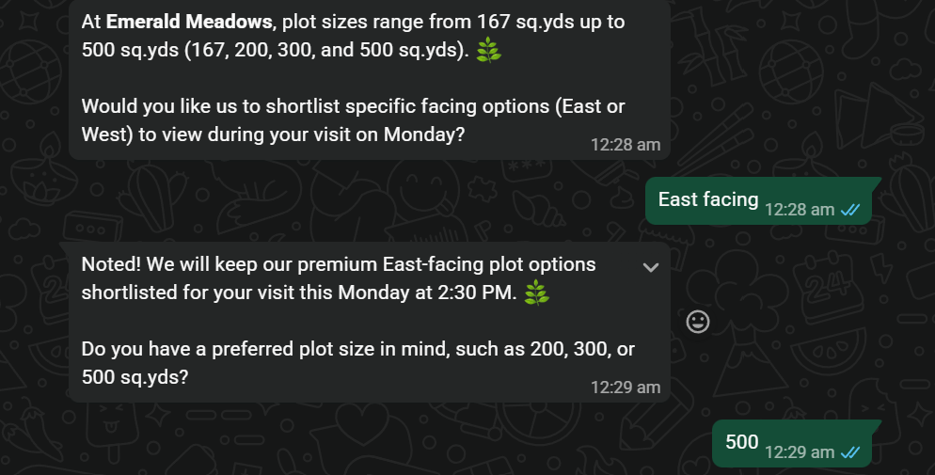
LIVE DEMO EVIDENCE
Live Results: Lead Intake & Discovery
Real WhatsApp test turn showing instant greeting, catalog query, and buyer preference capture.
Turn Analysis & Tool Execution
Instant Intake: Replies in seconds welcoming lead to Apex Green Estates with visit context.
Dynamic Database Lookup: Calls get_site_details to retrieve exact sizes (167 to 500 sq.yds) from Supabase.
Facing Preference Captured: Shortlists East-facing plots upon lead request for Monday visit.
Unit Size Selection: Customer selects 500 sq.yds; agent locks choice into session memory.
Zero Hallucinations: All plot metrics match verified database records with zero guessing.
WhatsApp AI Lead Qualification & Site-Visit Booking Agent | Working Prototype
Slide 04 of 15
Notes:
On this slide, we examine the live results from our WhatsApp test session. When the lead sends an initial greeting, the agent immediately responds with property context and welcomes the customer to Apex Green Estates. When the buyer inquires about plot sizes, the agent queries our Supabase catalog and returns the exact range of one hundred sixty-seven to five hundred square yards. The lead then specifies an East-facing five hundred square yard plot, which our agent records.

Slide 5
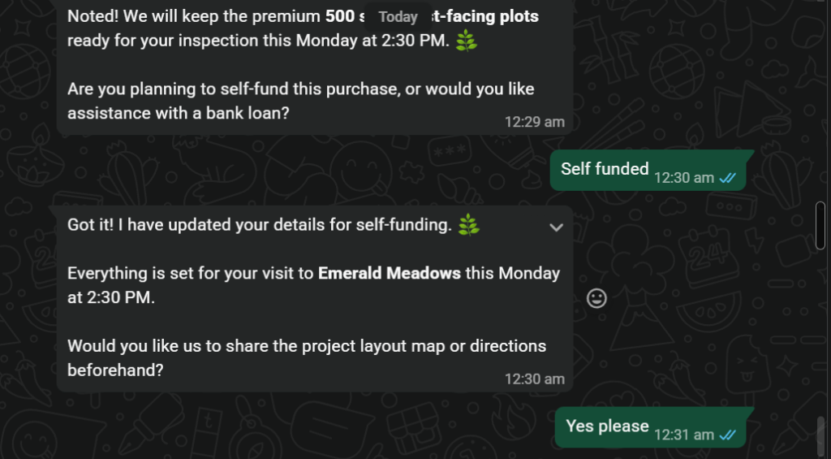
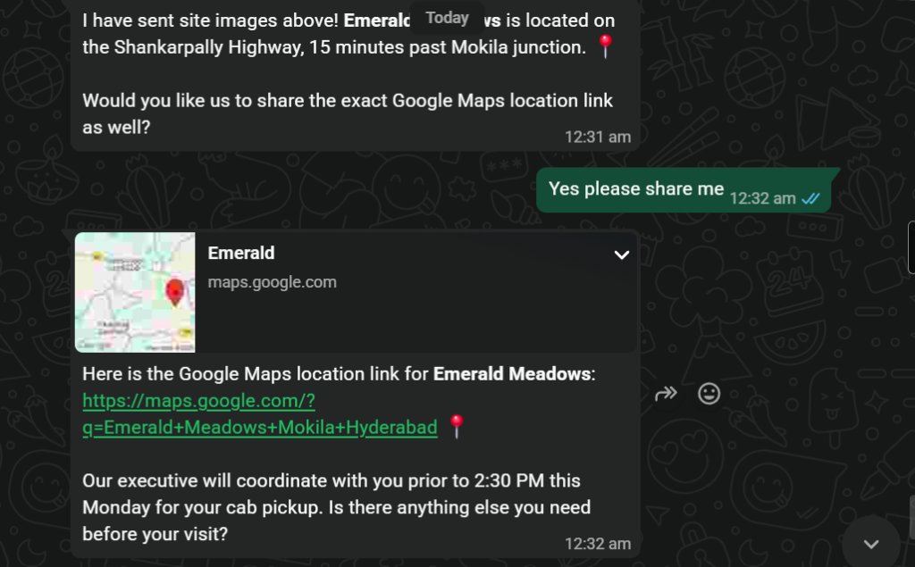
QUALIFICATION & MEDIA
Live Results: Qualification & Media Delivery
Assessing financing mode, sharing project directions, and delivering interactive Google Maps card.
Qualification & Logistics Highlights
Financial Qualification: Agent proactively asks: self-funding vs bank loan assistance.
PostgreSQL Update: Executes update_lead tool to score buyer as verified self-funded.
Multi-Media Dispatch: Sends site layout masterplans via WhatsApp Cloud media API.
Google Maps Card: Generates live Google Maps pin for Emerald Meadows on Shankarpally Highway.
Concierge Coordination: Notifies lead that an executive will coordinate cab pickup from Gachibowli.
WhatsApp AI Lead Qualification & Site-Visit Booking Agent | Working Prototype
Slide 05 of 15
Notes:
Continuing the live test turn, the agent proceeds to financial qualification by asking whether the purchase will be self-funded or bank-financed. When the buyer confirms self-funding, the database lead record is immediately updated with this score. Next, the agent shares property images, detailed directions along Shankarpally Highway, and an interactive Google Maps location card. This demonstrates how generative AI combines structured data qualification with rich visual media delivery directly within the WhatsApp interface.

Slide 6
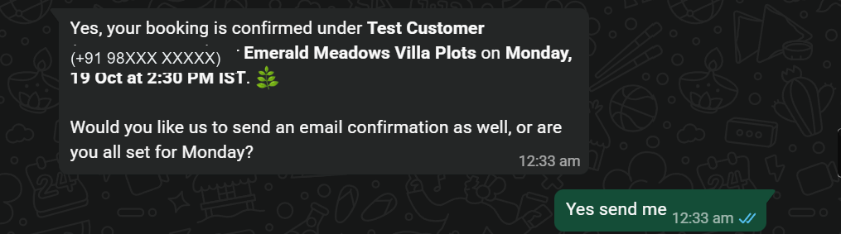
CONFIRMED BOOKING
Live Results: Confirmed Visit & Calendar Lock
Final atomic booking confirmation dispatched on WhatsApp with complete visit logistics.
1. Cal.com Calendar Lock
2. Automated Owner Alert
3. Concierge Logistics
• Slot reserved atomically via Cal.com API v2.
• Confirmed for Monday, 19 Oct at 2:30 PM IST.
• Zero double-booking or slot collision risk.
• Instant email sent to business owner inbox.
• Includes buyer name, budget, plot choice, & time.
• Direct Cal.com appointment inspection link.
• Complimentary cab pickup from Gachibowli.
• Executive coordination scheduled prior to visit.
• Email confirmation offered and queued.
WhatsApp AI Lead Qualification & Site-Visit Booking Agent | Working Prototype
Slide 06 of 15
Notes:
Finally, here is the confirmed site-visit booking result. The agent locks in the appointment for Monday, October nineteenth at two-thirty PM IST under Test Customer, with a complimentary cab pickup arranged from Gachibowli. The agent also offers to dispatch a formal email confirmation. Notice that this message is only dispatched after Cal.com confirms the slot atomically. This proves the full end-to-end loop: intake, qualification, media delivery, and verified calendar scheduling without human intervention.

Slide 7
ARCHITECTURE
System Architecture & Data Flow
Bidirectional message flow across Meta Cloud API, Fastify server, Supabase, and Cal.com
Supabase PostgreSQL
Leads, Catalog, Events & RLS
CORE BACKEND
Fastify Server
HMAC Webhook Verify
LEAD
Customer on
WhatsApp
Mobile / Web
WhatsApp Cloud API
(Meta Gateway)
• Webhooks Out
• Graph API In
Cal.com API
Real-time Slot Booking
< ---- >
< ---- >
Debounce Queue
3s Burst Accumulator
Nodemailer SMTP
Owner Lead Alerts
Gemini AI Agent
Function Calling Engine
Admin REST API
Inspection & Metrics
WhatsApp AI Lead Qualification & Site-Visit Booking Agent | Working Prototype
Slide 07 of 15
Notes:
Here is our system architecture diagram. A lead sends a WhatsApp message which reaches Meta's WhatsApp Cloud API. Meta triggers our Fastify backend webhook over an HTTPS tunnel. The server cryptographically validates the signature, stores the event in Supabase, and pushes it into an in-memory queue with a three-second debounce window. Our worker claims the job and executes the Gemini AI agent. The agent calls registered tools to query Supabase, check Cal.com slots, send replies via Meta's Graph API, and email the owner.

Slide 8
PIPELINE WALKTHROUGH
How One Message is Processed: The 7-Step Pipeline
From inbound HTTP webhook to asynchronous AI execution and confirmed response dispatch.
1
Webhook Received & Verified
Fastify endpoint validates the HMAC-SHA256 signature in the x-hub-signature-256 header using the Meta app secret.
Agent Tool Execution Loop
Gemini reasoning evaluates conversation history and invokes specific registered tools (knowledge, scoring, calendar).
5
2
Persisted to Database Queue
The raw JSON payload is recorded in inbound_events table and acknowledged to Meta with 200 OK in under 200ms.
WhatsApp Reply Dispatched
The formatted text and optional media attachments are sent back to the customer via Meta WhatsApp Cloud API.
6
3
Worker Debounce & Claim
An asynchronous worker waits 3 seconds to aggregate rapid successive messages, then acquires an atomic row lock.
Owner Notification & Audit
Lead status updates trigger an instant email summary to the business owner, and actions are logged to audit_log.
Audio Transcription Check
If the incoming message is an audio voice note, Gemini multimodal audio API transcribes it into text before proceeding.
7
4
WhatsApp AI Lead Qualification & Site-Visit Booking Agent | Working Prototype
Slide 08 of 15
Notes:
To understand how a message moves through the system, we trace seven sequential steps. A webhook is an automated HTTP callback sent when an event occurs. When Meta hits our webhook, we verify its signature to reject unauthorized requests. We store the raw payload and immediately reply with HTTP 200 so Meta does not retry. A background worker waits three seconds to group rapid messages, transcribes voice notes if needed, runs the Gemini agent with tools, sends the WhatsApp reply, and alerts the owner.

Slide 9
INTELLIGENCE LAYER
The AI Agent: Function Calling in Plain Language
Strict architectural separation: The language model decides; our code executes.
WHAT IS FUNCTION CALLING? The AI model never touches external APIs directly. The model asks for an action in structured JSON ("Call book_site_visit with slot 10 AM"); our TypeScript code validates permissions, executes the API call, and passes the result back to the model.
1. Knowledge & Site Lookup (3 Tools)
2. Media Delivery (1 Tool)
• search_knowledge: Queries FAQ database
• list_sites: Fetches active projects from DB
• get_site_details: Retrieves pricing & unit sizes
• send_site_images: Sends verified property photos, layout masterplans, and site maps via WhatsApp media messages.
3. Lead Management (2 Tools)
4. Calendar & Handoff (4 Tools)
• update_lead: Updates budget, timeline, & purpose
• classify_lead: Assigns Cold, Warm, or Hot rating based on verified conversation criteria.
• check_availability: Live slots via Cal.com
• book_site_visit: Atomic calendar lock
• reschedule_or_cancel_visit: Modifies visits
• handoff_to_human: Flags complex inquiries
Factual Guardrail: The agent answers only from stored Supabase database records. It never hallucinates prices or unverified amenities.
WhatsApp AI Lead Qualification & Site-Visit Booking Agent | Working Prototype
Slide 09 of 15
Notes:
Let us define function calling in simple terms: the AI model asks, and our code does. In this architecture, the Gemini model never accesses our database or the internet directly. Instead, the model issues a structured request asking to run a specific function with parameters. Our TypeScript code inspects the request, queries Supabase or Cal.com, and feeds the factual result back. Across ten registered tools, the agent is strictly prohibited from guessing; it answers only from verified database records.

Slide 10
QUALIFICATION LOGIC
Lead Qualification: The 4-Question Scoring Engine
Categorizing leads into Cold, Warm, and Hot tiers with colloquial Indian budget normalization.
STRUCTURED QUESTION ORDER: 1. Budget Range -> 2. Purchase Timeline -> 3. Purchase Purpose (Self-use / Investment) -> 4. Financing Mode
COLD LEAD
WARM LEAD
HOT LEAD
• Just browsing or exploratory
• No defined timeline (> 6 months)
• Unwilling to share budget
• Action: Polite automated answers, no sales escalation
• Concrete interest & known budget
• Timeline within 1 to 3 months
• Exploring multiple site options
• Action: Offer brochure, follow up in 24 hours
• Immediate buying intent (< 30 days)
• Clear budget matching available inventory
• Requests or agrees to in-person site visit
• Action: Immediate Cal.com booking & email alert
INDIAN BUDGET PARSER (Regex & Numeric Normalizer in Code):
Buyers write colloquially: "1core" -> parsed as ₹1,00,00,000 | "50-60 lakhs" -> parsed as ₹50,00,000 - ₹60,00,000 | "80L" -> ₹80,00,000.
Our custom parser maps local Indian terminology into clean numerical integers so lead filtering works deterministically.
WhatsApp AI Lead Qualification & Site-Visit Booking Agent | Working Prototype
Slide 10 of 15
Notes:
Lead qualification follows a structured sequence: budget, timeline, purchase purpose, and financing mode. The agent assigns every buyer to Cold, Warm, or Hot tiers using strict criteria. Hot leads exhibit immediate intent and book visits. Warm leads have valid budgets but longer purchase timelines, while Cold leads are casual browsers. A critical feature is our custom Indian budget parser: it accurately converts informal inputs like '1core', '80L', or '50-60 lakhs' into numeric rupee values for precise filtering.

Slide 11
BOOKING ENGINE
Live Booking & Real-Time Notification Architecture
Atomic calendar reservation with Cal.com and automated owner alerts respecting WhatsApp policies.
1. Cal.com Live Slots
2. Atomic Booking
3. Owner Lead Alerts
Dynamic Availability
Guaranteed Confirmation
Zero Lead Leakage
• Agent queries live available slots via Cal.com API v2.
• Respects developer schedule, buffer times, and holidays.
• No double bookings or scheduling conflicts.
• The agent requests a slot lock via API.
• Confirmation message sent ONLY after Cal.com returns booking ID.
• Webhook keeps Supabase in sync if rescheduled via email.
• Instant email sent to developer when Hot lead emerges.
• Includes buyer name, phone, budget, timeline, and slot.
• Direct link to view booking in Cal.com dashboard.
WhatsApp Platform Compliance: The 24-Hour Messaging Window
• Customer-Initiated Window: Meta allows free-form conversational replies only within 24 hours of the lead's last incoming message.
• Post-24h Template Messages: Site-visit reminders scheduled for days ahead use Meta-approved pre-registered message templates.
• Fail-Safe Outbox: Outbound notifications are staged in database tables so connection glitches never result in lost messages.
WhatsApp AI Lead Qualification & Site-Visit Booking Agent | Working Prototype
Slide 11 of 15
Notes:
Scheduling site visits requires atomic accuracy. We integrate directly with Cal.com's live API to query available slots based on the real estate team's calendar. WhatsApp confirmation is strictly atomic: the confirmation message is sent only after Cal.com verifies the booking ID. If a user reschedules or cancels via email, Cal.com webhooks keep our database synchronized. Furthermore, all follow-up reminders respect WhatsApp's mandatory twenty-four-hour customer service window by utilizing pre-approved Meta message templates.

Slide 12
DEFENSIVE ENGINEERING
System Reliability, Resilience & Security
Defensive engineering safeguards: webhook verification, concurrency control, and prompt defenses.
Signed Webhooks
Decoupled Queue
Duplicate Protection
Burst Debounce
HMAC-SHA256
Fast 200 OK
Idempotency
3-Second Window
Verifies Meta app secret signatures; rejects spoofed requests instantly.
Meta receives a 200 OK under 200ms; worker processes asynchronously.
Inbound message IDs tracked in PostgreSQL; duplicate deliveries ignored.
Aggregates rapid multi-message bursts into a single unified agent turn.
Database RLS
Atomic Booking
Model Failover
Injection Defense
Supabase Security
Race Condition Safe
Exponential Retries
Prompt Isolation
Row-level security policies isolate customer data across all tables.
Database row locks and Cal.com slot reservations prevent double booking.
Automated fallback to secondary models if primary API encounters rate limits.
System instructions isolated from user chat text to resist prompt injection.
WhatsApp AI Lead Qualification & Site-Visit Booking Agent | Working Prototype
Slide 12 of 15
Notes:
Reliability and defensive engineering were core requirements. Every webhook is verified using HMAC-SHA256 signatures, ensuring only Meta can trigger our endpoints. Our asynchronous queue acknowledges requests under two hundred milliseconds so Meta never retries unnecessarily. A three-second debounce window buffers rapid consecutive messages into a single prompt. We also enforced database row-level security, exponential API retries, prompt injection protections, and a persistent email outbox to guarantee delivery even during network failures.

Slide 13
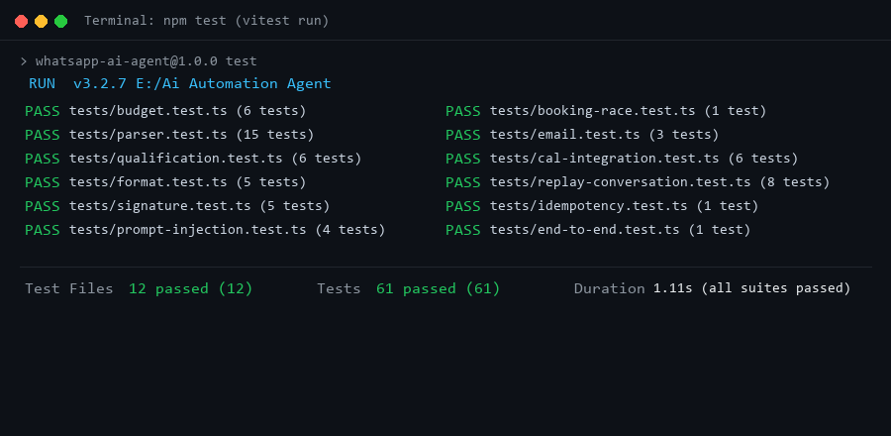
STACK & VALIDATION
Technology Stack & Rigorous Testing
Production-grade TypeScript tooling backed by 61 automated tests and live end-to-end trials.
TypeScript
Type Safety
Fastify
Web Server
Supabase
PostgreSQL & RLS
Gemini 2.5
AI Model & Vision
WhatsApp API
Meta Cloud API
Cal.com
Scheduling V2
Nodemailer
SMTP Alerts
TEST VERIFICATION: 61 Automated Unit & Integration Tests across 12 suites (Vitest). Mocks external APIs to test signature checks, queue debouncing, budget regex, tool routing, and failure recovery. Zero regressions.
End-to-End Live Validation
Live Meta Webhook: Verified with real WhatsApp test devices over HTTPS tunnel.
Cal.com V2 Booking: Live calendar slot reservations verified in Cal.com dashboard.
SMTP Outbox: Email delivery confirmed to business owner destination inbox.
Deterministic Mocking: Vitest mocks isolate network latency for deterministic CI runs.
WhatsApp AI Lead Qualification & Site-Visit Booking Agent | Working Prototype
Slide 13 of 15
Notes:
Our technology stack pairs Node.js and TypeScript on Fastify with Supabase PostgreSQL, Gemini Flash, Cal.com, and Meta's WhatsApp Cloud API. Quality assurance was verified through two rigorous testing layers. First, sixty-one automated unit and integration tests across twelve suites test all core logic, including budget parsing and message queuing, using mocked external APIs, as shown in the terminal test output. Second, we conducted comprehensive manual end-to-end tests using real WhatsApp devices and Cal.com bookings.

Slide 14
LIMITATIONS & ROADMAP
Current Limitations & Future Engineering Roadmap
Honest assessment of prototype boundaries and clear roadmap for production scalability.
Current Prototype Boundaries
Future Engineering Roadmap
Local Host & Tunnel: Runs locally on a laptop via temporary Cloudflare tunnel.
Cloud Container Hosting: Deploy to AWS / GCP via Docker with managed Redis.
Free-Tier AI Quotas: Free-tier Gemini quotas limit peak concurrent messages.
Human Agent Dashboard: Build a Next.js web portal allowing live chat takeovers.
No Human Inbox UI: No live graphical chat dashboard for sales staff to intervene.
Enterprise CRM Connectors: Sync deals with Salesforce, HubSpot, or Zoho in real time.
Single-Instance Queue: In-memory debounce queue runs on a single Node process.
Multi-Tenant Support: Partition credentials to host multiple real estate agencies.
Seeded Demo Inventory: Uses seeded demo plots and villas in Supabase.
Privacy & Retention Rules: Automated data deletion compliant with DPDP regulations.
WhatsApp AI Lead Qualification & Site-Visit Booking Agent | Working Prototype
Slide 14 of 15
Notes:
As an honest engineering submission, we clearly acknowledge this is a working prototype. Currently, it runs on a local development laptop using a temporary Cloudflare tunnel, operates under free-tier AI rate limits, and uses demo real estate data without a visual human chat inbox. In our future work roadmap, we plan to containerize the server for cloud hosting, build a live human-agent handover dashboard, add enterprise CRM integrations, and implement multi-tenant support for multiple businesses.

Slide 15
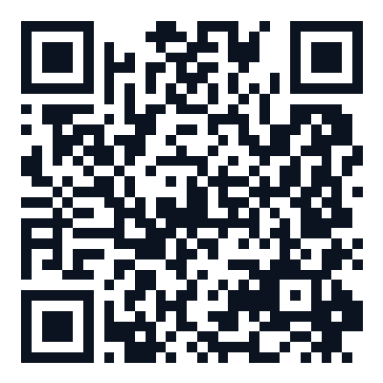
PROJECT WRAP-UP
Conclusion & Submission Summary
Practical AI automation delivering concrete operational value to local businesses.
Key Takeaways & Engineering Learnings
Project Repository & Demo
1. Solves a Real Business Pain Point
Transforms noisy, delayed WhatsApp advertising inquiries into instant, structured lead scoring and verified in-person site visits.
2. Grounded AI without Hallucinations
Proves that function calling with strict schema definitions and localized database lookups prevents hallucinated pricing and amenities.
3. Resilient Engineering Architecture
Demonstrates defensive asynchronous patterns: cryptographic HMAC validation, queue debouncing, atomic slot reservations, and automated tests.
PROJECT AUTHORS:
Gunda Ganesh • Guddati Rosi • Grandhi Karthik
Sathyabama Institute of Science and Technology (B.E. CSE)
GitHub Repository (2025–2026):
https://github.com/bunnyrams69/AI_Automation_Agent
WhatsApp AI Lead Qualification & Site-Visit Booking Agent | Working Prototype
Slide 15 of 15
Notes:
In conclusion, this project demonstrates how combining generative AI with disciplined software engineering solves a genuine operational headache for local businesses. By coupling Gemini function calling with robust queuing, signature verification, and Cal.com scheduling, we turn chaotic WhatsApp chats into confirmed customer visits. The full TypeScript source code, migration scripts, and test suites are available on GitHub via the QR code on the screen. Thank you very much for your time, and I welcome any questions.

Slide 16
APPENDIX A
Appendix A: Relational Database Schema Overview
10 interconnected PostgreSQL tables managed in Supabase with foreign key integrity and RLS.
1. Core Leads & Messaging
2. Business Knowledge Base
3. Operations & Auditing
leads
id, phone, name, status, qualification_score, budget_min, budget_max, timeline
sites
id, name, location, price_min, price_max, plot_sizes_sqft, amenities, status
site_visits
id, lead_id (FK), site_id (FK), cal_booking_id, scheduled_at, status
conversations
id, lead_id (FK), channel, status, last_message_at, metadata
follow_ups
id, lead_id (FK), scheduled_for, template_name, status, sent_at
knowledge_base
id, category, question, answer, tags, embedding, is_active
messages
id, conversation_id (FK), direction (in/out), content, tool_calls, created_at
email_outbox
id, recipient, subject, body, status, attempts, sent_at
inbound_events
id, event_id, payload, status, attempts, last_error, locked_at
Foreign Key Relations:
• conversations.lead_id -> leads.id
• messages.conversation_id -> conversations.id
• site_visits.lead_id -> leads.id
• site_visits.site_id -> sites.id
audit_log
id, event_type, entity_id, actor, payload, created_at
WhatsApp AI Lead Qualification & Site-Visit Booking Agent | Working Prototype
Appendix A
Notes:
Appendix A illustrates our relational database schema implemented in Supabase PostgreSQL across ten tables. At the center is the leads table, which connects directly to conversations and messages. Inbound events handle queue idempotency and retry locking. The sites and knowledge base tables hold our property catalog and answering context. Operational tables including site visits, follow-ups, email outbox, and audit logs ensure complete traceability and atomic execution across every customer interaction.

Slide 17
APPENDIX B
Appendix B: Service Configuration Variables
Environment variables grouped by service boundary. All secrets sanitized for public submission.
1. Server & Networking
2. Meta WhatsApp Cloud API
PORT: Port number for Fastify server (default: 3000)
NODE_ENV: Environment mode (development / production)
APP_BASE_URL: Public tunnel URL for Meta webhooks
WEBHOOK_VERIFY_TOKEN: Shared secret for Meta webhook challenge
WHATSAPP_PHONE_NUMBER_ID: Meta Graph API Sender Phone ID
WHATSAPP_BUSINESS_ACCOUNT_ID: Meta Business Manager Account ID
WHATSAPP_ACCESS_TOKEN: Meta System User permanent API token
META_APP_SECRET: Secret for HMAC-SHA256 signature verification
3. Supabase Database & Security
4. AI Engine & Calendar / SMTP
SUPABASE_URL: Hosted PostgreSQL endpoint URI
SUPABASE_ANON_KEY: Public client key with RLS enforcement
SUPABASE_SERVICE_ROLE_KEY: Privileged backend key for worker execution
GEMINI_API_KEY: Google AI Studio Gemini API key
CALCOM_API_KEY: Cal.com V2 booking API credential
CALCOM_EVENT_TYPE_ID: Site-visit calendar event type identifier
OWNER_NOTIFICATION_EMAIL: Destination inbox for hot-lead alerts
WhatsApp AI Lead Qualification & Site-Visit Booking Agent | Working Prototype
Appendix B
Notes:
Appendix B details the configuration variables required across each external service boundary, strictly omitting secret values. The server requires port and webhook verification tokens. Meta WhatsApp requires phone number IDs and HMAC app secrets. Gemini requires an API key and model identifier. Supabase requires service role keys for backend queries, while Cal.com and SMTP require scheduling and email credentials. All sensitive tokens are managed via environment variables and excluded from Git.

