Slide 1

DEPARTMENT OF COMPUTER SCIENCE AND ENGINEERING
Professional Training I
REAL ESTATE AI SALES & MARKETING AUTOMATION AGENT
An AI-Powered Platform for Intelligent Lead Management, Customer Engagement and Site Visit Automation
PROJECT STUDENTS
1. GUNDA GANESH (Reg: 44110224)
2. G. ROSI (Reg: 44110219)
3. G. KARTHIK (Reg: 44110218)
INTERNAL GUIDE
Dr. V. Nirmala Devi, M.Tech., Ph.D.
Assistant Professor, CSE
Department of Computer Science and Engineering
3 November 2026
School of Computing - CSE
1

Slide 2
AGENDA
• Course Certificate
• Abstract
• Introduction & Problem Statement
• Project Objectives
• System Architecture / Ideation Map
• Customer Enquiry & Execution Workflow
• Module Implementation (Modules 1 – 4)
• Module Implementation (Modules 5 – 7)
• Database Schema & Technology Stack
• Results, Verification & Discussions
• Project Output & Live Execution
• Conclusion & Future Enhancements
• References
3 November 2026
School of Computing - CSE
2

Slide 3
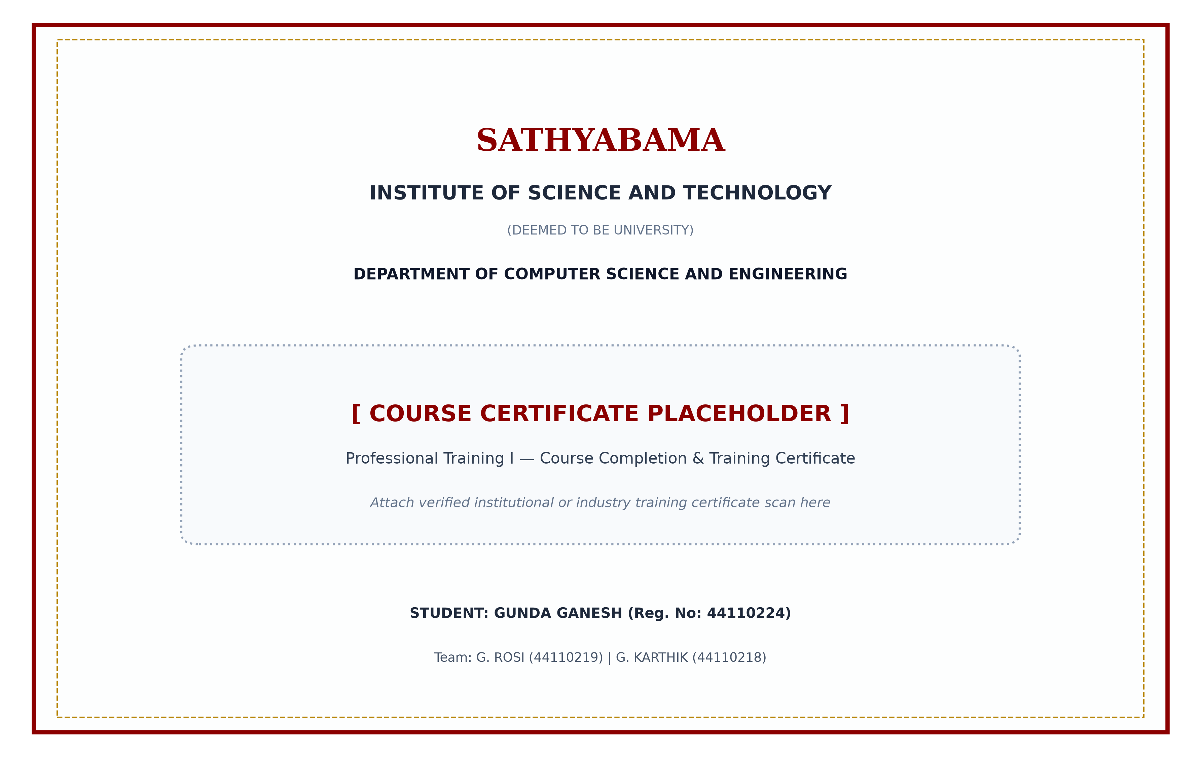
COURSE CERTIFICATE
[ COURSE CERTIFICATE PLACEHOLDER ]
Professional Training I — Certification Document
Student: GUNDA GANESH (44110224) | Team: G. ROSI (44110219), G. KARTHIK (44110218)
3 November 2026
School of Computing - CSE
3

Slide 4
ABSTRACT
Traditional real estate sales operations suffer from severe lead leakage due to manual qualification delays, slow customer response times, and disjointed appointment coordination. In modern property markets, prospective buyers expect instantaneous responses via messaging platforms like WhatsApp. Response latency exceeding minutes often results in lost buyer interest and drastically diminished conversion rates.
This project presents the Real Estate AI Sales & Marketing Automation Agent, an enterprise-grade autonomous system developed to streamline property marketing and lead management. Built on a high-performance Python FastAPI backend, the platform integrates with the official Meta WhatsApp Business Cloud API via secure, idempotency-protected webhooks ensuring 100% reliable inquiry capture with zero dropped events.
At the core is an advanced LLM Conversation Engine (OpenRouter Llama 3.3 70B) operating with deterministic tool-calling to extract buyer constraints (budget, BHK, locality, timeline, and funding). An automated Lead Qualification Engine calculates lead scores to categorize prospects into HOT, WARM, and COLD tiers, queries verified properties in Supabase PostgreSQL, schedules site visits via Cal.com API v2, and tracks follow-ups. Validated by 27 automated tests, the agent eliminates human delay and delivers 24/7 autonomous sales conversion.
3 November 2026
School of Computing - CSE
4

Slide 5
INTRODUCTION
Real Estate Lead Management Challenges:
• High Inbound Enquiry Latency: Inbound digital ad leads suffer from slow manual responses; delays beyond 5 minutes exponentially increase lead drop-off rates.
• Manual & Subjective Lead Qualification: Human sales agents ask repetitive screening questions, causing inconsistent buyer qualification and data omissions.
• Inefficient Inventory Matching: Finding properties matching exact budget ranges, localities, and BHK configurations from hundreds of listings creates bottlenecks.
• Friction in Site Visit Coordination: Manual back-and-forth phone calls lead to schedule overlaps, miscommunication, and high visit no-show rates.
• Neglected Pipeline & Poor Follow-up Discipline: Sales agents routinely forget to follow up with Warm or Cold leads, resulting in substantial revenue leakage.
The AI Automation Solution:
• An autonomous 24/7 conversational sales agent on WhatsApp that immediately engages prospects, extracts exact requirements, scores and segments leads, matches verified inventory, and books calendar-synchronized site visits with zero human delay.
3 November 2026
School of Computing - CSE
5

Slide 6
OBJECTIVE
1. Omnichannel WhatsApp Ingestion: Ingest customer inquiries 24/7 via Meta WhatsApp Cloud API with HMAC-SHA256 signature verification and idempotency deduplication.
2. Autonomous AI Conversation Engine: Develop an intelligent LLM dialogue agent using OpenRouter (Llama 3.3 70B) for natural language understanding and function execution.
3. Automated Requirement Extraction: Parse unstructured messages into structured buyer criteria including property type, budget, bedrooms, preferred locality, and timeline.
4. Multi-Factor Lead Qualification: Calculate dynamic lead scores and classify prospects into HOT (immediate buyer), WARM (3-6 month window), and COLD (exploratory) tiers.
5. Dynamic Property Matching: Query verified PostgreSQL inventory in real time to recommend matching villas and apartments with pricing, details, and visuals.
6. Automated Site Visit Scheduling: Integrate Cal.com API v2 to check real-time availability, prevent appointment overlaps, book inspections, and issue email confirmations.
7. Intelligent Follow-Up Management: Schedule automated CRM follow-up tasks according to lead classification, automatically suppressing reminders when visits are booked.
8. Audit Logging & Sales Analytics: Record end-to-end conversation histories, AI decision logs, and buyer profiles for complete administrative transparency.
3 November 2026
School of Computing - CSE
6

Slide 7
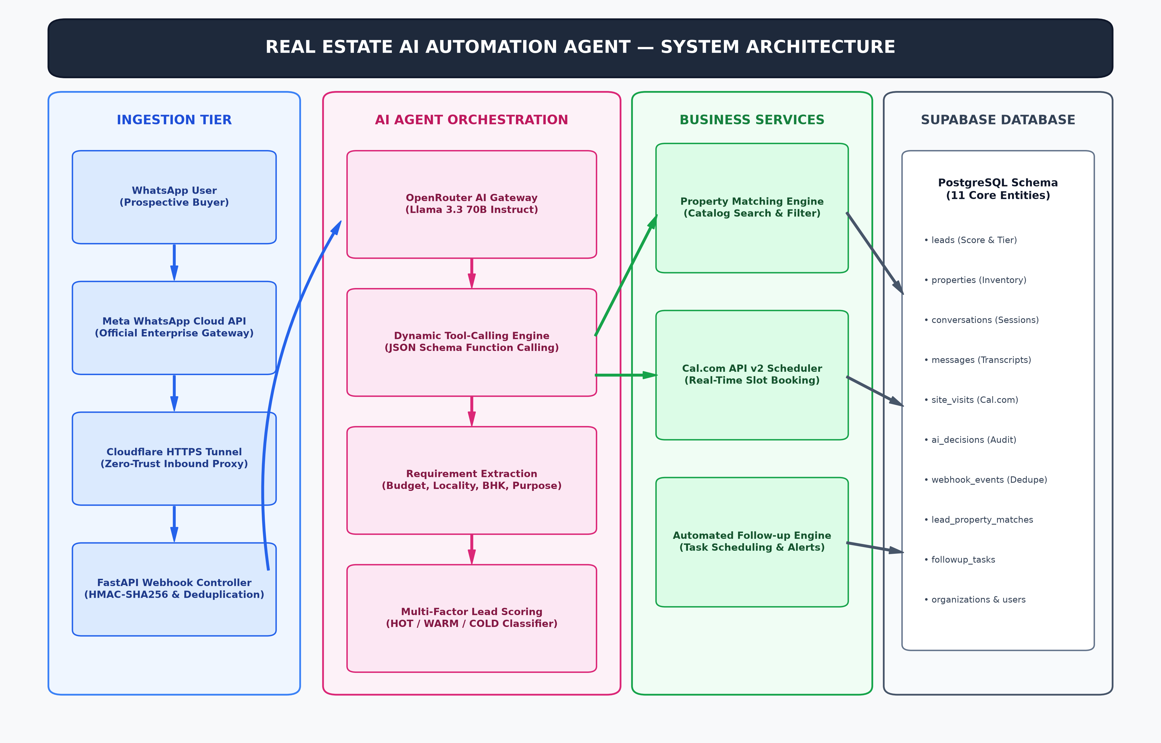
SYSTEM ARCHITECTURE / IDEATION MAP
3 November 2026
School of Computing - CSE
7

Slide 8
CUSTOMER ENQUIRY & EXECUTION WORKFLOW
Step 1: Inbound WhatsApp Inquiry — Prospective buyer initiates conversation via WhatsApp expressing property interest.
Step 2: Webhook Authentication & Deduplication — FastAPI verifies Meta signature; checks event_id in database to prevent duplicates.
Step 3: Session & Context Retrieval — System fetches existing lead profile, interaction history, and active session state from PostgreSQL.
Step 4: AI Intent & Parameter Parsing — OpenRouter Llama 3.3 70B evaluates intent, extracting budget, BHK, location, timeline, and financing.
Step 5: Dynamic Lead Scoring & Tiering — Scoring algorithm computes buyer score and assigns HOT (>=80), WARM (50-79), or COLD (<50) tier.
Step 6: Real-Time Inventory Matching — Agent queries database catalog, retrieving matching active properties with photos and specifications.
Step 7: Slot Retrieval & Schedule Presentation — Cal.com API v2 is called to fetch real available time slots; options are presented on WhatsApp.
Step 8: Instant Site Visit Confirmation — Buyer confirms slot and email; agent books Cal.com appointment and sends confirmation summary.
Step 9: State Persistence & Follow-Up Lifecycle — Complete transcript, AI audit decisions, and CRM follow-up tasks are committed to PostgreSQL.
3 November 2026
School of Computing - CSE
8

Slide 9
MODULE IMPLEMENTATION (MODULES 1 - 4)
Module 1 — WhatsApp Business Cloud API Integration:
• Purpose: Provides official, reliable bidirectional messaging gateway with Meta's cloud infrastructure.
• Implementation: Asynchronous FastAPI endpoint (/api/v1/webhook) handling GET verification and POST webhooks. Enforces HMAC-SHA256 signature validation and unique event_id deduplication to prevent duplicate message processing.
Module 2 — AI Conversation & Tool-Calling Engine:
• Purpose: Orchestrates autonomous multi-turn dialogue and tool execution without rigid rule trees.
• Implementation: Integrates OpenRouter API utilizing Llama 3.3 70B Instruct with system prompts enforcing real estate sales persona. Utilizes deterministic JSON schema tool definitions allowing the LLM to search listings and book visits.
Module 3 — Customer Requirement Extraction:
• Purpose: Translates unstructured customer text into verified, structured property requirement entities.
• Implementation: Validates extracted entities using Pydantic schemas: buyer name, property type (Apartment/Villa/Plot), budget ceiling, target location, bedroom count, purchase urgency, and funding method (Self/Loan).
Module 4 — Lead Qualification & Scoring Engine:
• Purpose: Evaluates prospective buyer purchase intent objectively to prioritize high-value leads.
• Implementation: Weighted multi-criteria scoring algorithm (+30 budget viability, +25 immediate purchase <3 months, +20 loan pre-approval, +15 locality match). Categorizes leads dynamically into HOT, WARM, and COLD.
3 November 2026
School of Computing - CSE
9

Slide 10
MODULE IMPLEMENTATION (MODULES 5 - 7)
Module 5 — Property Inventory Matching Engine:
• Purpose: Filters active database inventory to present tailored listings matching exact buyer criteria.
• Implementation: Executes parameterized SQLAlchemy relational queries filtering by city, locality, budget ceiling, and BHK configuration (e.g., Prestige Falcon Villa, Greenwood Villa). Formats detailed WhatsApp messages with prices, specs, and imagery.
Module 6 — Site Visit Scheduling & Cal.com Integration:
• Purpose: Enables frictionless, conflict-free appointment booking directly inside the WhatsApp conversation.
• Implementation: Integrates Cal.com API v2 (/v2/slots/available & /v2/bookings) with Event Type ID 6869694. Fetches real calendar availability, validates slot conflicts, captures buyer email, commits booking, and sends calendar invites.
Module 7 — Follow-Up Automation & CRM Analytics Engine:
• Purpose: Manages lead lifecycle schedules and prevents lead abandonment across sales pipeline stages.
• Implementation: Asynchronous follow-up task scheduler calculating interval reminders based on lead tier (HOT: 24h, WARM: 48h, COLD: 7d). Automatically cancels pending follow-up tasks upon confirmed site visit and records AI decision audit logs.
3 November 2026
School of Computing - CSE
10

Slide 11
DATABASE SCHEMA & TECHNOLOGY STACK
TECHNOLOGY STACK
• Programming Language: Python 3.12 (Async Core)
• Backend Framework: FastAPI (Uvicorn ASGI)
• AI Reasoning Engine: Llama 3.3 70B (OpenRouter)
• Messaging: Meta WhatsApp Business Cloud API
• Calendar / Booking: Cal.com API v2 Integration
• Relational Database: Supabase Cloud PostgreSQL
• ORM & Schema: SQLAlchemy 2.0 / Pydantic v2
• Automated Testing: Pytest / Pytest-Asyncio Suite
• Ingress / Tunnel: Cloudflare Quick Tunnel (HTTPS)
• Security: HMAC-SHA256 Webhook Verification
POSTGRESQL DATABASE SCHEMA
• leads: lead_id, phone, name, score, status, budget, locality
• properties: property_id, title, city, locality, price, beds
• conversations: conversation_id, lead_id, channel, status
• messages: message_id, conversation_id, sender_type, text
• site_visits: visit_id, lead_id, property_id, time, uid, status
• lead_property_matches: match_id, lead_id, property_id, score
• followup_tasks: task_id, lead_id, scheduled_at, status
• ai_decisions: decision_id, lead_id, action_type, confidence
• webhook_events: event_id, payload_hash, status (dedupe)
• organizations & users: org_id, user_id, email, role, keys
3 November 2026
School of Computing - CSE
11

Slide 12
RESULTS AND DISCUSSIONS
VERIFIED AUTOMATION & TEST METRICS
Automated Test Suite Status:
✓ 27 / 27 Automated Tests Passed (100% Pass)
✓ Suite Execution Duration: 155.69 seconds
Key Capabilities Verified by Tests:
✓ Webhook HMAC-SHA256 signature verification: PASS
✓ Duplicate webhook event deduplication: PASS
✓ Entity extraction & Pydantic validation: PASS
✓ Dynamic lead scoring (HOT/WARM/COLD): PASS
✓ Relational property matching query filters: PASS
✓ Cal.com slot overlap conflict prevention: PASS
✓ Follow-up task creation & cancellation: PASS
OPERATIONAL PERFORMANCE & DISCUSSION
Operational Latency Breakdown:
• Webhook ingestion & authentication: < 45 ms
• AI reasoning & tool dispatch: 1.8s – 2.4s
• Total round-trip WhatsApp reply: < 2.5 seconds
Practical Impact Achieved:
• 100% inquiry capture with zero dropped leads
• Instant lead qualification without sales rep delay
• Automated calendar booking with email dispatch
System Boundaries & Current Scope:
• Dependent on OpenRouter and Meta API uptime
• Administration accessible via authenticated REST APIs
3 November 2026
School of Computing - CSE
12

Slide 13
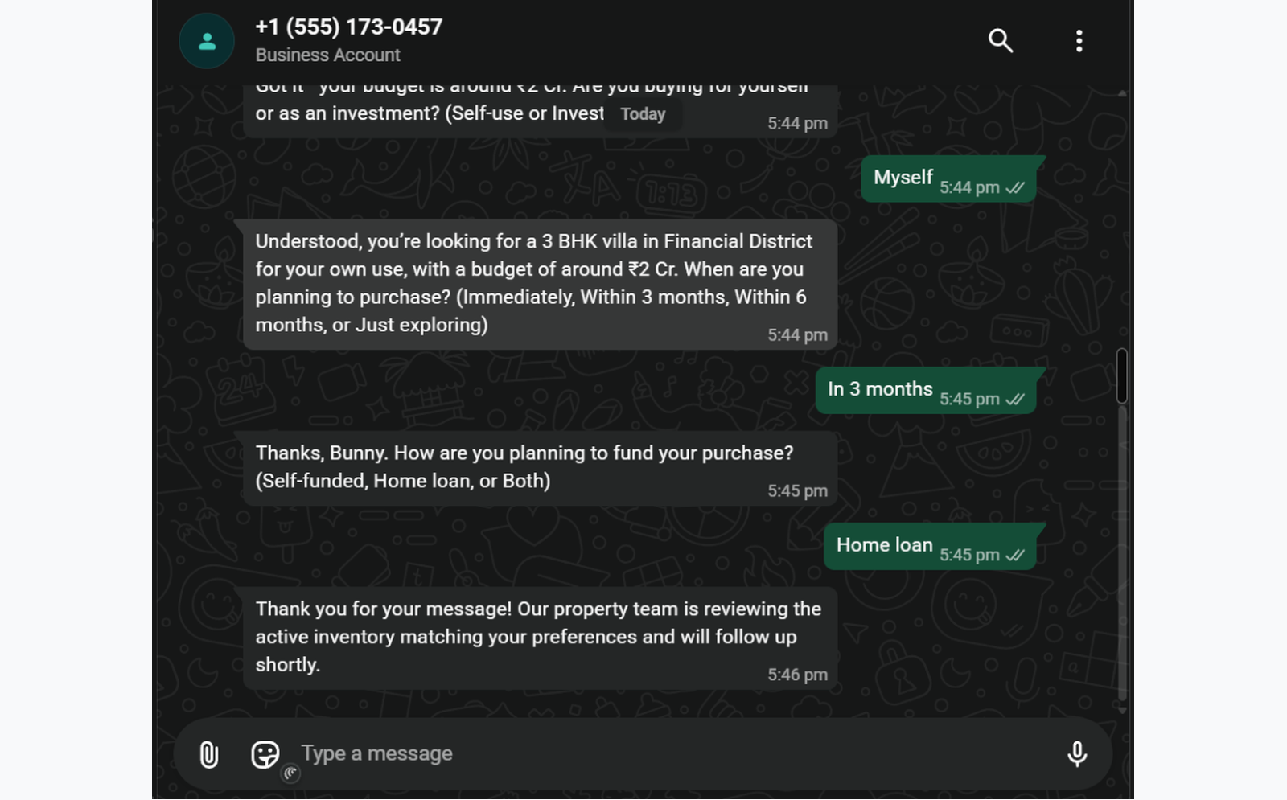
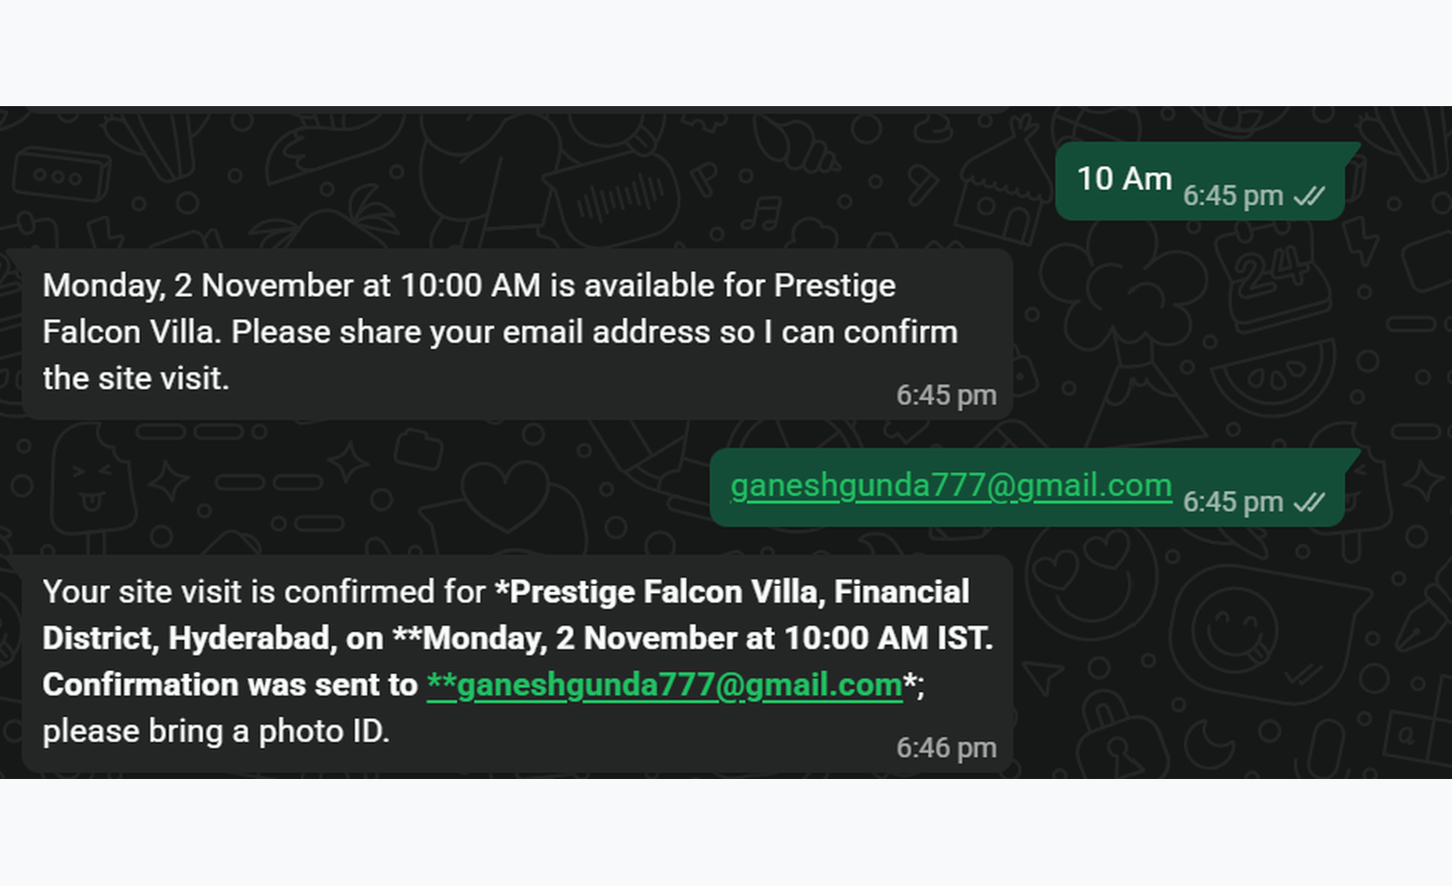
OUTPUT
Output A: Requirement Extraction & Lead Qualification
WhatsApp conversation demonstrating extraction of budget (₹2 Cr), 3 BHK villa in Financial District, 3-month timeline, and home loan funding.
Output B: Cal.com Live Site Visit Booking & Confirmation
WhatsApp conversation demonstrating real-time slot selection, booking of Prestige Falcon Villa for Mon 2 Nov 10:00 AM, and email confirmation dispatch.
✓ Live System Verified: Real WhatsApp conversation turns showing autonomous lead parameter extraction and live Cal.com calendar scheduling with instant email notifications sent to the prospective buyer.
3 November 2026
School of Computing - CSE
13

Slide 14
CONCLUSION & FUTURE ENHANCEMENTS
Project Summary:
Successfully engineered the Real Estate AI Sales & Marketing Automation Agent, an enterprise-grade autonomous system integrating Meta WhatsApp Business Cloud API with FastAPI and OpenRouter LLM intelligence. The platform automates the entire customer journey from initial inquiry to verified site visit booking.
Key Practical Advantages:
• Zero Response Latency: Instantaneous (<2.5s) 24/7 inquiry handling eliminates the critical 5-minute lead drop-off window.
• Objective Lead Prioritization: Algorithmic scoring ensures sales teams focus immediately on high-intent HOT buyers.
• Frictionless Appointment Booking: Self-service calendar scheduling via Cal.com eliminates human phone-tag delays.
• Centralized Relational Audit Trail: Complete conversation history, AI tool decisions, and lead preferences unified in PostgreSQL.
Future Enhancements:
1. Administrative Web Dashboard: Build a full-stack Next.js/Tailwind CRM dashboard for visual pipeline and lead management.
2. Meta Marketing API Integration: Connect directly with Meta Ads to evaluate campaign performance and Cost Per Qualified Lead (CPQL).
3. Multilingual Conversational Voice AI: Incorporate speech-to-text and voice synthesis for vernacular audio inquiries.
4. Direct Google Calendar Two-Way Sync: Native service-account OAuth synchronization for multi-agent sales teams.
3 November 2026
School of Computing - CSE
14

Slide 15
REFERENCES
[1] Meta Platforms, Inc., 'WhatsApp Business Platform Cloud API Documentation & Webhook Architecture,' Meta for Developers, 2026. [Online]. Available: https://developers.facebook.com/docs/whatsapp/cloud-api/
[2] S. Ramírez, 'FastAPI: Modern, High-Performance Web Framework for Building APIs with Python,' Tiangolo Documentation, 2026. [Online]. Available: https://fastapi.tiangolo.com/
[3] OpenRouter AI, 'OpenRouter Unified LLM API Specification and Tool-Calling Protocols,' OpenRouter Docs, 2026. [Online]. Available: https://openrouter.ai/docs
[4] Supabase Inc., 'Supabase PostgreSQL Architecture: Managed Relational Database and Storage,' Supabase Documentation, 2026. [Online]. Available: https://supabase.com/docs
[5] M. Bayer, 'SQLAlchemy 2.0 Unified Documentation: Database Toolkit for Python,' SQLAlchemy Authors, 2026. [Online]. Available: https://docs.sqlalchemy.org/
[6] S. Colvin et al., 'Pydantic V2: Data Validation and Settings Management Using Python Type Annotations,' Pydantic Docs, 2026. [Online]. Available: https://docs.pydantic.dev/
[7] Cal.com, Inc., 'Cal.com API v2 Documentation: Scheduling Infrastructure for Developers,' Cal.com Developer Portal, 2026. [Online]. Available: https://cal.com/docs/api-reference/v2
[8] H. Krekel et al., 'Pytest: Scalable Python Testing Framework and Asynchronous Test Suites,' Pytest Documentation, 2026. [Online]. Available: https://docs.pytest.org/
3 November 2026
School of Computing - CSE
15

Slide 16
THANK YOU
We express our sincere gratitude to Sathyabama Institute of Science and Technology, Department of Computer Science and Engineering, our Respected Project Guides, Review Panel Members, and Supportive Faculty for their invaluable guidance and mentorship throughout this project.
PROJECT TEAM MEMBERS:
1. GUNDA GANESH — Register Number: 44110224
2. G. ROSI — Register Number: 44110219
3. G. KARTHIK — Register Number: 44110218
Questions & Discussion
3 November 2026
School of Computing - CSE
16

