Slide 1
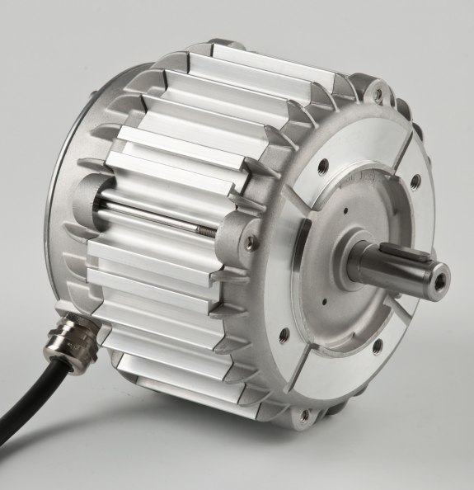
MysonLink
● Taiwan Headquarters
2F, No.24-2, Industry East Road IV, Science-Based Industrial Park, Hsinchu 300, Taiwan (R.O.C.)
Tel: 886-3-578-4866 / Fax: 886-3-578-5002
URL: www.myson.com.tw / Email: sales@myson.com.tw
● China Contact
Tel: 86-755-2674-5588 / Fax: 86-755-2674-5566

Slide 2
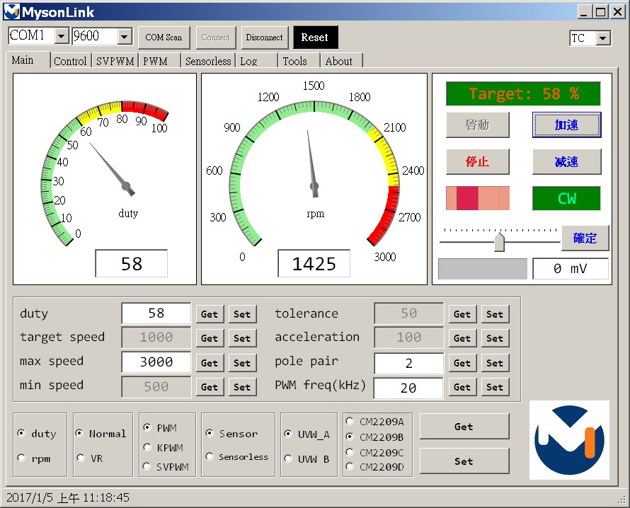
MysonLink

Slide 3
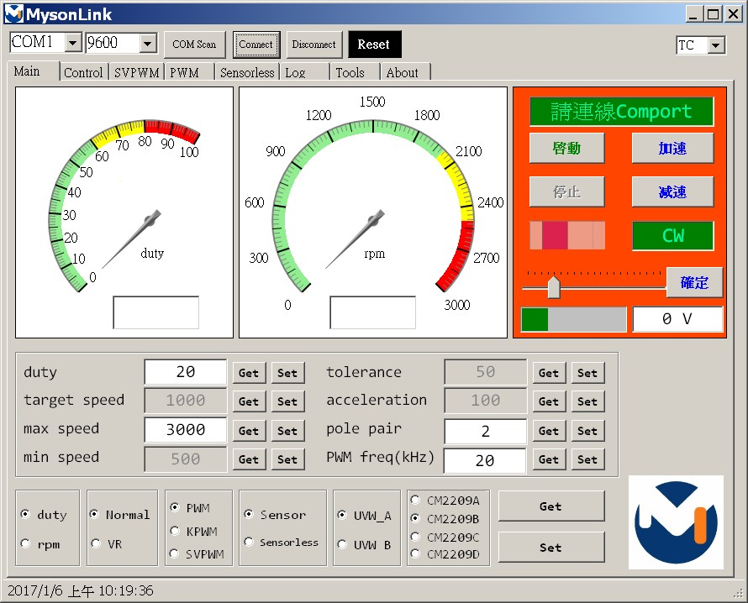
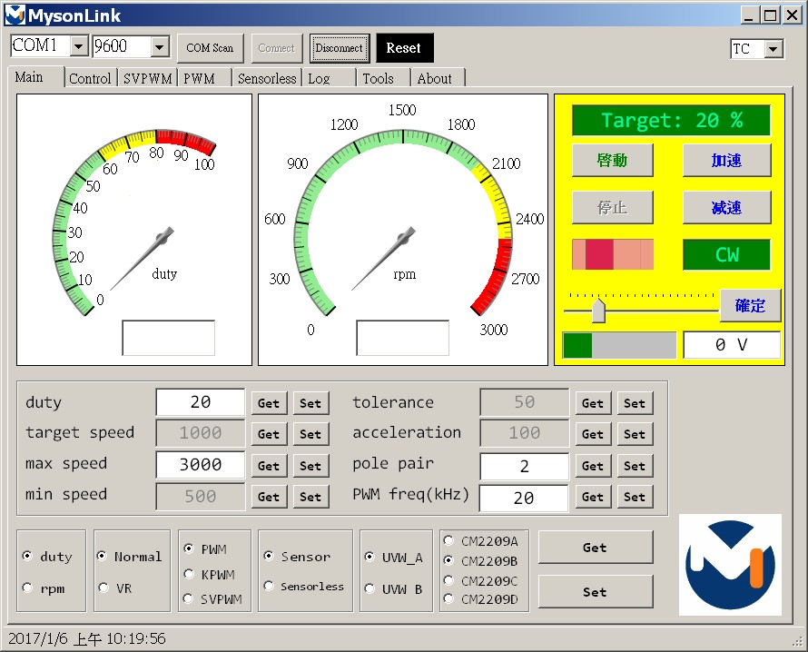
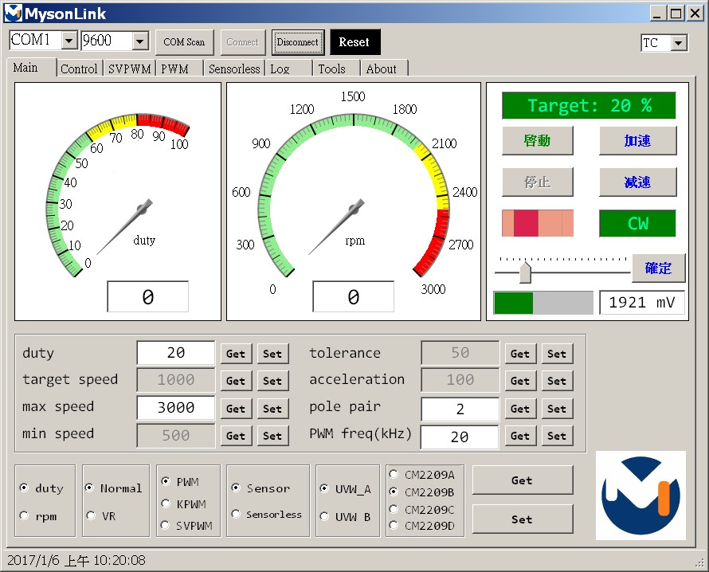
Comport連線
紅底：Comport未連線。
黃底：Comport已連線，下位未回應。
白底：Comport已連線，下位已回應，可以操作。

Slide 4
MysonLink
選擇語系
顯示訊息
基本控制
選擇轉向
顯示duty
顯示轉速
調整速度
顯示VR結果

Slide 5
MysonLink取得與設定參數
Get 取得下位的設定值
Set 將設定值傳送給下位

Slide 6
MysonLink取得與設定參數
duty：上位設定duty。
rpm：上位設定轉速。
Normal：由上位控制啟停加減速。
VR：由VR控制啟停加減速，上位監看結果。
PWM：六步方波、KPWM：改良式六步方波、SVPWM：類弦波。
Sensor / Sensorless：使用Hall Sensor與否。
UVW_A / UVW_B：UVW驅動相位種類。
CM2209A/B/C/D：使用的demo板。
本頁設定只在停止運轉狀態下有用

Slide 7
MysonLink取得與設定參數
duty：取得/設定duty，只在duty模式下有用。
target speed：取得/設定目標轉速，只在rpm模式下有用。
max speed：取得/設定最大轉速。
min speed：取得/設定最小轉速。
tolerance：取得/設定目標轉速和實際轉速的容忍值，只在rpm模式下有用。
acceleration：取得/設定加速度，只在rpm模式下有用。
pole pair：取得/設定馬達磁極對數。
PWM freq(kHz) ：取得/設定PWM頻率，以kHz為單位。
本頁設定可以隨時套用

Slide 8
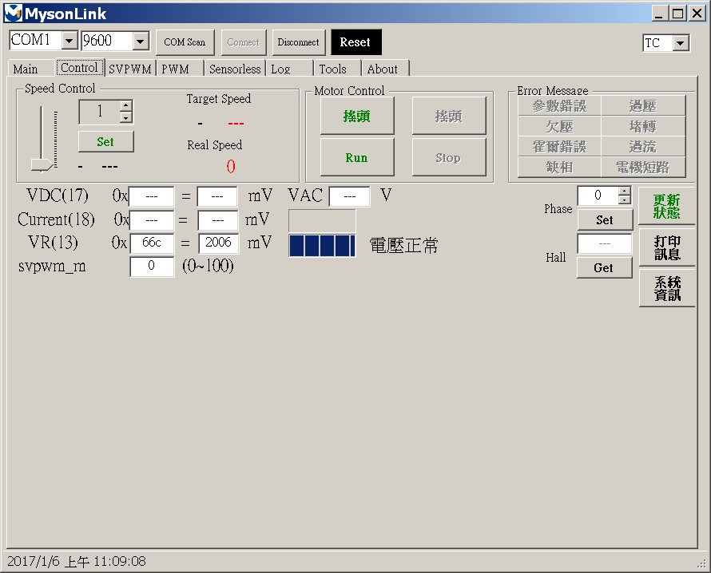
SVPWM控制頁

Slide 9
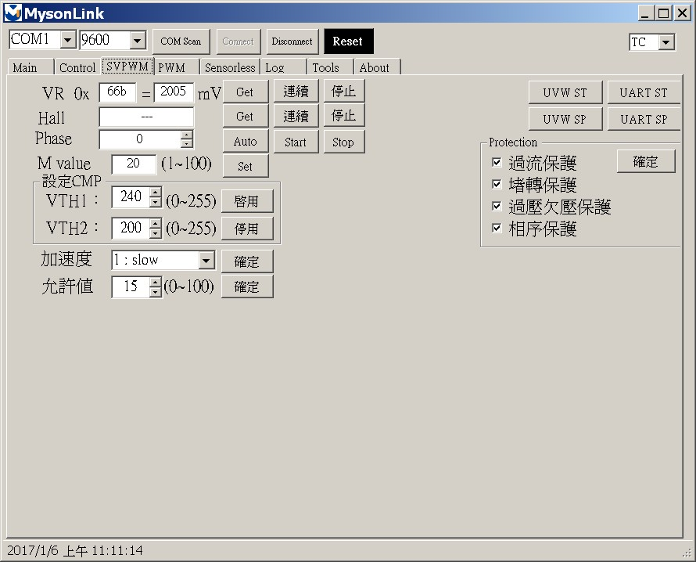
SVPWM調試頁

Slide 10
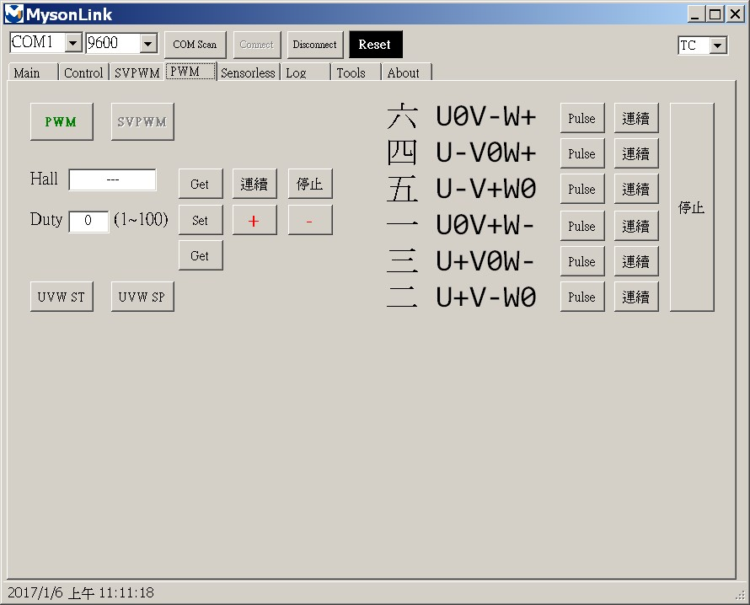
PWM調試頁

Slide 11
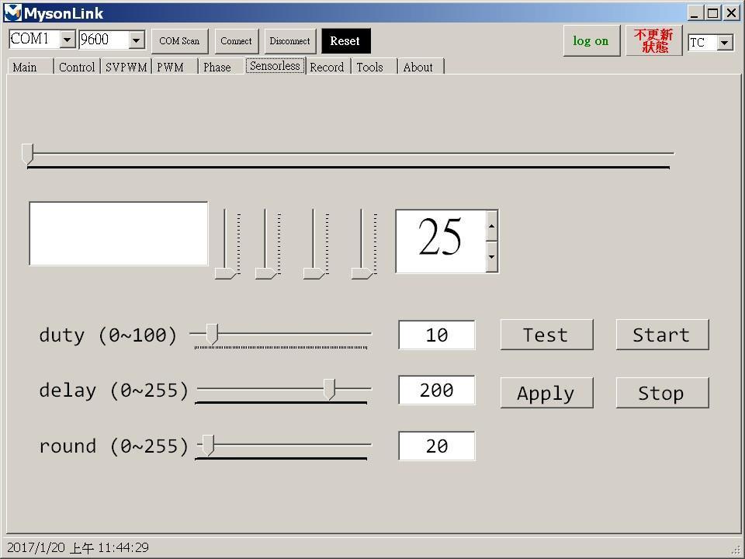
無傳感調試頁

Slide 12
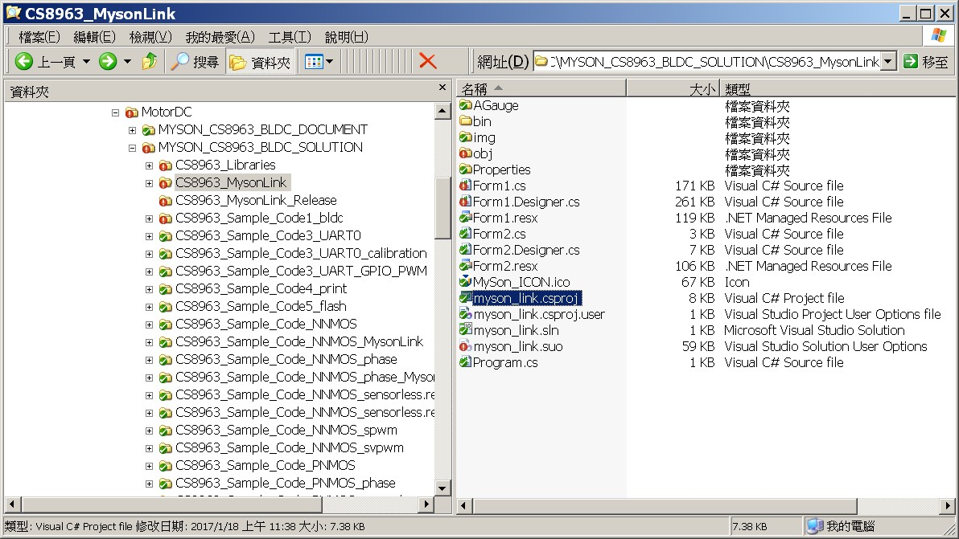
開啟.csproj

Slide 13
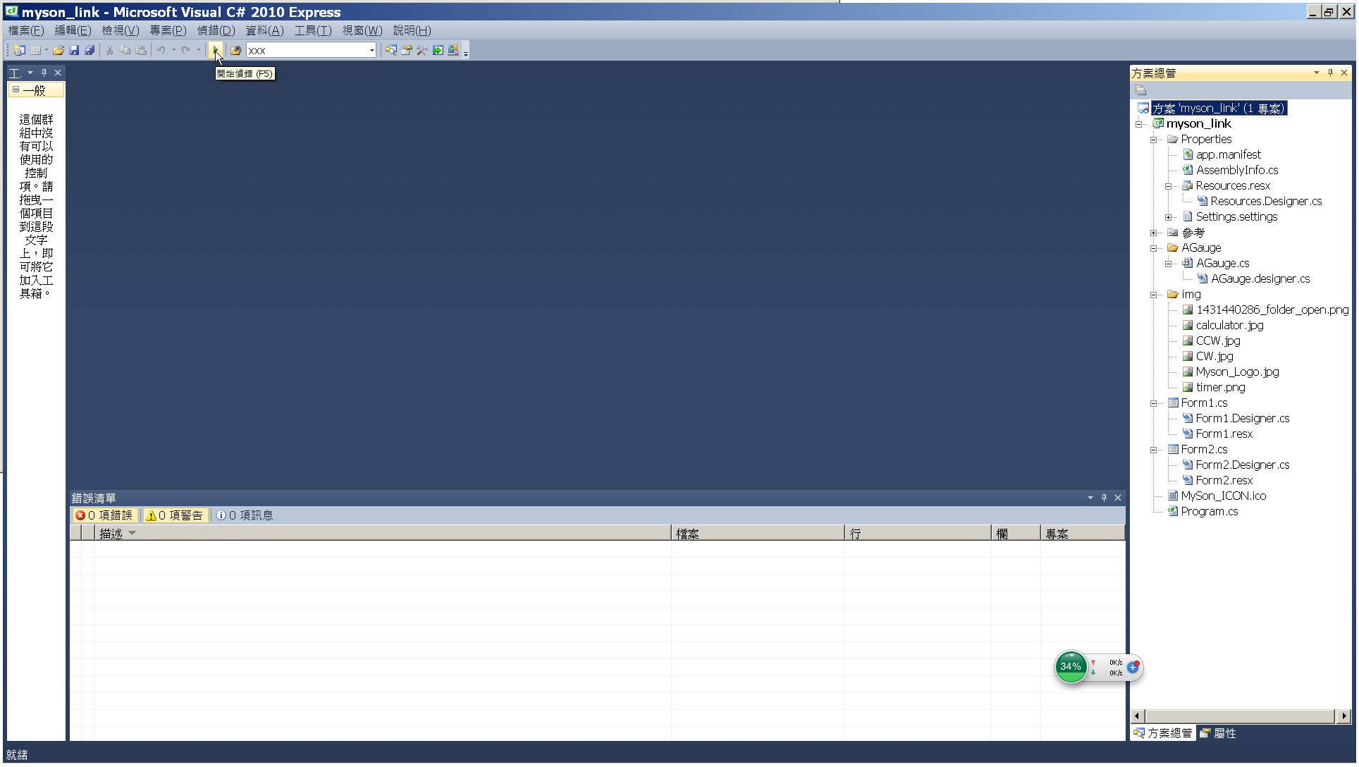
Vcs開始偵錯

Slide 14
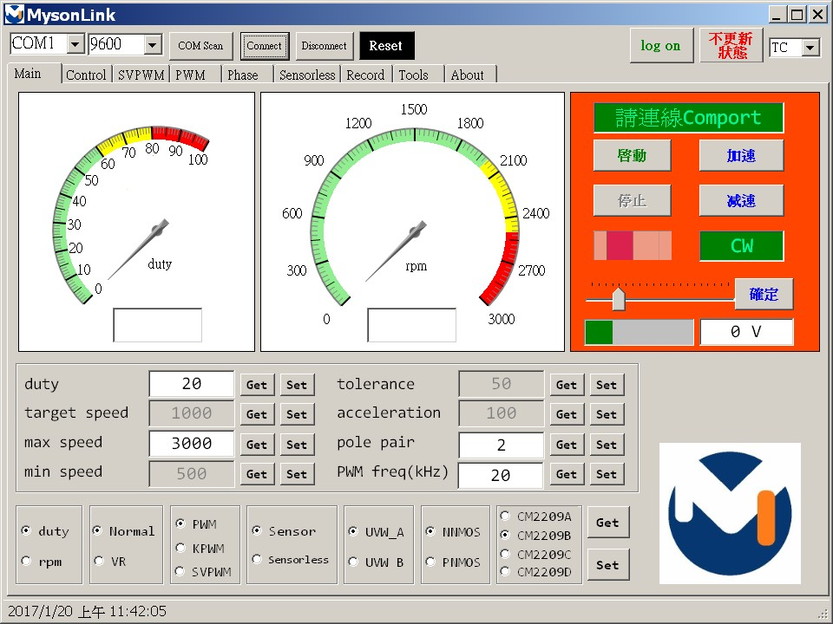
執行MysonLink

Slide 15
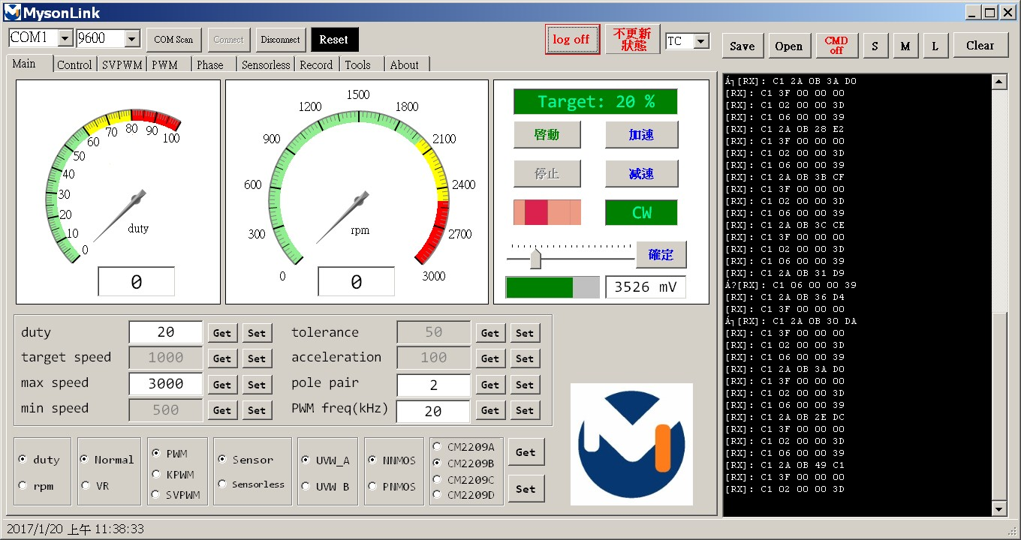
連線Comport並顯示Log

Slide 16
CS8963 / CS8964
Myson Link Protocol
● Taiwan Headquarters
2F, No.24-2, Industry East Road IV, Science-Based Industrial Park, Hsinchu 300, Taiwan (R.O.C.)
Tel: 886-3-578-4866 / Fax: 886-3-578-5002
URL: www.myson.com.tw / Email: sales@myson.com.tw
● China Contact
Tel: 86-755-2674-5588 / Fax: 86-755-2674-5566

Slide 17
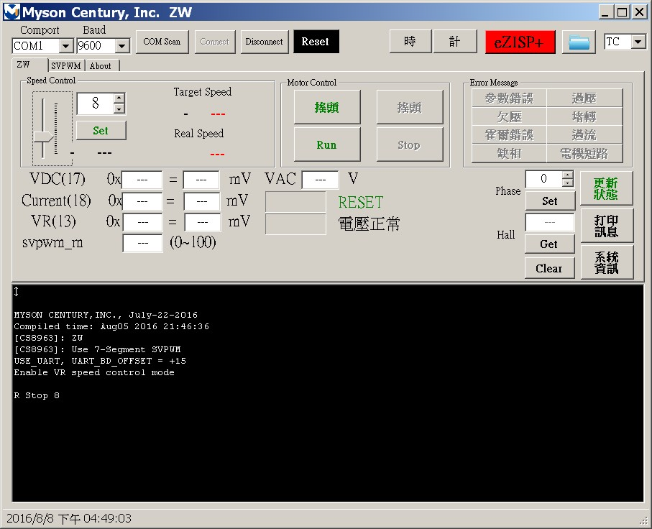
MysonLink

Slide 18
MysonLink Communication Protocol
 | Parameters | Parameters | Command | Description
PC to MCU | D1 XX CS | XX[0:5]=5’b00000 STOP XX[0:5]=5’b00001 1 speed XX[0:5]=5’b00010 2 speed : XX[0:5]=5’b11000 24speed XX[6]=1’b1 swing XX[6]=1’b0 no swing XX[7]： Reserved XX[7:0]=0xF5 No update XX[7:0]=0xFA update XX[7:0]=0xFC print mesg XX[7:0]=0xFF reboot | Send_Speed_Cmd() | Send speed command rpm=300+50*(speed-1)
MCU to PC | C5 VDC CS | VDC ADC result | Send_VDC_Result_Cmd() | Send VDC result
 | DD XX CS | XX the same as command | Send_Got_Speed_Cmd() | Send Got Speed Command
 | EE XX CS | XX=4’b0000 Normal XX=4’b0001 ParameterError XX=4’b0010 OV XX=4’b0011 UV XX=4’b0100 Lock-rotor XX=4’b0101 Hall-error XX=4’b0110 OC XX=4’b0111 Lack-phase XX=4’b1000 Short XX=4’b1111 Recover | Send_Error_Speed_Cmd() | Send Error Command

Slide 19
MysonLink Example(PC)
Send_Speed_Cmd(1); //Start motor
public bool Send_Speed_Cmd(int on_off)
{
byte[] data = new byte[3];
byte speed;
int swing;
int value;
speed = (byte)trackBar1.Value; //get speed
swing = (button_NoSwing.Enabled == true)?1:0;
if (on_off == 0) speed = 0; //0: stop
IsRunning = (speed ==0)?0:1; //store key status
if (IsRunning == 0)
{
button_Run.Enabled = true;
button_Stop.Enabled = false;
}
else
{
button_Run.Enabled = false;
button_Stop.Enabled = true;
}
data[0] = 0xD1; //HEADER
value = (speed & 0x1f) | (byte)swing << 6;
data[1] = (byte)value; //DATA
data[2] = CalcCheckSum(data, 2); //CHECKSUM
if (serialPort1.IsOpen) //Send data out
serialPort1.Write(data, 0, data.Length);
else
return false;
return true;
}
//CheckSum, sum of all 3 bytes is a multiple of 256.
private byte CalcCheckSum(byte[] pData, int len)
{
byte sum = 0x00;
short ii = 0;
for (ii = 0; ii < len; ii++)
sum += pData[ii];
sum = (byte)((sum ^ 0xFF) + 1);
return sum;
}

Slide 20
MysonLink Example(MCU)
void UART0_SP(void) interrupt 4
{
unsigned char SBUF0_temp;
UINT UartRxBuf[UART_BUF_LENGTH]; //for checksum
UINT checksum;
if(RI0 == 1)
{
RI0 = 0;
SBUF0_temp = SBUF0;
if((SBUF0_temp >= 0xD1)&&(SBUF0_temp <= 0xDA))
gui_cmd_index = 0;
gui_cmd[gui_cmd_index] = SBUF0_temp;
//get one byte once, put it in buffer
if(gui_cmd_index == 0)
{
if((SBUF0_temp >= 0xD1)&&(SBUF0_temp <= 0xDA))
//Check Header
gui_cmd_index++;
else
gui_cmd_index = 0;
}
else
gui_cmd_index++;
if (gui_cmd_index == UART_BUF_LENGTH) //get 3 bytes
{
gui_cmd_index = 0;
UartRxBuf[0] = gui_cmd[0]; UartRxBuf[1] = gui_cmd[1];
checksum = CalcCheckSum(UartRxBuf, 2); //check checksum
if(gui_cmd[2] != checksum) //checksum error, abort
else if(gui_cmd[0] == 0xD1) //check header, correct
{
speed = gui_cmd[1] & 0x1f;
swing = (gui_cmd[1]>>6) & 0x1;
if(speed == 0) //stop motor
else
{
if(ERROR_number == 0) //No error
{
targ_speed = 300 + 50 * (speed - 1);
if(swing) P3_2 = 0; //swing
else P3_2 = 1; //no swing
Send_Got_Speed_Cmd(gui_cmd[1]);
//Send the same command to PC
if(MtState == stop)
//Start motor
}
else
//error, no start motor
}

Slide 21
MysonLink Example(MCU)
//Send got speed command
Send_Got_Speed_Cmd(gui_cmd[1]);
void Send_Got_Speed_Cmd(BYTE cmd)
{
int i;
UINT UartTxBuf[UART_BUF_LENGTH];
UartTxBuf[0] = 0xDD;
UartTxBuf[1] = cmd;
UartTxBuf[2] = CalcCheckSum(UartTxBuf, 2);
for(i=0;i<UART_BUF_LENGTH;i++)
printS(UartTxBuf[i]); //Send data out
}
UINT CalcCheckSum(UINT *pData, UINT len)
{
unsigned char i = 0,sum = 0;
for (; i < len; i++)
sum += (unsigned char) pData[i];
sum = (sum^0xFF) + 1;
return (sum&0xFF);
}
//use ADC to read DCBUS voltage and send result
ADC_B_InstanceCurrent = 0;
Initial_ADC(SAMPLE_DCBUS_ADC);
Get_ADC_Result(SAMPLE_DCBUS_ADC);
Disable_ADC(SAMPLE_DCBUS_ADC);
VDC_result =
(BYTE)((ADC_B_InstanceCurrent>>4)&0xff);
Send_VDC_Result_Cmd(VDC_result);
void Send_VDC_Result_Cmd(BYTE vdc)
{
int i;
UINT UartTxBuf[UART_BUF_LENGTH];
UartTxBuf[0] = 0xC5;
UartTxBuf[1] = vdc;
UartTxBuf[2] = CalcCheckSum(UartTxBuf, 2);
for(i=0;i<UART_BUF_LENGTH;i++)
printS(UartTxBuf[i]);
}

Slide 22
MysonLink Example(PC)
private void SerialPortTimer100ms_Tick(object sender, EventArgs e) //PC get UART data every 100ms
{
if (serialPort1.IsOpen)
{
BytesToRead = serialPort1.BytesToRead;
if (BytesToRead > 0)
{
serialPort1.Read(receive_buffer, 0, BytesToRead);
if (BytesToRead == 3) //check 3-bytes data
SpyMonitorRX();
private void SpyMonitorRX()
{
input = "";
for (int i = 0; i < BytesToRead; i++)
input += (char)receive_buffer[i];
if (input[0] == 0xC5) //0xC5，MCU sends VDC result to PC
{
tb_ADCB.Text = Convert.ToString(input[1], 16); //Show ADC result
tb_ADCB_mV.Text = Convert.ToString((input[1] << 4) * 5000 / 4096); //Show ADC voltage
tb_VAC.Text = Convert.ToString((input[1] << 4) * 5000 / 4096 *(2000+20)/20/1414); //Show VAC voltage
Application.DoEvents(); //delay a while
for (int j = 0; j < 10; j++)
System.Threading.Thread.Sleep(1);
}

