Slide 1
Synology NAS架設Git Server
參考文件:
https://blog.yslifes.com/archives/2364

Slide 2
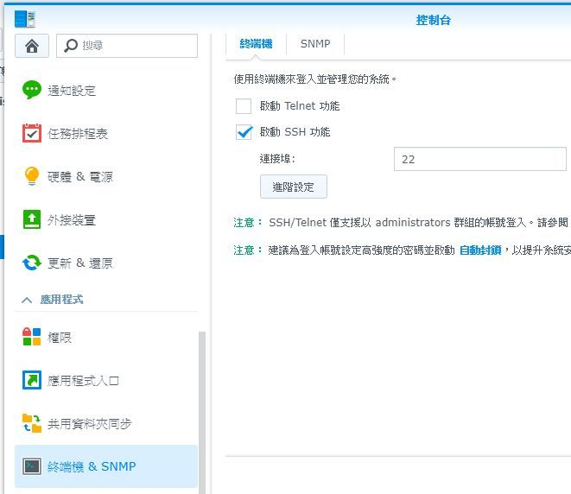
1.開啟SSH service功能
ps.如果有防火牆或在內網請開放相對應port 22

Slide 3
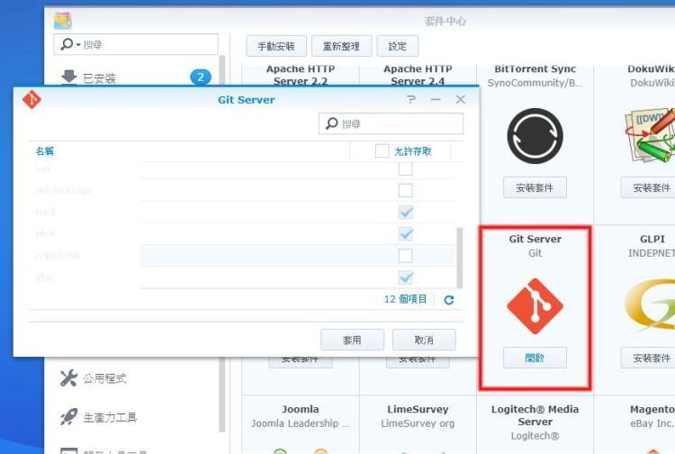
2.在套件中心安裝Git Server

Slide 4
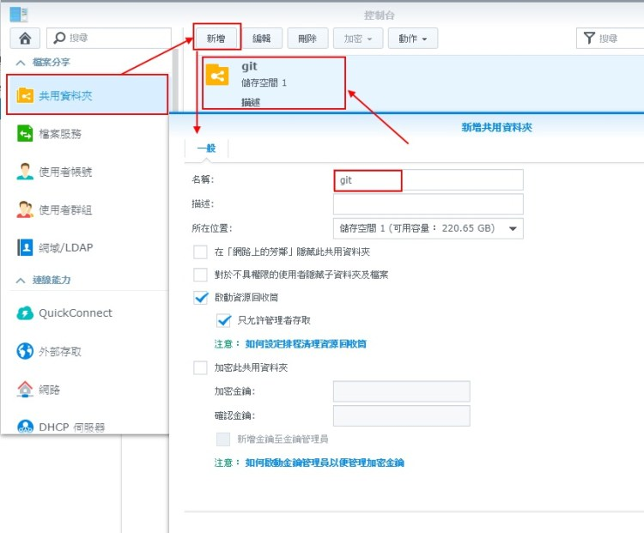
3.在控制台裡新增共用資料夾，來當做git存放資料夾
寫git就好

Slide 5
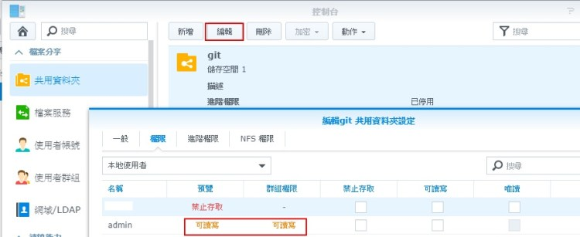

4.新增資料夾後記得要把目錄權限開放給需要的使用者或群組
要勾這個
在此設定使用者，及讀寫權限。

Slide 6
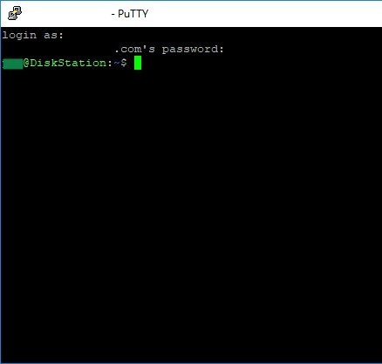
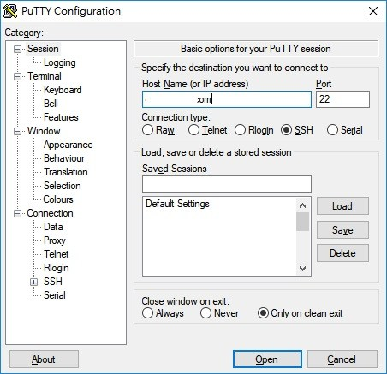
5.利用ssh軟體登入主機 例如使用putty 需要root才可登入

Slide 7
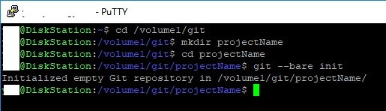
6.專案目錄下達git初始化
變換資料夾至所建立的共享目錄
建立專案目錄 例如 projectName
進入專案目錄
git --bare init
改專案目錄

Slide 9
綠色：好的frame， 紅色：壞的frame
2秒
2秒
OSD顯示
信號不良
判斷條件:
兩秒內掉了>10個frame
信號恢復正常後持續顯示警告2秒
OSD顯示條件
中斷
狀態顯示

Slide 10

































































Slide 11
31
0
31
DATA_2_RO
E000_A068
30
0
30
29
0
29
28
0
28
27
0
27
26
0
26
25
0
25
24
0
24
23
0
23
22
0
22
21
0
21
20
0
20
19
0
19
18
IO2
18
17
IO1_KEY
17
16
IO0_CD
16
15
SW_BRIGHT
15
14
SW_DARKEN
14
13
SW_METER
13
12
SW_START
12
11
SW_SMART
11
10
CAM_LED
10
9
FAN_EN
9
8
LED_RED
8
7
LED_5
7
6
LED_4
6
5
LED_3
5
4
LED_2
4
3
LED_1
3
2
LED_AUTO
2
1
LED_AVG
1
0
LED_CEN
0

Slide 12
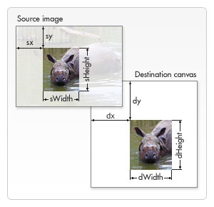
gdispImage *p_Image;
p_Image = &myImage;
gdispImageOpenFile(p_Image, step_3);
W H sx sy dx dy
pixmap_draw(pixmap_1, surface_1, LAYER1_WIDTH, LAYER1_HEIGHT, p_Image, 100, 200, 300, 400, alpha, POSITION_MIDDLE_LEFT);
1920 W 16 16
gdispBlitArea(LAYER0_WIDTH - LAYER1_WIDTH - BORDER_X, BORDER_Y,
W H
LAYER1_WIDTH, LAYER1_HEIGHT, surface_1);
gdispImageClose(p_Image);
pixmap_draw(pixmap, surface, W, H, p_Image, sx, sy, dx, dy, alpha, position)
{
  sWidth = p_Image->width;
  sHeight = p_Image->height;
  status = gdispGImageDraw(pixmap, p_Image, dx, dy, sWidth, sHeight, sx, sy);
不透明貼圖
sx = 0; sy = 0;
sWidth = p_Image->width;
sHeight = p_Image->height;
dx = 200; dy = 100;
status = gdispImageDraw(p_Image, dx, dy, sWidth, sHeight, sx, sy);
w
h
H
W

Slide 13

設定圖層
L0
(688, 16)
L1
1216 X 912
(16,584)
L2
640 X 480
L3

Slide 14
設定圖層
製作右大圖(L1)
pixmap_1 = gdispPixmapCreate(LAYER1_WIDTH, LAYER1_HEIGHT);
// 開啟 1216 X 912
surface_1 = gdispPixmapGetBits(pixmap_1);
pixmap_draw(pixmap_1, surface_1, LAYER1_WIDTH, LAYER1_HEIGHT, NULL,
0, 0, 0, 0, 0, POSITION_MIDDLE_CENTER);
把右大圖(L1)加到底圖(L0)之上
// Blit surface_1 to the real display at the new position
L1之左上角x L1之左上角y, L1之W, L1之H
gdispBlitArea(LAYER1_START_X, LAYER1_START_Y, LAYER1_WIDTH, LAYER1_HEIGHT, surface_1);
void RunMixer(XV_Mix_l2 *mix)
{
layer1.StartX = LAYER1_START_X;
layer1.StartY = LAYER1_START_Y;
XVMix_LayerEnable(periphs_inst.p_vid_output_mixer_l2_inst, XVMIX_LAYER_1);

Slide 15
draw
開啟一圖
gdispImage *p_Image;
p_Image = &myImage;
status = gdispImageOpenFile(p_Image, step_3); //開檔並讀資料到p_Image裏
gdispImageClose(p_Image);
畫不透明圖, 可畫多張
status = gdispImageDraw(p_Image, dx, dy, sWidth, sHeight, sx, sy);
用來畫透明圖, 只能畫一張
pixmap_draw(pixmap_1, surface_1, LAYER1_WIDTH, LAYER1_HEIGHT, p_Image, 0, 0, 0, 0, alpha, POSITION_MIDDLE_CENTER);
gdispBlitArea(LAYER0_WIDTH-LAYER1_WIDTH-BORDER_X, BORDER_Y, LAYER1_WIDTH, LAYER1_HEIGHT, surface_1);
清除圖片, 只能全部清除
pixmap_draw(pixmap_1, surface_1, LAYER1_WIDTH, LAYER1_HEIGHT, NULL, 0, 0, 0, 0, 0, POSITION_MIDDLE_CENTER);
gdispBlitArea(LAYER0_WIDTH-LAYER1_WIDTH-BORDER_X, BORDER_Y, LAYER1_WIDTH, LAYER1_HEIGHT, surface_1);

Slide 16
draw
漸層色
W H
pixmap_draw_gradient(pixmap_1, surface_1, LAYER1_WIDTH, LAYER1_HEIGHT,
dx dy dW dH c_st c_sp alpha
200, 200, 256*3, 100, Lime, Blue, 0xff);
gdispBlitArea(LAYER0_WIDTH-LAYER1_WIDTH-BORDER_X, BORDER_Y, LAYER1_WIDTH, LAYER1_HEIGHT, surface_1);
在LAYER1上畫漸層色，起點(dx,dy)，畫dW X dH，顏色由c_st到c_sp，分256階
(dx, dy) dW
c_st c_sp
dH

Slide 17
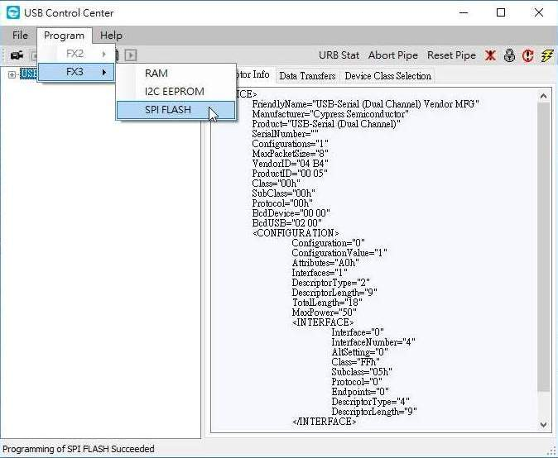
Cypress FF3 燒錄
開啟Cypress/Control Center
Program/FX3/SPI FLASH
選取燒錄檔案(xxx.img)即行燒錄

Slide 18
Cypress FF3 使用
建立專案
開啟Cypress/EZ USB Suite
File/Inport
General/File System
Project/Clean
Project/Build All，產出燒錄檔案(xxx.img)

Slide 19
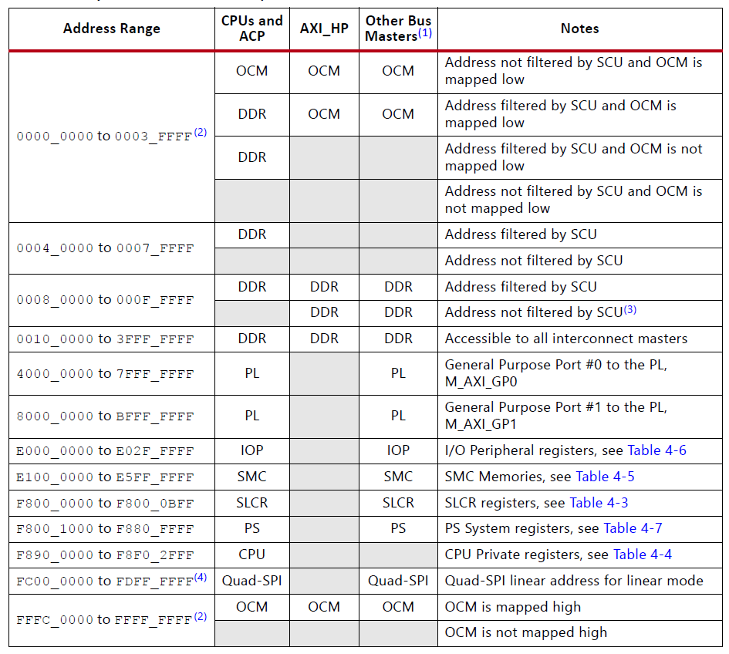
Address Map

Slide 20
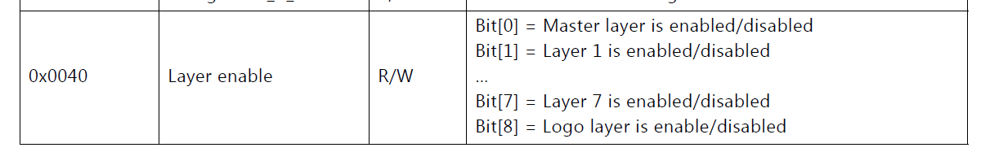
Mixer
Xilinx_VideoMixer_v1.0_PG243.pdf
Mixer 43CC_0000 ~ 43CF0000
Offset 0x0040
L0 => bit0 //background
L1 => bit1 //right
L2 => bit2 //left
L3 => bit3 //OSD
1: enable, 2: disable

Slide 21
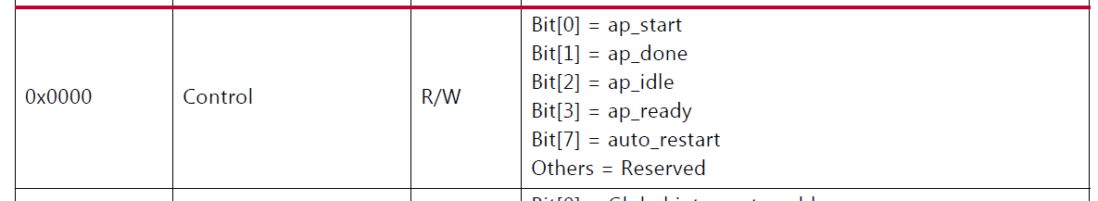
Mixer
0x43CC_0000
Auto start
bit7 auto_restart
Register直接寫0x80
XV_mix_Start
Bit7 保留 bit0填1

Slide 22
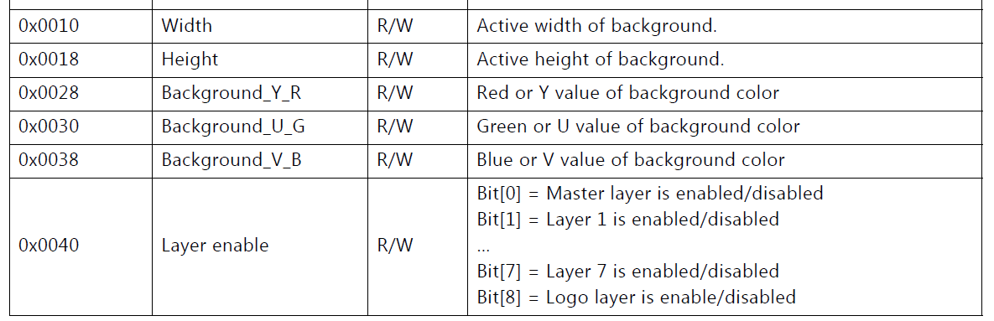
Mixer
0x0010 XV_mix_Set_HwReg_width Layer width
0x0018 XV_mix_Set_HwReg_height Layer height
0x0028 XV_mix_Set_HwReg_background_Y_R R
0x0030 XV_mix_Set_HwReg_background_U_G G
0x0038 XV_mix_Set_HwReg_background_U_B B
0x0040 XV_mix_Set_HwReg_layerEnable Enable

Slide 23
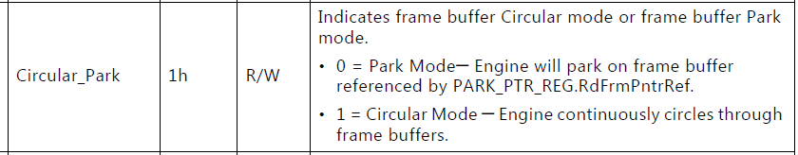
VDMA
Xilinx_VDMA_v6.2_PG020.pdf
Camera VDMA 4300_0000 ~ 4300_0000 左小圖
Camera Freeze VDMA 4303_0000 ~ 4303_0000 右大圖
Freeze
MM2S_VDMACR(0x00) bit 1
0: Freeze(Park mode)
1: Circular Mode(Normal mode)
左小圖(0x43000000) 右大圖(0x43030000)

Slide 24
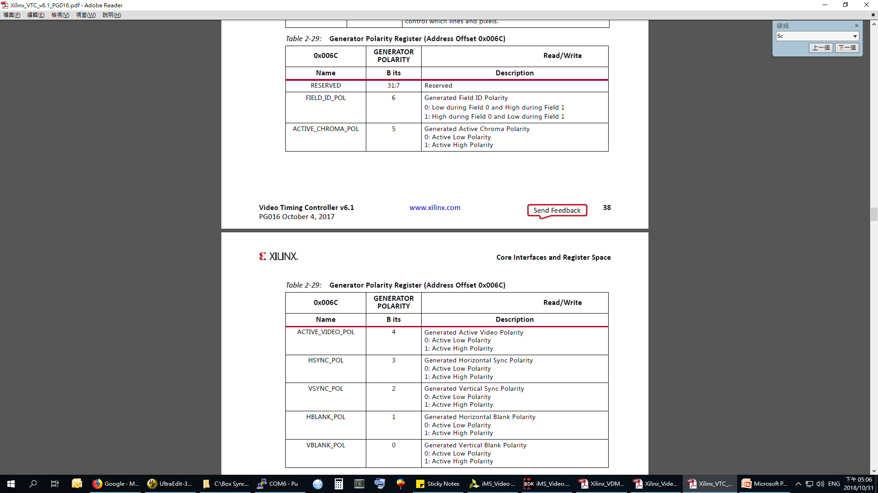
Video Timing Controller (VTC)
Xilinx_VTC_v6.1_PG016.pdf
Setup polarity
xvtc.c:XVtc_SetPolarity
BaseAddr = 0x43C90000
offset= 0x0000006C
data = 0x0000003F

