Slide 1
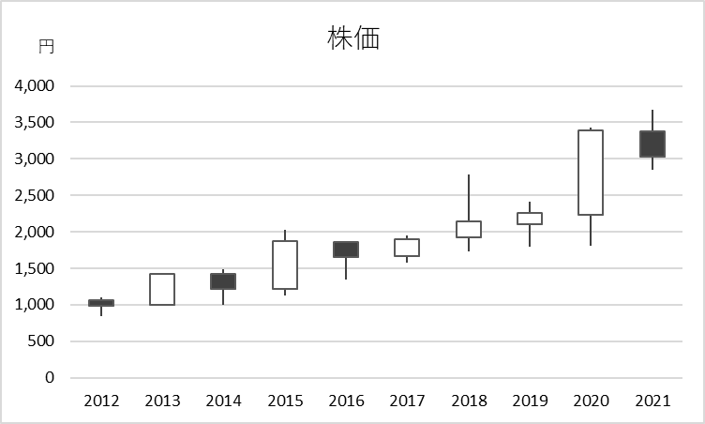
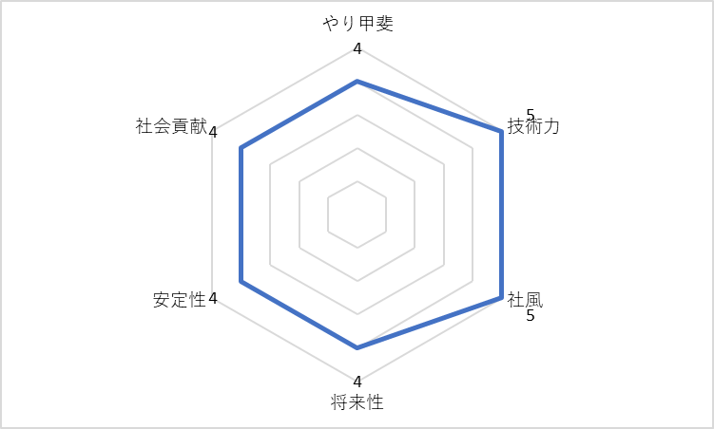
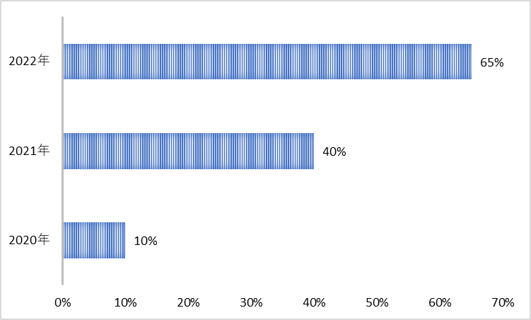
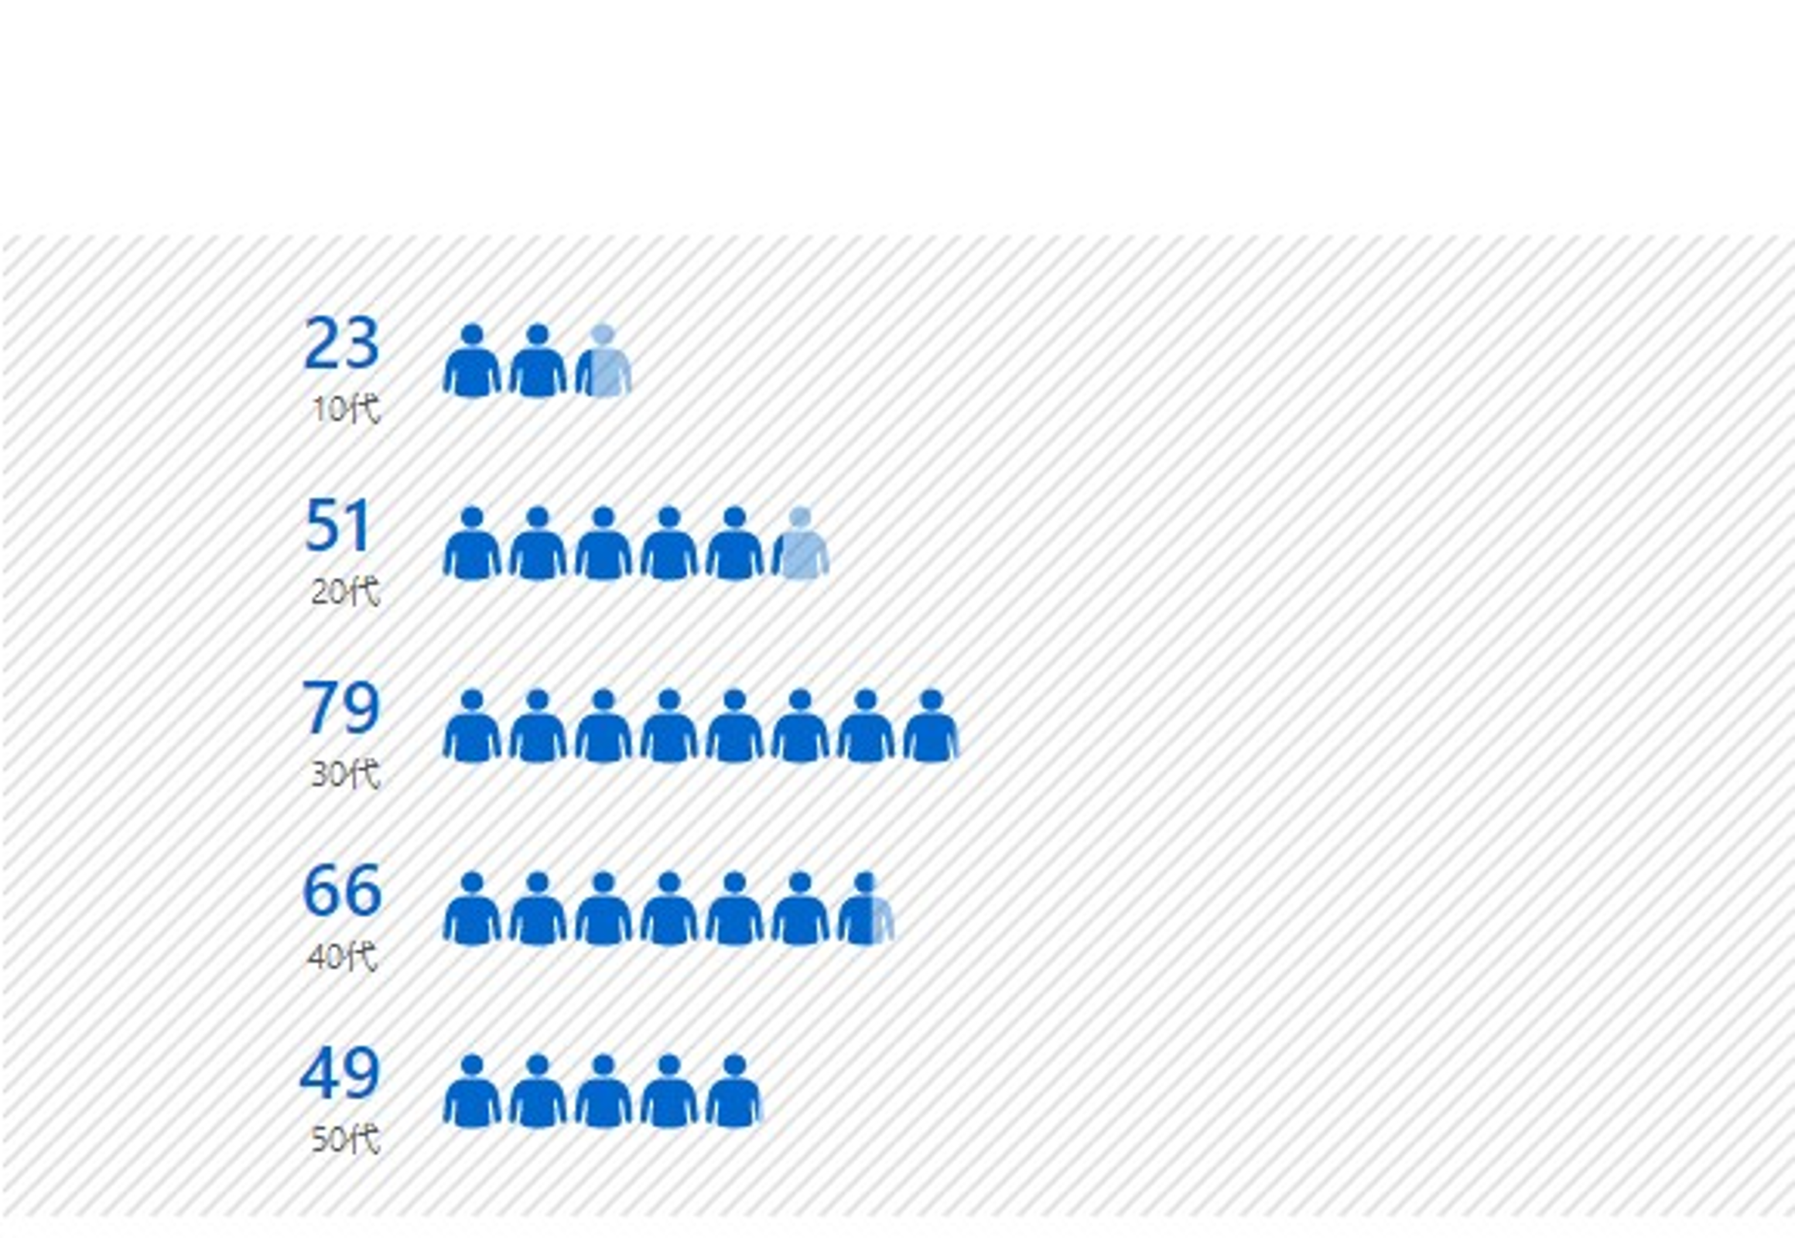
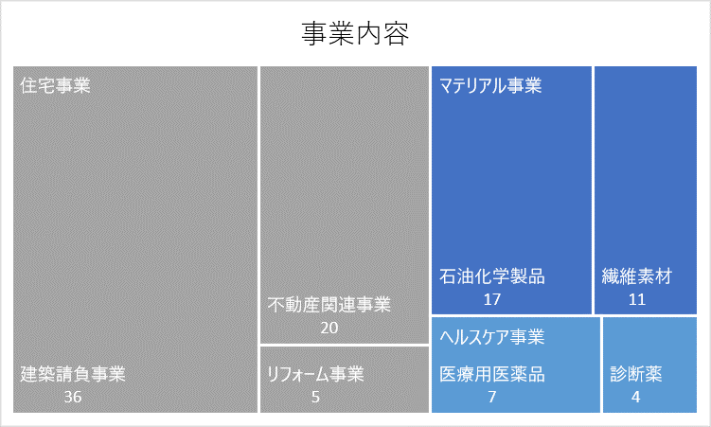
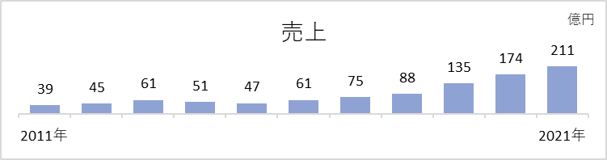
Our Company in Figures
Stock price
3.0倍
Company Evaluation (average score)
Remote work
4.3pt
65%
Ratio of people under 40
61%
Main business (Housing)
51%
5.4倍
Sales compared to 10 years ago

