Slide 1
MATLAB 程式設計入門篇
音訊讀寫、錄製與播放
(Audio Reading, Writing, Recording, and Playback)
張智星 (Roger Jang)
台大資訊系 多媒體檢索實驗室
CSIE/NTU, MIR Lab

Slide 2
音訊的基本介紹
聲音訊號（Audio Signals）簡稱音訊，泛指由人耳聽到的各種聲音的訊號。
音訊的基本聲學特徵
  音量（Volume）：聲音的大小稱為音量，又稱為力度、強度（Intensity）或是能量（Energy）。音量越大，代表音訊波形的震幅越大。
  音高（Pitch）：聲音的基本頻率（Fundamental Frequency）越高，代表音高越高（例如女高音的歌聲）；反之，聲音的基本頻率越低，代表音高越低（例如男低音的歌聲）。
  音色（Timbre）：音訊波形在每個週期內的變化，就形成了此音訊的音色。不同的音色即代表不同的音訊內容，例如不同的字有不同的發音，或是不同的歌手有不同的特色，這些都是由於音色不同而產生。
Demo via CoolEdit

Slide 3
Basics about Audio Signals
Audio signals: signals that are audible to human
Basic perceptible acoustic features of speech
  Volume (音量): the amplitude of audio signals
    Also known as intensity, or energy.
  Pitch (音高): Fundamental frequency (the number of fundamental periods in a second) in audio signals.
    Usually males have a lower pitch while females have a higher one
  Timbre (音色): Waveform inside a fundamental period.
    Different vowels have different timbres
    Different singers also have different timbres.
Demo via CoolEdit
Quiz!

Slide 4
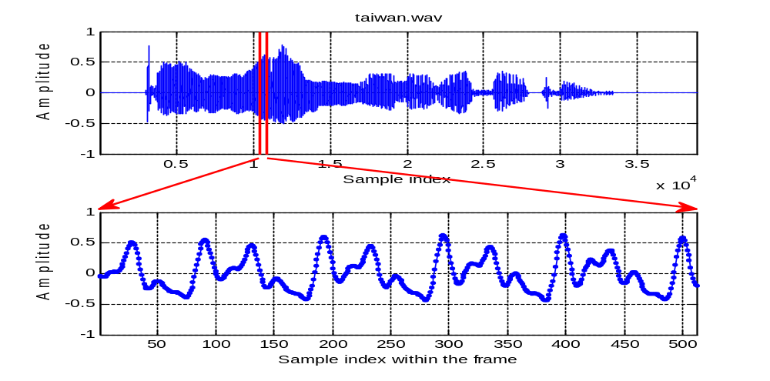
Time-domain Features
Time-domain audio features presented in a frame (analysis window of 20-40 ms)
Fundamental period
Intensity
Timbre: Waveform within an FP

Slide 5
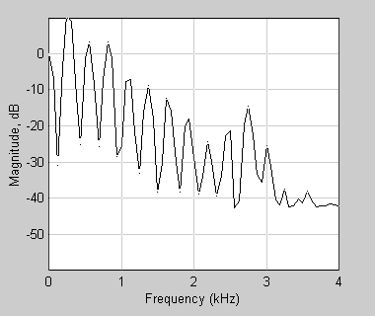
Frequency-domain Features
Frequency-domain audio features in a frame
  Energy: Sum of power spectrum
  Pitch: Distance between harmonics
  Timbre: Smoothed spectrum
Second formant
F2
First formant
F1
Pitch freq
Energy

Slide 6
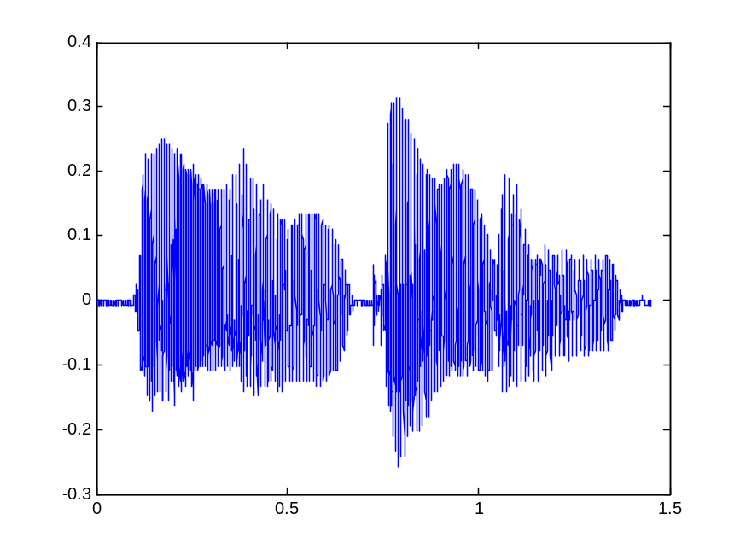
音檔的讀取、寫檔與播放
使用audioread讀取wav檔案，畫出音訊的波形並播放此音訊：
  audioRead01.m
[y, fs]=audioread('welcome.wav');
sound(y, fs); % 播放此音訊
time=(1:length(y))/fs; % 時間軸的向量
plot(time, y); % 畫出時間軸上的波形
放大波形後即可看到基本週期！

Slide 7
Read, Write and Playback
Use “audioread” to read a .wav file, plot its waveform and play the sound.
  audioRead01.m
[y, fs]=audioread('welcome.wav');
sound(y, fs); % Playback
time=(1:length(y))/fs; % Time vector
plot(time, y); % Waveform display
Enlarge to see
fundamental periods!

Slide 8
Read Metadata from .wav Files
中介資料
Reading metadata
  info=audioInfo('file');
  Different types of audio files may return different fields of info.
Two types of reading data from audio files
  Read audio signals
    y= audioread('file')
  Read metadata
    info=audioinfo('file')
Metadata of a .wav file
  audioInfo01.m
fileName='flanger.wav';
info=audioinfo(fileName);
fprintf('檔案名稱 = %s\n', info.Filename);
fprintf('壓縮方式 = %s\n', info.CompressionMethod);
fprintf('通道個數 = %g 個\n', info.NumChannels);
fprintf('取樣頻率 = %g Hz\n', info.SampleRate);
fprintf('取樣點總個數 = %g 個\n', info.TotalSamples);
fprintf('音訊長度 = %g 秒\n', info.Duration);
fprintf('取樣點解析度 = %g 位元/取樣點\n', info.BitsPerSample);

Slide 9
Metadata of Other Audio Files
*.aif
  audioInfo02.m
*.mp3
  audioInfo03.m
fileName='whale.aif';
info=audioinfo(fileName);
disp(info);
fileName='youAtLeast.mp3';
info=audioinfo(fileName);
disp(info);
Filename: 'D:\users\...
CompressionMethod: 'Uncompressed'
NumChannels: 1
SampleRate: 2000
TotalSamples: 4000
Duration: 2
Title: []
Comment: []
Artist: []
BitsPerSample: 16
Filename: 'D:\users\...
CompressionMethod: 'MP3'
NumChannels: 2
SampleRate: 44100
TotalSamples: 317953
Duration: 7.2098
Title: '02_至少還有你'
Comment: []
Artist: '林憶蓮'
BitRate: 128

Slide 10
Scaling of Audio Signals by “audioread”
Internal data types of audio signals in a file (音訊檔案內部儲存方式)
  8 bits ➔ uint8, [0, 2⁸-1]
  16 bits ➔ int16, [-2¹⁵, 2¹⁵-1]
MATLAB’s method to scale raw audio signals to the range [-1, 1]
  8 bits ➔ (y-128)/128
  16 bits ➔ y/32768
Verification of MATLABs’ scaling
  audioRead03.m
  difference = 0
fileName='welcome.wav';
[y, fs]=audioread(fileName);
info=audioinfo(fileName);
nbits=info.BitsPerSample;
% y0 是原先儲存在音訊檔案中的值
y0=y*(2^nbits/2)+(2^nbits/2);
difference=sum(abs(y0-round(y0)))
Original audio signals
in integer

Slide 11
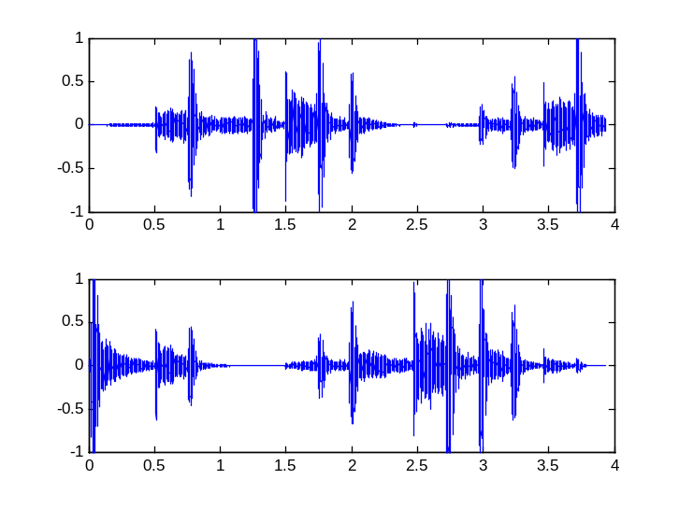
讀取雙聲道檔案
audioread 可以讀取雙聲道或立體聲（Stereo）的音檔，此時傳回的變數具有兩直行，每一直行代表一個聲道的音訊。
  audioRead04.m
fileName='flanger.wav';
[y, fs]=audioread(fileName); % 讀取音訊檔
sound(y, fs); % 播放音訊
left=y(:,1); % 左聲道音訊
right=y(:,2); % 右聲道音訊
subplot(2,1,1), plot((1:length(left))/fs, left);
subplot(2,1,2), plot((1:length(right))/fs, right);
聲音會在左右喇叭游移！

Slide 12
Read Stereo Audio Files
“audioread” can also read stereo audio files. The returned variable has two columns representing two channels of audio signals.
  audioRead04.m
fileName='flanger.wav';
[y, fs]=audioread(fileName); % Read
sound(y, fs); % Playback
left=y(:,1); % Left channel
right=y(:,2); % Right channel
subplot(2,1,1), plot((1:length(left))/fs, left);
subplot(2,1,2), plot((1:length(right))/fs, right);
Moving sound source
between two speakers!

Slide 13
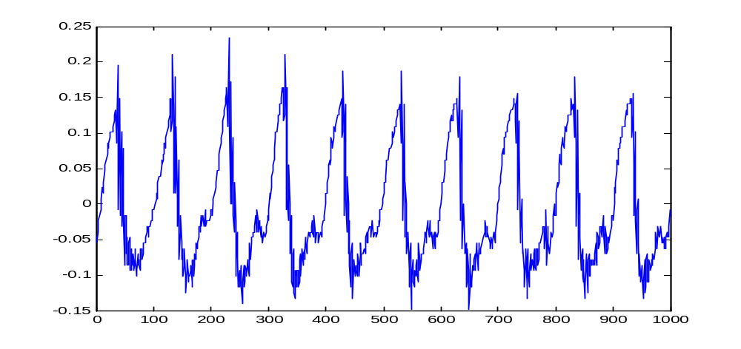
讀取部分音檔
  如果音檔很大，無法一次讀入記憶體，我們也可以使用 audioread 來讀出音檔的一部份，例如：
  audioRead05.m
[y,fs]=audioread('welcome.wav', [4001 5000]); % 讀取第4001至5000點
figure; plot(y)
可看到明顯的基本週期！

Slide 14
Read a Portion Only
  If the audio file is too big, we can read a portion from the whole file:
  audioRead05.m
[y,fs]=audioread(‘welcome.wav’, [4001 5000]); % Read data points 4001 to 5000
figure; plot(y)
Obvious fundamental periods!

Slide 15
聲音訊號的播放
一旦我們可以讀入音訊檔案，就可以對聲音訊號進行各種處理，例如增大或減小音量、提高或降低音高、消除雜訊等。
要確認處理後的聲音訊號是否符合所需，就要能夠把音訊直接透過接到電腦的喇叭播放出來，本節就是要介紹如何使用 MATLAB 來進行音訊的播放。

Slide 16
Playback of Audio Signals
Once we have read audio signals, we can perform all kinds of processing, such as volume modification, pitch scaling, noise reduction, etc.
To verify the result, you need to play the audio via speakers, as shown in the following examples.

Slide 17
播放聲音 (1/2)
一旦 MATLAB 讀入音訊資料，並將之設定成工作空間中的變數後，我們就可以使用 sound 指令來直接播放此變數。
播放單一聲音
  audioPlay01.m
同時播放兩種聲音
  audioPlay02.m
load handel.mat % 載入音訊
sound(y, Fs); % 播放音訊
[y, fs]=audioread('welcome.wav'); % 載入音訊
sound(5*y, fs); % 播放音訊
load handel.mat % 載入音訊
sound(y, Fs); % 播放音訊
sound的播放模式為「非同步播放」！

Slide 18
Playback (1/2)
We can use “sound” to play audio signals that has been read and stored as a variable in MATLAB’s workspace.
Audio playback
  audioPlay01.m
Simultaneous playback
  audioPlay02.m
load handel.mat % Load audio
sound(y, Fs); % Playback
[y, fs]=audioread('welcome.wav'); % Read audio
sound(5*y, fs); % Playback
load handel.mat % Load audio
sound(y, Fs); % Playback
Playback mode of “sound” is asynchronous!

Slide 19
播放聲音 (2/2)
若要控制聲音的播放模式，則必須採用功能較為強大的指令：
  audioplayer
  play
  playblocking
播放單一聲音
  audioPlay03.m
循序播放兩種聲音
  audioPlay04.m
load handel.mat % 載入音訊
p=audioplayer(y, Fs);% 產生播放物件
play(p); % 播放音訊
[y, fs]=audioread(‘welcome.wav’); % 讀入音訊
p=audioplayer(y, fs); % 產生播放物件
playblocking(p); % 播放音訊
load handel.mat % 載入音訊
p=audioplayer(y, Fs); % 產生播放物件
playblocking(p); % 播放音訊
playblocking 的播放模式為「同步播放」！

Slide 20
Playback (2/2)
If you want to control the playback mode, you need to invoke other commands:
  audioplayer
  play
  playblocking
Single playback
  audioPlay03.m
Sequential playback
  audioPlay04.m
load handel.mat % Load audio
p=audioplayer(y, Fs);% Player object
play(p); % Playback
[y, fs]=audioread(‘welcome.wav’); % Read audio
p=audioplayer(y, fs); % Player object
playblocking(p); % Playback
load handel.mat % Load audio
p=audioplayer(y, Fs); % Player object
playblocking(p); % Playback
Playback mode of “playblocking” is synchronous!

Slide 21
改變音訊的震幅
  我們在第一節提到過，聲音的音量是由聲波的震幅來決定，因此我們可藉由震幅的大小來改變音量，例如：
  playVolume01.m
[y, fs]=audioread('welcome.wav');
p=audioplayer(1*y, fs); playblocking(p); % 播放 1 倍震幅的音訊
p=audioplayer(3*y, fs); playblocking(p); % 播放 3 倍震幅的音訊
p=audioplayer(5*y, fs); playblocking(p); % 播放 5 倍震幅的音訊
聲音聽起來並沒有變成3或5倍大聲，為什麼？

Slide 22
Change of Audio Amplitude
  Volume of audio signals is determine by their amplitude. Here are modify amplitude to change the volume:
  playVolume01.m
[y, fs]=audioread('welcome.wav');
p=audioplayer(1*y, fs); playblocking(p); % Original audio
p=audioplayer(3*y, fs); playblocking(p); % Audio of 3x amplitude
p=audioplayer(5*y, fs); playblocking(p); % Audio of 5x amplitude
The playback doesn’t sound like 5-times louder, why?

Slide 23
改變音訊播放的取樣率 (1/2)
  如果在播放時，改變取樣頻率，就會改變整個音訊的時間長度，進而影響到音高。
  在下例中，我們漸漸提高播放時的取樣頻率，聽到的聲音就會越來越快、越來越高，最後出現像唐老鴨的聲音。為什麼？
  playFs01.m
[y, fs]=audioread('welcome.wav');
p=audioplayer(y, fs);
p.SampleRate=1.0*fs; playblocking(p); % 播放 1.0 倍速度的音訊
p.SampleRate=1.2*fs; playblocking(p); % 播放 1.2 倍速度的音訊
p.SampleRate=1.5*fs; playblocking(p); % 播放 1.5 倍速度的音訊
p.SampleRate=2.0*fs; playblocking(p); % 播放 2.0 倍速度的音訊

Slide 24
Change of Sample Rates (1/2)
  Change of sample rate during playback ➔ Change of duration ➔ Change of the perceived pitch
  Increase the sample rate during playback, and you’ll hear Donald Duck (唐老鴨). Why?
  playFs01.m
[y, fs]=audioread('welcome.wav');
p=audioplayer(y, fs);
p.SampleRate=1.0*fs; playblocking(p); % Duration ratio: 1
p.SampleRate=1.2*fs; playblocking(p); % Duration ratio: 1/1.2
p.SampleRate=1.5*fs; playblocking(p); % Duration ratio: 1/1.5
p.SampleRate=2.0*fs; playblocking(p); % Duration ratio: 1/2

Slide 25
改變音訊播放的取樣率 (2/2)
  反之，如果漸漸降低播放的頻率，聽到的聲音就會越來越慢、越來越低，最後出現像牛叫的聲音。
  playFs02.m
[y, fs]=audioread('welcome.wav');
p=audioplayer(y, fs);
p.SampleRate=1.0*fs; playblocking(p); % 播放 1.0 倍速度的音訊
p.SampleRate=0.9*fs; playblocking(p); % 播放 0.9 倍速度的音訊
p.SampleRate=0.8*fs; playblocking(p); % 播放 0.8 倍速度的音訊
p.SampleRate=0.6*fs; playblocking(p); % 播放 0.6 倍速度的音訊

Slide 26
Change of Sample Rates (2/2)
  On the other hand, decrease the sample rate during playback, and you’ll hear cow moo…
  playFs02.m
[y, fs]=audioread('welcome.wav');
p=audioplayer(y, fs);
p.SampleRate=1.0*fs; playblocking(p); % Duration ratio: 1
p.SampleRate=0.9*fs; playblocking(p); % Duration ratio: 1/0.9
p.SampleRate=0.8*fs; playblocking(p); % Duration ratio: 1/0.8
p.SampleRate=0.6*fs; playblocking(p); % Duration ratio: 1/0.6

Slide 27
Observations
Observations
  Larger sample rate for playback leads to…
    Shorter duration and higher pitch
  Smaller sample rate for playback leads to...
    Longer duration and lower pitch
How to…
  Generate higher pitch without duration change?
    ➔ Pitch modification
  Create longer duration without pitch change?
    ➔ Duration modification
  Demo
Quiz!

Slide 28
改變符號及改變時序
  如果我們將聲波訊號上下顛倒，聽到的聲音基本上是一樣的，但是如果前後顛倒，聽到的聲音就如同錄音帶「倒放」的聲音，聽起來很像是某種外國語音，請試試下列範例：
  範例20-11： playReverse01.m
[y, fs]=audioread('welcome.wav');
p=audioplayer(y, fs); playblocking(p); % 播放正常的音訊波形
p=audioplayer(-y, fs); playblocking(p); % 播放上下顛倒的音訊波形
p=audioplayer(flipud(y), fs); playblocking(p); % 播放前後顛倒的音訊波形

Slide 29
Change of Sign & Time Sequence
  Change of sign ➔ No perceptional difference
  Reverse sequence ➔ Sounds like another spoken language?
  範例20-11： playReverse01.m
[y, fs]=audioread('welcome.wav');
p=audioplayer(y, fs); playblocking(p); % Normal playback
p=audioplayer(-y, fs); playblocking(p); % Change of sign
p=audioplayer(flipud(y), fs); playblocking(p); % Reverse the sequence

Slide 30
同步及非同步播放
  通常在播放音訊時，MATLAB 停止進行其他動作，直到音訊播放完畢後，才會再進行其他指令的運算，此種運作方式稱為「同步式」（Synchronous）。若需要一邊播放、一邊進行其他運算，就必須使用「非同步式」（Asynchronous）的播放方式。
  範例20-12： playSync01.m
[y, fs]=audioread('welcome.wav');
p=audioplayer(y, fs);
playblocking(p); % 同步播放 1.0 倍速度的音訊
sound(y, 0.8*fs); % 非同步播放 0.8 倍速度的音訊
sound(y, 0.6*fs); % 非同步播放 0.6 倍速度的音訊

Slide 31
非同步播放
  在此例中，我們會聽到類似男女兩部合唱，一快一慢，這是因為 sound 指令的預設播放方式就是「非同步」。
  範例20-13： playSync02.m
load handel.mat
sound(y, Fs);
sound(y, 1.2*Fs);

Slide 32
Playback Modes
  There are two playback modes
    Synchronous mode: Block everything till the end of playback.
    Asychronous mode: Nonblocking
  playSync01.m
  playSync02.m
[y, fs]=audioread('welcome.wav');
p=audioplayer(y, fs);
playblocking(p); % Synchronous
sound(y, 0.8*fs); % Asynchronous
sound(y, 0.6*fs); % Asynchronous
load handel.mat
sound(y, Fs);
sound(y, 1.2*Fs);

Slide 33
音量自動調整
  另一個類似的指令是 soundsc，可針對音訊變數的數值先進行正規化（介於 –1 和 1 中間）後，再送到喇叭播放，以達到最好的播放效果。
  soundsc01.m
[y, fs]=audioread('welcome.wav');
sound(y, fs);
fprintf('Press any key to continue...\n'); pause
soundsc(y, fs);
在影像顯示方面，對應的命令是 imagesc。

Slide 34
Automatic Volume Adjustment
  “soundsc” adjusts the volume (by normalizing the signals to have max of 1 or min of -1) before playback
  soundsc01.m
[y, fs]=audioread('welcome.wav');
sound(y, fs);
fprintf('Press any key to continue...\n'); pause
soundsc(y, fs);
The corresponding command for
image display is “imagesc”.

Slide 35
聲音訊號的錄製
我們在第一節已經說明了如何讀取音訊檔案，並在第二節說明如何播放。MATLAB 也支援直接由麥克風讀取訊號，因此可以直接進行聲音的錄製，所使用的指令是
  audiorecorder
  recordblocking

Slide 36
Recording of Audio Signals
We can use the following MATLAB commands for recording from the microphone directly:
  audiorecorder
  recordblocking

Slide 37
音訊的錄製範例 (1/2)
使用預設參數，由麥克風進行3秒錄音：
  audioRecord01.m
  預設錄音參數
    取樣頻率為 8000 Hz
    取樣點解析度為 8 bits
    單聲道錄音
duration=3; % 錄音時間
recObj=audiorecorder;
fprintf('按任意鍵後開始 %g 秒錄音：', duration); pause
fprintf('錄音中...');
recordblocking(recObj, duration);
fprintf('錄音結束\n');
fprintf('按任意鍵後開始播放：'); pause
play(recObj);

Slide 38
Recording (1/2)
Use default setting for 3-sec recording:
  audioRecord01.m
  Default settings for recording
    Sample rate: 8000 Hz
    Bit resolution: 8 bits
    Mono
duration=3; % Duration of recording
recObj=audiorecorder;
fprintf('按任意鍵後開始 %g 秒錄音：', duration); pause % Prompt
fprintf('錄音中...'); % During recording
recordblocking(recObj, duration);
fprintf('錄音結束\n'); % End of recording
fprintf('按任意鍵後開始播放：'); pause % Press any key for playback
play(recObj);

Slide 39
音訊的錄製範例 (2/2)
設定各項錄音參數來進行3秒錄音，並畫出波形：
  audioRecord02.m
fs=16000; % 取樣頻率
nBits=16; % 取樣點解析度，必須是 8 或 16 或 24
nChannel=1; % 聲道個數，必須是1(單聲道)或2(雙聲道或立體音)
duration=3; % 錄音時間（秒）
recObj=audiorecorder(fs, nBits, nChannel);
fprintf('按任意鍵後開始 %g 秒錄音：', duration); pause
fprintf('錄音中...');
recordblocking(recObj, duration);
fprintf('錄音結束\n');
fprintf('按任意鍵後開始播放：'); pause
play(recObj);
y = getaudiodata(recObj, 'double'); % get data as a double array
plot((1:length(data))/fs, y);
xlabel('Time (sec)'); ylabel('Amplitude');
設定錄音參數
取得音訊資料

Slide 40
Recording (2/2)
Set recording parameters, record, plot the waveform:
  audioRecord02.m
fs=16000; % Sample rate
nBits=16; % Bit resolution (must be 8, 16, or 24)
nChannel=1; % No. of channels (must be 1 or 2)
duration=3; % Duration for recording in sec
recObj=audiorecorder(fs, nBits, nChannel);
fprintf('按任意鍵後開始 %g 秒錄音：', duration); pause
fprintf('錄音中...');
recordblocking(recObj, duration);
fprintf('錄音結束\n');
fprintf('按任意鍵後開始播放：'); pause
play(recObj);
y = getaudiodata(recObj, 'double'); % get data as a double array
plot((1:length(data))/fs, y);
xlabel('Time (sec)'); ylabel('Amplitude');
Set up recording
parameters
Obtain audio signals

Slide 41
聲音訊號的寫檔 (1/2)
我們也可以經由 MATLAB 將音訊資料直接儲存為音訊檔案，以便直接在電腦播放。寫入音訊檔案的指令是 audiowrite，其格式為:
  audiowrite(audioFile, y, fs)
    audioFile 則是欲寫入資料的檔案名稱，y 是音訊變數，fs 是取樣頻率。
  範例：audioWrite01.m
load handel.mat
audioFile='handel.wav'; % 欲儲存的 wav 檔案
fprintf('Saving to %s...\n', audioFile);
audiowrite(audioFile, y, round(1.5*Fs));
fprintf('按任意鍵後開始播放 %s...\n', audioFile);
dos(['start ', audioFile]); % 開啟與 wav 檔案對應的應用程式

Slide 42
Storing Audio Files (1/2)
We can use “audiowrite” to save audio files, with the following I/O format:
  audiowrite(audioFile, y, fs)
    audioFile: file to write to, y: audio signals, fs: sample rate
  範例：audioWrite01.m
load handel.mat
audioFile='handel.wav'; % wav file to write to
fprintf('Saving to %s...\n', audioFile);
audiowrite(audioFile, y, round(1.5*Fs));
fprintf('按任意鍵後開始播放 %s...\n', audioFile);
dos(['start ', audioFile]); % Use default application to open the wav file

Slide 43
聲音訊號的寫檔 (2/2)
錄音、播放、存檔的範例：
  範例：audioWrite02.m
fs=16000; % 取樣頻率
nBits=16; % 取樣點解析度，必須是 8 或 16 或 24
nChannel=1; % 聲道個數，必須是 1（單聲道） 或 2（雙聲道或立體音）
duration=3; % 錄音時間（秒）
recObj=audiorecorder(fs, nBits, nChannel);
fprintf('按任意鍵後開始 %g 秒錄音：', duration); pause
fprintf('錄音中...');
recordblocking(recObj, duration);
fprintf('錄音結束\n');
fprintf('按任意鍵後開始播放：\n'); pause
y = getaudiodata(recObj, 'double'); % get data as a double array
plot((1:length(data))/fs, y); xlabel('Time (sec)'); ylabel('Amplitude');
sound(y, fs);
audioFile='myRecording.wav'; % 欲儲存的 wav 檔案
fprintf('Saving to %s...\n', audioFile);
audiowrite(audioFile, y, fs);
system(audioFile); % Use default application to open the wav file

Slide 44
Storing Audio Files (2/2)
Example of recording, playback, and saving:
  範例：audioWrite02.m
fs=16000; % Sample rate
nBits=16; % Bit resolution (must be 8, 16, or 24)
nChannel=1; % No. of channels (must be 1 or 2)
duration=3; % Recording duration in sec
recObj=audiorecorder(fs, nBits, nChannel);
fprintf('按任意鍵後開始 %g 秒錄音：', duration); pause
fprintf('錄音中...');
recordblocking(recObj, duration);
fprintf('錄音結束\n');
fprintf('按任意鍵後開始播放：\n'); pause
y = getaudiodata(recObj, 'double'); % get data as a double array
plot((1:length(data))/fs, y); xlabel('Time (sec)'); ylabel('Amplitude');
sound(y, fs);
audioFile='myRecording.wav'; % wav file to be saved
fprintf('Saving to %s...\n', audioFile);
audiowrite(audioFile, y, fs);
system(audioFile); % 開啟與 wav 檔案對應的應用程式

Slide 45
Cross-version Issues
File mapping for different versions of MATLAB
  wavread ➔ audioread
  wavwrite ➔ audiowrite
  wavplay ➔ audioplayer, sound
  wavrecord ➔ audiorecorder
Other supports
  audiodevinfo
  playblocking
  play
SAP toolbox
  Version-independent audio file reading ➔ myAudioRead.m
  Progressive bar ➔ audioPlayWithBar.m

Slide 46
Supplementary Material
Other resources
  ASPR: Audio Signal Processing and Recognition
    Texts for this set of slides can be found at Chapter 4.
    Pitch tracking by visual inspection can be found at Section 4 of Chapter 5. (Slides)

