Slide 1
Software Safety Case Study
Medical Devices : Therac 25 and beyond
Matthew Dwyer

Slide 2
History
The Therac 25 was a 3rd generation medical linear accelerator
  Used as a radiation therapy machine for treating cancers
Improved on older machines by being a dual-mode machine, i.e., capable of x-ray and electron therapy
  Allows for treatment of deep cancers
  X-ray therapy requires very high energy levels
  The beams are then filtered for dosing

Slide 3
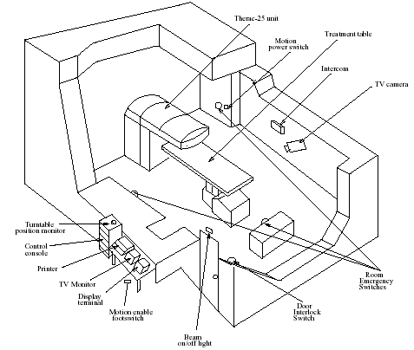
Therac 25

Slide 4
Traditional LINACs
Were purely electro-mechanical systems
  All patient and therapy setting were entered in hardware
  Delivering a treatment was time consuming
  Hardware interlocks prevented unsafe emission of radiation, e.g., door/beam interlock
  think of the button that controls your refrigerator light as an interlock that assures the light isn’t on when the door is closed

Slide 5
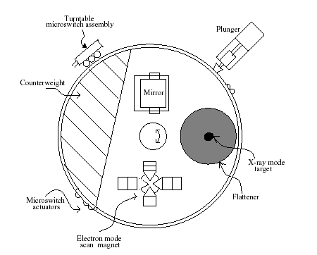
Therac 25 Turntable

Slide 6
Turntable Positioning
Is essential for safety
  X-ray position and electron power ➔ underdose
  Electron position and X-ray power ➔ overdose
Computer-control of turntable position
  Computer controls rotation
  3 sensors indicate positioning
  Sensor readings are recorded
  Software tests recorded readings to insure proper positioning
  Hardware inter-locks removed

Slide 7
Machine Operation
Enter treatment room
Position patient on treatment table
Set field size, gantry rotation and attach accessories to machine
Leave treatment room
Enter patient id, prescription, field size, gantry rotation and accessory info
If info matches settings then “VERIFIED” is indicated and treatment may proceed

Slide 8
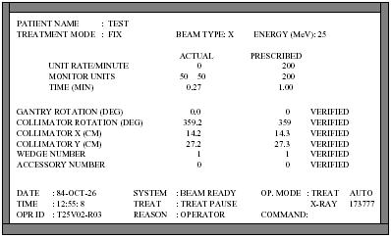
Operator Interface Screen

Slide 9
Usability
An operator can administer therapy to up to 30 patients a day
Setup time was an issue
Operators complained that re-keying data took too long
  The machine developers implemented a feature that allowed “enter” to be used to keep an existing entry unchanged

Slide 10
Patient/Operator Communication
Operators monitored patients through a closed circuit video/audio link
In case of a problem (e.g., patient complaint) there are two ways to stop the machine
  Treatment suspend (requires complete machine reset to restart)
  Treatment pause (requires a single keystroke to resume treatment)
  Pause-resume bounded at 5 times before reset

Slide 11
Segmentation fault …
As with many software systems, the usefulness of error messages was a low priority
Error messages were
  Cryptic (“Malfunction 47”, “VTILT”, …)
  Commonly occurring (e.g., 40 times/day)
  Rarely involved patient safety
Operators became desensitized to them
  Trained to rely on “builtin safety mechanisms”
  Assumed they would be resolved during the next machine servicing visit

Slide 12
Machine Usage
11 Therac 25 Machines installed in US and Canada
6 massive overdoses reported between 1985 and 1987
Recalled in 1987

Slide 13
Ontario, July 1985
Patient being treated for cervical cancer with a 200 rad dose
Machine stops with an “HTILT” error
Console displays “NO DOSE”
Operator resumes treatment
  As mentioned resuming after an error was standard procedure
Same error
Stop-resume repeated 4 more times until reset
Patient died 5 months later
Estimated overdose: 15000 rads (1000 is fatal)

Slide 14
Texas, March 1986
Patient being treated for tumor on his back with a 180 rad dose of electron therapy
Operator enters data and noticed she had entered “x” (for X-ray in mode)
  Used the up-arrow key to move up and change the entry to “e”
  No other parameter changes so she “entered” back down
Start treatment, stops immediately with “MALFUNCTION 54”
  Undocumented, but this means that a dose had been delivered that was either too low or too high
Machine showed underdose
Resume treatment, stops again with same error
Operator hears banging on door

Slide 15
Texas, March 1986
After first dose, patient felt a “shock” on his back and called to the operator
  The video display was unplugged and audio monitor was broken at the time
Getting no response, he sat up to get off the table when the second dose was applied
Patient died from complications of the overdose 5 months later
Estimated overdose: 16-25 krads

Slide 16
Texas, April 1986
Patient being treated for skin cancer on face with a 180 rad dose of electron therapy
Same operator, same error
Operator enters data and noticed she had entered “x” (for X-ray in mode)
  Used the up-arrow key to move up and change the entry to “e”
  No other parameter changes so she “entered” back down
Start treatment, stops immediately with “MALFUNCTION 54”
Operator hears patient cry out
  Audio monitor has been fixed
Patient died 20 days later due to high-dose radiation injury to his right temporal lobe
Estimated overdose: 25krads

Slide 17
Diagnosing the problem
Hospital physicist and operator worked diligently to try to recreate the problem
  Found that the speed of data-entry was a factor in creating the MALFUNCTION 54
This problem was reproduced on an earlier LINAC (Therac 20)
  It existed in the software
  It did not compromise safety due to hardware interlocks

Slide 18
There were many problems …
with this system
The Texas accidents have been traced to an error in the software
Accidents in Washington were traced to another error
This was a system’s safety problem not simply bugs in a program
There were many other bugs found in the software that were not safety critical

Slide 19
Therac 25 Software
Runs on a custom-built cyclic pre-emptive executive
  “tasks” are executed in series based on criticality
  More critical tasks can pre-empt less critical tasks
  No synchronization operations (except for test & set)
4 main components of the software
  Stored data (machine setup and patient-treatment data)
  Interrupt handlers
  Critical tasks
  Non-critical tasks

Slide 20
A Race Condition
Non-critical keyboard handler task
Parses text input
Encodes result in 2-byte shared variable
Sets data entry complete flag
Critical task treatment processor (Treat)
Detects data entry
Reads encoded data to lookup operating parameters
Calls routine to set the bending magnets (8 second latency)
Loop to delay until magnets set
  Appears to check for new data entry while waiting
Once set treatment processing proceeds

Slide 21
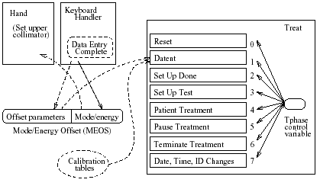
Texas Bug

Slide 22
Datent Internals
Magnet:
[1] set bending flag
repeat
[2] set next magnet
[3] call Ptime
[4] if mode/enegy changed then exit
[5] until all magnets are set
[6] return
Ptime:
repeat
[7] if bending flag then
[8] if edit taking place then
[9] if mode/energy changed then exit
[10] until delay expired
[11] clear bending flag
[12] return
Trace
[1] bending set
[2]
[3]
[7] test true
[8]
[10]
…
[11] bending reset
[12]
[4]
[5]
[2]
[3]
[7] test false
… edit occurs here …
[10]
8 sec

Slide 23
Washington Bug
Treat
Set Up Test called multiple times during setup; increments shared variable “Class 3” each time
Check if housekeeping task (Hkeper) has detected an inconsistent collimator setting by reading shared variable “F$mal”; if not setup is done
Hkeper
If “Class 3” is not 0 check collimator position
Set “F$mal” to result of collimator position test

Slide 24
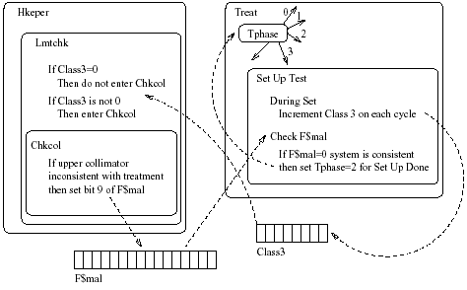
Another Race Condition
2) Class 3 rolls over to 0
4) Test succeeds
1) 256th iteration
3) Collimator misaligned

Slide 25
Lessons
Overconfidence in software control
Confusing reliability with safety
  History of correct operation doesn’t assure absence of future errors
Lack of defensive design
Failure to eliminate root causes
  Diagnosis and fix of presumed problems weren’t actually addressing the real problem
Complacency

Slide 26
Lessons
Unrealistic risk assessment
  Therac 25 had a risk analysis (it did not consider software)
Inadequate investigation and followup
Inadequate software engineering practices
  Keep critical software simple and testable
Software Reuse
  Just because it worked in another system doesn’t mean it works
Safe versus Friendly User Interfaces
  Identify critical interfaces and design them appropriately

Slide 27
FDA Response
First big failure of a radiological device
Center for Devices and Radiological Health (CDRH) became involved
Quickly determined that the manufacturer had such poor practice that a fix was impossible
  Hesitated in recalling (re “undue burden”)
Instituted reforms at FDA/CDRH
  Increased emphasis on software
  Much more stringent reporting requirements

Slide 28
Issues in Software Safety
What are the responsibilities of these parties?
System designer/programmer
Operators
Manufacturer
Hospital
Government

Slide 29
Levels of Computer Control
The operator does everything.
The computer tells the operator the options available.
The computer tells the operator the options available and suggests one.
The computer suggests an action and implements it if asked.
The computer suggests an action, informs the operator, and implements the action if not stopped in time.
The computer selects and implements an action if not stopped in time and then informs the operator.
The computer selects and implements an action and tells the operator if asked.
The computer selects and implements an action and tells the operator if the designer decides the operator should be notified.
The computer selects and implements an action without any human involvement.

Slide 30
What level of control is this …
an error message is given (e.g. Malfunction 54), but the system allows the operator to press a "proceed" key to retry the treatment.
the treatment is suspended after any error and all treatment data must be typed in over again
when the operator is required to "visually check the settings" on the treatment machine
when the machine set itself up based on the treatment data entered and then proceeds with the treatment

Slide 31
Software Safety Myths
1. The cost of computers is lower than that of analog or electromechanical devices.
2. Software is easy to change.
3. Computers provide greater reliability than the devices they replace.
4. Increasing software reliability will increase safety.
5. Testing software and formal verification of software can remove all the errors.
6. Reusing software increases safety.
7. Computers reduce risk over mechanical systems.

Slide 32
Safety Technologies
Risk/hazard analysis
  Use dependence analysis to identify potential causal relationships in the system
  Identifies critical software components
Rigorous specification
  Drives inspections and testing
Exhaustive (sound) analyses
  Catch subtle bugs (e.g., race conditions)
  Analyze HCI systems (e.g., cockpit mode confusion)
Nothing is perfect

