Slide 1
The Economic Legacy of the Olympic Games
By: Sam Bunten

Slide 2

Agenda
Research Question
Problem
Approach
Data Findings
Implications
Ethical Concerns
Conclusion

Slide 3
Research Question
What are the long-term economic effects of hosting the Olympics?

Slide 4
Problem
Olympics selection committees make lofty promises
Increased tourism, improved infrastructure, job creation, tourism
Requires a lot of money upfront
Bidding typically costs 50-100 million
Most Olympics do not make a profit
Only the 1984 Los Angeles Olympics is known to have turned a profit
Where is the money coming from?
Private vs Public

Slide 5
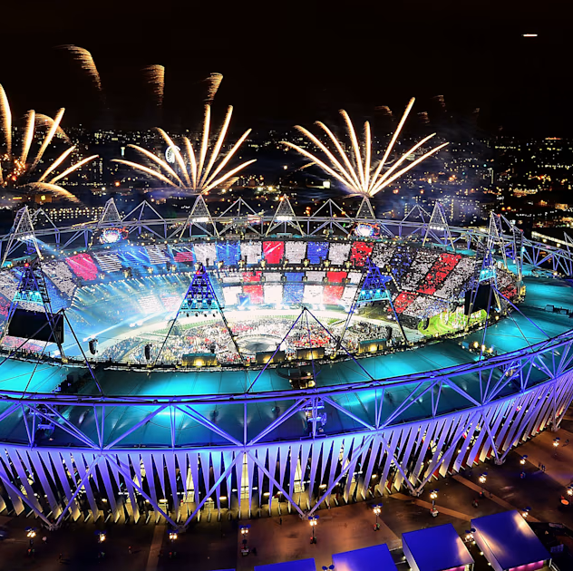
Approach: Difference in Differences (DiD)
Focused on 7 Olympic Hosts between 2010-2022
Data from World Bank, IMF, Macrotrends
Metrics: GDP Growth Rate, Unemployment Rate, Inflation Rate
Timeline: Year Prior, Year of Event, 3 Years after Event
2 Case Studies using DiD methodology
Brazil and United Kingdom

Slide 6
What is DiD?
Experimental method measuring the effects of a treatment group vs control
In this case, I had to look at similar countries during the same time period
This is done to try to isolate the effects of hosting the Olympics

Slide 7
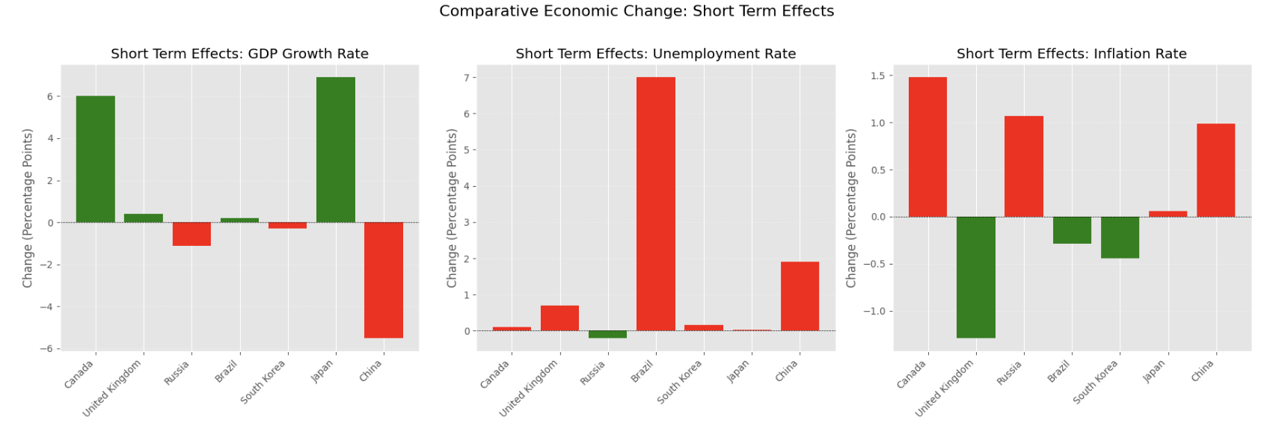
Preliminary Findings: Short Term

Slide 8
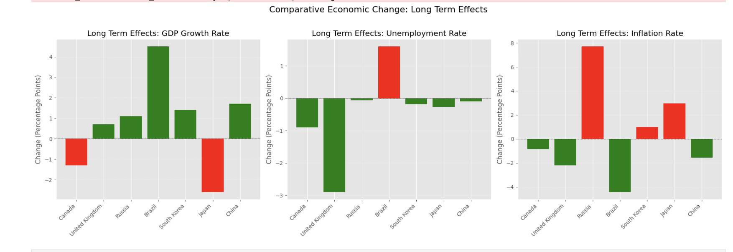
Preliminary Findings: Long Term

Slide 9
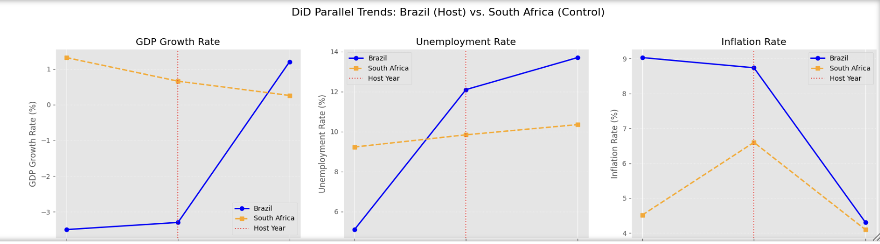
Case Study: Brazil
Rio Olympics were considered a major economic failure
Brazil was in a recession prior to hosting the event
Brazil (Rio 2016) controlled by South Africa: Both BRICS, commodity-dependent emerging markets facing similar global economic shocks

Slide 10
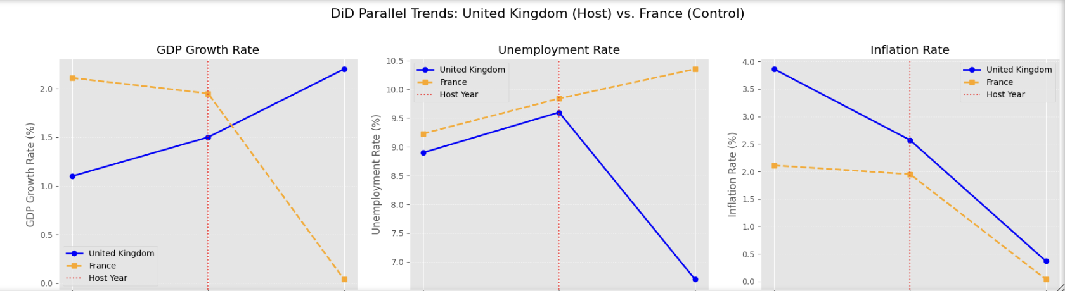
Case Study: United Kingdom
London Olympics widely considered an economic success
Created thousands of jobs and revitalized East London
UK (London 2012) controlled by France: G7 economies recovering from the 2008 financial crisis

Slide 11

"The Savannah, not the Zoo"
Real world data is messy
It is easy to come to a conclusion without understanding the bigger picture
Economies are impacted by a variety of factors
Overall global fluctuations need to be accounted for

Slide 12
Implications
Stakeholder | Finding | Implication
Developed Nations/Hosts | UK DiD data is extremely positive. The games acted as a catalyst for investment and job creation | If done correctly hosting can provide economic growth and new opportunities
Emerging Nations/Future Hosts | Brazil DiD is negative. The games failed to improve prior negative economic situations | Hosting isn't guaranteed to solve all economic issues like it is typically promised to do
Governing Bodies/Selection Committees | Cost of failed events is felt by the citizens | Potentially require hosts to come up with a long-term plan to help mitigate risks
Investors | Costs typically go way over budget which impacts the economy negatively | Legal restrictions should be placed on various steps throughout this process

Slide 13

Ethics
Governing agencies typically exaggerate potential effects
Stricter legal requirements needed to protect citizens
Infrastructure is often times abandoned afterwards
Citizens feel the effects firsthand

Slide 14
Conclusion
Analyzing economies for a city is difficult
Most data is only available on a national level
DiD results validates that the Olympics provide a measurable causal effect on economic performance, but only in certain contexts.
The Olympics do not create economic stability. However, they do seem to amplify the economic stability or instability that already exists.
For any country seeking to host, the focus should not be on GDP projections, but on answering: Can the local economy absorb the shock of massive investment without creating a disproportionate surge in joblessness relative to global trends?

