Slide 1

An easier way to file for bankruptcy.
Notes:
This is ‘Easy Way Out’, an easier way to file for bankruptcy.

Slide 2
Why go with the Easy(er) Way Out?
Filing for bankruptcy is a stressful and emotional time.
Current form is long and overwhelming.
Asset value estimates without the cost of an appraiser.
Reduce evaluation errors and ensure assets are fairly valued.
Notes:
Filing for bankruptcy can be highly emotional and stressful. The current process for filing for bankruptcy involves completing a 25-page PDF covering all aspects of your financial position.
Our team saw that completing this form could add to an already overwhelming situation,
especially for those who may not be as financially literate or have access to financial advice.

Slide 3
Our Solution

Slide 4
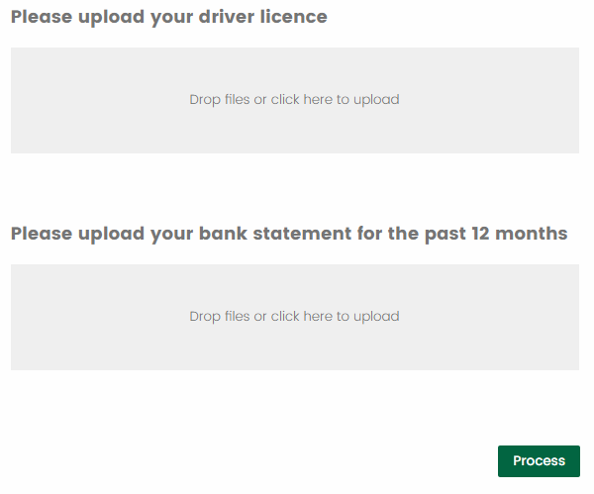





Add snapshot of
web form here
OCR
.pdf, .jpeg
.pdf, .csv, .jpeg
Bank Statement
Driver’s License
Parse OCR output into tabular data
.csv
WEBFORM
Property Statement
Other Relevant Docs
Auto-populates web form
Statistical Data Extraction Model
Demographic Clustering Model (ATO Dataset)
Large Asset Threshold
Bankruptcy
Applicant
Loan Detection
(Recurring Payments)
Outputs:
List of Assets
List of Creditors
Income Info
Personal Info
Etc.
Past Income
Other Personal Info.
Notes:
This is a high-level overview of our current solution to overcome the stresses when filing for bankruptcy.
When the applicant decides to file for bankruptcy, a digitised webform will be presented to the user to upload their required documents.
The uploaded document will be fed through our processing pipeline. How it is processed depends on its document type.
Optical character recognition is also used for unstructured file, such as PDFs or scanned documents. The parsed document will then be used to construct the statistical data extraction model in assistance with the demographic clustering model. The statistical model will attempt to extract the relevant information presented in the parsed document and feed it back to the webform. This process can be performed for multiple uploaded documents.
The applicant will be able to validate the final result before it is populated to the webform.

Slide 5
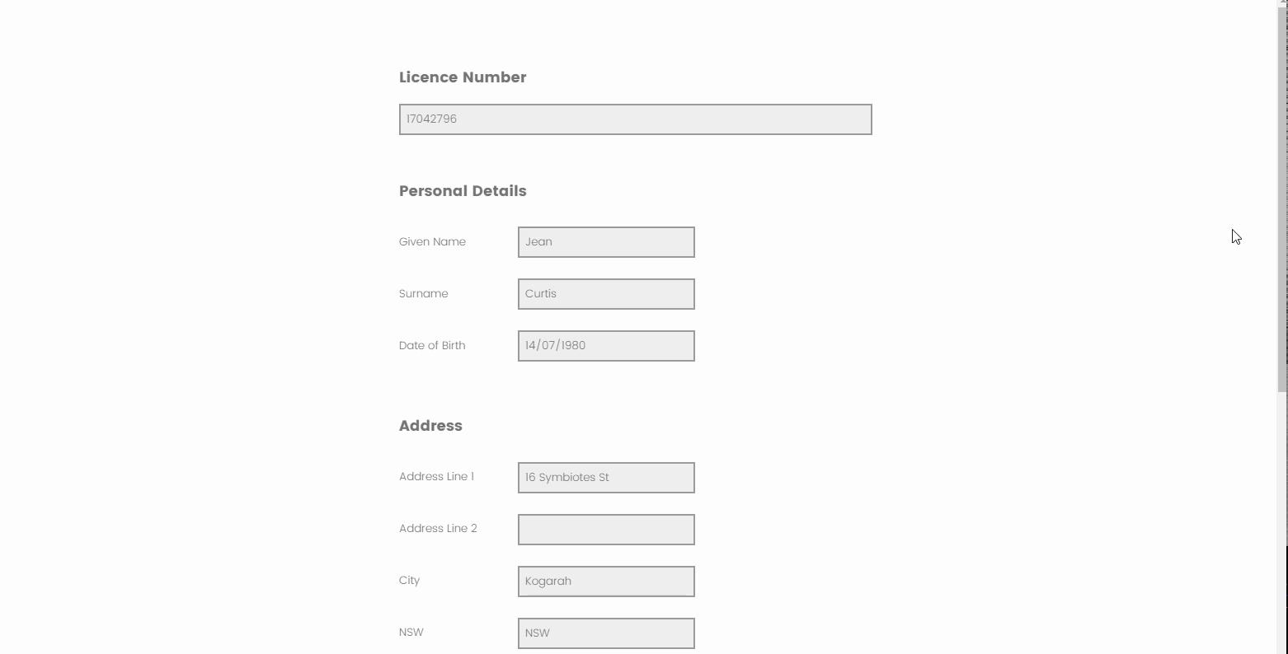
Notes:
Here's an example of pre-population. You will be asked to provide your driver licence and bank statement. From these two documents alone, we can extract information such as your name, date of birth, address, as well as income and assets, which can be inferred from transactions in the bank statement.

Slide 6
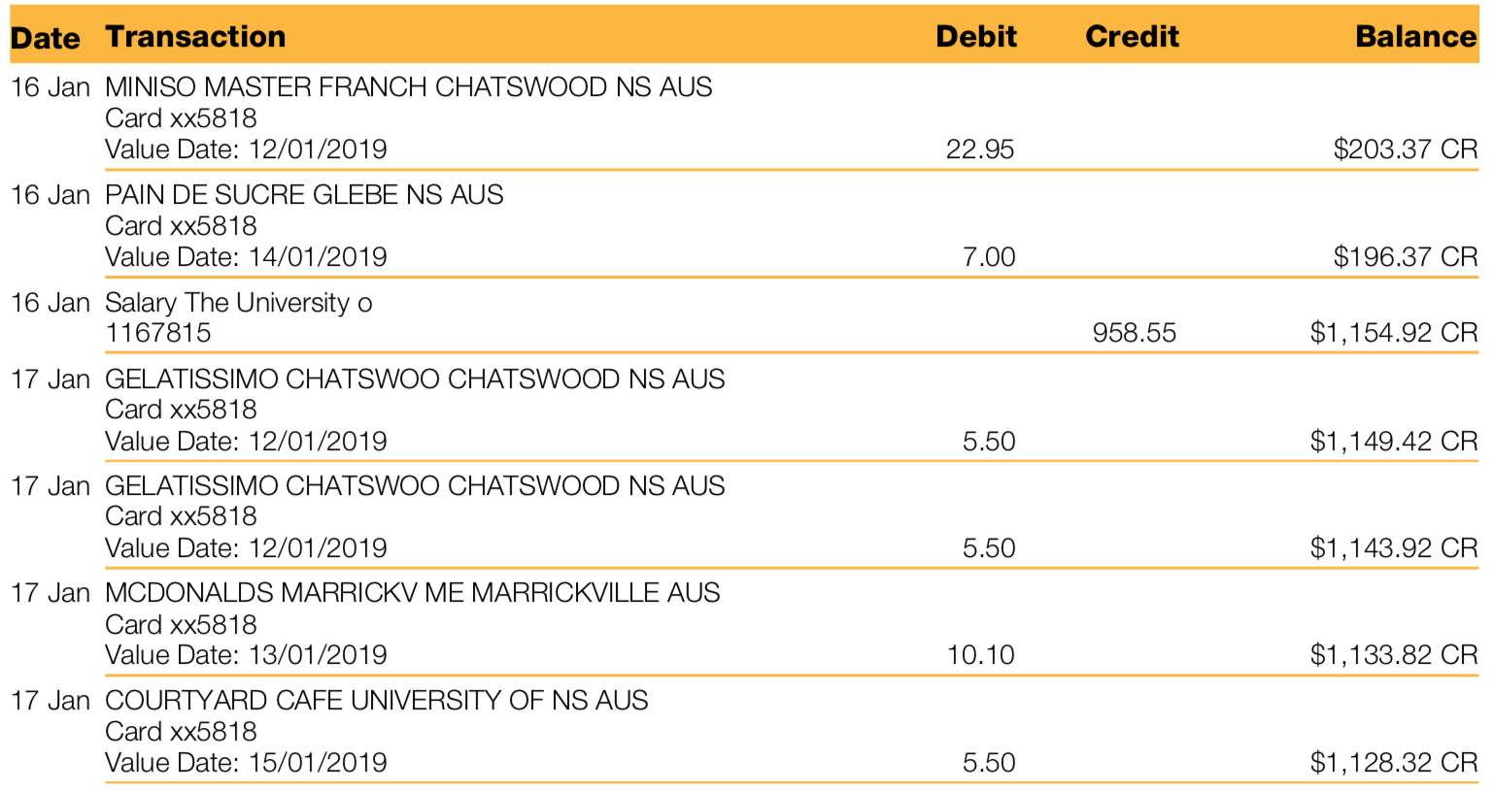
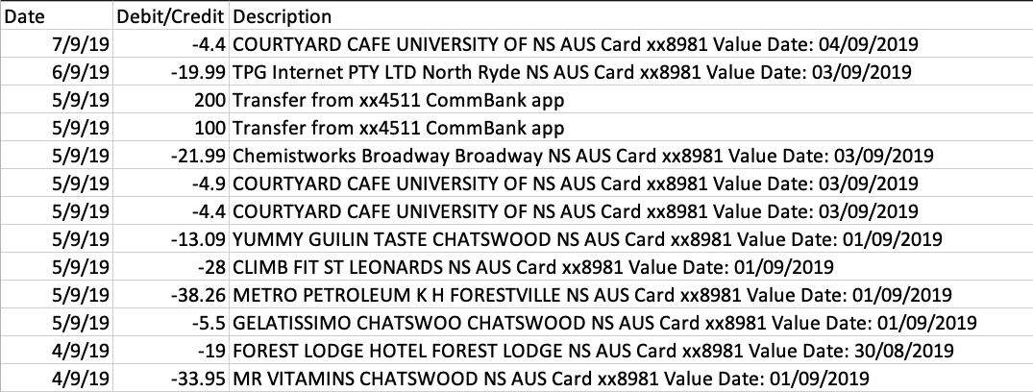
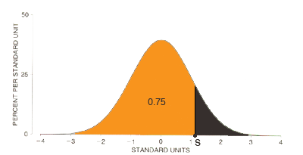
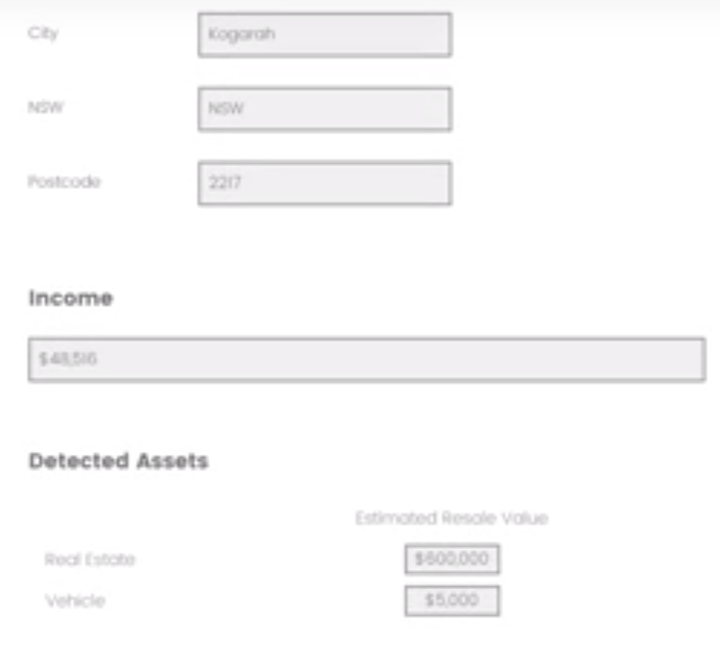
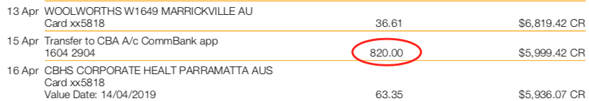
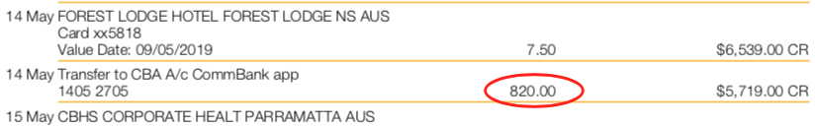
Asset and Recurring Pattern Detection
16 Jan MINISO MASTER FRANCH CHATSWOOD NS AUS
Card xx5818
Value Date: 12/01/2019 22.95 $203.37 CR
16 Jan PAIN DE SUCRE GLEBE NS AUS
Card xx5818
Value Date: 14/01/2019 7.00 $196.37 CR
16 Jan Salary The University o
1167815 958.55 $1,154.92 CR
OCR
Parse
Statistical Model
Threshold Filter
Large Asset Detection
Transaction Distribution
Auto-populate
Pattern Finding
Recurring Pattern Detection
Auto Populate webform
Recurring Transaction
Notes:
But what happens behind the scenes? When the applicant uploads their document (in this case, a bank statement), OCR will be applied to a variety of document types, including PDFs and scanned documents. The raw output will then be parsed into a tabular data structure to prepare for the Statistical model.
Two main algorithms are included in the statistical model for the bank statement. The distribution of the transaction data will be modeled, and the third quantile of the distribution can be used as the threshold for finding potentially large assets purchased within the past year. Through this approach, the dynamic threshold can adjust for different applicants depending on their spending pattern.
Another algorithm, the Recurring Pattern Detection Algorithm, coexists with the Large asset detection model. This algorithm will be able to identify any recurring pattern that exists in the uploaded bank statement, such as past income and outstanding loan.
All the extracted data will be automatically populated in the digitised bankruptcy application form and validated by the applicant.

Slide 7
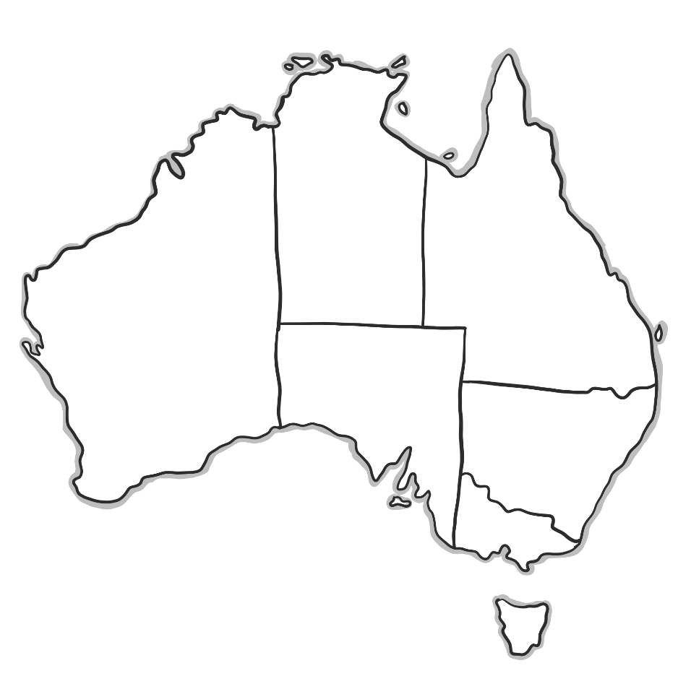
Plan for Rolling Out Solution
Based on reviewing historical insolvency data:
PHASE 2:
Townsville
PHASE 1:
Wyong
PHASE 1: Campbelltown
Additional Considerations:
Singles without dependants
Couples with dependants
Pensioners, retirees, unemployed, students
Map vector created by rocketpixel - www.freepik.com
Notes:
The key focus points of this solution’s roll out include:
NSW as the ``initial state to focus on, followed by QLD and VIC
The NSW focus will initially be on SA3 locations “Wyong” and “Campbelltown”
The QLD focus will initially be on SA3 Location “Townsville”
Roll out in a phase step based on Welfare payment indicators in chart
This roll out plan has been developed based on reviewing historical Insolvency Data (between 2007 and 2018).
[IGNORED]
There were some additional considerations that were identified from this analysis:
“Singles without Dependants” and “Couples with dependants” are highly represented
“Males” are the highest gender represented
“AFSA” is the most commonly reported Job linked with Insolvency by far
Source: Attributes of insolvent debtors Dataset
https://data.gov.au/data/dataset/attributes-of-insolvent-debtors

Slide 8
Future Work
Bankruptcy Fraud Detection
With the digitised bankruptcy application form, a pre-screening of the inputs can performed to detect any anomaly for the entered details, which will be matched against the demographics group data to identify potential bankruptcy fraud.
Application Prioritisation:
Furthermore, a digital form may assist the government to prioritise applicants with overwhelming debt relative to their financial position and those in greater need of protection from creditors.
Notes:
As we add more data to the models, we believe that the solution can enable more potential benefits in the future.
Bankruptcy Fraud Detection
With the digitised bankruptcy application form, a pre-screening of the inputs can performed to detect any anomaly for the entered details, which will be matched against the demographics group data to identify potential bankruptcy fraud.
Application Prioritisation:
Furthermore, a digital form may assist the government to prioritise applicants with overwhelming debt relative to their financial position and those in greater need of protection from creditors.

Slide 9
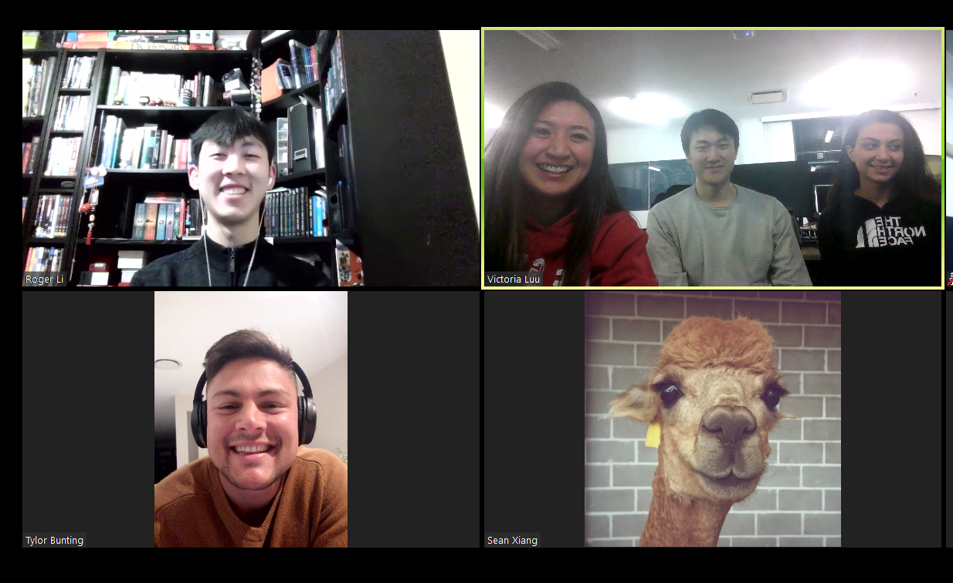

Slide 10
Roll out in a phase step based on Welfare payment indicators in chart
This roll out plan has been developed based on reviewing historical Insolvency Data (between 2007 and 2018).
The key focus points of this solution’s roll out include:
NSW as the initial state to focus on followed by QLD and VIC
The NSW focus will initially be on SA3 locations “Wyong” and “Campbelltown”
The QLD focus will initially be on SA3 Location “Townsville”
Some additional considerations that were identified from this analysis:
“Singles without Dependants” and “Couples with dependants” highly represented
“Males” are the highest gender represented
“AFSA” is the most commonly reported Job linked with Insolvency by far
Source: Attributes of insolvent debtors Dataset
https://data.gov.au/data/dataset/attributes-of-insolvent-debtors

Slide 11
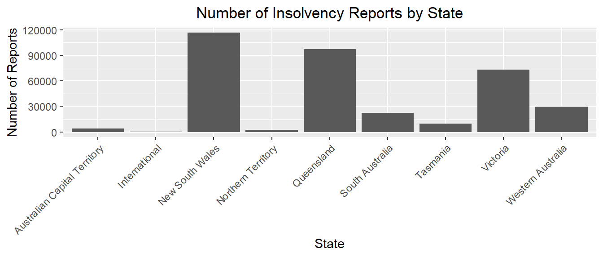
Historical data needs to be analysed to determine the best place to start rolling out this new solution. In the diagram below, it is evident that NSW, QLD and VIC are the three leading states.
Notes:
Roll out in a phase step based on Welfare payment indicators in chart

Slide 12
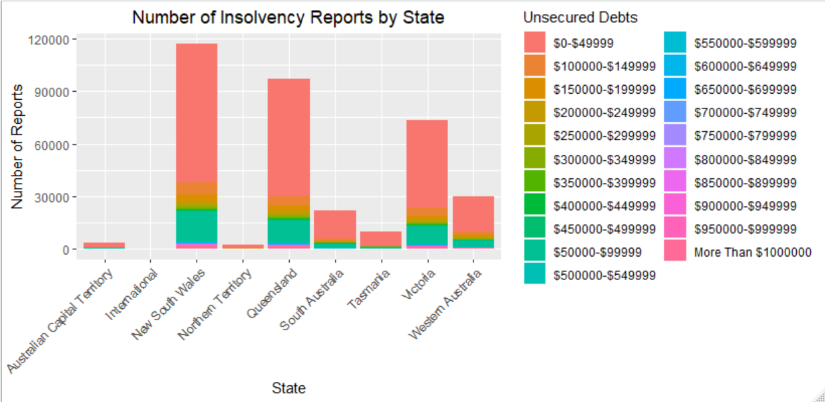
These three states remain the leaders when looking at other factors such as Unsecured Debts and Value of Assets.
Notes:
Roll out in a phase step based on Welfare payment indicators in

Slide 13
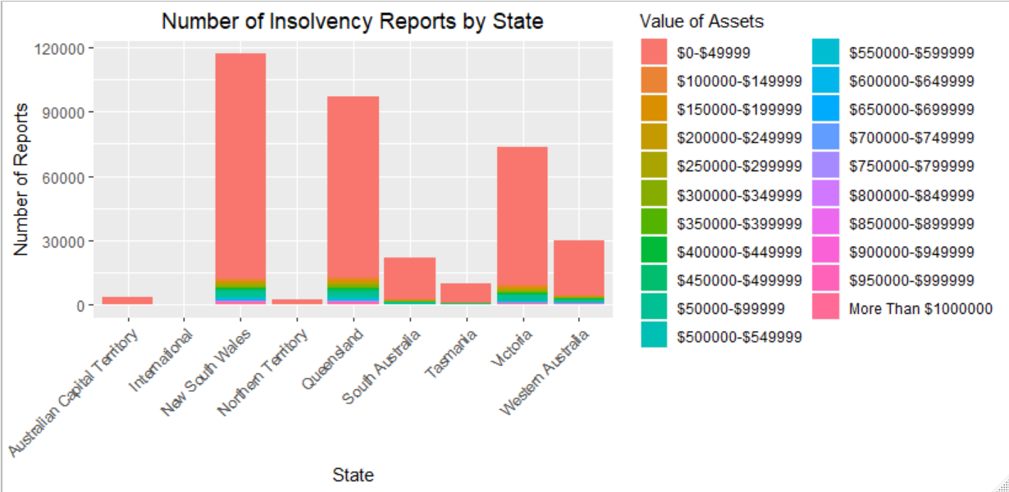
These three states remain the leaders when looking at other factors such as Unsecured Debts and Value of Assets.
Notes:
Roll out in a phase step based on Welfare payment indicators in chart

Slide 14
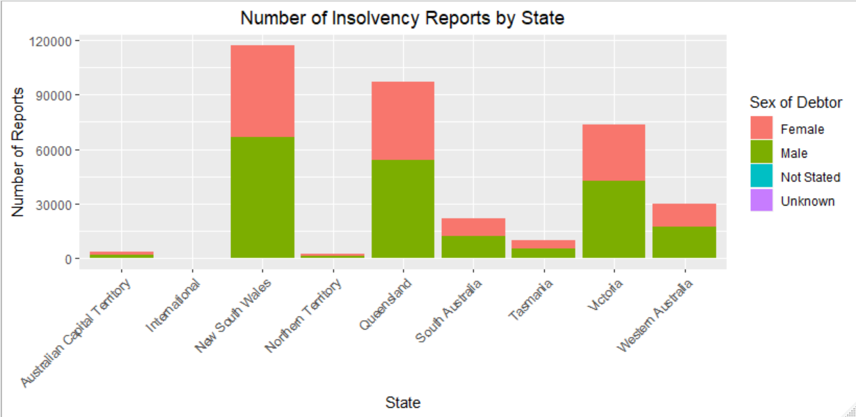
When looking over all states, it can be seen that males are the highest represented gender.
Notes:
Roll out in a phase step based on Welfare payment indicators in chart

Slide 15
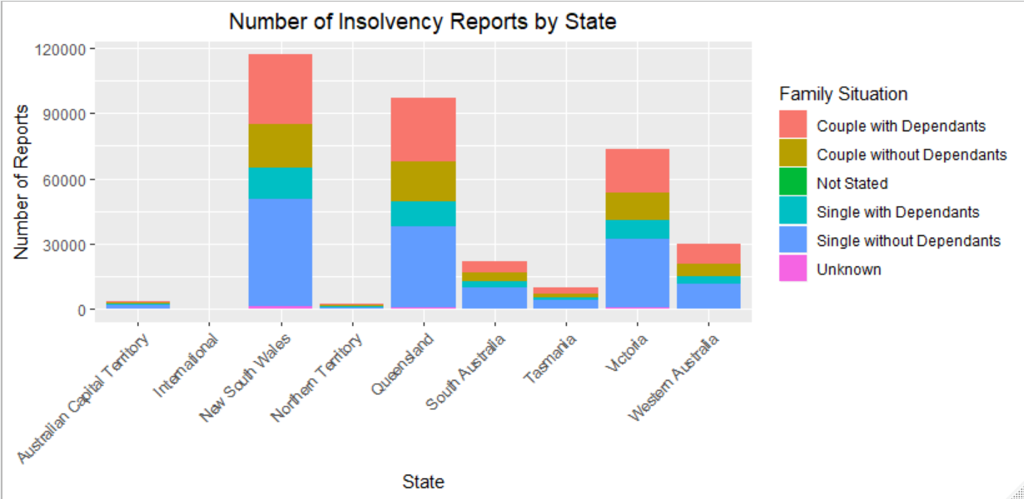
Additionally, Singles without Dependants and Couples with Dependants appear to be most commonly represented for insolvency.
Notes:
Roll out in a phase step based on Welfare payment indicators in chart

Slide 16
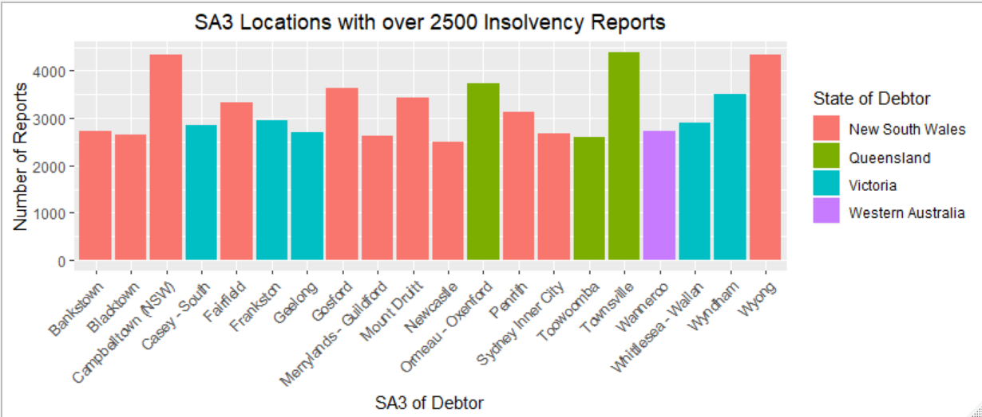
When taking a look at the highest represented SA3 locations, it is again NSW, QLD and VIC that are most commonly represented—mainly Townsville, Wyong, and Campbelltown.
Notes:
Roll out in a phase step based on Welfare payment indicators in chart

Slide 17
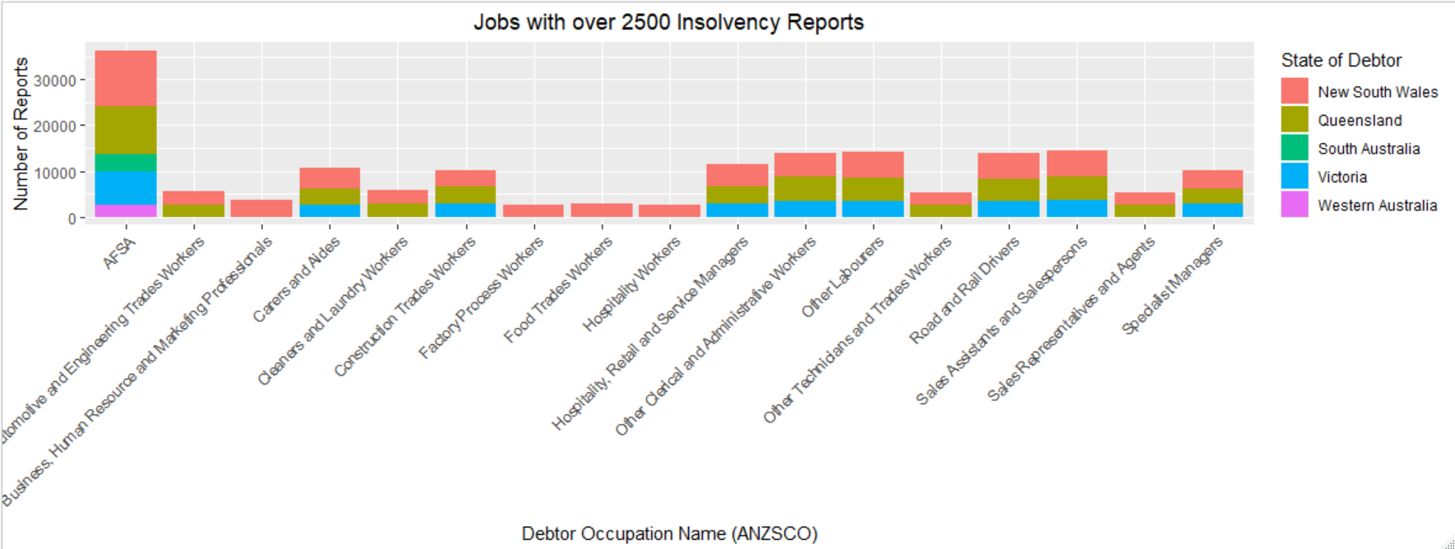
NSW is seen to have the most commonly occurring instances of jobs that are linked with insolvency reports, and AFSA jobs are clearly the most commonly represented jobs.
Notes:
Roll out in a phase step based on Welfare payment indicators in chart

Slide 18
<div>Icons made by <a href="https://www.flaticon.com/authors/freepik" title="Freepik">Freepik</a> from <a href="https://www.flaticon.com/" title="Flaticon">www.flaticon.com</a></div>
<a href="https://www.freepik.com/free-photos-vectors/map">Map vector created by rocketpixel - www.freepik.com</a>

