Slide 1


CORONA VIRUS ANALYSIS
Data-Driven Insights into the Spread and Impact of CORONA VIRUS
Author: Bunty Patil
Date: 06-06-2024

Slide 2
TABLE OF CONTENTS
01
02
Project Overview
Dataset
03
Analysis Report
04
Conclusion

Slide 3
Note
This project is associated with ‘Mentorness’ while working as a data analyst intern. All analysis questions have been assigned by the ‘Mentorness’ team, and the same has been completed using MySQL.

Slide 4
01
Project Overview

Slide 5
Project Overview
The CORONA VIRUS pandemic has significantly impacted public health and has created an urgent
need for data-driven insights to understand the spread of the virus. As a data analyst, you have been
tasked with analyzing a CORONA VIRUS dataset to derive meaningful insights and present your findings.

Slide 6
02
Dataset

Slide 7

DATASET
VARIABLE | DESCRIPTION
province | Geographic subdivision within a country/region.
country_or_region | Geographic entity where data is recorded.
latitude | North-south position on Earth's surface.
longitude | East-west position on Earth's surface.
date | Recorded date of CORONA VIRUS data.
confirmed | Number of diagnosed CORONA VIRUS cases.
deaths | Number of CORONA VIRUS related deaths.
recovered | Number of recovered CORONA VIRUS cases.

Slide 8
03
Analysis Report

Slide 9
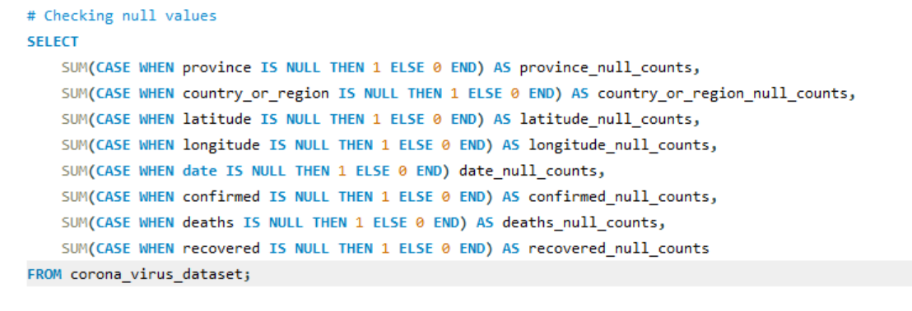
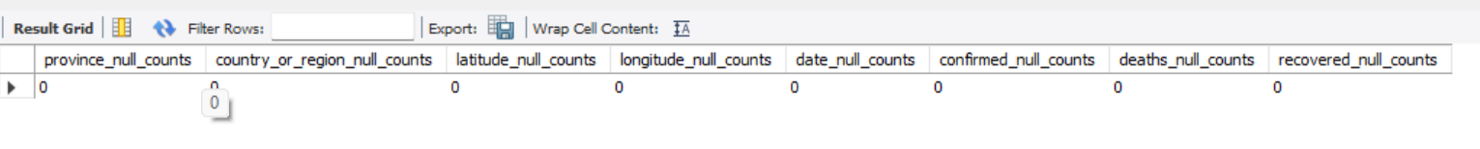
Q-1 Write a code to check the null values
The dataset did not contain any null values.

Slide 10
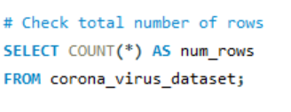
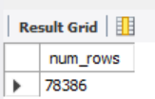
Q-2 Check total number of rows
A total of 78386 rows are present in the dataset.

Slide 11
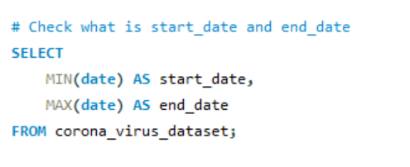
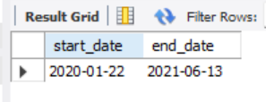
Q-3 Check what the start date and end date is
Start date: January 22, 2020
End date: June 13, 2021

Slide 12
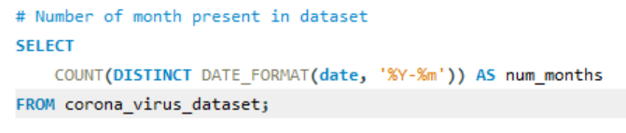
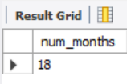
Q-4 Number of months present in the dataset
A total of 18 months present in the dataset.

Slide 13
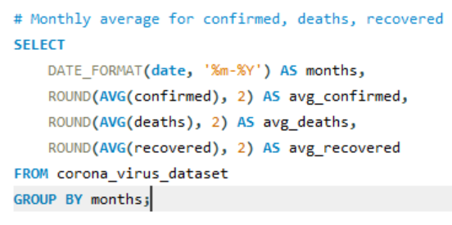
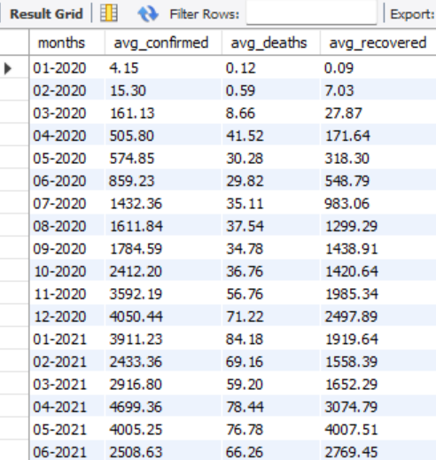
Q-5 Find the monthly average for confirmed, deaths, and recovered cases.
Based on the monthly average for confirmed, deaths, and recovered cases, it is evident that there was a significant peak in average cases during the first wave, from April 2020 to January 2021. There was a gradual increase during this period.
In February and March 2021, there was a slight decrease in the monthly average cases.
However, in April 2021, the monthly average cases increased again and reached a peak, which lasted until June 2021.

Slide 14
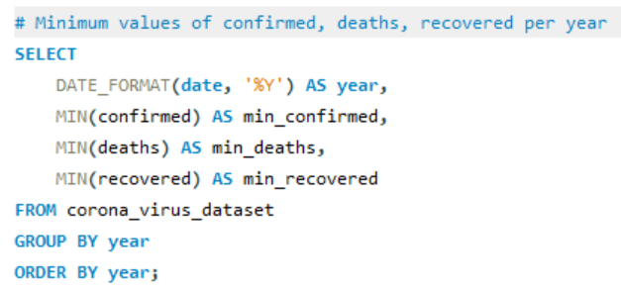
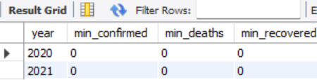
Q-6 Find the minimum values for confirmed, deaths, and recovered cases per year.
The minimum number of confirmed, deaths, and recovered cases was 0 in both 2020 and 2021.
In 2020, the minimum value could be 0 during the initial stages of the pandemic when the virus had not yet spread nationwide.
In 2021, when the number of cases was at its peak, it was not possible for the minimum values in 2021 to be 0. This could happen if the Null values were replaced by 0 in the dataset.

Slide 15
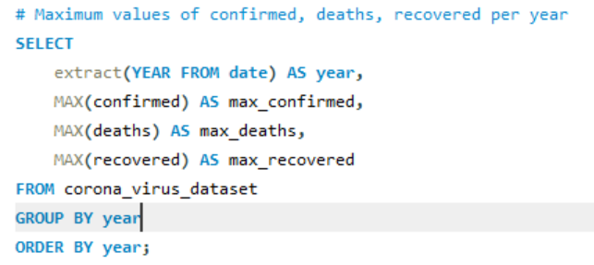
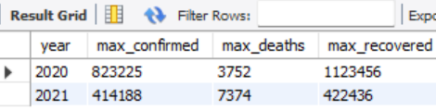
Q-7 Find the maximum values for confirmed, deaths, and recovered cases per year.
The maximum number of confirmed cases in 2020 is comparatively higher than in 2021.
In 2020, the reported number of deaths is lower than in 2021.
The number of recovered cases is lower in 2021, possibly due to a decrease in confirmed cases for the same period.

Slide 16
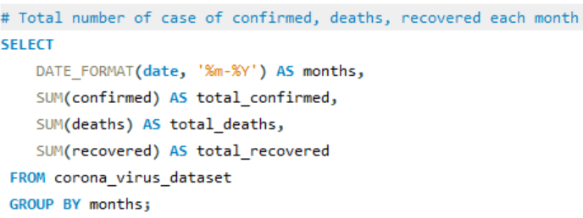
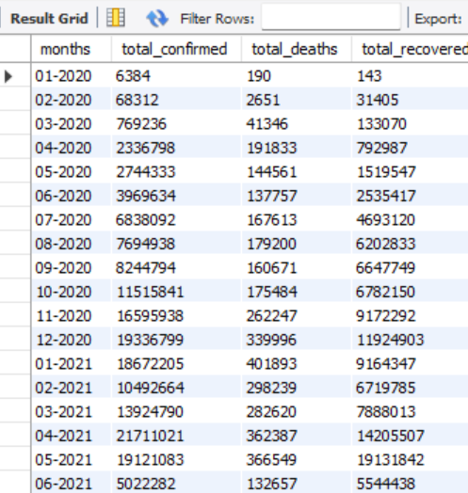
Q-8 Find the total number of confirmed, deaths, and recovered cases per month.
The total number of confirmed and recovered cases peaked in December 2020 during the first wave of COVID-19.
In April 2021, the total confirmed and recovered cases reported were the highest across both waves.

Slide 17
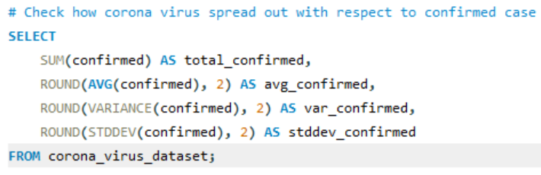

Q-9 Check how corona virus spread out with respect to confirmed cases.
The global impact of the virus is evident with a total of 169,065,144 confirmed cases.
On average, each record in the dataset reports 2,157 confirmed cases, indicating high transmission rates of the virus.
The high variance (157,288,925.08) and standard deviation (12,541.49) indicate significant variability in the spread of the virus in different areas and at different times.
A high standard deviation indicates varying numbers of confirmed cases, highlighting localized outbreaks or surges in specific regions or periods.

Slide 18
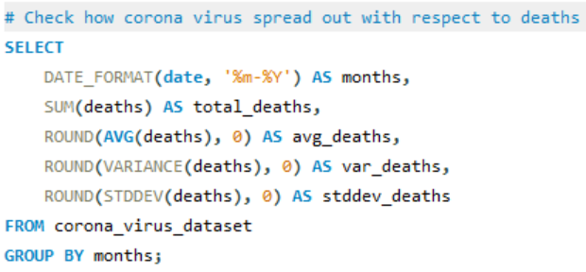
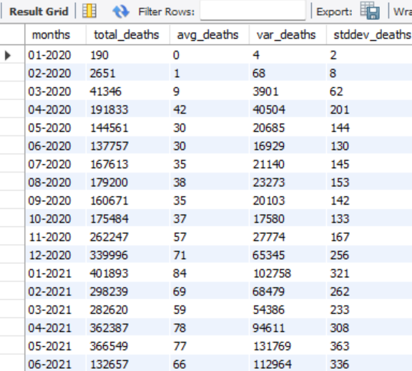
Q-10 Check how corona virus spread out with respect to deaths per month.
Significant rise in deaths from 190 in January 2020 to 41,346 in March 2020.
Highest number of deaths recorded at 339,996 in December 2020
Average death peaks in December 2020 with an average of 71 deaths.
Variance and standard deviation peak in December 2020 indicating higher variability.

Slide 19
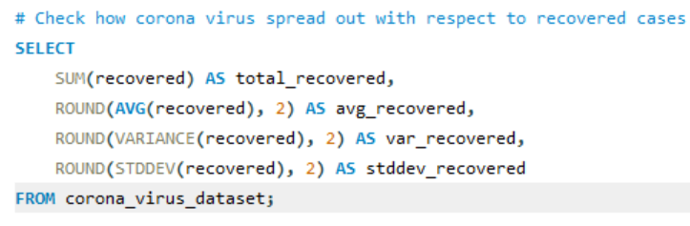

Q-11 Check how the corona virus spread out with respect to recovered cases.
The total number of recovered cases from COVID-19 is 113,089,548, indicating significant progress in treatment and recovery efforts.
The average number of recovered cases is 1,442.73, providing insight into the recovery rate during the analyzed period.
The variance in recovered cases is 10,702,952.26. A high variance indicates a wide spread in the number of recovered cases, which can be attributed to fluctuations over time, different waves of infections, and varying recovery rates.
The standard deviation is 10,345.51, indicating significant fluctuations in the number of recovered cases due to varying impacts of the pandemic over time.

Slide 20
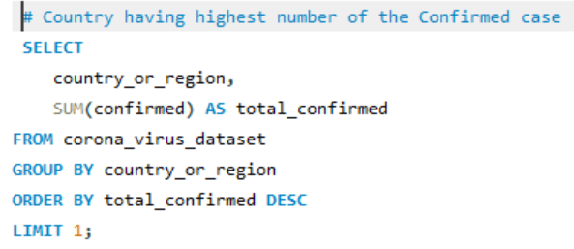

Q-12 Find the country having the highest number of confirmed cases.
The US (United States) is the country with the highest number of confirmed cases.

Slide 21
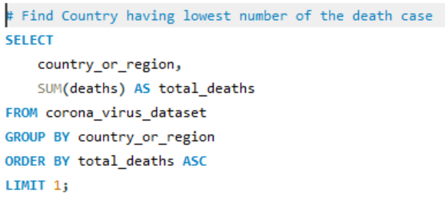
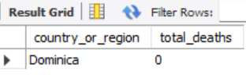
Q-13 Find the country having the lowest number of deaths.
Dominica is the country with the lowest number of deaths.

Slide 22
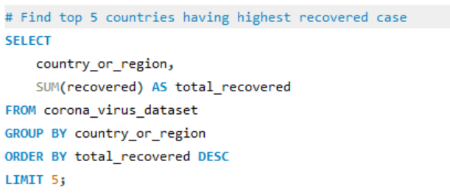
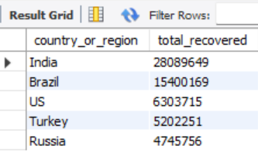
Q-14 Find the top 5 countries having the highest number of recovered cases.
Top 5 countries by total recovered cases:
INDIA
BRAZIL
US
TURKEY
RUSIA

Slide 23
04
Conclusion

Slide 24
CONCLUSION
In summary, our analysis of the coronavirus dataset reveals the extensive impact of COVID-19, with 169 million confirmed cases highlighting its global reach. The high average of 2,156 confirmed cases per record and significant variability underscores the uneven spread and frequent surges. These insights stress the importance of continuous monitoring, targeted interventions, and efficient resource allocation to manage the pandemic effectively. Understanding these patterns helps us to better prepare for and respond to future public health challenges, ensuring more resilient and adaptable healthcare systems.

Slide 25

THANKS!
Does anyone have any questions?
Mail me at:
buntypatil1305@gmail.com

