Slide 1


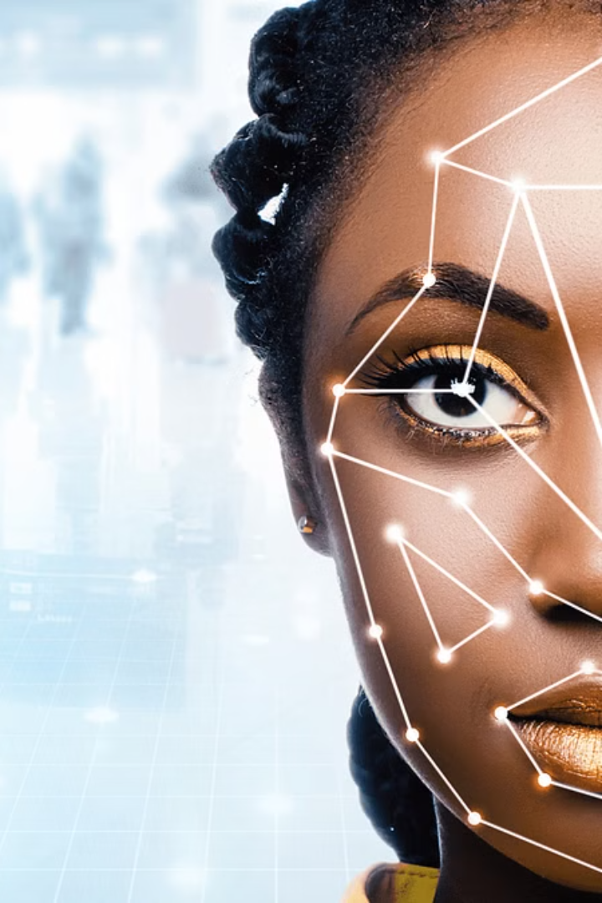
Revolutionizing Attendance with Face Recognition Technology
Welcome to the future of attendance management, where precision meets convenience. A sophisticated approach tailored to meet the needs of modern organizations.
Unleash Your Potential with the Guidance of : Dr. T. Sampath Kumar Sir
Embark on a journey to greatness with the brilliant minds behind our revolutionary project.
VIGNESH LAGISHETTI - 2103A51271
VINAY SIRIKONDA - 2103A51290
SAKETH REDDY - 2103A51164
SAIRAM - 2103A51519

Slide 2
Abstract
The project introduces a modernized approach to attendance management by leveraging face recognition technology. This system aims to automate attendance tracking, reducing administrative burdens and errors. Key features include advanced machine learning algorithms for precise face recognition, real-time attendance tracking, and a user-friendly web interface. This system incorporates advanced machine learning algorithms for accurate face recognition, enabling real-time attendance tracking through a user-friendly web interface. Overcoming challenges such as algorithm development and privacy concerns, the project aims to deliver a reliable solution customized for educational institutions, corporate entities, and other organizations.

Slide 3
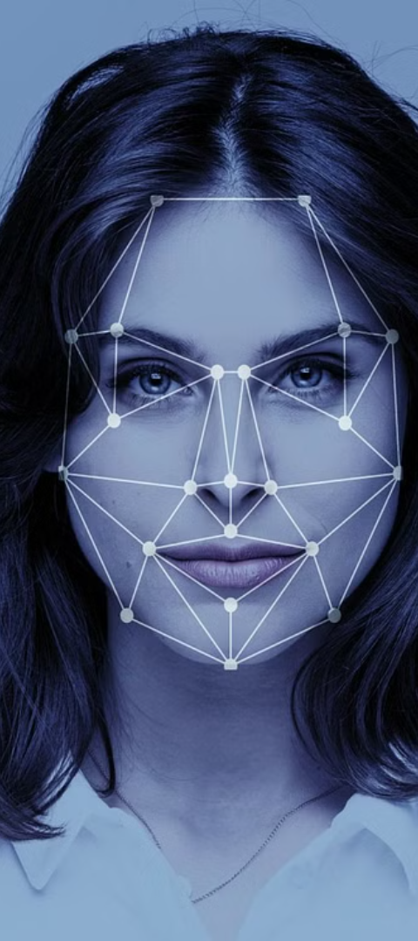
Introducing the Face Recognition-based Attendance System
In our fast-paced world, traditional methods of tracking attendance, like manual roll calls or swipe cards, often fall short. They're prone to errors, time-consuming, and can be a hassle for both administrators and attendees.
To address these challenges, we've developed the Face Recognition-based Attendance System, a cutting-edge solution that harnesses the power of face recognition and machine learning. This innovative system enables the identification of individuals through their facial features, providing real-time updates on attendance status and valuable insights for informed decision-making.
1
Advanced Recognition
2
Instantaneous Updates
Utilizes machine learning for highly accurate face recognition.
Real-time attendance updates foster operational efficiency.
3
User-Centric Design
A sleek, user-friendly web interface for effortless navigation.

Slide 4
Revolutionizing Attendance with Face Recognition Technology
Introducing the Face Recognition-based Attendance System
CV2
File Management
Web Development
Data and Time Handling
CV2 is a powerful computer vision library that we use for various image processing tasks.
We have implemented efficient file management techniques to handle data storage and retrieval.
We employ web development technologies to create user-friendly and interactive web applications.
We have incorporated robust methods to handle data and time operations effectively.

Slide 5
Revolutionizing Attendance with Face Recognition Technology
Scikit-Learn
User Interface
Routing Functions
Dynamic Updates
The KNeighbors
HTML templates are used to create a user-friendly interface for adding new users, capturing faces for training, and displaying attendance records
Flask routes are defined for different functionalities, such as adding users, capturing faces, starting attendance tracking, etc. Each route handles specific HTTP requests and returns appropriate responses or renders HTML templates.
The web interface dynamically updates attendance records and other information without requiring page reloads, providing a seamless user experience
Classifier from scikit-learn is utilized to train a machine learning model for face recognition

Slide 6
Major Trends
1. Advancements in Machine Learning Algorithms:
Continued development and optimization of machine learning algorithms, such as
Convolutional Neural Networks (CNN) and Support Vector Machines (SVM), have led to improved
face recognition accuracy and performance.
2. Real-time Processing Capabilities:
Enhanced computing power and optimized algorithms enable real-time face recognition,
allowing for instantaneous attendance updates and improved operational efficiency.
3. Integration with Web Technologies:
Face recognition technology is increasingly being integrated with web-based attendance systems,
leveraging technologies like HTML, CSS, JavaScript, and Flask to create user-friendly
and interactive interfaces.
4. Mobile Attendance Tracking:
The adoption of mobile applications with face recognition capabilities for attendance tracking,
providing flexibility and convenience for both administrators and attendees.

Slide 7
Major Trends
5. Privacy and Security Enhancements:
Continued development and optimization of machine learning algorithms, such as
Convolutional Neural Networks (CNN) and Support Vector Machines (SVM), have led to improved
face recognition accuracy and performance.
2. Real-time Processing Capabilities:
Enhanced computing power and optimized algorithms enable real-time face recognition,
allowing for instantaneous attendance updates and improved operational efficiency.
3. Integration with Web Technologies:
Face recognition technology is increasingly being integrated with web-based attendance systems,
leveraging technologies like HTML, CSS, JavaScript, and Flask to create user-friendly
and interactive interfaces.
4. Mobile Attendance Tracking:
The adoption of mobile applications with face recognition capabilities for attendance tracking,
providing flexibility and convenience for both administrators and attendees.

Slide 8
The Technical Stack
1
Computer Vision
Employing OpenCV for sophisticated image processing.
2
Web Framework
Leveraging Flask for dynamic web application construction.
3
Data Handling
Utilizing Python modules for efficient file and date management.

Slide 9
LITERATURE SURVEY
S.No | PAPER | TECHNIQUE | RESULT | ISSUES
1. | Turk & Pentland (1991) | Eigenfaces | High accuracy in controlled environments | Sensitivity to variations in lighting
2. | Viola & Jones (2001) | Viola-Jones Algorithm | Real-time face detection with high accuracy | Limited performance with occluded faces
3. | Belhumeur et al. (1997) | Eigenfaces | Effective in recognizing faces | Vulnerable to variations in facial expressions
4. | Phillips et al. (2000) | Eigenfaces, Fisherfaces, LDA | Comparative analysis of different techniques | Limited robustness in uncontrolled environments
5. | Taigman et al. (2014) | DeepFace | Near-human-level performance on large datasets | Computational complexity

Slide 10
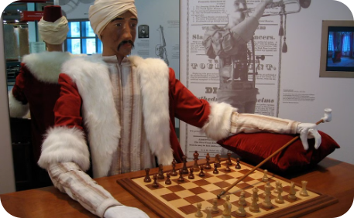
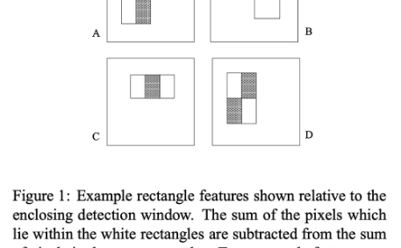
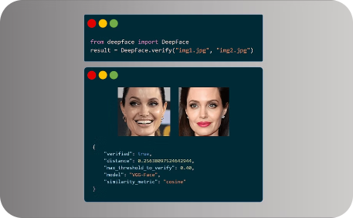
Key Research Contributions
Turk & Pentland
Viola & Jones
DeepFace
Introduced eigenfaces by leveraging PCA.
Enhanced face detection through AdaBoost algorithm.
Marked a milestone with near-human recognition capabilities.

