Slide 1


NEXT GEN EMPLOYABILITY PROGRAM
CREATING A FUTURE-READY WORKFORCE
Student Name :
VIGNESH LAGISHETTI
Student ID :
College Name :
STU6421a3121f96a1679926034
SR UNIVERSITY

Slide 2
CAPSTONE PROJECT SHOWCASE
Project Title
JOB PORTAL APPLICATION USING DJANGO
Abstract | Problem Statement | Project Overview | Proposed Solution | Technology Used | Modelling & Results | Conclusion | Q&A

Slide 3
Abstract
1
Development of a Job Portal Application Using Django to streamline job searching and hiring processes
2
Addresses inefficiencies in traditional methods through user-friendly interfaces for job seekers and recruiters.
3
Features include job posting, application management, advanced search options, and security measures.
4
Utilizes Django framework, PostgreSQL database, Bootstrap, and Heroku for development and deployment.

Slide 4


Problem Statement
The current job search and recruitment landscape is plagued by inefficiencies, lengthy processes, and a lack of transparency, resulting in frustration and challenges for both job seekers and employers. Traditional methods often involve manual sorting through countless job postings, leading to a significant time investment for applicants and recruiters alike. Additionally, the process lacks transparency, with applicants often left in the dark about the status of their applications, leading to frustration and uncertainty. Moreover, the growing demand for remote work opportunities and the need for specialized skill sets further complicate the job search process. Overall, there is a pressing need for a more streamlined, transparent, and efficient job portal solution that addresses these challenges and provides a better experience for both job seekers and employers.

Slide 5

Project Overview
The Job Portal Application using Django simplifies job search and recruitment processes.
It connects job seekers with employers through an intuitive web-based platform.
Features include advanced search, personalized profiles, real-time alerts, and messaging.
Employers can post listings, review applications, and manage recruitment efficiently.
Leveraging Django's robustness and scalability, along with modern web technologies.
Responsive and user-friendly experience across devices.
Aims to streamline job search and recruitment for better outcomes.

Slide 6
Proposed Solution
Develop a comprehensive job portal application using Django framework.
Implement user-friendly interfaces for job seekers and employers.
Provide advanced search and filtering options for job listings.
Enable job seekers to create personalized profiles and upload resumes.
Employers can post job listings, review applications, and communicate with candidates.
Implement real-time notifications for new job listings and application updates.
Utilize Django's built-in authentication and security features to protect user data.
Ensure scalability and performance optimization for handling large amounts of data.
Integrate with popular payment gateways for premium job listings and services.
Offer analytics and reporting features for employers to track recruitment metrics.
Regular updates and maintenance to improve functionality and user experience.

Slide 7
Technology used
Django framework for backend development.
HTML, CSS, and JavaScript for frontend interface.
Bootstrap for responsive design and layout.
SQLite or PostgreSQL for database management.

Slide 8
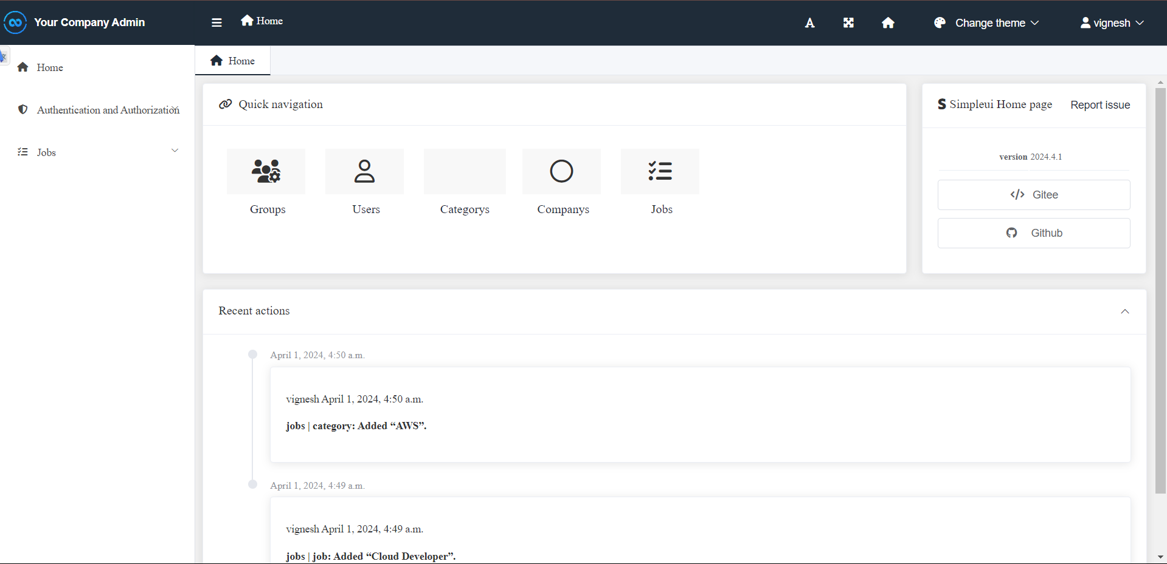
Modelling & Result

Slide 9
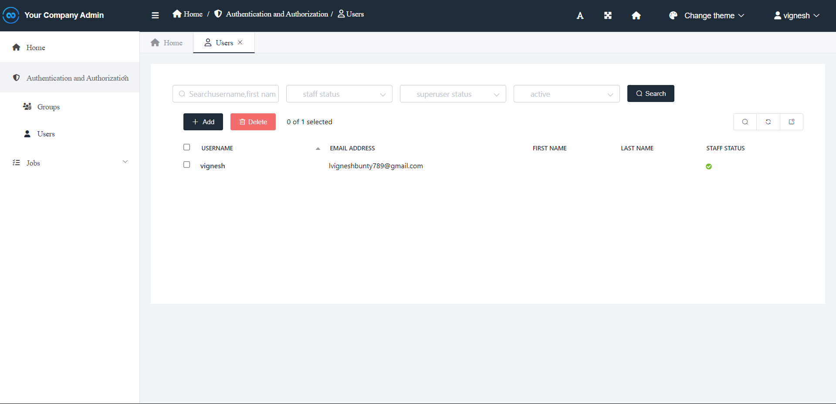
Modelling & Result

Slide 10
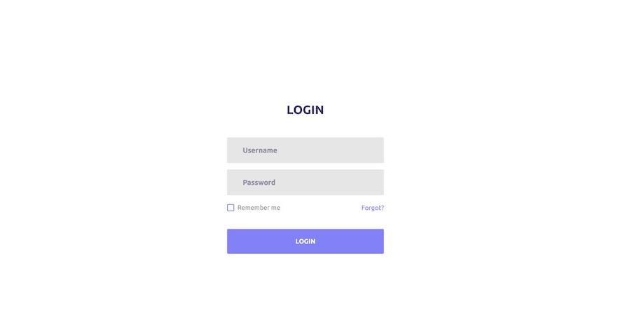
Modelling & Result

Slide 11

Modelling & Result

Slide 12

Conclusion
In conclusion, the Job Portal Application developed using Django provides a comprehensive solution for connecting job seekers and employers efficiently. Through its user-friendly interface, streamlined application process, and robust security features, the platform offers a seamless experience for users. With scalability and flexibility built into its framework, the application is well-equipped to adapt to changing market demands and cater to the evolving needs of both job seekers and employers. Overall, the Job Portal Application stands as a testament to the power of technology in revolutionizing the recruitment process and facilitating meaningful connections in the job market.

Slide 13


Notes:
Thank You !!

