Slide 1
Agenda
Why Secure App
Types of Security threats
iOS Security
Secure Coding Guidelines
Man in middle Attack
Certificate Pinning
Notes:
Give a brief introduction about what we are going to discuss today?

Slide 2
About me!
Bunty Madan
Twitter/Github/Stackoverflow @buntylm
Developer at Accenture
Notes:
Small Introduction
Working Experience
What doing apart from work?

Slide 3

Developing Secure iOS Apps
Notes:
Why Security is concern. Take a case study like banking or ewallet.

Slide 4
iOS
Application
Client Attack
Network Attack
Server Attack
TCP Attack
HTTP Attack
Platform Mapping
Arch. Mapping
Binary Analysis
File System Analysis
Runtime Analysis
Runtime Traffic
Install Traffic

Slide 5
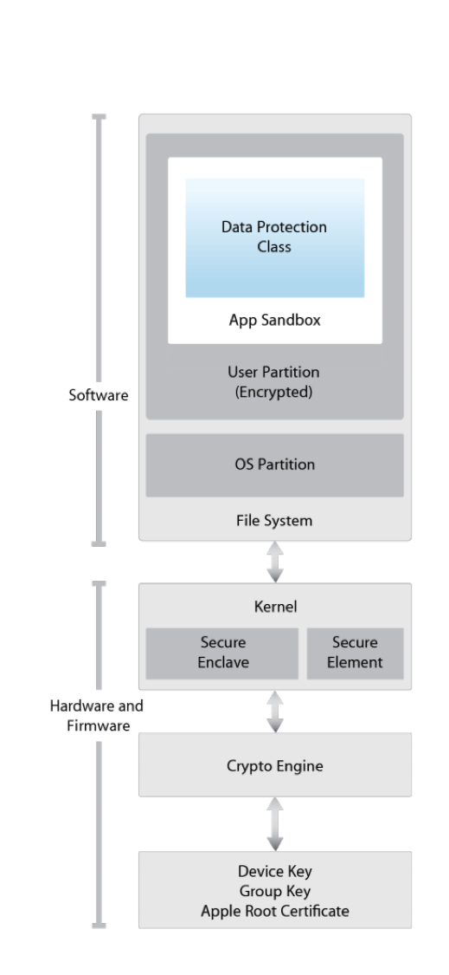
iOS Security Architecture
Notes:
Need to learn here more.
File Protection, lock phone will encrypte the file

Slide 6
General iOS Platform Security
Notes:
System architecture: The secure platform and hardware foundations of iPhone, iPad, and iPod touch.
Encryption and Data Protection: Provides architecture and design that protects the user’s data when the device is lost or stolen, or when an unauthorized person attempts to use or modify it.
Network security: Provides industry-standard networking protocols that provide secure authentication and encryption of data in transmission.
Device access: Provides methods that prevent unauthorized use of the device and enable it to be remotely wiped if lost or stolen.
Define what are the responsibility as a developer in each area.
Device access
Jail broken devices
Document directory back up
File Encryption
File Protection
App Transport Security

Slide 7
System Architecture
Secure bot chain
App Code Signing
Runtime Process Security
System Software Personalization
Notes:
The secure platform and hardware foundations of iPhone, iPad, and iPod touch.
The Secure bot chain, when you starts you device the boot up process contains lots of components to ensure the integrity and processed after verifying chain of trust. This includes boot loaders, kernels, kernel extensions etc. if all goes well then only it allow to run iOS on validated Apple Devices only.
System Software Personalization, Apple regularly releases software updates due to security concerns for all supported devices. During installation device connect to Apple Authorization Server and sends a list of cryptographic measurements for each part of installation example Boot, Kernel or the OS image. Server validate and save the measurements and return it back to user, then boot-time chain of trust verifies everything.
App Code Signing, Now the iOS App is Booted, it will verify the apps are signed with Apple issued certificate or not ? if yes then TestFlight/App Store? signing entities? Expiry date?
Runtime Process Security, Apps are in Sandbox that will prevent the access of other apps, Each apps has unique key for directory for files that will assign when we install the app. Third party apps access data like iCloud, needs entitlement first. entitlement are signed to an app.

Slide 8
Encryption and Data Protection
File Data Protection & Classes
Pass codes
Keychain Data Protection
Hardware Security Features
Notes:
The architecture and design that protects the user’s data when the device is lost or stolen, or when an unauthorized person attempts to use or modify it.
Encryption and data protection
Hardware Security Features, Every device has a dedicated AES 256 crypto engine build between flash storage and main memory. making file encryption highly fast and efficient.
File Data Protection, for data protection in flash memory on the device. encrypt the file, behavior can be controlled on per-file basis.
Pass codes, provides entropy for encryption keys. wrong passcode also enforce time delays.
File Protection Classes, when we create new file it provides different policies to determine the accessibility. Complete Protection, protected with a key derived from the user passcode once device locked it will discard the key and data will be inaccessible until user enters the pass code again. Protected Unless Open your app can continue to access the file if the device is locked. Protected Util First User Authentication, Same as complete file protection only it won’t remove the key when device is locked. No Protection class key protected by UID.
Keychain Data Protection, Sensitive data stored here. Encrypted container share data between same developer
Key bags, keys for both file and keychain data protection collected and managed in key bags.

Slide 9
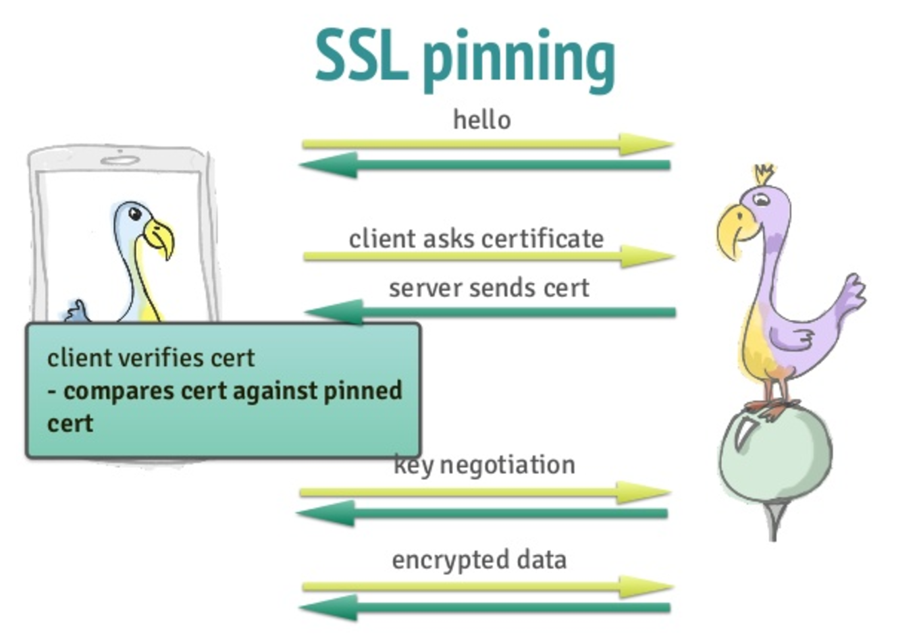
Network security
SSL/TLS
SSL Pinning
Notes:
The architecture and design that protects the user’s data when the device is lost or stolen, or when an unauthorized person attempts to use or modify it.
Because iOS achieves a reduced attack surface by limiting listening ports and removing unnecessary network utilities like telnet, shells or a web server it does’t need firewall. Communication using iMessage or FaceTime is fully encrypted and authenticated.
SSL/TLS, iOS Support secure socket layer(SSL V3) as well as Transport layer security(TLS V1.2).

Slide 10
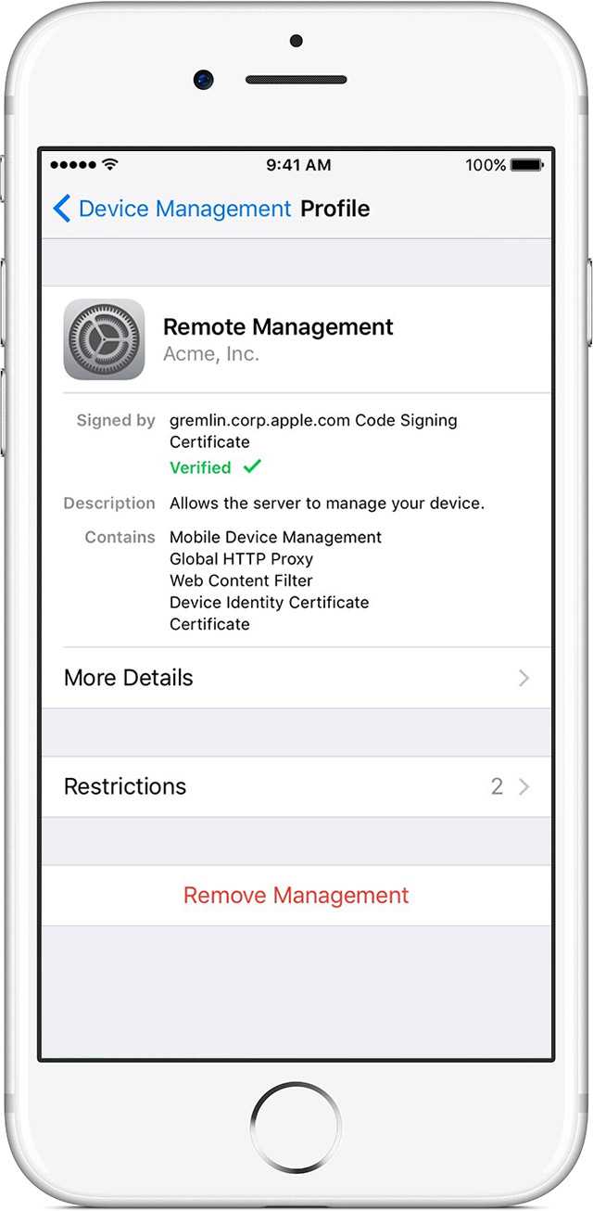

Device access
Configuration Enforcement
Mobile Device Management
Apple Configurator
Notes:
iOS Supports flexible security polices and configurations that enables enterprises to protect corporate information. Also user can enable longer and more complex passcode that are recommended for enterprise use. wipe the device after 10 wrong attempts.
Configuration Enforcement installed config can not be changed by user.
Mobile Device Management, allow business to securely configure and manage devices.
Apple Configurator, quickly configure large number of iOS devices with settings and restrictions.
The following restrictions are available:
• Allow app installs
• Allow use of camera
• Allow FaceTime
• Allow screen capture
• Allow voice dialing
• Allow automatic sync while roaming
• Allow in-app purchases
• Allow syncing of Mail recents
• Force user to enter store password for all purchases
• Allow multiplayer gaming

Slide 11
Secure Coding Guide
Notes:
Secure coding is the practice of writing programs that are resistant to attack by malicious or mischievous people or programs. Secure coding helps protect a user’s data from theft or corruption. In addition, an insecure program can provide access for an attacker to take control of a server or a user’s computer, resulting in anything from a denial of service to a single user to the compromise of secrets, loss of service, or damage to the systems of thousands of users.

Slide 12

Avoid cached application
HTTP Request/Response
Files
Encryption
SQLCipher
Keychain
Protection classes and backup
Decryption key generation – Use iOS AES Crypto library
Deletion of Data
Authentication Mechanism

Slide 13
Always Obscure sensitive value in UI
Implement Anti tempering technique
Track debugger or Trace checking
Use of UIWebView to prevent framing
Certificate Pinning must be there
Request/Resource timeout

Slide 14
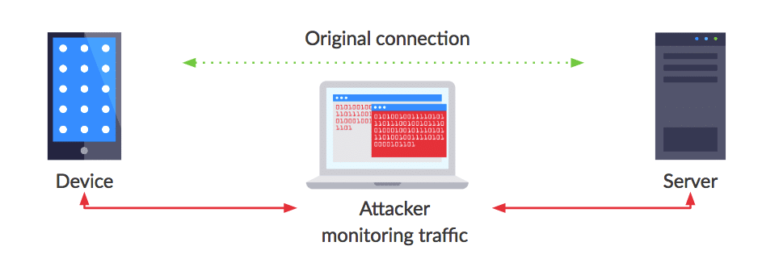
Man In The Middle Attack

Slide 15

SSL Certificate Pinning

Slide 16
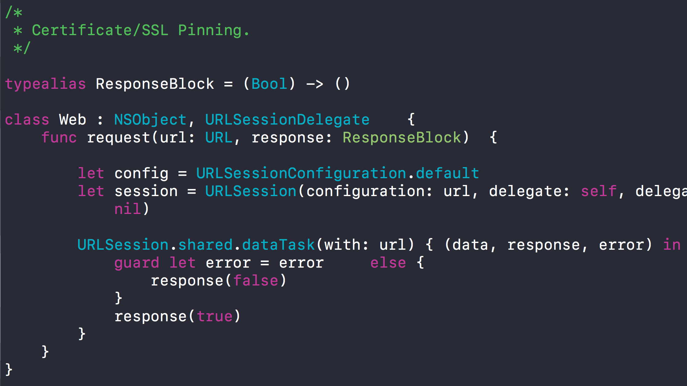

Slide 17
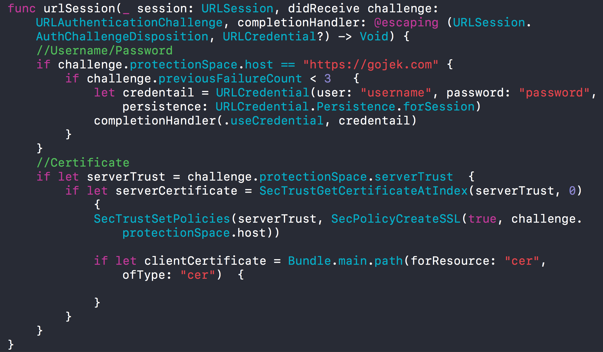

Slide 18
Recap
Why Security
Where Security fits
Device, Application, Network, Server
Coding Guidelines
MIMA
Prevent using SSL/Certificate Pinning

Slide 19
Thank you
For more
Twitter/Github/Stackoverflow @buntylm

