Slide 1
Mobile App for UNEB Services Presentation to the NIISP
Presented by
InfoTronics Business Systems

Slide 2
Outline of the Presentation
Problem Statement
Innovation Description
Stage of innovation
Objectives
Commercial Viability and scalability
Budget summary
Project Team and Partnerships

Slide 3
Problem Statement
Currently, the registration process involves the use of desktop/laptop computers,& requires a digital photograph of the candidate is taken and imported into the system
Lack of equipment has forced centres to hire service providers who are not familiar with the candidates leading to errors.
Candidates realize too late they aren’t registered to sit UNEB exams

Slide 4
Problem Statement
After S1 and S5 selections, the students (and parents or guardians) have to trek long distances across the country to crosscheck whether they were placed in their schools of choice;
This internet footprint is still a problem in some areas

Slide 5
Innovation Description
We propose a cross-platform mobile App with a single code-base that is compatible with multiple mobile operating systems (iOS, Android and Windows).
It shall be used for registering candidates, checking for registration status, results, placement after S1 and S5 selections. It shall also permit centres to check for the status of their invoices with UNEB, as well as make payments.
Online/offline modes of operation

Slide 6
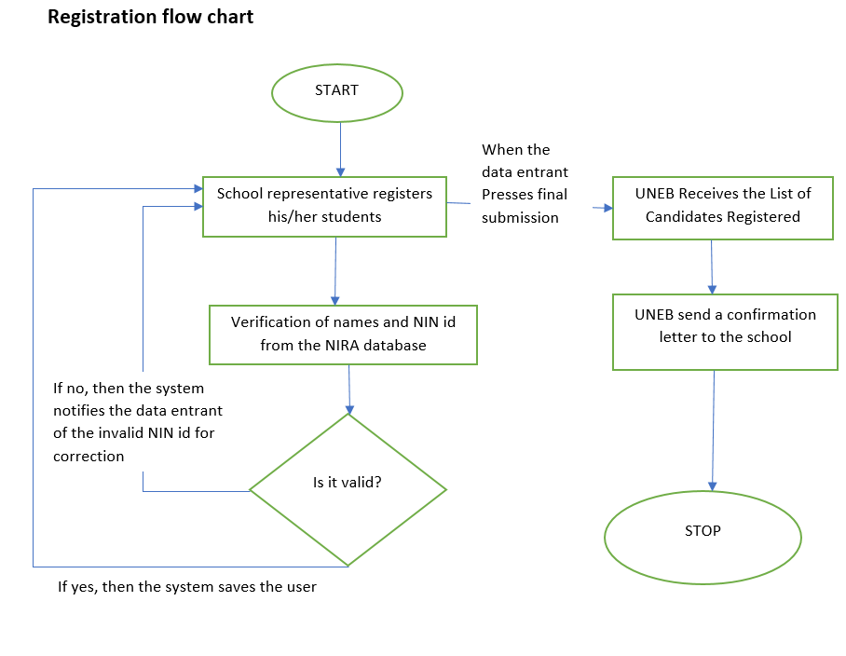
Stage of innovation - Concept Stage

Slide 7
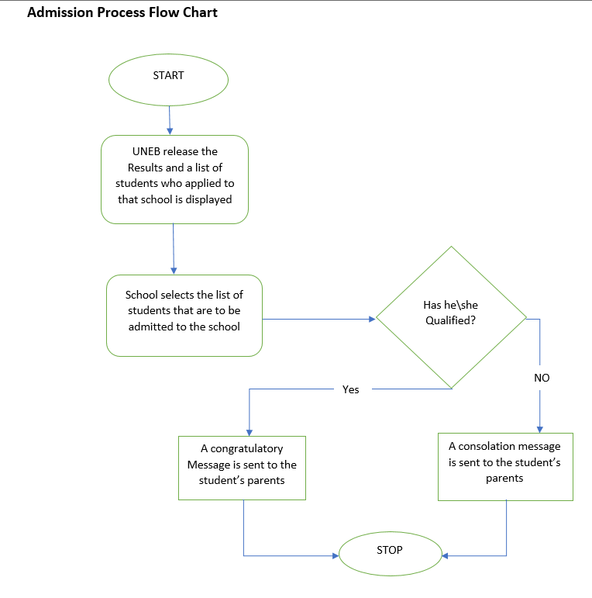
Stage of innovation - Concept Stage

Slide 8
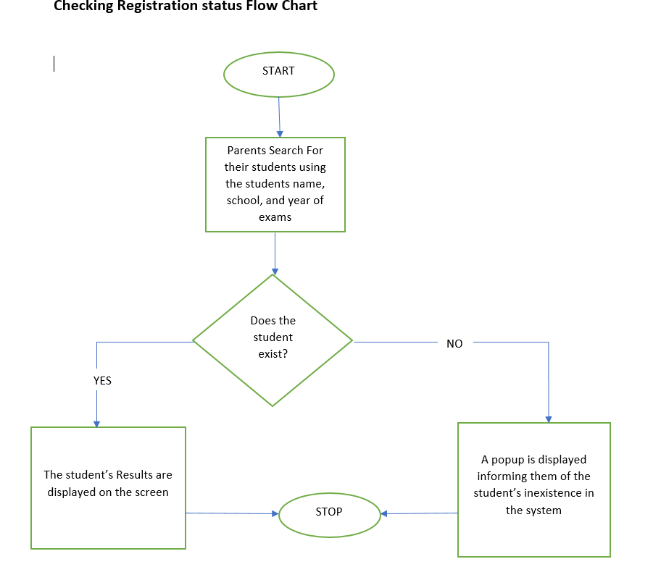
Stage of innovation - Concept Stage

Slide 9
Objectives
The main objective is to make UNEB services more user-accessible, friendly and improve data quality
Schools shall be able to handle their own business hence less errors in misspelt names or interchanged photos/bio-data
Candidates/parents/guardians shall be able to check for registration status therefore reduction missing exams due to non-registration
Checking for S1 & S5 placement made easy

Slide 10
Commercial Viability and scalability
UNEB services are needed services and we shall work closely with the UNEB Top Management to ensure that the services are paid for;
Schools without computers & digital cameras have been hiring service providers to carry out their registration exercise. At a small fee the schools shall register their own candidates.

Slide 11
Budget summary
App Development 240,000,000
Software tools, equipment 45,000,000
Payment Gateway 45,000,000
Security (SSL certificates, etc.) 30,000,000
Documentation 50,000,000
Training materials 25,000,000
Training across the country 150,000,000
Cloud Services 75,000,000
Bandwidth 12,000,000
Total 672,000,000

Slide 12
Project Team and Partnerships
Peter P. Wakabi-Waiswa, PhD
Henry Wokwera
Simon Bunya,
Brain Bukombi and
James Sekamatte.

Slide 13
Thank You
Responses, Comments & Questions

