Slide 1


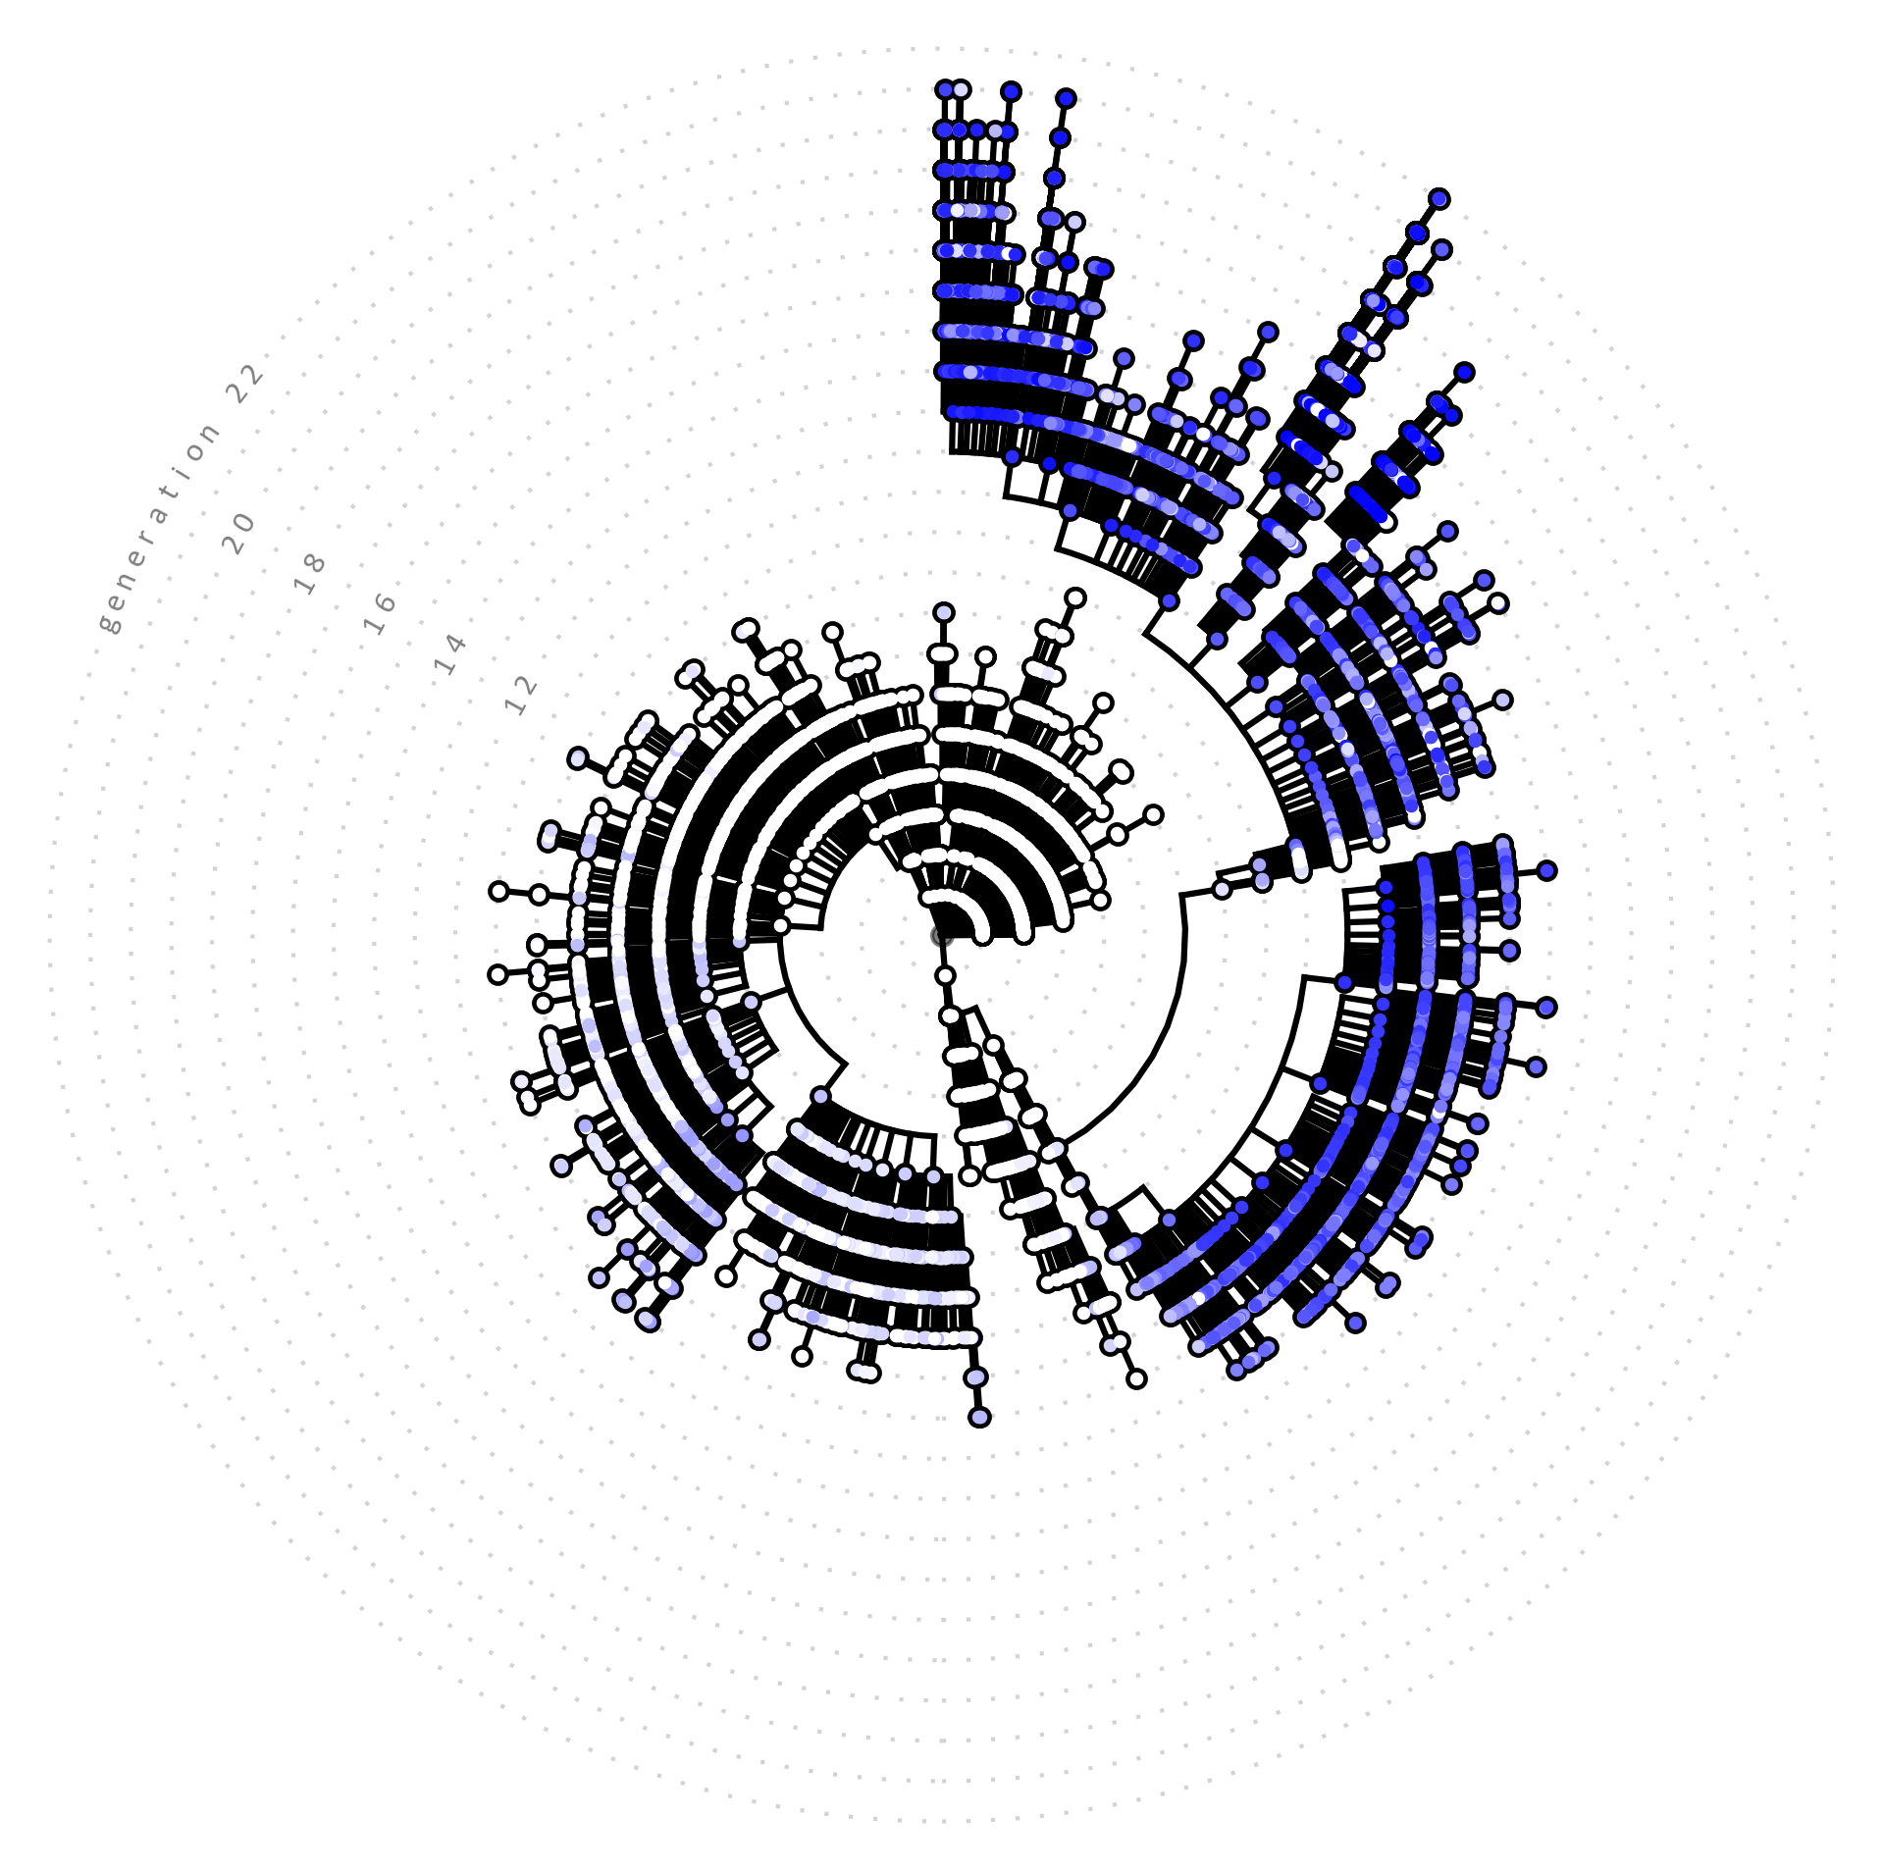
4..01
4.01
AI.zymes
A modular platform for evolutionary enzyme design
AI.zymes is in active development!
We are happy to assist you with running AI.zymes.
For questions, reach out to:
Adrian.Bunzel@mpi-marburg.mpg.de
Merlicek LP, Neumann J, Lear A, Degiorgi V, Waal MMdW, Cotet T-S, Mulholland AJ, Bunzel HA,
Angewandte Chemie International Edition 2025, https://doi.org/10.1002/anie.202507031 (accepted).

Slide 2
4..01
4.01

