Slide 1
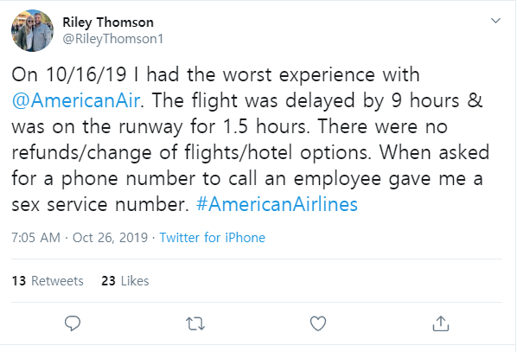






$$w_{1}$$
$$w_{2}$$
$$p_{0}$$
$$p_{1}$$
$$p_{2}$$
$$w_{3}$$
$$w_{n}$$
Text input
Neural net
Final output

